Slide 1
Online clustering, Scale-based clustering and self-organizing map

Slide 2
K-means
clustering
Online
K-means
clustering
Scale-based
clustering
Self-organizing
Map (SOM)

Slide 3
Online clustering
- m_{i(j)} is the centroid closest to x_{j}
- E is SSE
Finding m_{i} by gradient descent:

Slide 4
Scale-based Clustering
Clustering is done at a “scale”
An answer to the question of “how many clusters”
Best clusters tend to live over the longest range of scales

Slide 5
Algorithm
Start with a large number of clusters
Initialize by selecting from data set
Initialize “sigma” to a small value
Update all centroids
Eliminate duplicate centroids whenever there is a merger
Increase sigma by a constant factor
If there are more than 1 unique centroid continue update of centroids
Stop only when a single unique centroid remains

Slide 6
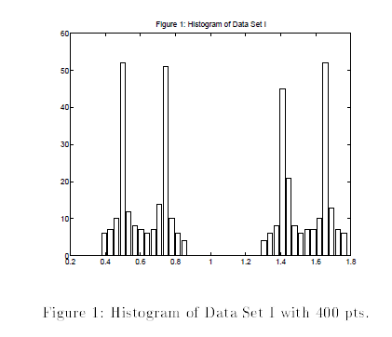
Data set

Slide 7
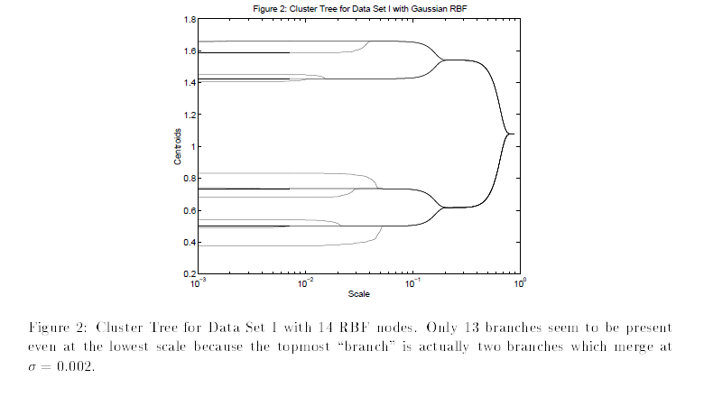
Clustering result: Evolution of the centroids

Slide 8
The self-organizing map

Slide 9
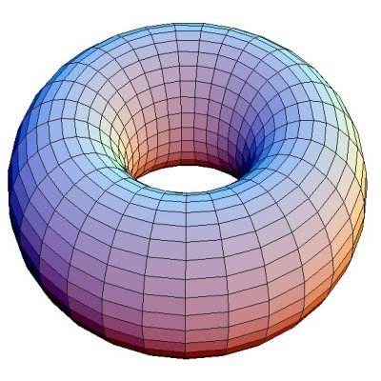
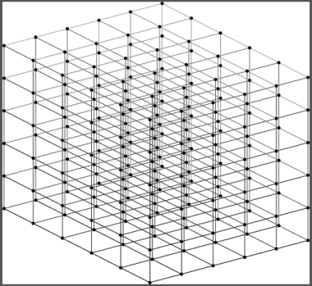
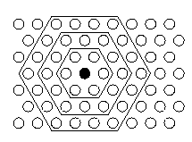
SOM topology
2D SOM
(rectangular)
1D SOM
3D SOM
Toroid SOM
(hexagonal)

Slide 10
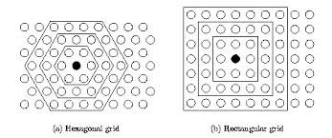
Neighborhood

Slide 11
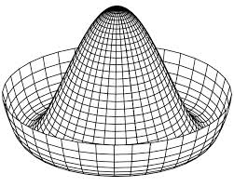
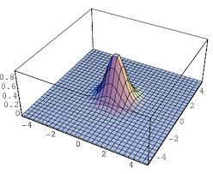
Neighborhood functions (Λ(r*, r))
Mexican Hat function
Gaussian function

Slide 12
SOM algorithm
Randomly initialize the weights from the training data set, X
Begin Loop
Present xp to all neurons and find the Winner (r*)
Update the weights of the winner and its neighbors
End Loop (when weights converge)

Slide 13
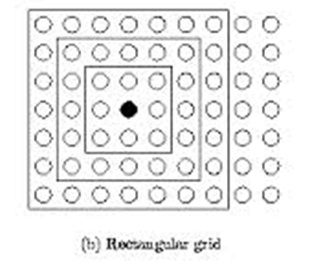
Move the “winner” towards xp
Neighborhood, N
Move the neighbors of the “winner”
also towards xp, but to a lesser extent

Slide 14
Annealing
as training proceeds reduce
neighborhood size
Learning rate

Slide 15
Learning stages
Ordering phase
Settling phase:

Slide 16
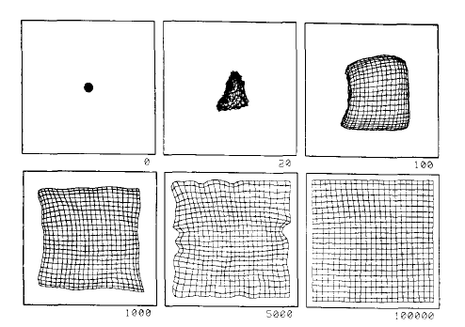
Ordering and Settling

Slide 17
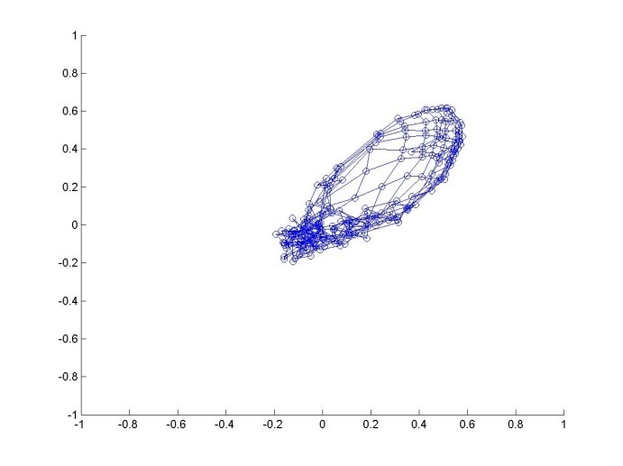
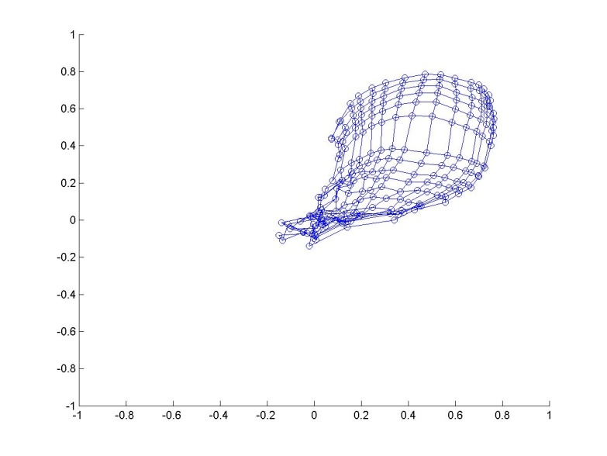
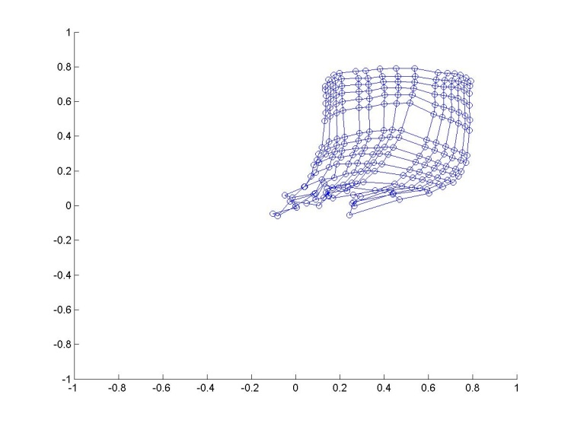
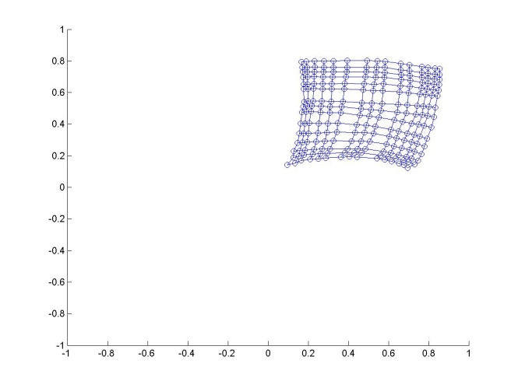
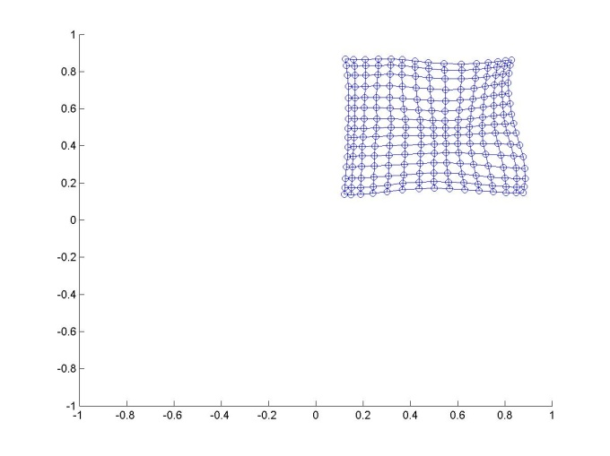
ordering
ordering
ordering
settling
settling

Slide 18
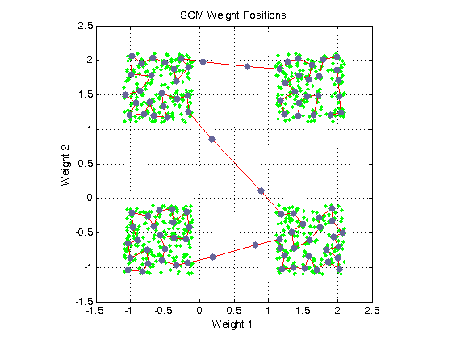
Simple examples (2D data; 1D SOM)

Slide 19
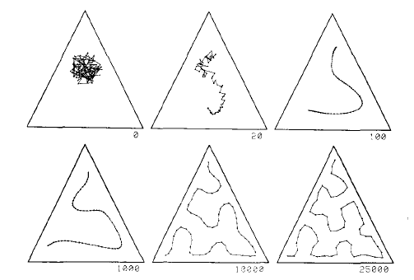
2D data; 1D SOM
Peano’s curve
Or
Space-filling
curve
(Kohonen 1990)

Slide 20
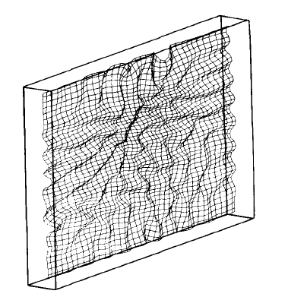
3D data; 2D SOM

Slide 21
3D data; 2D SOM

Slide 22
Initial random weights

Slide 23
Network after 100 iterations

Slide 24
Network after 1000 iterations

Slide 25
Network after 10,000 iterations

Slide 26
Another example

Slide 27
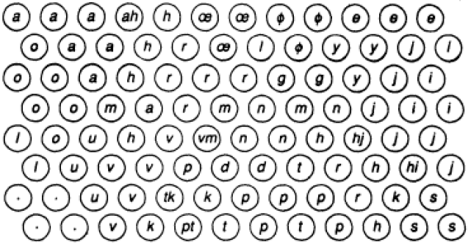
Phonetic Keyboard

Slide 28
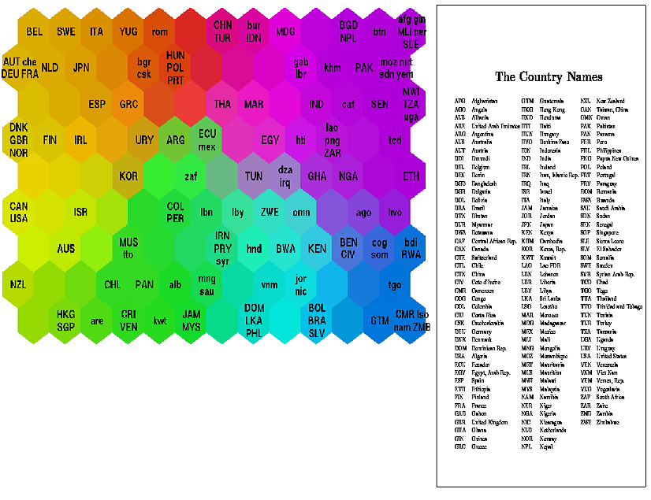
Mapping World Poverty
FV=39 indices of quality of life

Slide 29
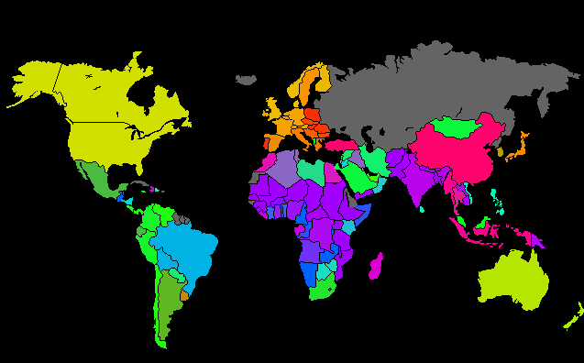

Slide 30
Som In biology

Slide 31
Insulin resistance syndrome revisited: application of self-organizing maps
Understand risk factors through clustering
Variables considered:
Blood glucose
Serum insulin
Triglycerides
High density lipoprotein cholesterol
Systolic Blood pressure
Body mass index
Waist to hip ratio

Slide 32
C1 – healthy controls
C4 – hypertensive and compensatory hyperinsulinaemic subjects
C4b – insulin resistant
C2, C3 – intermediate groups

Slide 33
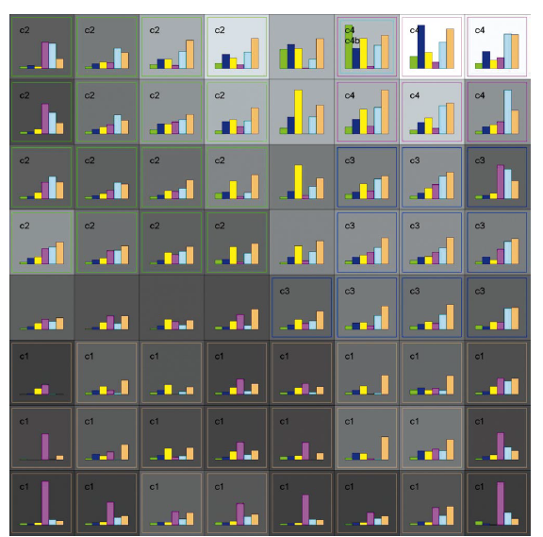

Slide 34
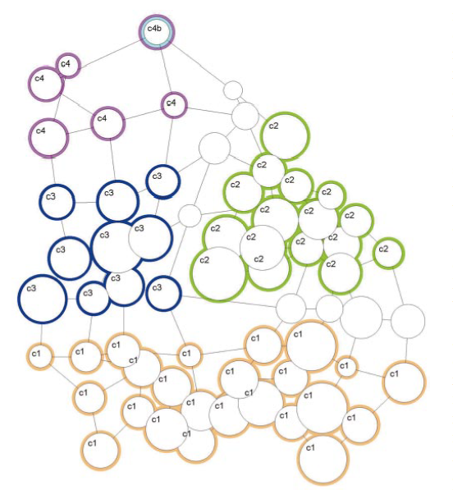
Sammon’s mapping
Each circle → a neuron in SOM
Circle size → # data points in that cluster
Inter-neuron dist → distance between
Centroids in the original n-d space

Slide 35
Interpreting patterns of gene expression with self-organizing maps: Methods and application to hematopoietic differentiation (Tamayo et al , PNAS,1999)
Using SOMs to interpret gene expression data
Hierarchical clustering is not quite suitable; more suitable when there is true hierarchical descent
K-means produces “an unorganized collection of clusters”

Slide 36
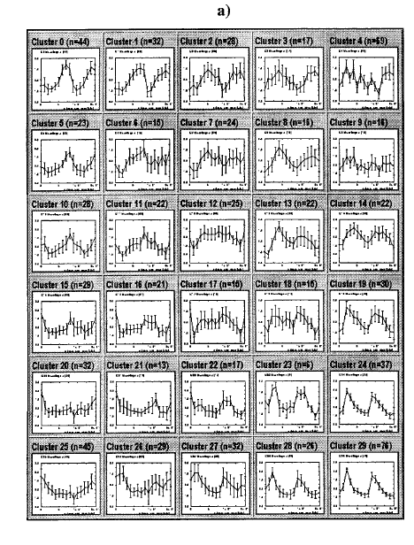
Yeast cell cycle SOM

Slide 37
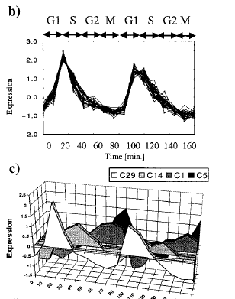
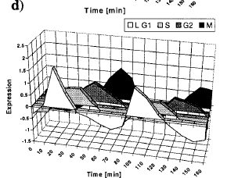
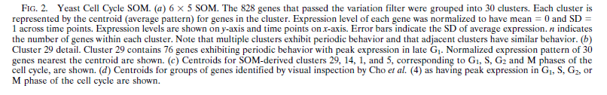

Slide 38
Salient Features
SOM picked cell cycled periodicity as a prominent feature
Genes in the same cluster typically peak during the same phase (cluster 29, fig. b)
Genes in neighboring clusters peak in nearby phases (fig. c, 24, 28, 29 have genes that peak in late G1 phase)

