Slide 1
Data Mining: Introduction
Figures for Chapter 1
Introduction to Data Mining
by
Tan, Steinbach, Kumar

Slide 2
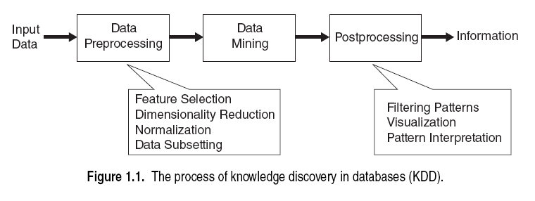

Slide 3
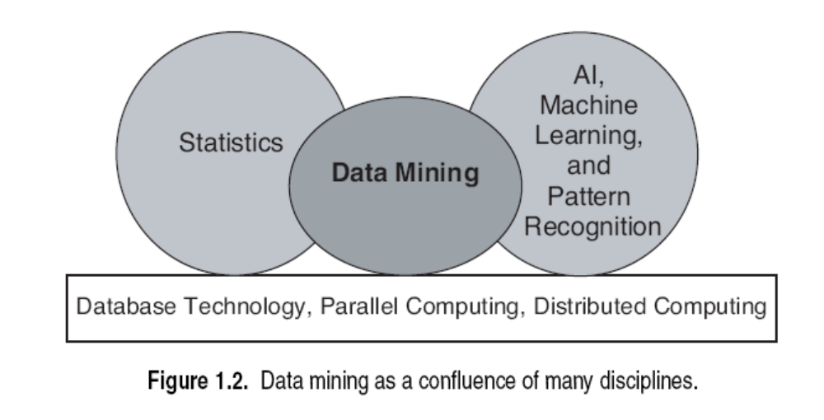

Slide 4
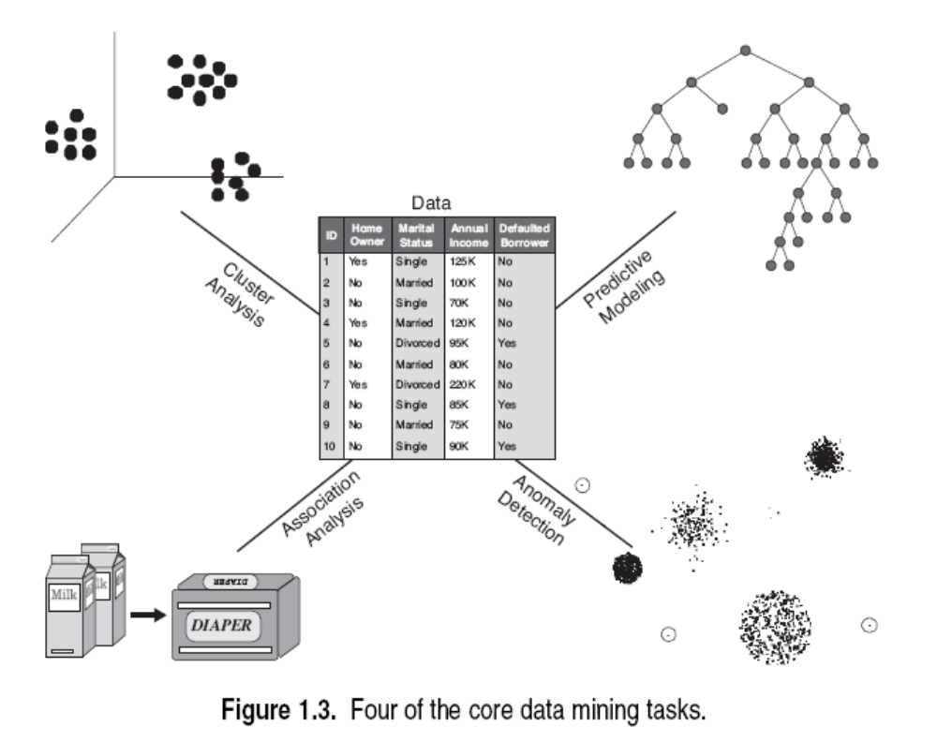

Slide 5
