Slide 1
Data Mining
Cluster Analysis: Basic Concepts and Algorithms
Lecture Notes for Chapter 8
Introduction to Data Mining
by
Tan, Steinbach, Kumar
Modified by S. Parthasarathy 5/01/2007
© Tan,Steinbach, Kumar Introduction to Data Mining 4/18/2004 <number>

Slide 2
What is Cluster Analysis?
Finding groups of objects such that the objects in a group will be similar (or related) to one another and different from (or unrelated to) the objects in other groups
Inter-cluster distances are maximized
Intra-cluster distances are minimized

Slide 3
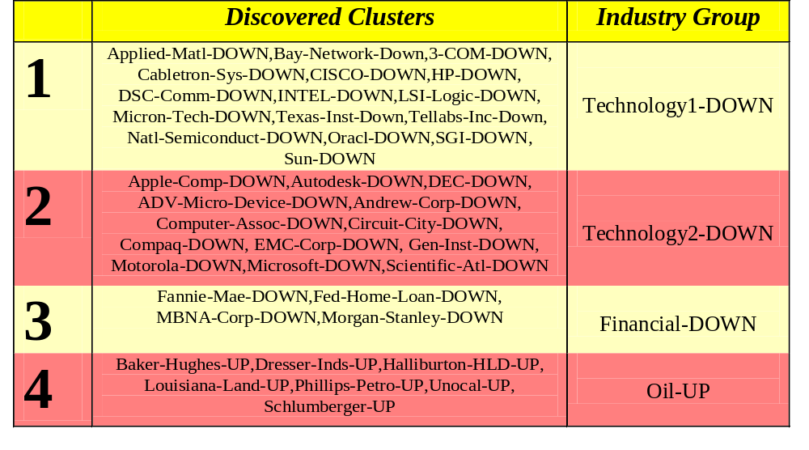
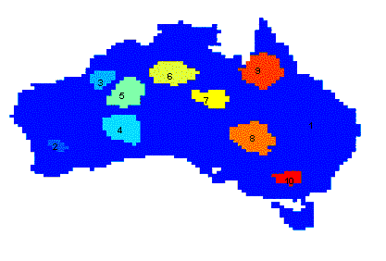
Applications of Cluster Analysis
Understanding
  Group related documents for browsing, group genes and proteins that have similar functionality, or group stocks with similar price fluctuations
Summarization
  Reduce the size of large data sets
Clustering precipitation in Australia

Slide 4
What is not Cluster Analysis?
Supervised classification
  Have class label information
Simple segmentation
  Dividing students into different registration groups alphabetically, by last name
Results of a query
  Groupings are a result of an external specification
Graph partitioning
  Some mutual relevance and synergy, but areas are not identical

Slide 5
Notion of a Cluster can be Ambiguous
How many clusters?
Six Clusters
Two Clusters
Four Clusters

Slide 6
Types of Clusterings
A clustering is a set of clusters
Important distinction between hierarchical and partitional sets of clusters
Partitional Clustering
  A division data objects into non-overlapping subsets (clusters) such that each data object is in exactly one subset
Hierarchical clustering
  A set of nested clusters organized as a hierarchical tree

Slide 7

Partitional Clustering
Original Points
A Partitional Clustering

Slide 8
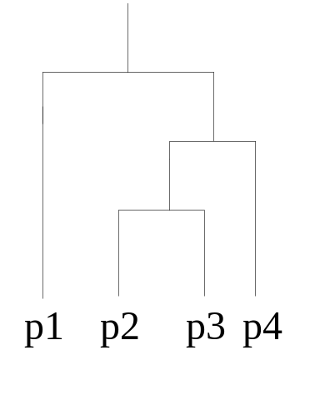
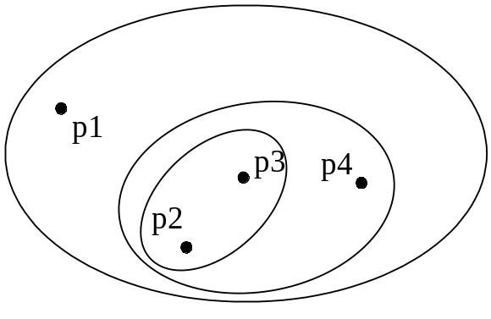
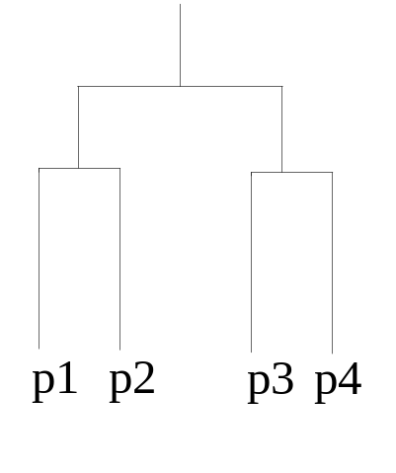
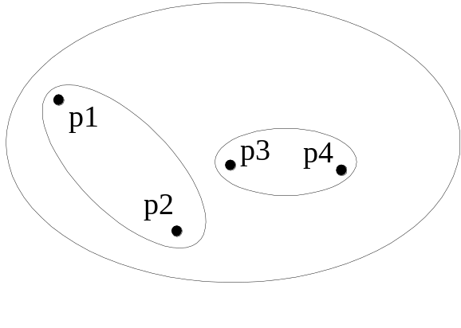
Hierarchical Clustering
Traditional Hierarchical Clustering
Traditional Dendrogram
Non-traditional Hierarchical Clustering
Non-traditional Dendrogram

Slide 9
Types of Clusters: Well-Separated
Well-Separated Clusters:
  A cluster is a set of points such that any point in a cluster is closer (or more similar) to every other point in the cluster than to any point not in the cluster.
3 well-separated clusters

Slide 10
Types of Clusters: Center-Based
Center-based
  A cluster is a set of objects such that an object in a cluster is closer (more similar) to the “center” of a cluster, than to the center of any other cluster
  The center of a cluster is often a centroid, the average of all the points in the cluster, or a medoid, the most “representative” point of a cluster
4 center-based clusters

Slide 11
Types of Clusters: Contiguity-Based
Contiguous Cluster (Nearest neighbor or Transitive)
  A cluster is a set of points such that a point in a cluster is closer (or more similar) to one or more other points in the cluster than to any point not in the cluster.
8 contiguous clusters

Slide 12
Types of Clusters: Density-Based
Density-based
  A cluster is a dense region of points, which is separated by low-density regions, from other regions of high density.
  Used when the clusters are irregular or intertwined, and when noise and outliers are present.
6 density-based clusters

Slide 13
Characteristics of the Input Data Are Important
Type of proximity or density measure
  This is a derived measure, but central to clustering
Sparseness
  Dictates type of similarity
  Adds to efficiency
Attribute type
  Dictates type of similarity
Type of Data
  Dictates type of similarity
  Other characteristics, e.g., autocorrelation
Dimensionality
Noise and Outliers
Type of Distribution

Slide 14
Clustering Algorithms
K-means and its variants
Hierarchical clustering
Density-based clustering

Slide 15

K-means Clustering
Partitional clustering approach
Each cluster is associated with a centroid (center point)
Each point is assigned to the cluster with the closest centroid
Number of clusters, K, must be specified
The basic algorithm is very simple

Slide 16
K-means Clustering – Details
Initial centroids are often chosen randomly.
  Clusters produced vary from one run to another.
The centroid is (typically) the mean of the points in the cluster.
‘Closeness’ is measured by Euclidean distance, cosine similarity, correlation, etc.
K-means will converge for common similarity measures mentioned above.
Most of the convergence happens in the first few iterations.
  Often the stopping condition is changed to ‘Until relatively few points change clusters’
Complexity is O( n * K * I * d )
  n = number of points, K = number of clusters,
  I = number of iterations, d = number of attributes

Slide 17



Two different K-means Clusterings
Original Points
Optimal Clustering
Sub-optimal Clustering

Slide 18






Importance of Choosing Initial Centroids

Slide 19
Importance of Choosing Initial Centroids

Slide 20
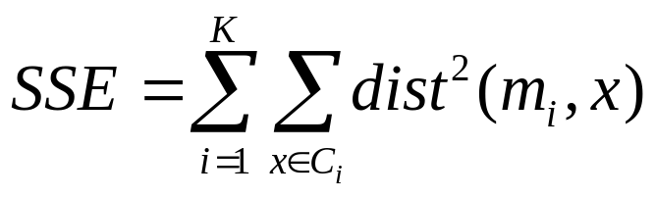
Evaluating K-means Clusters
Most common measure is Sum of Squared Error (SSE)
  For each point, the error is the distance to the nearest cluster
  To get SSE, we square these errors and sum them.
  x is a data point in cluster C_{i} and m_{i} is the representative point for cluster C_{i}
    can show that m_{i} corresponds to the center (mean) of the cluster
  Given two clusters, we can choose the one with the smallest error
  One easy way to reduce SSE is to increase K, the number of clusters
    A good clustering with smaller K can have a lower SSE than a poor clustering with higher K

Slide 21
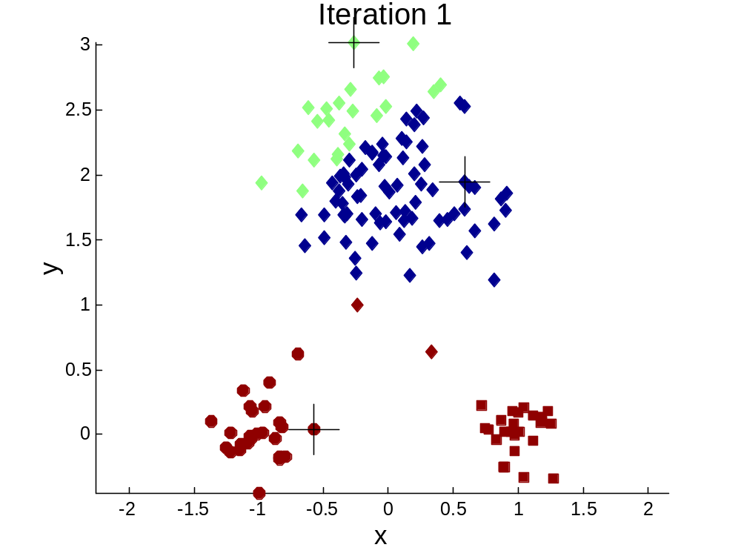


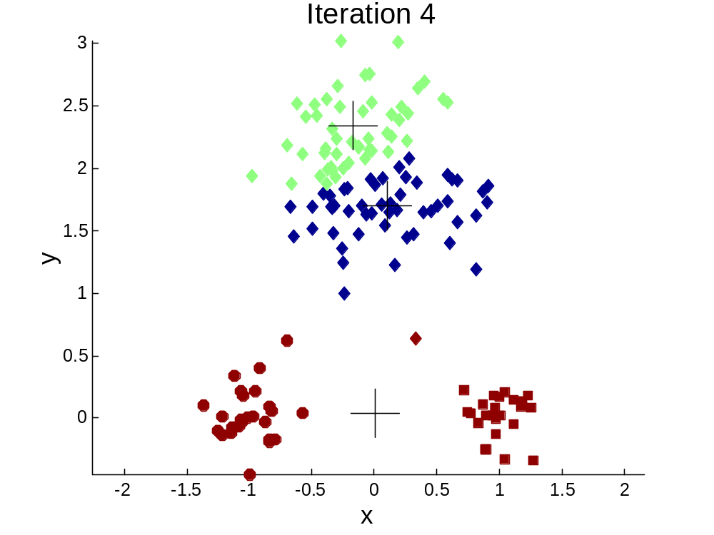
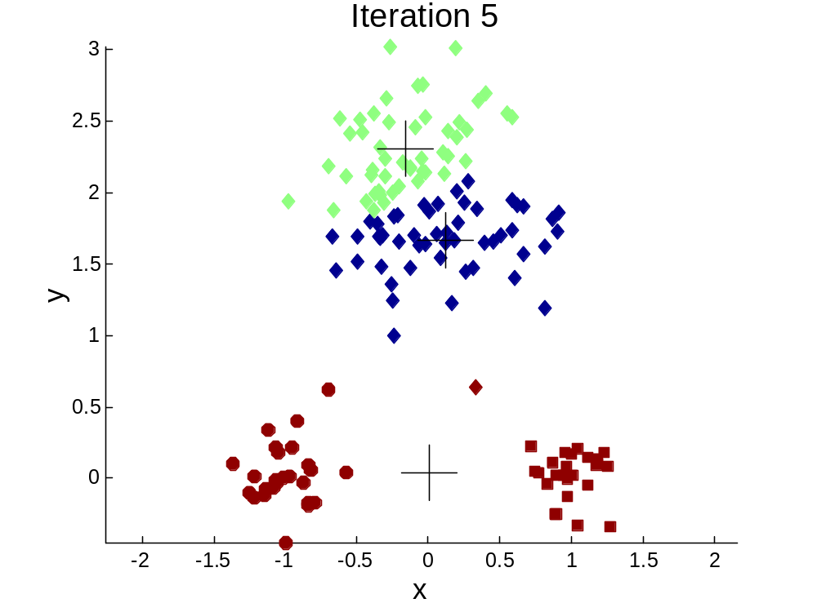
Importance of Choosing Initial Centroids …

Slide 22
Importance of Choosing Initial Centroids …

Slide 23
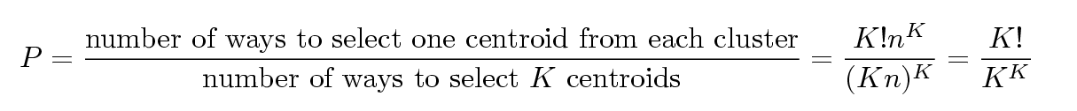
Problems with Selecting Initial Points
If there are K ‘real’ clusters then the chance of selecting one centroid from each cluster is small.
  Chance is relatively small when K is large
  If clusters are the same size, n, then
  For example, if K = 10, then probability = 10!/10¹⁰ = 0.00036
  Sometimes the initial centroids will readjust themselves in ‘right’ way, and sometimes they don’t
  Consider an example of five pairs of clusters

Slide 24
Solutions to Initial Centroids Problem
Multiple runs
  Helps, but probability is not on your side
Sample and use hierarchical clustering to determine initial centroids
Select more than k initial centroids and then select among these initial centroids
  Select most widely separated
Postprocessing
Bisecting K-means
  Not as susceptible to initialization issues

Slide 25
Handling Empty Clusters
Basic K-means algorithm can yield empty clusters
Several strategies
  Choose the point that contributes most to SSE
  Choose a point from the cluster with the highest SSE
  If there are several empty clusters, the above can be repeated several times.

Slide 26
Updating Centers Incrementally
In the basic K-means algorithm, centroids are updated after all points are assigned to a centroid
An alternative is to update the centroids after each assignment (incremental approach)
  Each assignment updates zero or two centroids
  More expensive
  Introduces an order dependency
  Never get an empty cluster
  Can use “weights” to change the impact

Slide 27
Pre-processing and Post-processing
Pre-processing
  Normalize the data
  Eliminate outliers
Post-processing
  Eliminate small clusters that may represent outliers
  Split ‘loose’ clusters, i.e., clusters with relatively high SSE
  Merge clusters that are ‘close’ and that have relatively low SSE
  Can use these steps during the clustering process
    ISODATA

Slide 28
Limitations of K-means
K-means has problems when clusters are of differing
  Sizes
  Densities
  Non-globular shapes
K-means has problems when the data contains outliers.
The mean may often not be a real point!

Slide 29


Limitations of K-means: Differing Density
Original Points
K-means (3 Clusters)

Slide 30


Limitations of K-means: Non-globular Shapes
Original Points
K-means (2 Clusters)

Slide 31
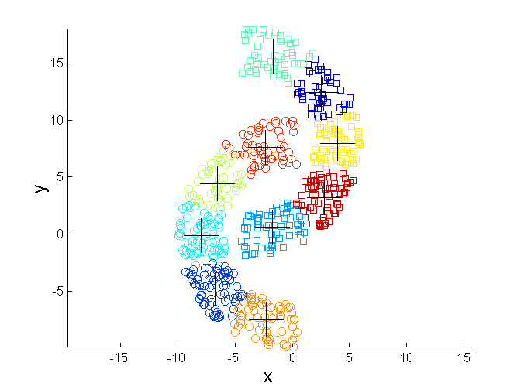
Overcoming K-means Limitations
Original Points K-means Clusters

Slide 32


Hierarchical Clustering
Produces a set of nested clusters organized as a hierarchical tree
Can be visualized as a dendrogram
  A tree like diagram that records the sequences of merges or splits

Slide 33
Strengths of Hierarchical Clustering
Do not have to assume any particular number of clusters
  Any desired number of clusters can be obtained by ‘cutting’ the dendogram at the proper level
They may correspond to meaningful taxonomies
  Example in biological sciences (e.g., animal kingdom, phylogeny reconstruction, …)

Slide 34
Hierarchical Clustering
Two main types of hierarchical clustering
  Agglomerative:
    Start with the points as individual clusters
    At each step, merge the closest pair of clusters until only one cluster (or k clusters) left
  Divisive:
    Start with one, all-inclusive cluster
    At each step, split a cluster until each cluster contains a point (or there are k clusters)
Traditional hierarchical algorithms use a similarity or distance matrix
  Merge or split one cluster at a time

Slide 35
Agglomerative Clustering Algorithm
More popular hierarchical clustering technique
Basic algorithm is straightforward
  Compute the proximity matrix
  Let each data point be a cluster
  Repeat
  Merge the two closest clusters
  Update the proximity matrix
  Until only a single cluster remains
Key operation is the computation of the proximity of two clusters
  Different approaches to defining the distance between clusters distinguish the different algorithms

Slide 36
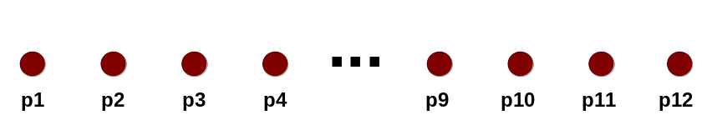
Starting Situation
Start with clusters of individual points and a proximity matrix
p1
p2
p3
p4
p5
. . .
p1
p2
p3
p4
p5
.
.
.
Proximity Matrix

Slide 37
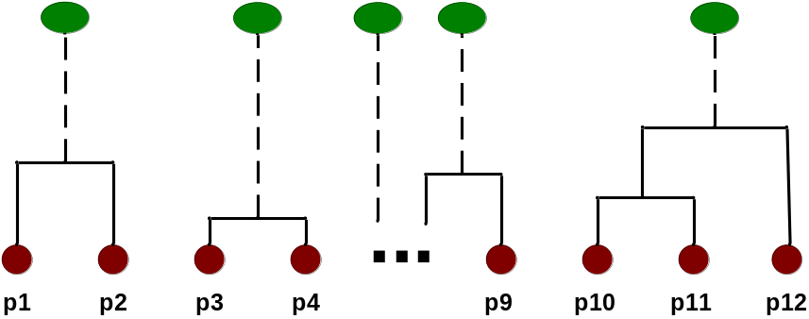
Intermediate Situation
After some merging steps, we have some clusters
C1
C2
C3
C4
C5
C1
C2
C3
C3
C4
C4
C5
Proximity Matrix
C1
C2
C5

Slide 38

Intermediate Situation
We want to merge the two closest clusters (C2 and C5) and update the proximity matrix.
C1
C2
C3
C4
C5
C1
C2
C3
C3
C4
C4
C5
Proximity Matrix
C1
C2
C5

Slide 39

After Merging
The question is “How do we update the proximity matrix?”
C2 U C5
C1
C3
C4
C1
?
C2 U C5
? ? ? ?
C3
C3
?
C4
C4
?
Proximity Matrix
C1
C2 U C5

Slide 40
How to Define Inter-Cluster Similarity
p1
p2
p3
p4
p5
. . .
p1
Similarity?
p2
p3
p4
p5
MIN
MAX
Group Average
Distance Between Centroids
.
.
.
Proximity Matrix

Slide 41
How to Define Inter-Cluster Similarity
p1
p2
p3
p4
p5
. . .
p1
p2
p3
p4
p5
MIN
MAX
Group Average
Distance Between Centroids
.
.
.
Proximity Matrix

Slide 42
How to Define Inter-Cluster Similarity
p1
p2
p3
p4
p5
. . .
p1
p2
p3
p4
p5
MIN
MAX
Group Average
Distance Between Centroids
.
.
.
Proximity Matrix

Slide 43
How to Define Inter-Cluster Similarity
p1
p2
p3
p4
p5
. . .
p1
p2
p3
p4
p5
MIN
MAX
Group Average
Distance Between Centroids
.
.
.
Proximity Matrix

Slide 44
How to Define Inter-Cluster Similarity
p1
p2
p3
p4
p5
. . .
p1
×
×
p2
p3
p4
p5
MIN
MAX
Group Average
Distance Between Centroids
.
.
.
Proximity Matrix

Slide 45
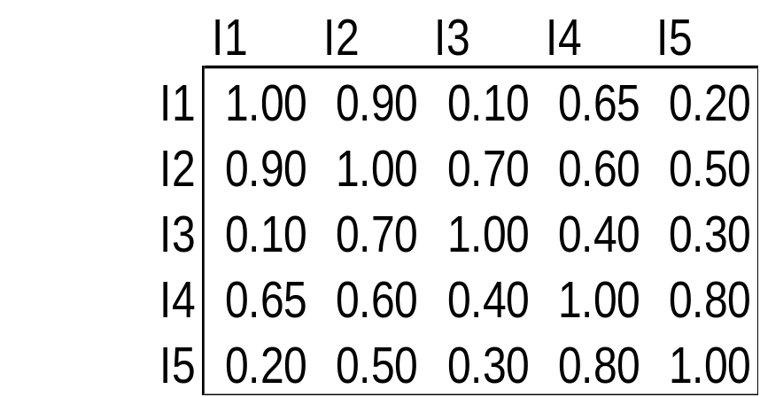
Cluster Similarity: MIN or Single Link
Similarity of two clusters is based on the two most similar (closest) points in the different clusters
  Determined by one pair of points, i.e., by one link in the proximity graph.
1
2
3
4
5

Slide 46

Hierarchical Clustering: MIN
5
1
3
5
2
1
2
3
6
4
4
Nested Clusters
Dendrogram

Slide 47
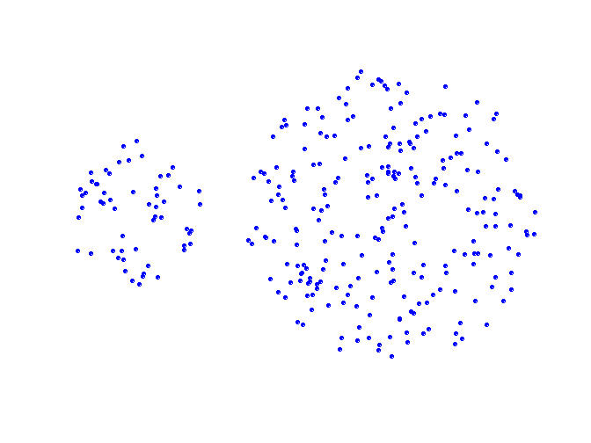
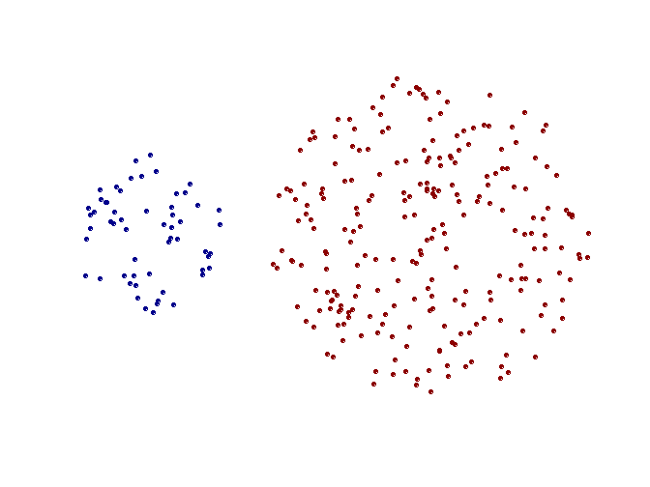
Strength of MIN
Original Points
Two Clusters
Can handle non-elliptical shapes

Slide 48
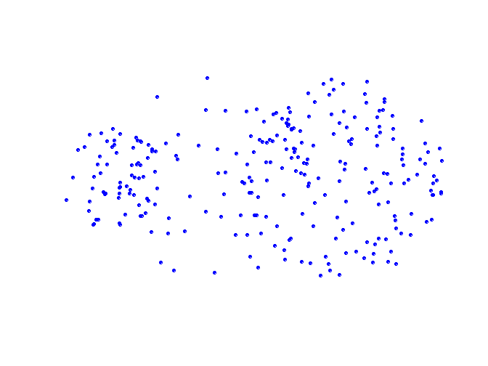
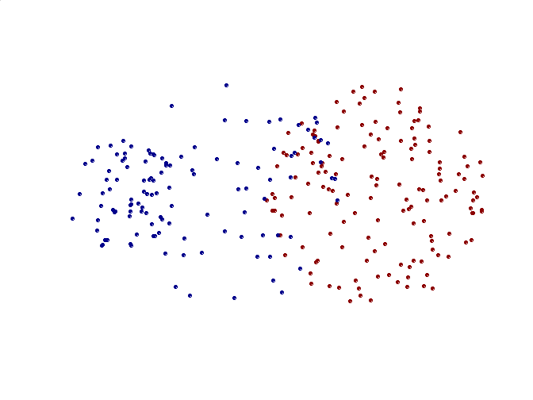
Limitations of MIN
Original Points
Two Clusters
Sensitive to noise and outliers

Slide 49

Cluster Similarity: MAX or Complete Linkage
Similarity of two clusters is based on the two least similar (most distant) points in the different clusters
  Determined by all pairs of points in the two clusters
1
2
3
4
5

Slide 50
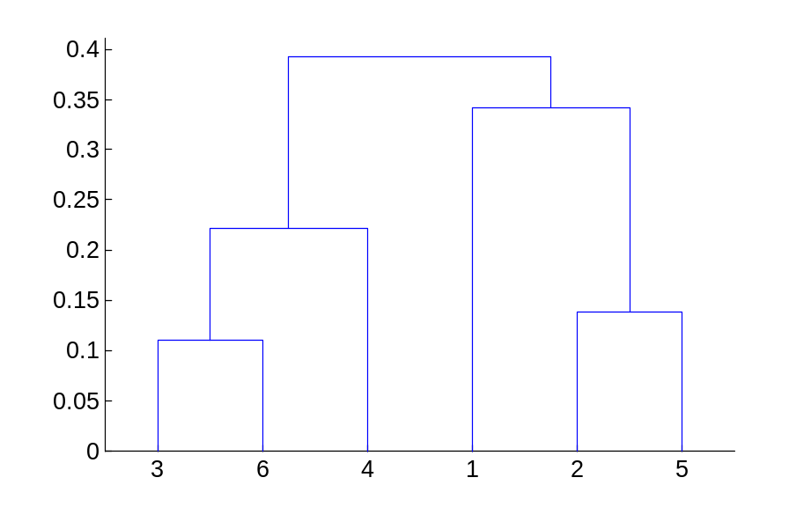
Hierarchical Clustering: MAX
4
1
2
5
5
2
3
6
3
1
4
Nested Clusters
Dendrogram

Slide 51
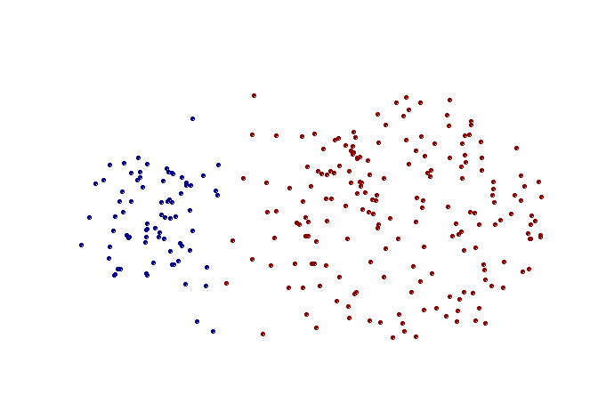
Strength of MAX
Original Points
Two Clusters
Less susceptible to noise and outliers

Slide 52
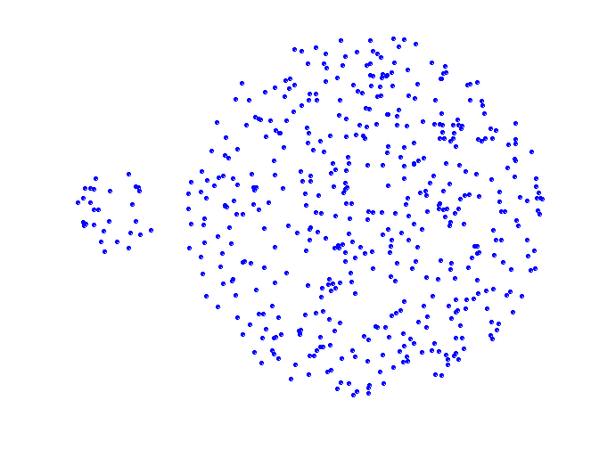
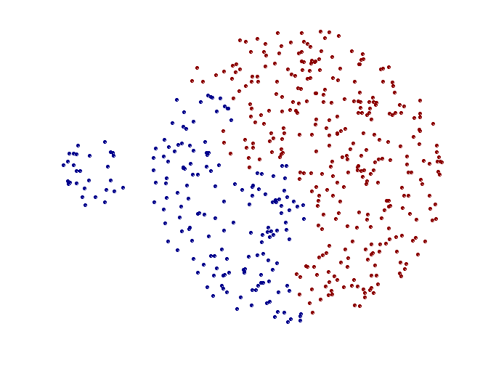
Limitations of MAX
Original Points
Two Clusters
Tends to break large clusters
Biased towards globular clusters

Slide 53
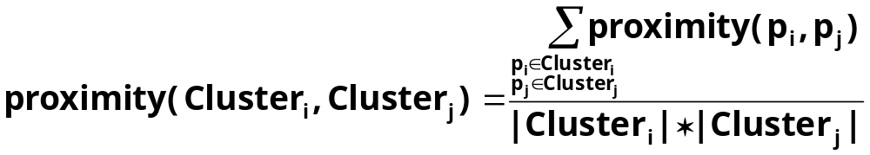

Cluster Similarity: Group Average
Proximity of two clusters is the average of pairwise proximity between points in the two clusters.
Need to use average connectivity for scalability since total proximity favors large clusters
1
2
3
4
5

Slide 54

Hierarchical Clustering: Group Average
5
4
1
2
5
2
3
6
1
4
3
Nested Clusters
Dendrogram

Slide 55
Hierarchical Clustering: Group Average
Compromise between Single and Complete Link
Strengths
  Less susceptible to noise and outliers
Limitations
  Biased towards globular clusters

Slide 56
Hierarchical Clustering: Time and Space requirements
O(N²) space since it uses the proximity matrix.
  N is the number of points.
O(N³) time in many cases
  There are N steps and at each step the size, N², proximity matrix must be updated and searched
  Complexity can be reduced to O(N² log(N) ) time for some approaches

Slide 57
Hierarchical Clustering: Problems and Limitations
Once a decision is made to combine two clusters, it cannot be undone
No objective function is directly minimized
Different schemes have problems with one or more of the following:
  Sensitivity to noise and outliers
  Difficulty handling different sized clusters and convex shapes
  Breaking large clusters

Slide 58
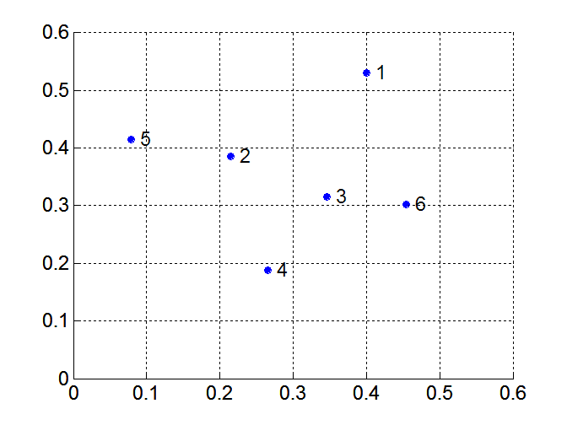
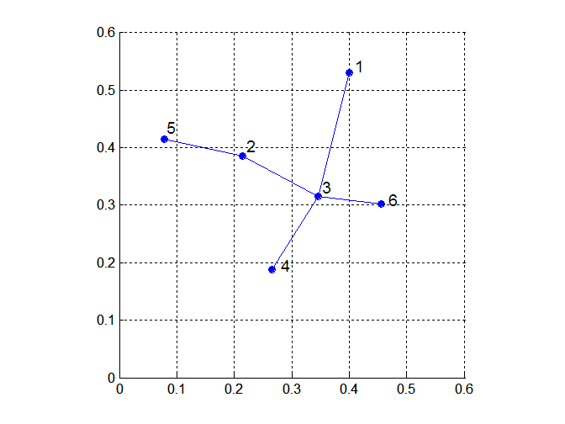
MST: Divisive Hierarchical Clustering
Build MST (Minimum Spanning Tree)
  Start with a tree that consists of any point
  In successive steps, look for the closest pair of points (p, q) such that one point (p) is in the current tree but the other (q) is not
  Add q to the tree and put an edge between p and q

Slide 59
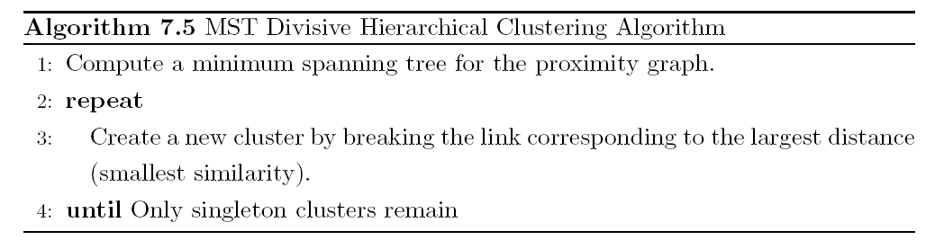
MST: Divisive Hierarchical Clustering
Use MST for constructing hierarchy of clusters

Slide 60
DBSCAN
DBSCAN is a density-based algorithm.
  Density = number of points within a specified radius (Eps)
  A point is a core point if it has more than a specified number of points (MinPts) within Eps
    These are points that are at the interior of a cluster
  A border point has fewer than MinPts within Eps, but is in the neighborhood of a core point
  A noise point is any point that is not a core point or a border point.

Slide 61

DBSCAN: Core, Border, and Noise Points

Slide 62
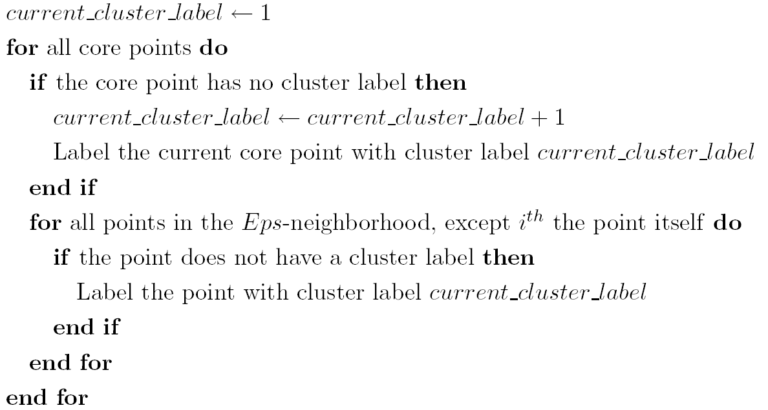
DBSCAN Algorithm
Eliminate noise points
Perform clustering on the remaining points

Slide 63


DBSCAN: Core, Border and Noise Points
Original Points
Point types: core, border and noise
Eps = 10, MinPts = 4

Slide 64

When DBSCAN Works Well
Original Points
Clusters
Resistant to Noise
Can handle clusters of different shapes and sizes

Slide 65



When DBSCAN Does NOT Work Well
(MinPts=4, Eps=9.75).
Original Points
Varying densities
High-dimensional data
(MinPts=4, Eps=9.92)

Slide 66
Cluster Validity
For supervised classification we have a variety of measures to evaluate how good our model is
  Accuracy, precision, recall
For cluster analysis, the analogous question is how to evaluate the “goodness” of the resulting clusters?
But “clusters are in the eye of the beholder”!
Then why do we want to evaluate them?
  To avoid finding patterns in noise
  To compare clustering algorithms
  To compare two sets of clusters
  To compare two clusters

Slide 67
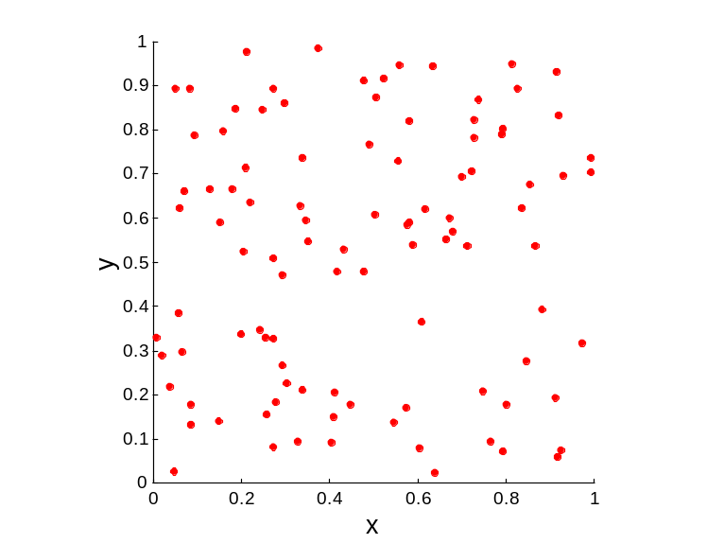
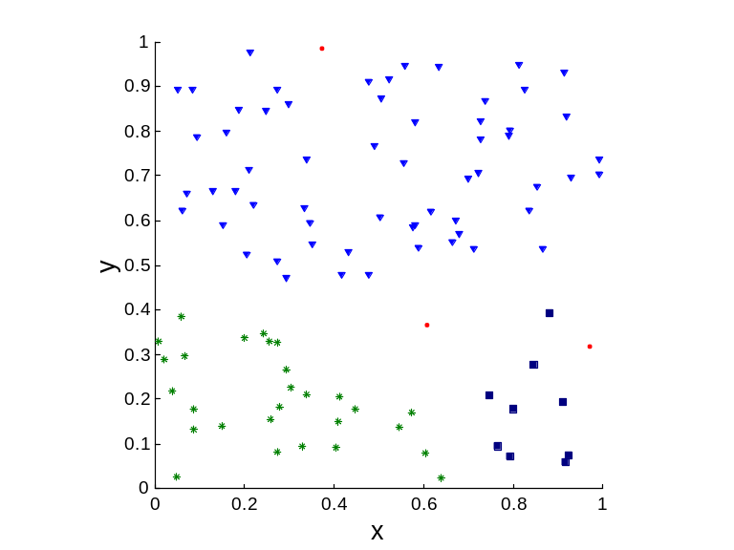
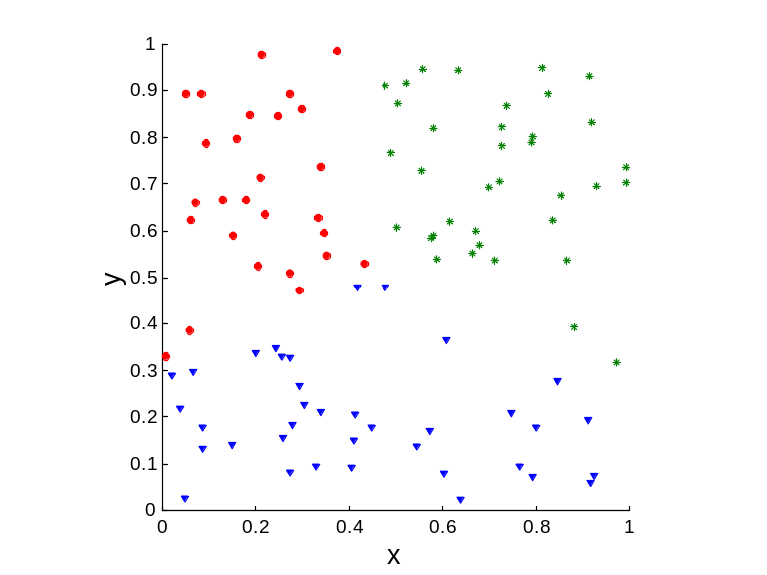
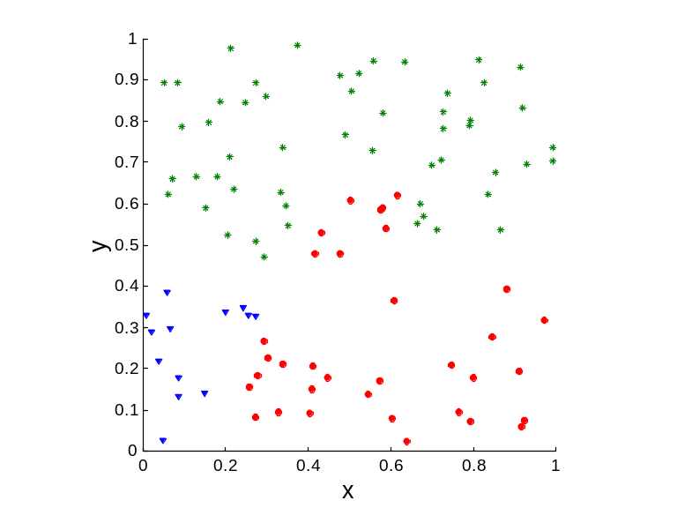
Clusters found in Random Data
Random Points
DBSCAN
K-means
Complete Link

Slide 68
Different Aspects of Cluster Validation
Determining the clustering tendency of a set of data, i.e., distinguishing whether non-random structure actually exists in the data.
Comparing the results of a cluster analysis to externally known results, e.g., to externally given class labels.
Evaluating how well the results of a cluster analysis fit the data without reference to external information.
  - Use only the data
Comparing the results of two different sets of cluster analyses to determine which is better.
Determining the ‘correct’ number of clusters.
For 2, 3, and 4, we can further distinguish whether we want to evaluate the entire clustering or just individual clusters.

Slide 69
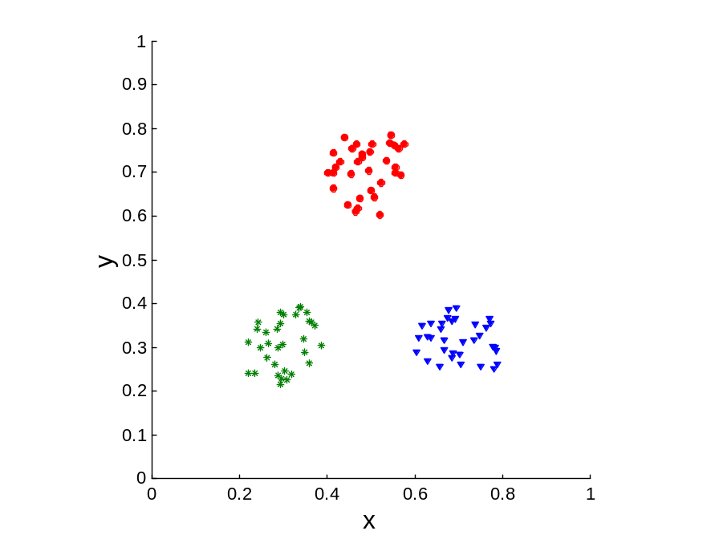
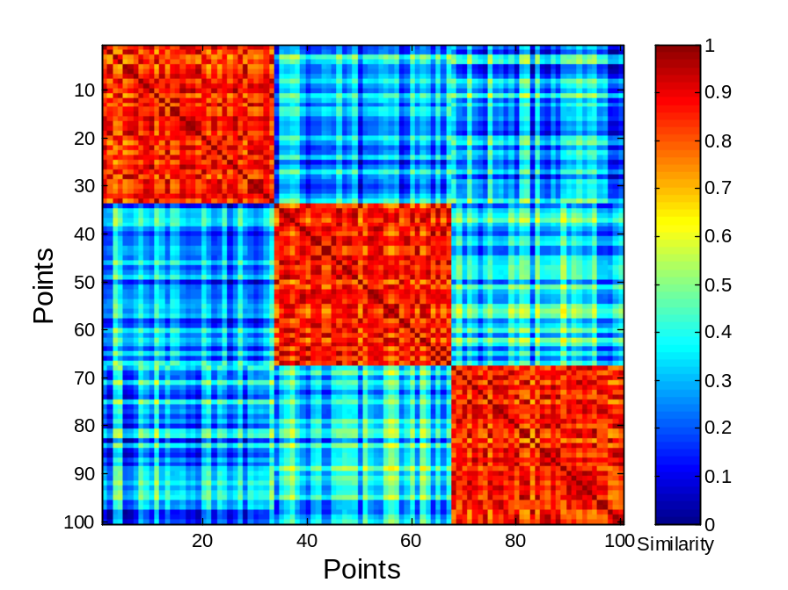
Using Similarity Matrix for Cluster Validation
Order the similarity matrix with respect to cluster labels and inspect visually.

Slide 70
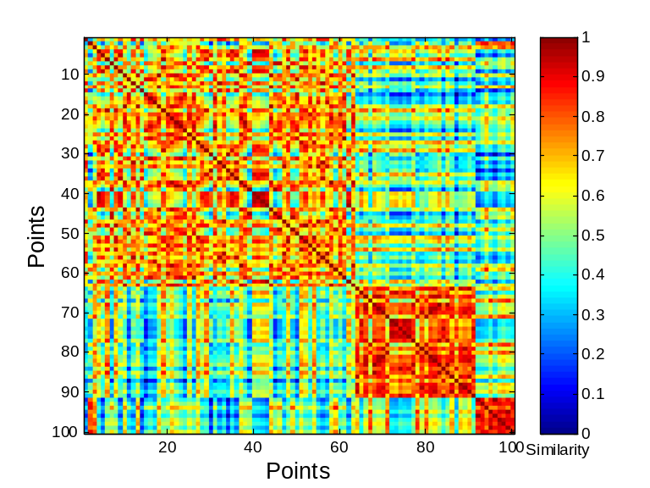
Using Similarity Matrix for Cluster Validation
Clusters in random data are not so crisp
DBSCAN

Slide 71
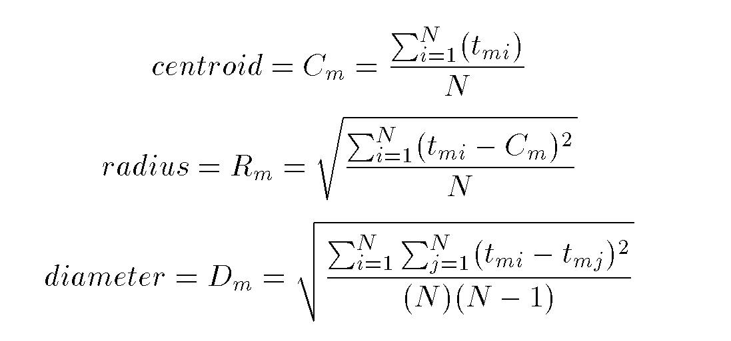
Intrinsic Measures of Clustering quality

Slide 72
Cohesion and Separation
A proximity graph based approach can also be used for cohesion and separation.
  Cluster cohesion is the sum of the weight of all links within a cluster.
  Cluster separation is the sum of the weights between nodes in the cluster and nodes outside the cluster.
cohesion
separation

Slide 73
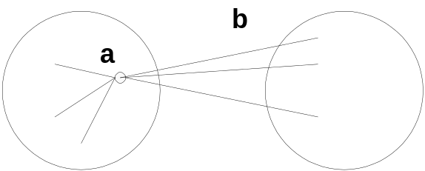
Silhouette Coefficient
Silhouette Coefficient combine ideas of both cohesion and separation, but for individual points, as well as clusters and clusterings
For an individual point, i
  Calculate a = average distance of i to the points in its cluster
  Calculate b = min (average distance of i to points in another cluster)
  The silhouette coefficient for a point is then given by
  s = 1 – a/b if a < b, (or s = b/a - 1 if a ≥ b, not the usual case)
  Typically between 0 and 1.
  The closer to 1 the better.
Can calculate the Average Silhouette width for a cluster or a clustering

Slide 74
Other Measures of Cluster Validity
Entropy/Gini
    If there is a class label – you can use the entropy/gini of the class label – similar to what we did for classification
    If there is no class label – one can compute the entropy w.r.t each attribute (dimension) and sum up or weighted average to compute the disorder within a cluster
Classification Error
    If there is a class label one can compute this in a similar manner

Slide 75
Extensions: Clustering Large Databases
Most clustering algorithms assume a large data structure which is memory resident.
Clustering may be performed first on a sample of the database then applied to the entire database.
Algorithms
  BIRCH
  DBSCAN (we have already covered this)
  CURE

Slide 76
Desired Features for Large Databases
One scan (or less) of DB
Online
Suspendable, stoppable, resumable
Incremental
Work with limited main memory
Different techniques to scan (e.g. sampling)
Process each tuple once

Slide 77
More on Hierarchical Clustering Methods
Major weakness of agglomerative clustering methods
  do not scale well: time complexity of at least O(n²), where n is the number of total objects
  can never undo what was done previously
Integration of hierarchical with distance-based clustering
  BIRCH (1996): uses CF-tree and incrementally adjusts the quality of sub-clusters
  CURE (1998): selects well-scattered points from the cluster and then shrinks them towards the center of the cluster by a specified fraction

Slide 78
BIRCH
Balanced Iterative Reducing and Clustering using Hierarchies
Incremental, hierarchical, one scan
Save clustering information in a tree
Each entry in the tree contains information about one cluster
New nodes inserted in closest entry in tree

Slide 79
BIRCH (1996)
Incrementally construct a CF (Clustering Feature) tree, a hierarchical data structure for multiphase clustering
  Phase 1: scan DB to build an initial in-memory CF tree (a multi-level compression of the data that tries to preserve the inherent clustering structure of the data)
  Phase 2: use an arbitrary clustering algorithm to cluster the leaf nodes of the CF-tree
Scales linearly: finds a good clustering with a single scan and improves the quality with a few additional scans
Weakness: handles only numeric data, and sensitive to the order of the data record.

Slide 80
Clustering Feature
CT Triple: (N,LS,SS)
  N: Number of points in cluster
  LS: Sum of points in the cluster
  SS: Sum of squares of points in the cluster
CF Tree
  Balanced search tree
  Node has CF triple for each child
  Leaf node represents cluster and has CF value for each subcluster in it.
  Subcluster has maximum diameter

Slide 81

Clustering Feature Vector
Clustering Feature: CF = (N, LS, SS)
N: Number of data points
LS: ∑^{N}_{i=1}=X_{i}
SS: ∑^{N}_{i=1}=X_{i}²
CF = (5, (16,30),(54,190))
(3,4)
(2,6)
(4,5)
(4,7)
(3,8)

Slide 82
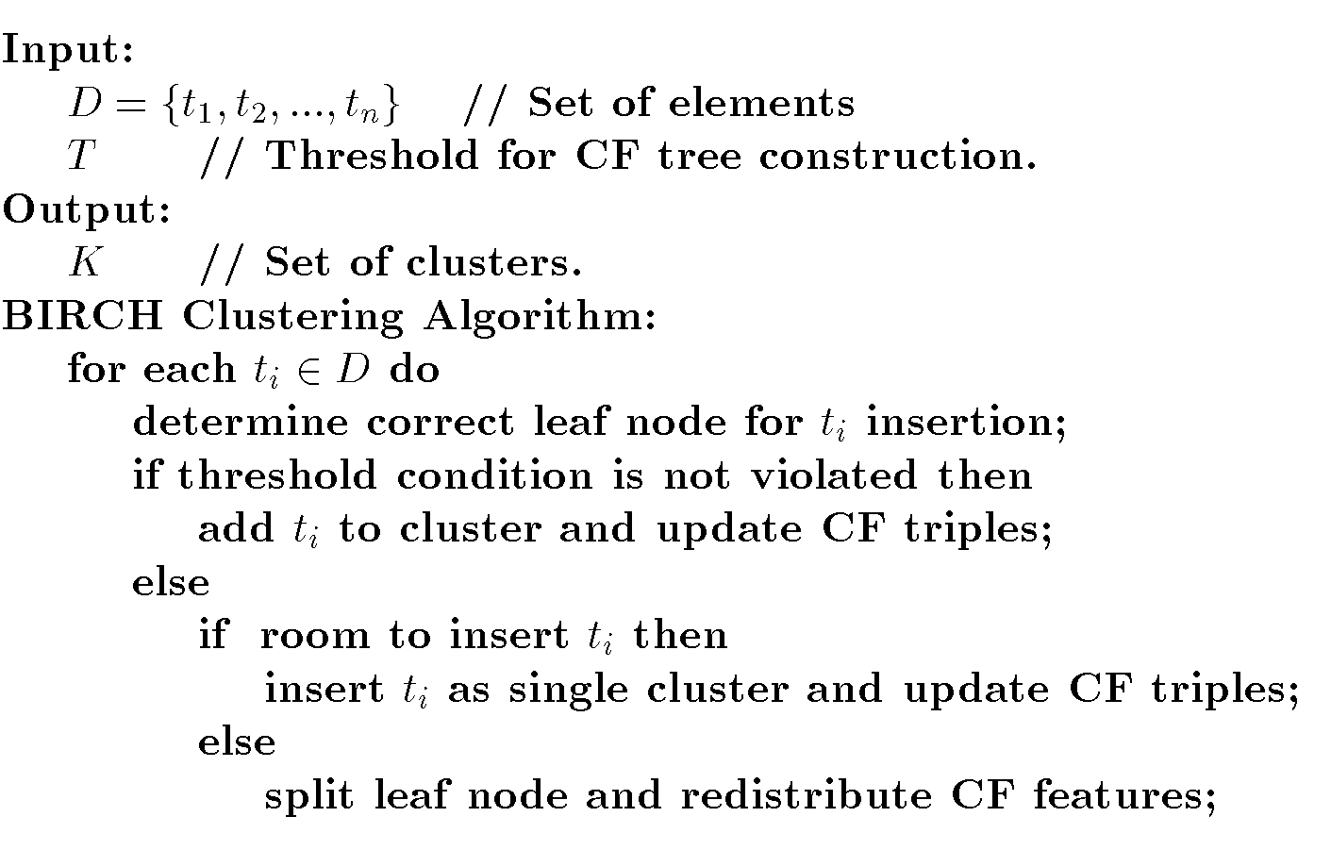
BIRCH Algorithm

Slide 83
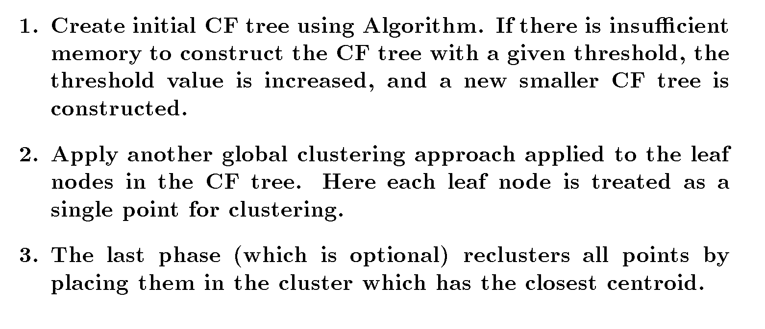
Improve Clusters

Slide 84
CF Tree
Root
B = 7
L = 6
CF₁
CF₂
CF₃
CF₆
child₁
child₂
child₃
child₆
Non-leaf node
CF₁
CF₂
CF₃
CF₅
child₁
child₂
child₃
child₅
Leaf node
Leaf node
prev
CF₁
CF₂
CF₆
next
prev
CF₁
CF₂
CF₄
next

Slide 85
CURE
Clustering Using Representatives (CURE)
  Stops the creation of a cluster hierarchy if a level consists of k clusters
Use many points to represent a cluster instead of only one
  Uses multiple representative points to evaluate the distance between clusters, adjusts well to arbitrary shaped clusters and avoids single-link effect
  Points will be well scattered
Drawbacks of square-error based clustering method
  Consider only one point as representative of a cluster
  Good only for convex shaped, similar size and density, and if k can be reasonably estimated

Slide 86
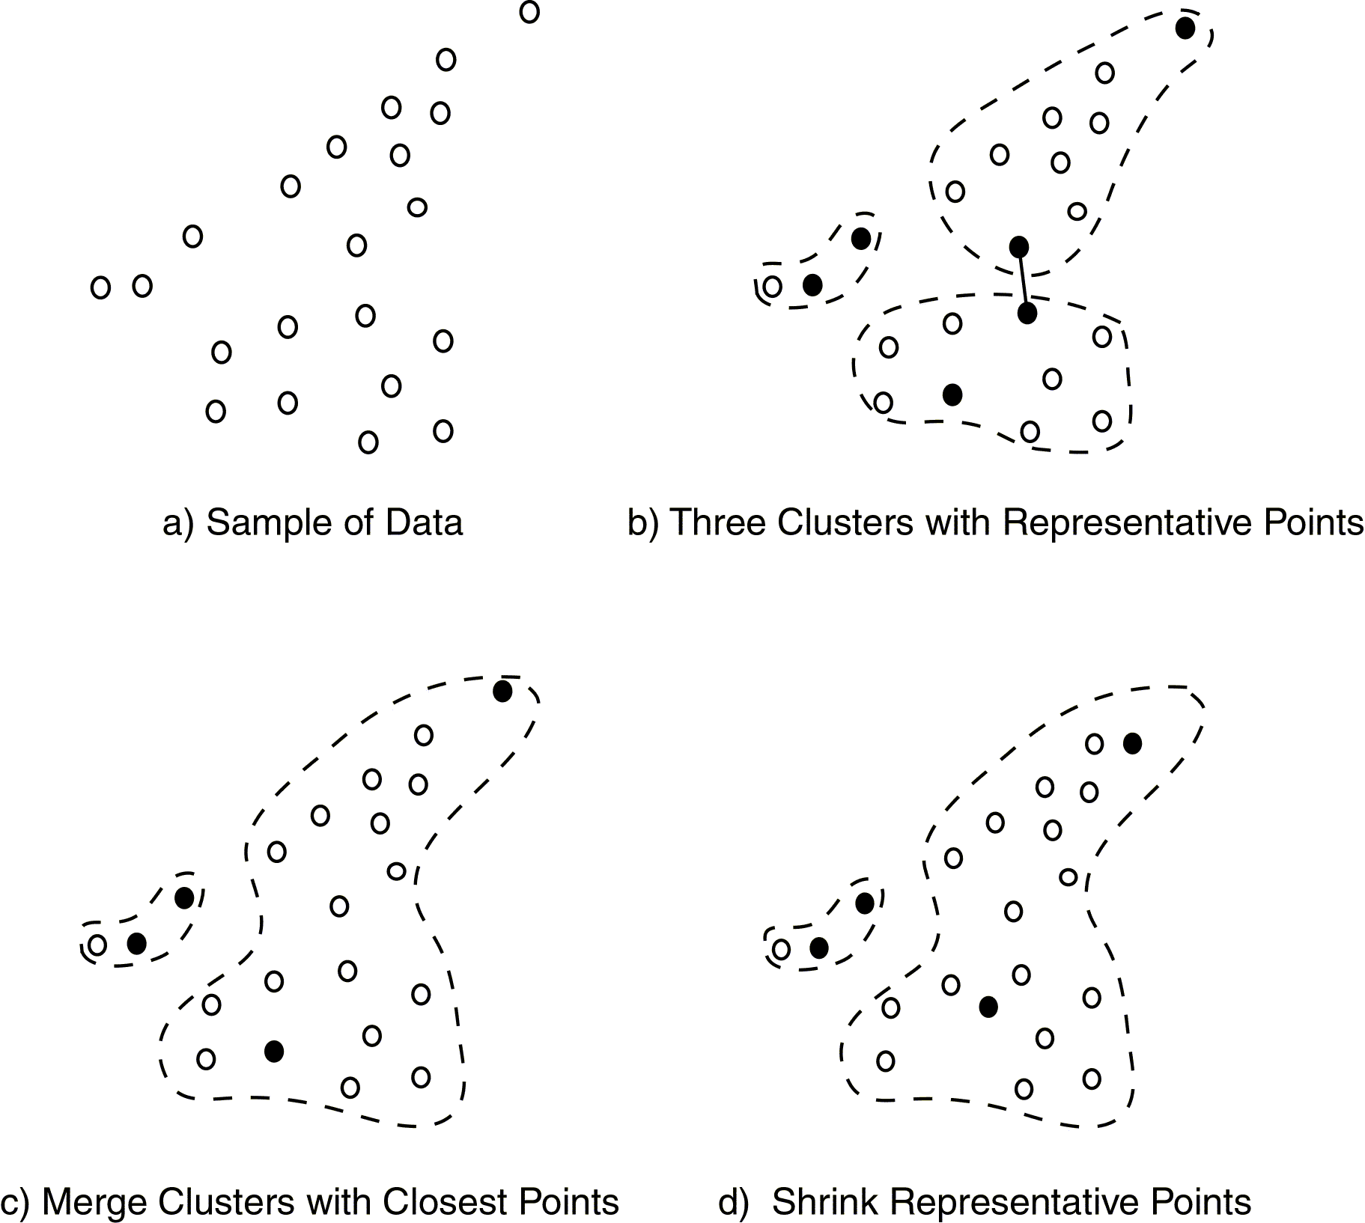
CURE Approach

Slide 87
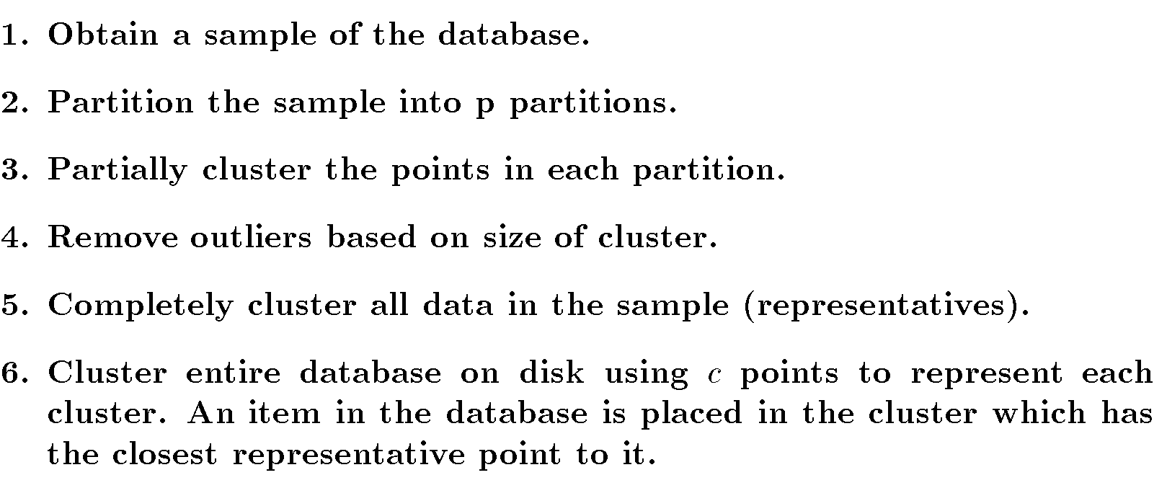
CURE for Large Databases

Slide 88
Cure: The Algorithm
  Draw random sample s.
  Partition sample to p partitions with size s/p
  Partially cluster partitions into s/pq clusters
  Eliminate outliers
    By random sampling
    If a cluster grows too slow, eliminate it.
  Cluster partial clusters.
  Label data in disk

Slide 89
Data Partitioning and Clustering
  s = 50
  p = 2
  s/p = 25
  s/pq = 5
y
y
y
x
y
y
x
x
x
x

Slide 90
Cure: Shrinking Representative Points
y
y
x
x
Shrink the multiple representative points towards the gravity center by a fraction of α.
Multiple representatives capture the shape of the cluster

Slide 91
Clustering Categorical Data: ROCK
ROCK: Robust Clustering using linKs,
by S. Guha, R. Rastogi, K. Shim (ICDE’99).
  Use links to measure similarity/proximity
  Not distance based
    Example (1,0,0,0,0,0), (0,1,1,1,1,0), (0,1,1,0,1,1), (0,0,0,0,1,0,1)
    Eucledian distance based approach would cluster
      Pt2, Pt3 and Pt1 and Pt4
      Problem? Pt1 and Pt4 have nothing in common

Slide 92
Rock: Algorithm
Links: The number of common neighbours for the two points. Using jacquard
  Use Distances to determine neighbors
    (pt1,pt4) = 0, (pt1,pt2) = 0, (pt1,pt3) = 0
    (pt2,pt3) = 0.6, (pt2,pt4) = 0.2
    (pt3,pt4) = 0.2
  Use 0.2 as threshold for neighbors
    Pt2 and Pt3 have 3 common neighbors
    Pt3 and Pt4 have 3 common neighbors
    Pt2 and Pt4 have 3 common neighbors
  Resulting clusters (1), (2,3,4) which makes more sense
Algorithm
  Draw random sample
  Cluster with links
  Label data in disk

Slide 93
Another example
Links: The number of common neighbours for the two points.
Algorithm
  Draw random sample
  Cluster with links
  Label data in disk
{1,2,3}, {1,2,4}, {1,2,5}, {1,3,4}, {1,3,5}
{1,4,5}, {2,3,4}, {2,3,5}, {2,4,5}, {3,4,5}
3
{1,2,3} {1,2,4}

Slide 94
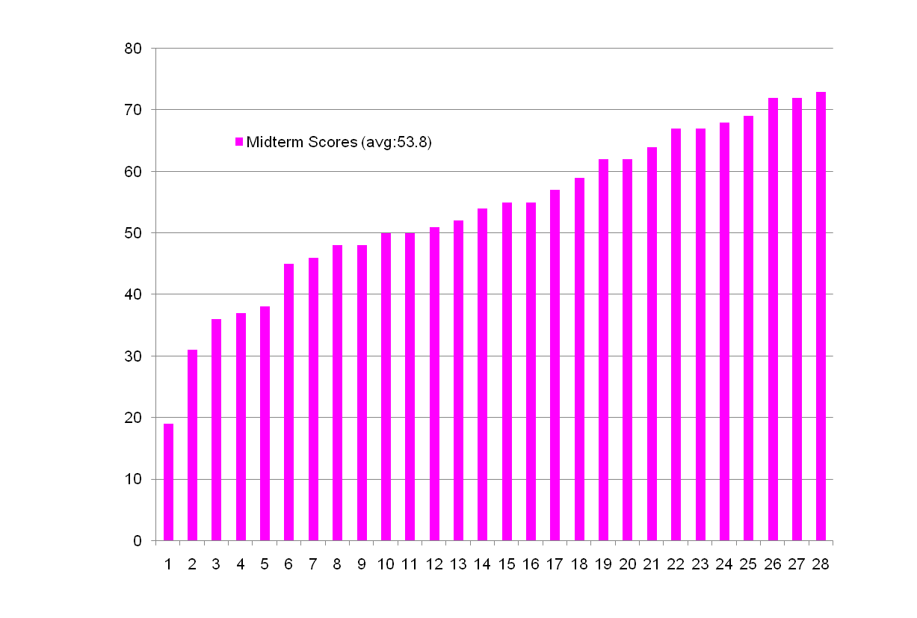
Midterm Performance (Winter 2009)

