Slide 1
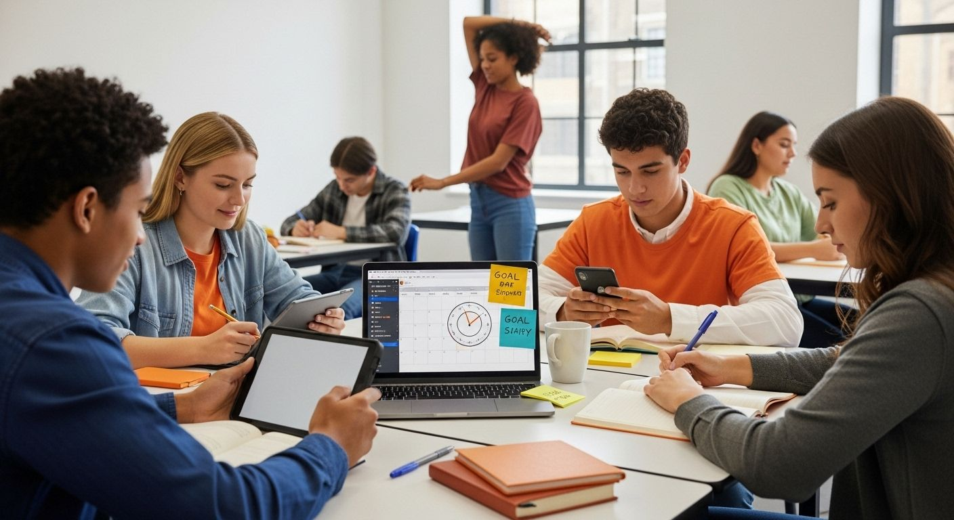
Student Productivity & Behaviour Analysis
Subtitle: Insights from 20,000 Students – Impact of Gaming, Phone Usage, Social Media, Sleep & More Presented by Mogulla Sowmya

Slide 2
objective
This dashboard provides a comprehensive overview of student productivity, behaviour, and academic performance. Examine how behaviours such as social media usage, phone habits, and attendance influence student productivity and final grades.

Slide 3
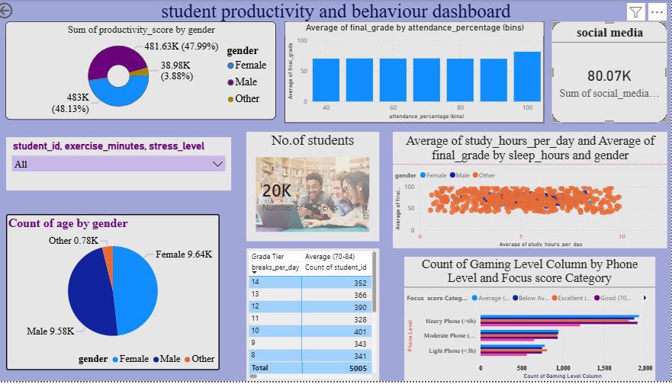

Slide 4
Dataset Snapshot
20,000 students
Key variables : age, gender, study_hours_per_day, sleep_hours, phone_usage_hours, social_media_hours, gaming_hours, breaks_per_day, exercise_minutes, stress_level, focus_score,productivity_score, final_grade, attendance_percentage

Slide 5
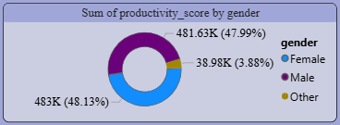
visualizations
Big number: 20K
Total number of students in the datasetOverall scale of the analysis≈20,000 students
Donut / Pie chart: Sum of productivity_score by genderTotal productivity score summed and split by gender category Which gender contributes most to the total productivity score in the dataset male ≈ 481.63K (48%) other≈ 38.98K (3.9%) ,female ≈ 483K (48.1%) → Very unusual distribution (Other almost = Female)

Slide 6
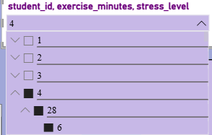
Showing values of exercise minutes and stress level according to student id

Slide 7
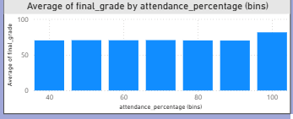
Bar chart: Average of final _ grade by attendance _ percentage bins
Displays being in class and academic success
X- axis(Categories): the data is grouped into “bins” representing ranges of attendance percentages y-axis(measurement): The height of each bar represents the average final grade for students within that attendance range

Slide 8
Focus Score Categories by Phone & Gaming Levels
Key visual: Your bar chart (Heavy Phone, Moderate Phone, Light Phone) with color-coded tiers (Below Avg, Good, Excellent)
Insight:
Heavy phone (>6h) → lowest average focus
Light phone (<3h) → highest focus, especially with light gaming
Visual: Clustered bars + annotations on worst/best combos

Slide 9
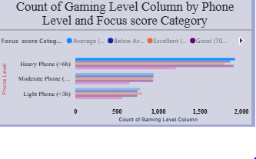
Horizontal bar chart: Count of Gaming Level Column by Phone Level + Focus score Category
Number of students in different combinations of Gaming level × Focus score category (probably colored by focus level)
Relationship between gaming intensity, phone usage level, and ability to focus
Heavy Phone users tend to have higher counts in lower focus categories

Slide 10
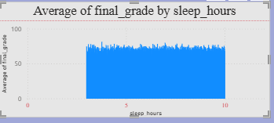
stacked column visualization
Title: Average of final_grade by sleep_hours
What it shows: How average final grade changes
with different sleep hours (from ~0 to 10+ hours).
Pattern: The line stays relatively high and stable
between 4 to 10 hours of sleep, with some fluctuations.
Insight: Sleep hours seem to have a mild positive or
stabilizing effect on grades, but not a very sharp trend.

Slide 11
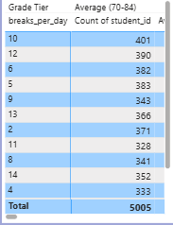
How Breaks Relate to Final Grade
Table: Grade Tier / Average (70-id) A / breaks_per_day / Count of students
Students grouped by how many breaks per day they take, showing count of students and possibly average grade or tier
Do students who take more breaks perform better / worse?
Top rows (10–12 breaks/day) have fewer students but possibly better performance indicators

Slide 12


