Slide 1
APEX PLANET SOLUTIONS
Sales Performance
& Customer Insights
Data Storytelling & Statistical Validation
Data Analytics Internship
Presented by: Sowmya

Slide 2
BUSINESS OBJECTIVE
How is overall sales performance?
Turn sales data into better decisions.
Which products contribute most to sales?
What customer and age-segment patterns can we identify?
Understand sales performance and customer behavior to identify opportunities for better business decision-making.
What relationships exist between sales variables?
Is the observed gender difference in average transaction sales statistically significant?
01
02
03
04
Business Question
Data Analysis
Insight
Decision
02

Slide 3
ANALYTICAL JOURNEY
From Raw Data to Business Insights
1,000 transactions analyzed
The analysis progressed from data quality validation to exploratory analysis, interactive dashboarding, customer segmentation, and statistical validation.
01
02
03
Data Cleaning
EDA & SQL Analysis
Power BI Dashboard
04
05
06
Customer Segmentation
Statistical Validation
Business Recommendations
03

Slide 4
PERFORMANCE SNAPSHOT
Overall Sales Performance
The dataset contains 1,000 sales transactions generating approximately ₹139.40 million in total sales.
Total Sales
Transactions
Average Quantity
Average Order Value
₹139.40M
1,000
5.44
₹139.40K
04

Slide 5
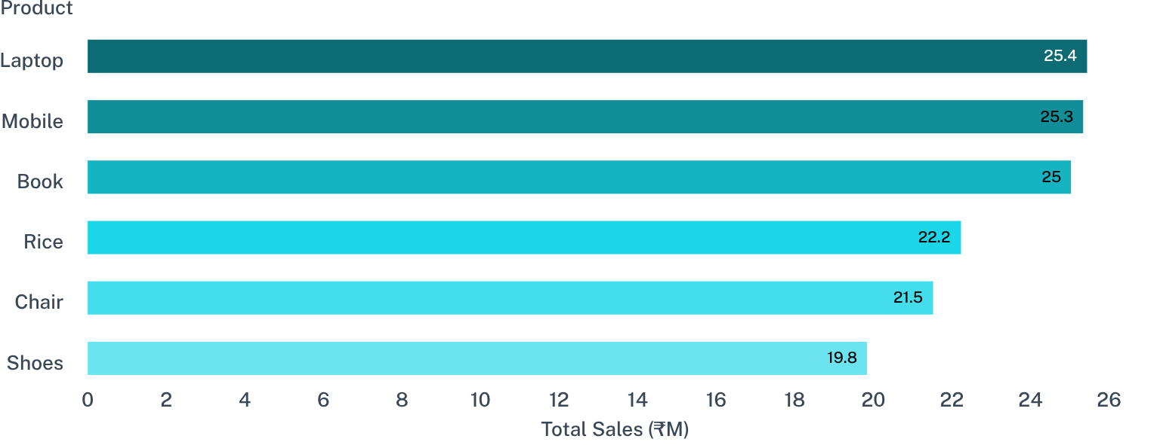
PRODUCT MIX
Laptop, Mobile, and Book lead product sales
Prioritize high-performing products for inventory planning and promotional campaigns; profitability is not assessed because profit data is unavailable.
05

Slide 6
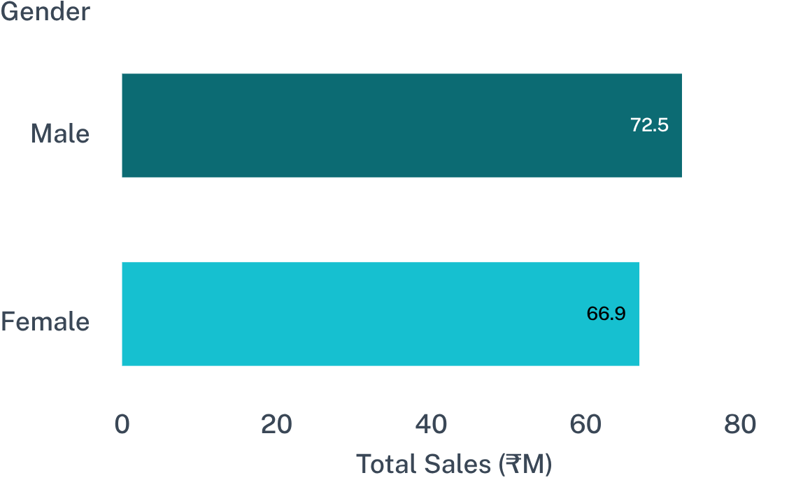
CUSTOMER MIX
Male customers contributed somewhat higher total sales
₹72.46M
Male customers contributed somewhat higher total sales in the sample.
OBSERVED DIFFERENCE → STATISTICAL VALIDATION
Does the observed difference represent a statistically meaningful difference in average transaction sales?
06

Slide 7
CUSTOMER SEGMENTATION
The Adult segment was the strongest contributor
AGE < 30
AGE 30–59
AGE ≥ 60
Young
Adult
Senior
Strongest contributor
Age-based segmentation can help identify customer groups for targeted marketing and sales strategies.
07

Slide 8
RELATIONSHIPS IN THE DATA
Quantity and unit price show moderate positive relationships with sales
Correlation indicates association, not causation.
Quantity ↔ Total Sales
Unit Price ↔ Total Sales
r = 0.647
r = 0.686
Moderate positive relationship
Moderate positive relationship
08

Slide 9
STATISTICAL QUESTION
Do average transaction sales differ by gender?
H₀: There is no statistically significant difference in average Total_Sales between Male and Female customers.
H₁: There is a statistically significant difference in average Total_Sales between Male and Female customers.
Test: Welch's Independent Two-Sample t-test
Significance level: α = 0.05
Confidence level: 95%
Business Question → H₀/H₁ → Statistical Test → Evidence
09

Slide 10
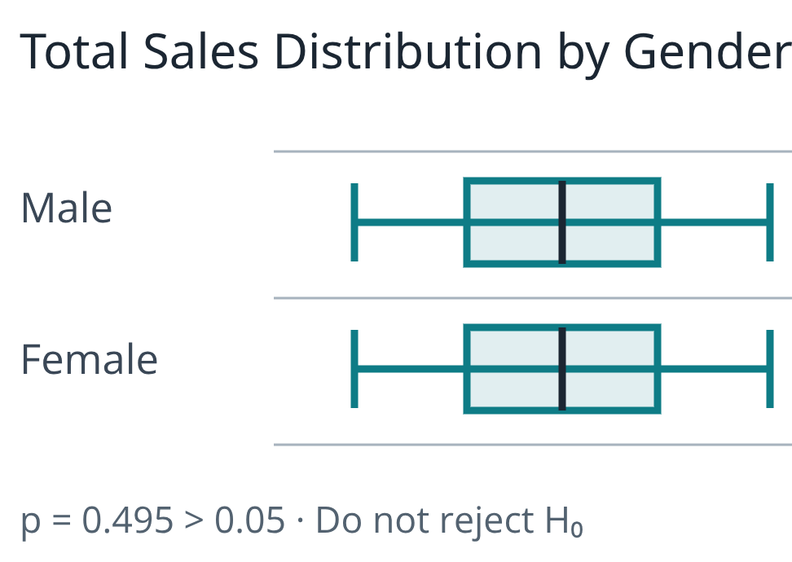
STATISTICAL RESULTS
The test did not establish a significant gender difference
METRIC | RESULT
Male sample size | 511
Female sample size | 489
Male mean transaction sales | ₹141,807.34
Female mean transaction sales | ₹136,883.21
Mean difference | ₹4,924.13
t-statistic | 0.6826
p-value | 0.4950
95% Confidence Interval | −₹9,231.58 to ₹19,079.85
Cohen's d | 0.0431
Decision | Do not reject H₀
10

