Slide 1
⭐ What is Maven?
Apache Maven is a build automation tool used mainly for Java projects.
Its main purpose is to manage:
  Project build
  Project dependencies
  Project lifecycle
  Project structure
Maven makes projects easy to create, build, test, and deploy.

Slide 2
⭐ 1. Why Maven? (Problems it solves)
    ❌ Without Maven
    You must manually add JAR files.
    Managing versions is difficult.
    Large projects need complex build scripts.
    Moving project to another system causes dependency issues.
✔ With Maven
    Automatically downloads all required JARs.
    Maintains proper versioning.
    Simplifies build → test → run → package.
    Standard directory structure.
    Works the same on any system.

Slide 3
⭐ 2. Key Concept: POM (Project Object Model)
Every Maven project contains a file:
📌 pom.xml
This file controls the entire project.
It contains:
Project info (name, version, artifactId)
Dependencies (JAR files)
Plugins
Build configuration

Slide 4
Example:
<project>
<modelVersion>4.0.0</modelVersion>
<groupId>com.example</groupId>
<artifactId>myproject</artifactId>
<version>1.0-SNAPSHOT</version>
<dependencies>
<dependency>
<groupId>mysql</groupId>
<artifactId>mysql-connector-java</artifactId>
<version>8.0.33</version>
</dependency>
</dependencies>
</project>

Slide 5
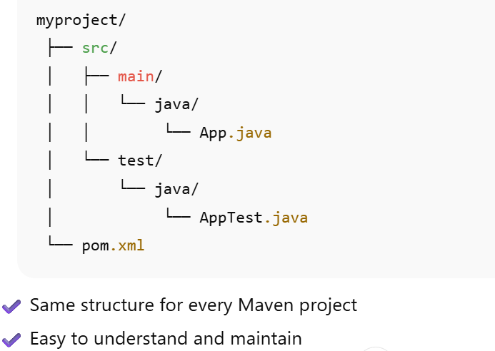
⭐ 3. Standard Maven Project Structure

Slide 6
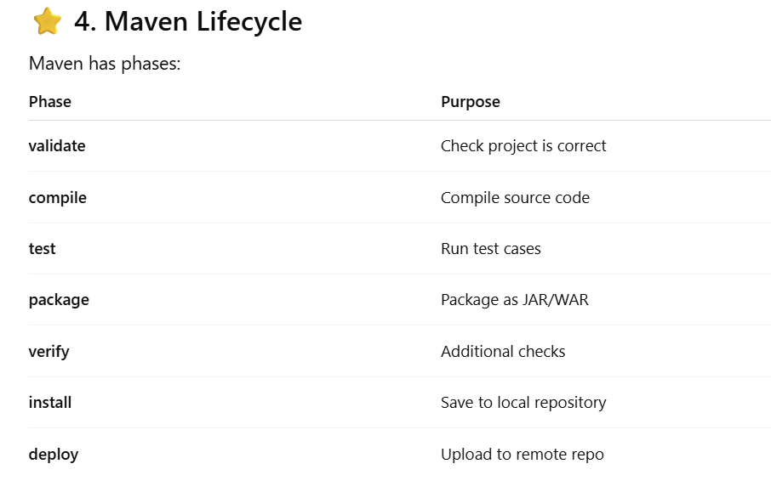

Slide 7
⭐ 5. Repositories in Maven
Maven uses 3 types of repositories:
1. Local Repository
    Your PC folder where downloaded JARs are stored
    Example: C:\Users\username\.m2\repository
2️. Central Repository
    Public repository provided by Maven
    Contains most Java libraries.
3️. Remote Repository
    Company/organization's repository (Nexus, Artifactory)

Slide 8
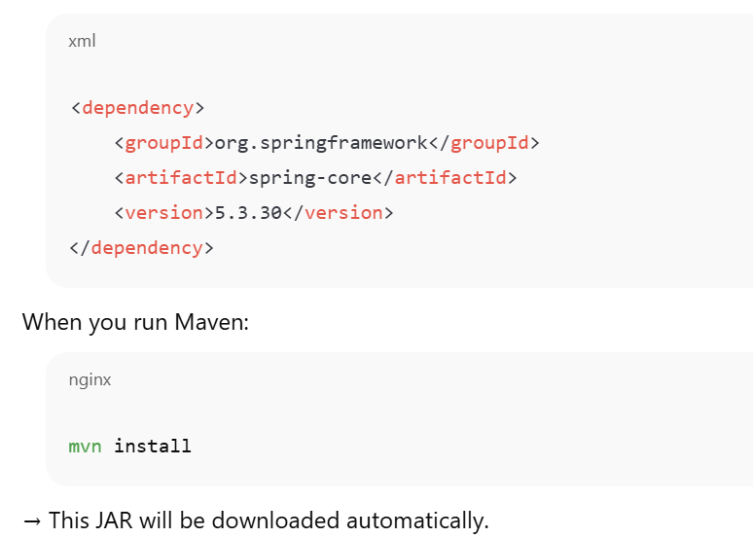
⭐ 6. What is a Dependency?
Dependency means the external jar libraries your project needs.
Example:

Slide 9
⭐ 7. What is a Plugin?
Plugins perform actions like:
    Compile Java code
    Run tests
    Build JAR/WAR
    Generate documentation
    Run your project
Example plugin:
        <build>
        <plugins>
        <plugin>
        <groupId>org.apache.maven.plugins</groupId>
        <artifactId>maven-compiler-plugin</artifactId>
        <version>3.8.1</version>
        <configuration>
        <source>17</source>
        <target>17</target>
        </configuration>
        </plugin>
        </plugins>
        </build>

Slide 10
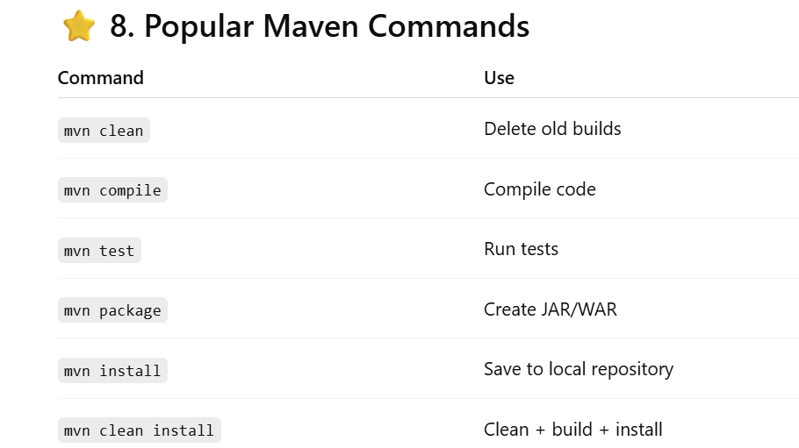

Slide 11
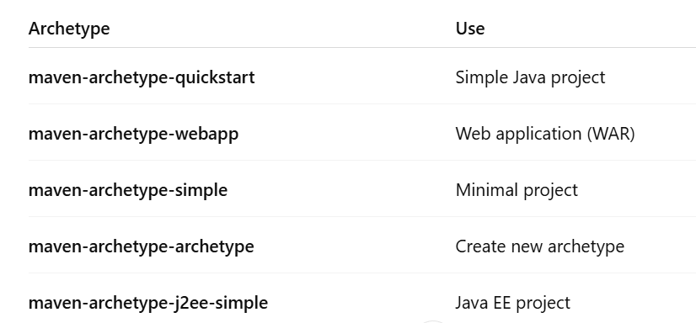
⭐ 9. Creating a Maven Project
Using Command Line:
mvn archetype:generate -DgroupId=com.example -DartifactId=myproject
-DarchetypeArtifactId=maven-archetype-quickstart -DinteractiveMode=false
-D = Define parameter for Maven command.
Using Eclipse:
File → New → Maven Project
Use Quickstart archetype
Fill groupId and artifactId
Done!

Slide 12
⭐ 10. Advantages of Maven
  ✔ Simple project creation
  ✔ Automatically downloads dependencies
  ✔ Standard directory structure
  ✔ Easy build (clean, compile, package)
  ✔ Supports large enterprise-level projects
  ✔ Integrates with Jenkins, GitHub CI/CD etc.

