Slide 1
Introduction
Analyzing and understanding prices of shoes based brands, colors, category.
Who would be interested
Retailers who plan to stock some shoes based on price, category, colors
Buyers who want to understand which brands go on sale more and
Manufacturers who want to understand new markets
Data
Datafiniti_Womens_Shoes1 is a dataset that consists of - different brands, along with their color, name of the shoe, price maximum, price minimum, whether its on sale or not , Category
Methodology
This dataset will be analyzed to answer the following questions
What is the average price of each distinct brand listed?
What are the prices range
s for different category of shoes and how many brands of shoes do we have in a category
Is there a price distribution based on the color of the shoes?
Which brand and category have sales?

Slide 2
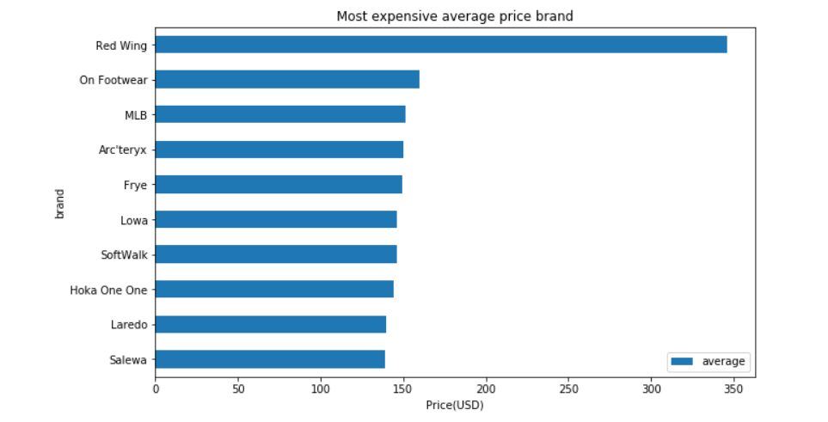
Methodology What is the average price of each distinct brand listed?
Observation: Red Wing is the most expensive followed by a bunch of other brands in the 2-10 rank

Slide 3
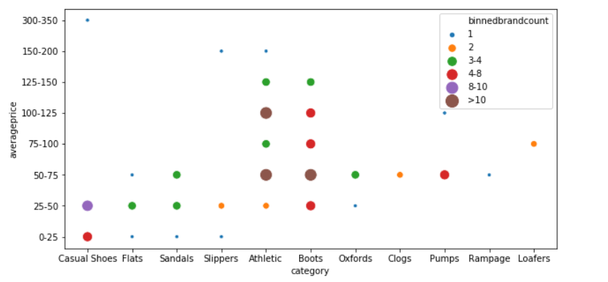
Question Which category and price ranges have more brands of shoes than others
Result
There are a lot of athletic shoe brands in the $25-$150 range , there are a lot of brands in the boots category in the $25-$150 range .
Observation
There is an opportunity to cut down on some of the casual shoe lines give there are so many
There is also an opportunity to have more athletic shoes in $25-$50 range

Slide 4
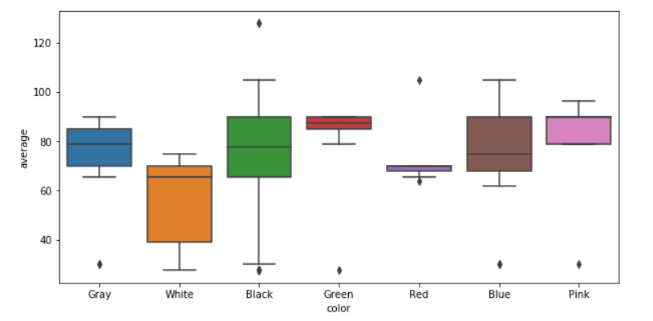
Question
For the Nike brand, what is the price distribution based on color
Observation
For Nike brand, which is an atheletic brand , gray and brown seems to have the least price variation and black shoes have the greatest variation
The price of white shoes are generally lower than black shoes
Recommendation
If a new shoe line is started, i recommend either gray or brown shoes instead of white shoes

Slide 5
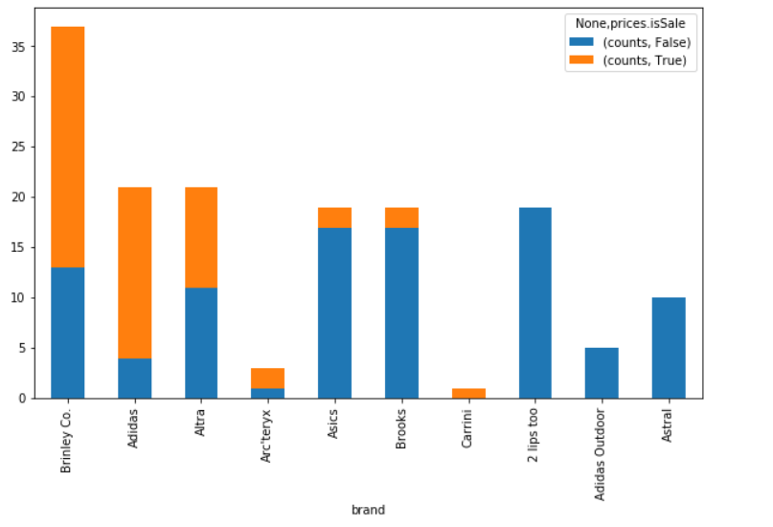
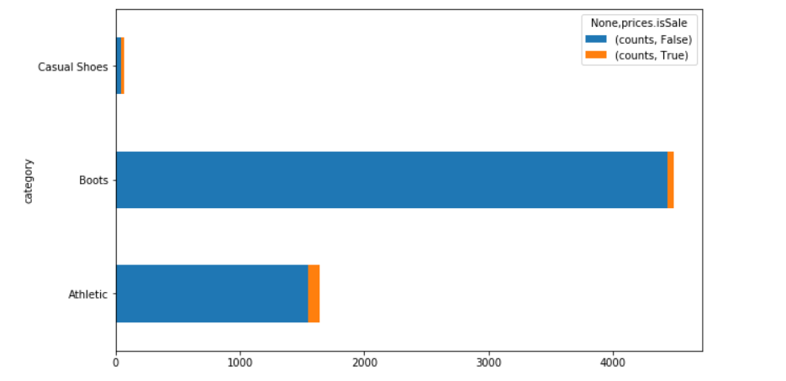
Question Which brands go on sale more
Result
The result shows Athletic shoes, boots and casual shoes go on sale more often
Observation
With so many brands of shoes in athletic and boots category, it is no surprise that they go on sale.
As for casual shoes, most of the shoes in the $25-$50 range go on sale given there are so many brands

