Slide 1
Newyork AirBnB Data Analysis
Sowmya Surampalli
Lutfullah Shifa

Slide 2
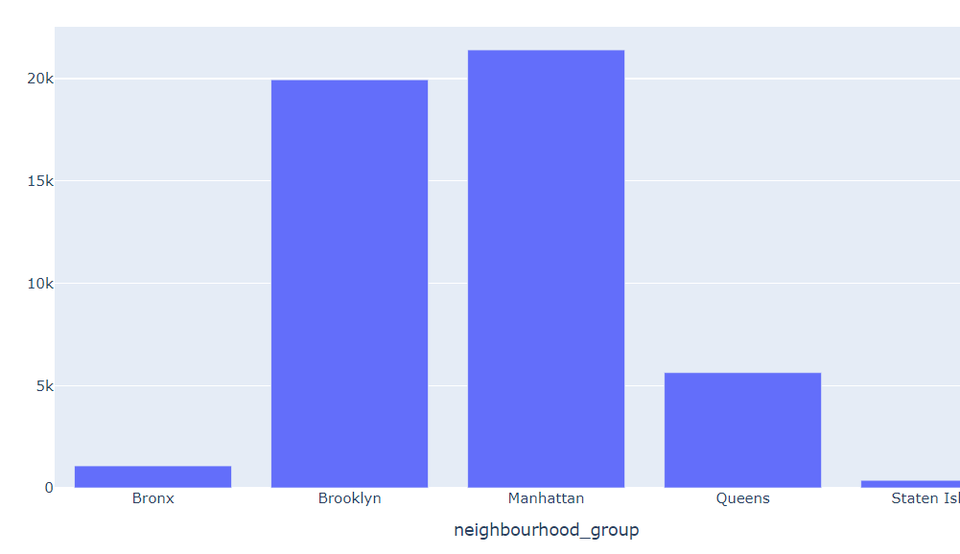
Neighbourhood groups - Available Stays
There are 5 neighbourhood groups in Newyork
Bronx
Brooklyn
Manhattan
Queens
Staten Island
Manhattan and Brooklyn have the highest number of listings
Staten Island and Bronx are the neighbourhoods that require special attention.

Slide 3
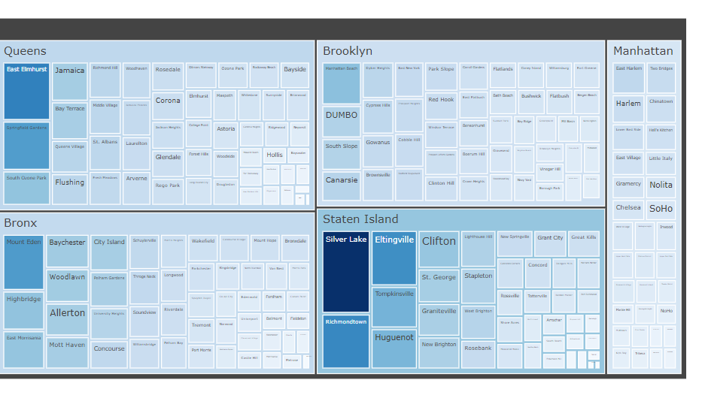
Most popular localities
- The most preferred neighbourhoods in the entire Newyork city are
Silver Lake (Staten Island)
Richmondtown (Staten Island)
Elting ville (Staten Island)
East Elmhurst (Queens)
Mount Eden (Bronx)
Manhattan and Brooklyn have the highest number of properties, but less occupancy. So we need not acquire more properties.
Staten Island and Bronx have least number of properties. Since they have higher occupancies, we can acquire more properties.

Slide 4
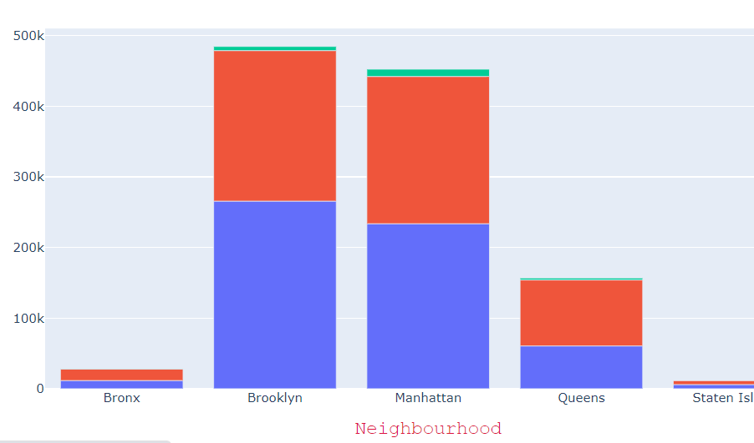
Types of properties – Customer preferences
In Brooklyn, apartments/homes are being preferred more than private rooms and shared rooms
In Manhattan, private rooms and entire homes are being preferred equally.
Shared rooms are being least preferred.
We better convert the shared rooms to private rooms

Slide 5
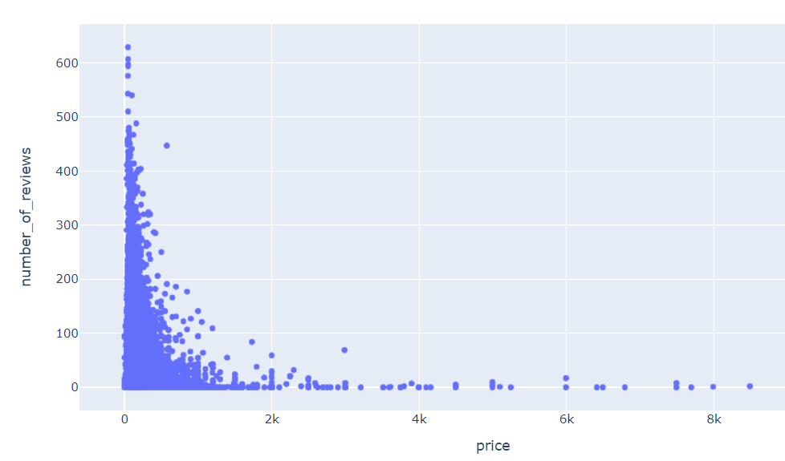
Price Ranges – Customer preferences
Most of the customers prefer price range less than 1000$
We can reduce the prices of highly expensive stays

Slide 6
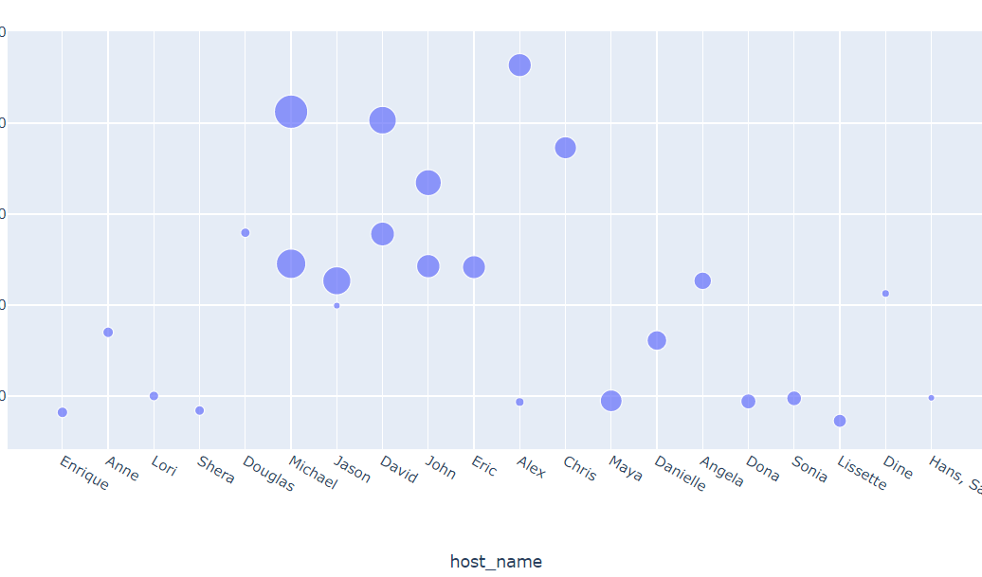
Prices Range – Most attracting hosts
For the hosts who are charging between 100$ to 250$, there is more customer attraction
We can negotiate with the other hosts to come into this range of prices for their properties to gain a greater number of customers.

Slide 7
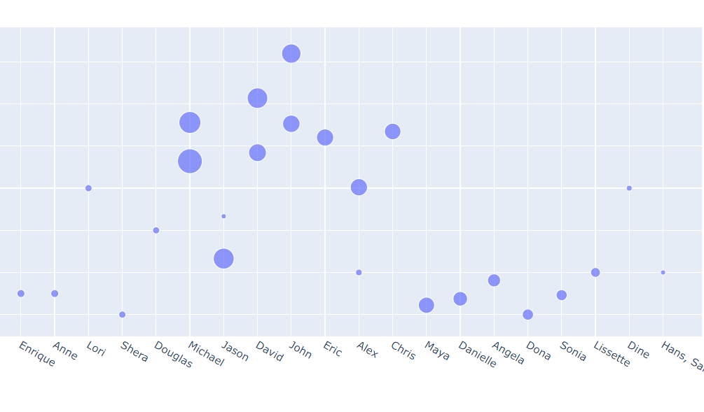
Minimum nights – Most attracting hosts
Hosts who are posing constraint of minimum nights to be lesser than 7 days have more customer attraction.
We can negotiate with the other hosts to have reduce their constraint of minimum nights to less than 7 days.

Slide 8
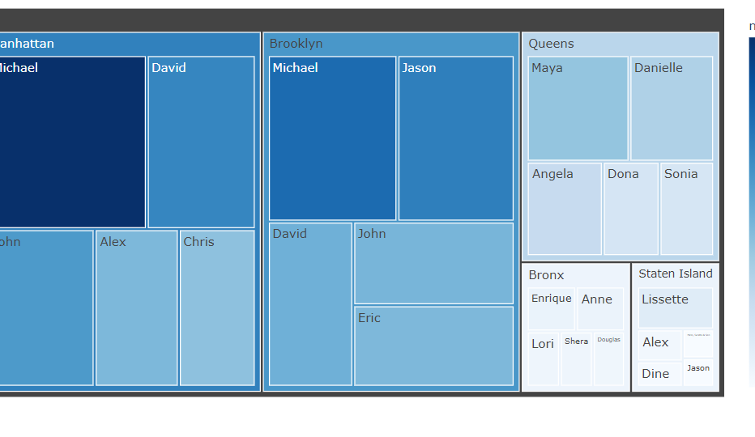
Most attracting hosts
Michael, David and John have high popularity among the customers in Manhattan and Brooklyn.
We can make them establish more properties in the other neighbourhoods as well.

Slide 9
Summary – Insights to the business
Convert shared rooms to private rooms
Concentrate on expanding the stays in Bronx and Staten Island
Reduce the price of highly expensive stays
Negotiate with the hosts to bring their price ranges between 100 – 250$
Negotiate with the hosts to reduce their constraint of minimum nights to be less than 7.
Encourage and support the top hosts to expand their properties in other neighbourhoods as well.

