Slide 1

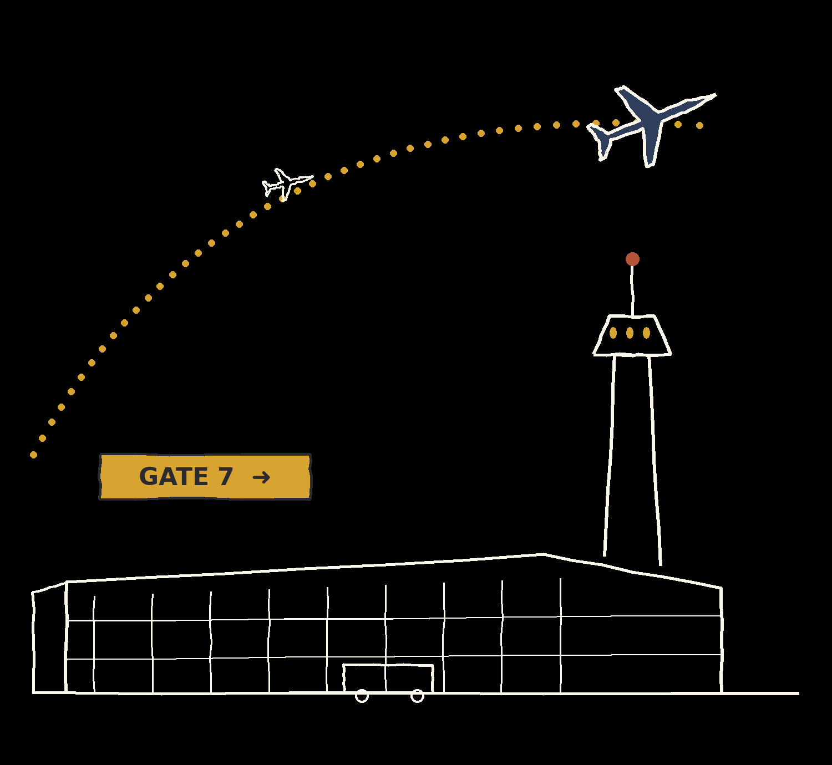
DATABASE CASE STUDY
OrientDB:
A Multi-Model NoSQL Database
(Graph + Document)
Team members & roll numbers:
[Aashika A – CB.SC.U4CSE25701]
[D Soniya Taslim – CB.SC.U4CSE25711]
[Sowmya R– CB.SC.U4CSE25756]
Course / Subject: Database Management Systems

Slide 2


1 · INTRODUCTION
Introduction
What is OrientDB?
Open-source multi-model NoSQL database in one engine
Stores records linked directly to each other and is queried with an SQL-like language
2010
Why databases like OrientDB matter
Object-oriented features: Supports classes, inheritance and records with identity.
Key-value style access: Records can be retrieved using their unique record IDs.
year of first release
Relevance in real applications
Document database: Stores data as documents containing fields and values.
Graph database: Represents entities as vertices and their relationships as edges.
Multi-model · Open source (Apache 2.0) · Java-based
Source: orientdb.org, db-engines.com
OrientDB Database Case Study
2

Slide 3
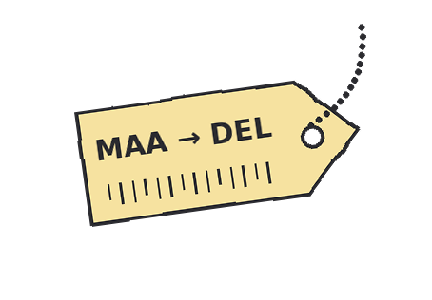
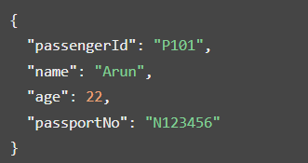
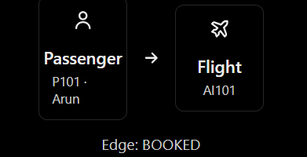
1 · INTRODUCTION
OrientDB Models
A. Document model
A document is a collection of fields and values.
It resembles a JSON object.
For example, a passenger record could look like this
B. Graph model
A graph contains two main components:
Vertex: An entity, such as a passenger, flight or aircraft.
Edge: A relationship connecting vertices,
such as a passenger booking a flight.
Dates from orientdb.org and db-engines.com; confirm exact versions/dates on the official site before presenting.
OrientDB Database Case Study
3

Slide 4

2 · DATABASE TYPE & MODEL
Database Type & Model
OrientDB term | Meaning | Airport example
Database | The complete collection of your data | Airport DB
Class | A category/type of records | Passenger, Flight
Record | One individual stored item | One passenger
Property | A field belonging to a class | passengerName
Cluster | Physical/logical storage location for records | Storage for passenger records
RID | Unique record identifier | # 12:0
Vertex | An entity in a graph | A passenger or flight
Edge | A connection between graph entities | A passenger booked a flight
Schema | Rules and structure defining classes and properties | Passenger fields and their types
Index | A structure that speeds up lookups | Finding a flight by flight number
Relational concept → OrientDB concept
Passenger
vertex
Booked (edge)
Flight
vertex
Graph view: one passenger node linked to a flight node by an edge
OrientDB Database Case Study
4

Slide 5
3 · ARCHITECTURE & DESIGN
Architecture & Design
Client / Application
Studio, Console, Java API, HTTP
OrientDB Server
binary 2424 · HTTP 2480
Database engine
SQL parser, graph/doc API, cache
Storage engine
plocal (disk) or memory
Disk files
clusters + write-ahead log
Deployment modes
Embedded: engine runs inside the Java application
Client-server: remote clients connect to the server
Distributed: several server nodes share the database
Main components
Server: connections, security, plugins, HTTP/binary protocols
Core engine: records, classes, indexes, transactions
Storage: plocal (paginated local storage) and memory
How a request flows
Client connects over the binary protocol (2424) or HTTP/REST (2480) and authenticates as a database user
The engine parses the SQL-like command, picks an execution plan (using indexes if available) and runs it
Changes are written to the write-ahead log before data files, so the database can recover after a crash
OrientDB Database Case Study
5

Slide 6
3 · ARCHITECTURE & DESIGN
Storage Management & Indexing
How data is stored
Records are grouped into clusters (physical files); each class uses one or more clusters
A record is found by its RID = #cluster:position
Edges/links store the RID of the target, a direct pointer: no index lookup per hop
Write-ahead log gives durability and crash recovery
Indexes map a key to a RID so full scans are avoided
Direct links between records
Booked
Passenger
#12:0
Flight
#13:4
Arrives
Airport
#11:2
Following an edge = reading the stored RID
Index types
SB-Tree
Default; equality and range queries
Hash
Equality lookups only
Lucene
Full-text and spatial search
UNIQUE
One record per key (e.g., airport code)
NOTUNIQUE
Duplicates allowed (e.g., city)
FULLTEXT / DICTIONARY
Word search / key-to-one-record map
OrientDB Database Case Study
6

Slide 7
3 · ARCHITECTURE & DESIGN
Query Processing, Transactions & Concurrency
SQL query
Parser
Optimizer / Planner
Executor
Result
OrientDB looks like SQL but adds graph commands (CREATE VERTEX/EDGE, TRAVERSE, MATCH). The planner uses indexes when they help. Inspect with EXPLAIN.
ACID properties
Atomicity: all steps or none
Consistency: schema constraints and indexes always hold
Isolation: concurrent transactions do not corrupt each other
Durability: committed data survives crashes (write-ahead log)
Commands: BEGIN, COMMIT, ROLLBACK
Concurrency control
A mechanism that manages multiple users accessing or modifying the same data at the same time
ensuring data remains consistent and correct.
If two users update the same record, the later commit detects the version conflict and must retry
Flight booking link
Booking + seat update must succeed together: COMMIT or ROLLBACK
A UNIQUE index stops two bookings of the same seat
Our case study uses a transaction for booking
OrientDB Database Case Study
7

Slide 8









4 · CORE FEATURES
Core Features
SQL-like language
SELECT, INSERT, UPDATE, DELETE plus graph extensions
Graph traversal
TRAVERSE, MATCH, shortestPath(), out()/in()
Schema modes
Schema-less, schema-full or hybrid
Indexes
SB-Tree, Hash, Lucene full-text/spatial
Transactions
ACID with MVCC; BEGIN / COMMIT / ROLLBACK
Constraints
MANDATORY, NOTNULL, MIN, MAX, READONLY, FULLTEXT,UNIQUE
Functions & hooks
Stored functions (SQL/JavaScript), triggers/hooks
Tools
Studio web UI, console, REST/HTTP API
Integration
Java API, drivers for several languages, Docker image
OrientDB Database Case Study
8

Slide 9
4 · CORE FEATURES
Security, Backup & Recovery
Security
Backup, recovery & integrity
Authentication
Database users and passwords; default users (admin, reader, writer) should be changed
Backup
BACKUP DATABASE creates a compressed archive
Authorization / roles
Roles carry permissions on resources (create, read, update, delete)
Export / Import
EXPORT/IMPORT DATABASE in JSON format; also used to move between versions
Record-level security
ORestricted lets each record list who may access it
Recovery
Write-ahead log replays committed changes after a crash
Encryption
SSL/TLS for connections; encryption at rest available
Data integrity
Constraints + unique indexes + ACID transactions
Practice tip: change default passwords first and test restoring a backup. Replication is not a backup.
OrientDB Database Case Study
9

Slide 10
5 · STRENGTHS & LIMITATIONS
Strengths & Limitations
Strengths | Limitations
Multi-model: graph, document and key-value in one engine | Smaller community and fewer learning resources than MySQL/PostgreSQL
Native graph traversal through direct links (no JOINs) | Query language is SQL-like, not standard SQL; MATCH/TRAVERSE need learning
SQL-like language is familiar to SQL users | Distributed mode is harder to set up and tune
ACID transactions and constraints supported | Fewer managed cloud offerings than mainstream databases
Flexible schema: schema-less, hybrid or full | Long-term roadmap is less visible than for larger competitors
Open source (Apache 2.0), embeddable in Java apps | Very large single-node 'supernode' vertices can slow traversals
Analysis note: how much each point matters depends on the workload and the team's experience.
OrientDB Database Case Study
10

Slide 11
5 · STRENGTHS & LIMITATIONS
OrientDB vs MySQL
Category | OrientDB | MySQL
Data model | Multi-model NoSQL (graph, document, key-value) | Relational (RDBMS)
Query language | SQL-like + MATCH / TRAVERSE | SQL
Schema | Schema-less, hybrid or full | Fixed schema (tables, columns)
Relationships | Direct links / edges (RIDs) | Foreign keys + JOINs
ACID / transactions | ACID, optimistic MVCC | ACID with InnoDB (default engine)
Indexing | SB-Tree, Hash, Lucene full-text/spatial | B-tree, full-text, spatial
Scalability | Distributed multi-master (Hazelcast) | Replication; partitioning
Typical use cases | Connected data, recommendations, fraud, routes | Web apps, CMS, OLTP, read-heavy sites
Ecosystem / maturity | Smaller community and tooling | Very large ecosystem; widely supported
License / owner | Apache 2.0; SAP (via Callidus) | GPL / commercial; Oracle
Differences are presented factually; the better choice depends on the application. Sources: OrientDB and MySQL official documentation.
OrientDB Database Case Study
11

Slide 12






6 · USE CASES
Use Cases / Applications
Social networks
Friends, followers, mutual connections
Recommendations
Customers who bought / liked similar items
Documented adoption
OrientDB's website and GitHub community list user stories and projects
Owned by SAP since 2018 (via Callidus acquisition)
Our flight-route case study shows the same idea: airports as nodes, flights as links
Fraud detection
Link accounts, devices and transactions
Routes & networks
Flights, roads, IT/network topology
Content & catalogs
Documents with links between them
Knowledge graphs
Entities and relationships for search and AI
Verify each example against its source before presenting; add 1–2 named customers from orientdb.org if available.
OrientDB Database Case Study
12

Slide 13
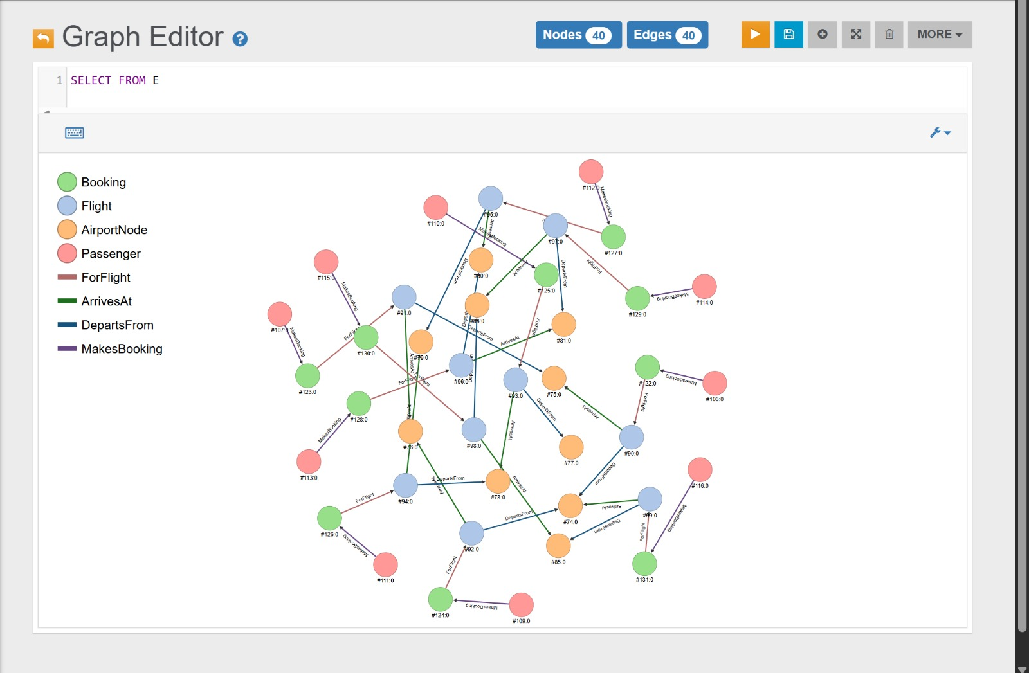
7 · HANDS-ON CASE STUDY
Airport Flight Network: Case Study
Flight network using OrientDB
Why a graph database?
Airports, flights and passengers are naturally connected
Edges model Departs, Arrives and Booked directly
Route queries follow links instead of multi-table JOINs
Shortest path between airports is a built-in function
Transactions keep booking + seat count consistent
UNIQUE indexes avoid duplicate airports and emails
OrientDB Database Case Study
13

Slide 14
7 · HANDS-ON CASE STUDY
Flight Network Database Design
Airport (V)
Flight (V)
Passenger (V)
code UNIQUE
name
city
country
flight_no UNIQUE
departure_time
arrival_time
seats
fare
pid UNIQUE
name
email UNIQUE
phone
Departs (E)
Arrives (E)
Booked (E)
Airport → Flight
Flight → Airport
Passenger → Flight
properties: seat_no, status, booked_at
Vertex classes extend V, edge classes extend E. Edges replace foreign keys: Airport –Departs→ Flight –Arrives→ Airport; Passenger –Booked→ Flight. This is a proposed design; refine it while implementing.
OrientDB Database Case Study
14

Slide 15
7 · HANDS-ON DEMONSTRATION
Hands-on Demonstration
OrientDB setup (Docker / zip)
Insert vertices and edges
1
6
Airport (MAA)
vertex
Departs
Flight (AI101)
vertex
Start server, open Studio
CRUD operations
2
7
Create database FlightDB
SELECT & graph traversal
Booked
Arrives
3
8
Passenger
vertex
Airport (DEL)
vertex
Create vertex & edge classes
MATCH & shortestPath
4
9
Properties & UNIQUE indexes
Transaction (booking)
5
10
Demonstrated on the Airport Flight Network schema.
OrientDB Database Case Study
15

Slide 16
7 · HANDS-ON DEMONSTRATION
Setup & Schema Creation
Installation (Docker)
Create database (console)
docker run -d --name orientdb \
-p 2424:2424 -p 2480:2480 \
-e ORIENTDB_ROOT_PASSWORD=root123 \
orientdb:3.2
# Studio: http://localhost:2480
# Console: bin/console.sh (zip install)
CONNECT remote:localhost root root123 (server)
2. CREATE DATABASE remote:localhost/FlightDB root root123 plocal (db/user/pass)
3. CONNECT remote:localhost/FlightDB admin admin (only if acc exist)
CREATE CLASS / PROPERTY / INDEX
INSERT vertices and edges
1) Node 1: AirportNode
CREATE CLASS AirportNode EXTENDS V;
CREATE PROPERTY AirportNode.code STRING;
CREATE PROPERTY AirportNode.name STRING;
CREATE INDEX AirportNode.code ON AirportNode(code) UNIQUE;
2) Node 2: Flight
CREATE CLASS Flight EXTENDS V;
CREATE PROPERTY Flight.flight_no STRING;
CREATE INDEX Flight.flight_no ON Flight(flight_no) UNIQUE;
3) Node 3: Passenger
CREATE CLASS Passenger EXTENDS V;
4) Node 4: Booking
CREATE CLASS Booking EXTENDS V;
-1) Insert data
CREATE VERTEX AirportNode SET code = 'MAA', name = 'Chennai Intl', city = 'Chennai';
CREATE VERTEX AirportNode SET code = 'DEL', name = 'Delhi Intl', city = 'Delhi';
CREATE VERTEX Flight SET flight_no = 'AI101', seats = 180, fare = 5200;
-2) Chennai Airport → DepartsFrom → AI101
CREATE EDGE DepartsFrom FROM
(SELECT FROM AirportNode WHERE code = 'MAA’) TO
(SELECT FROM Flight WHERE flight_no = 'AI101');
3) AI101 → ArrivesAt → Delhi Airport
CREATE EDGE ArrivesAt FROM
(SELECT FROM Flight WHERE flight_no = 'AI101’) TO
(SELECT FROM AirportNode WHERE code = 'DEL');
5) Edges
CREATE CLASS ForFlight EXTENDS E;
CREATE CLASS ArrivesAt EXTENDS E;
CREATE CLASS DepartsFrom EXTENDS E;
CREATE CLASS MakesBooking EXTENDS E;
OrientDB Database Case Study
16

Slide 17
7 · HANDS-ON DEMONSTRATION
Sample OrientDB Operations: CRUD, Traversal, Transactions
CRUD
Graph traversal (replaces JOINs)
1) Create a passenger
CREATE VERTEX Passenger
SET pid = 1, name = 'Asha', email = 'asha@x.com';
2) Retrieve flights with fares below 6000
SELECT FROM Flight WHERE fare < 6000
ORDER BY fare;
3) Update a flight's fare
UPDATE Flight
SET fare = 5500
WHERE flight_no = 'AI101';
-- 4) Delete a passenger
DELETE VERTEX Passenger
WHERE pid = 1;
1) Direct destinations from Chennai
SELECT expand(out('DepartsFrom').out('ArrivesAt'))
FROM AirportNode
WHERE code = 'MAA';
2) All bookings made by Asha
SELECT expand(out('MakesBooking'))
FROM Passenger
WHERE name = 'Asha';
MATCH & shortest path
Transaction + index (seat filled => reduce seat no (edge=seat no))
1) Retrieve the flights booked by Asha and their destination cities
MATCH {class: Passenger, as: p,
where: (name = 'Asha')}
.out('MakesBooking'){as: b}
.out('ForFlight'){as: f}
.out('ArrivesAt'){as: a}
RETURN p.name AS passenger,
f.flight_no AS flight,
a.city AS city;
2) Find the shortest path from Chennai to Delhi
SELECT expand(shortestPath($a, $b, 'OUT'))
LET $a = (SELECT FROM AirportNode WHERE code = 'MAA'),
$b = (SELECT FROM AirportNode WHERE code = 'DEL');
1) Book a flight transactionally
BEGIN;
UPDATE Flight
SET seats = seats - 1
WHERE flight_no = 'AI101';
CREATE EDGE MakesBooking FROM (SELECT FROM Passenger WHERE pid = 1) TO
(CREATE VERTEX Booking SET seat_no = '12A’) SET seat_no = '12A';
CREATE EDGE ForFlight FROM (SELECT FROM Booking WHERE seat_no = '12A')
TO (SELECT FROM Flight WHERE flight_no = 'AI101');
COMMIT;
2) Create an index on the booking seat number
CREATE INDEX Booking.seat ON Booking(seat_no) NOTUNIQUE;
OrientDB Database Case Study
17

Slide 18
8 · PERFORMANCE
Performance Considerations
Traversal speed
Following an edge reads a stored RID, so cost depends on records visited, not table size
Indexing
The right index avoids full scans; too many indexes slow writes
Joins vs links
Deep relationship queries avoid repeated JOIN lookups
Data size
Large clusters need good index design and enough memory/cache
Supernodes
A vertex with millions of edges makes traversals through it slow
Query optimization
Use EXPLAIN / PROFILE to check plans and index use
Tuning workflow
Slow query
EXPLAIN / PROFILE
Add index / rewrite
Re-measure
OrientDB Database Case Study
18

Slide 19
9 · FUTURE TRENDS
Future Trends / Roadmap
Latest release listed on DB-Engines: 3.2.29 (March 2024). Check GitHub for newer versions.
Ongoing development
3.2.x series: maintenance and bug-fix releases
Open-source code and issues are public on GitHub
Check the official roadmap for planned features
Multi-model trend
Databases combine graph, document and key-value models
OrientDB was an early example; competitors include Neo4j, ArangoDB, SurrealDB
Cloud & containers
Docker image available; Kubernetes deployment possible
Managed cloud offerings are limited compared with MySQL/PostgreSQL
AI & knowledge graphs
Graph data helps knowledge graphs and retrieval for AI
Graph + document storage suits linked, semi-structured data
Checked against db-engines.com (Oct 2026). Verify the current status on orientdb.org before presenting.
OrientDB Database Case Study
19

Slide 20
10 · CONCLUSION
Conclusion
What OrientDB is: an open-source multi-model NoSQL DBMS (graph + document) first released in 2010
Major features: SQL-like language, direct links, ACID transactions, indexes, distributed mode
Strengths: fast relationship traversal, flexible schema, SQL familiarity
Limitations: smaller ecosystem, harder distributed setup, less visible roadmap
Best suited to: highly connected data (networks, recommendations, fraud). For simple tabular OLTP, MySQL is often the simpler choice
What the case study demonstrates
Graph schema design with vertices and edges
CRUD, traversal, MATCH and shortestPath queries
UNIQUE indexes for data integrity
Transactions for consistent bookings
OrientDB Database Case Study
20

Slide 21
11 · REFERENCES
References
OrientDB. (n.d.). OrientDB manual (version 3.2). https://www.orientdb.com/docs/last/index.html
OrientDB. (n.d.). OrientDB official website. https://orientdb.org/
OrientDB Project. (n.d.). OrientDB source code and issues [GitHub repository]. https://github.com/orientechnologies/orientdb
DB-Engines. (n.d.). OrientDB system properties. https://db-engines.com/en/system/OrientDB
Robinson, I., Webber, J., & Eifrem, E. (2015). Graph databases (2nd ed.). O'Reilly Media.
Sadalage, P. J., & Fowler, M. (2012). NoSQL distilled. Addison-Wesley.
Silberschatz, A., Korth, H. F., & Sudarshan, S. (2019). Database system concepts (7th ed.). McGraw-Hill.
Oracle Corporation. (n.d.). MySQL reference manual. https://dev.mysql.com/doc/
OrientDB Database Case Study
22

