Slide 1
Analysis on user plays data on Vidio – sampling 1% dataset
By – Sowmya Tushar
For Job application ‘Data Scientist’ @Vidio.com Jakarta

Slide 2
Business Problem:
Extracting all the actionable insights from the VIDIO Dataset which will be helpful for:
Improvement of business
Easy Connectivity
Reduced Human Dependency
Effective Connectivity
24*7 Service

Slide 3
Objective:
Exploratory Analysis for improving the Resource Allocation, Content Modification & Service Improvement.
Data Set:
15 Days Plays activity from users on Vidio with 1% data sample
Structured Data

Slide 4
Project Architecture / Project Flow:
Start with Business Problem
Clean the Data
Perform EDA
Apply Machine Learning Techniques
Insights

Slide 5
DATA INSIGHT FROM DIFFERENT VARIABLE:
All the ID’s where in alphanumeric form.
Is_login: From is_login we can find that maximum users did not login when watching.
Playback_location: Users played in both embed and direct location were almost similar.
Platform: web-mobile was platform used my most of users.
Play_time/End_time: When you find the difference between these 2 ,It is same as the play_duration in seconds but provided extra information about the date.
Referrer: It has domain information the users used to browse. The highest used referrer was https://m.kapanlagi.com/
Title: Title of contect where SCTV was highest used by users.
Category_name: The name of content were entertainment was highest watched.

Slide 6
DATA INSIGHT FROM DIFFERENT VARIABLE:
Referrer_group: group of referrer had kapanlagi highest in list.
Completed: Count of not completing the show was much higher than once completed.
Player_name: Engine player name had videojs highest when compared to others like KmkExoVideoView and kmkexoplayer.
Has_ad: This feature says that the Play had lot of ads.
OS_name: The most used os_name of device use to play was Anroid.
Browser_name: The browser name of device use to play by the users are several but most used was Chrome Mobile.
App_name: The app_name used to play was Vidio which was dominating the rest of the app by more than 90%.

Slide 7
DATA INSIGHT FROM DIFFERENT VARIABLE:
Autoplay: This indicates the play is autoplay when watched on certain platform and maximum were False.
Is_premium: Indicated the content played is a premium content and 98% was not premium content.
Play_duration: This showed the duration of the play.
Content_type: content type had contents livestreaming | vod | catchup and vod was the highest type.
Event_stream: when content_type is livestreaming, stream_type is used to categorize the livestream (EventStream | TVStream | RadioStream) and TVStream was most used.
The rest of the features had lot of NA value and few were not significant features which was dropped.

Slide 8
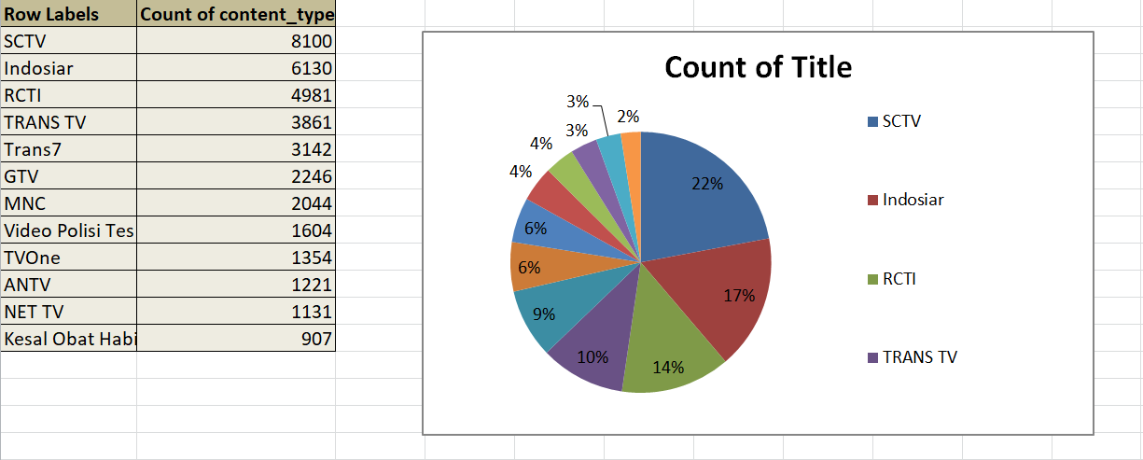
Exploratory Data Analysis (EDA) and Feature Engineering:
Comparison of Title based on the content_type:

Slide 9
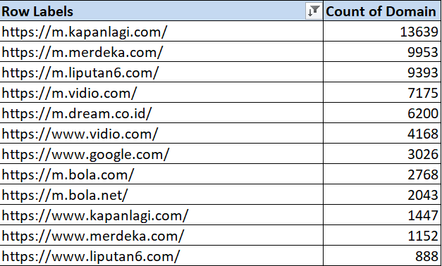
Referrer Url: Most used url for referrer was http://m.kapanlagi.com/

Slide 10
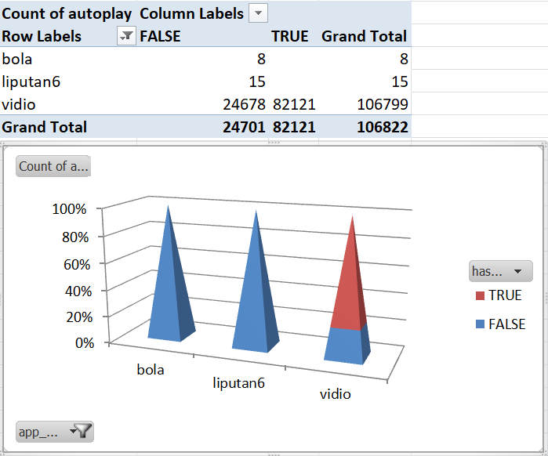
Comparison of App_name with auto_play and has_ad: Vidio has highest ads

Slide 11
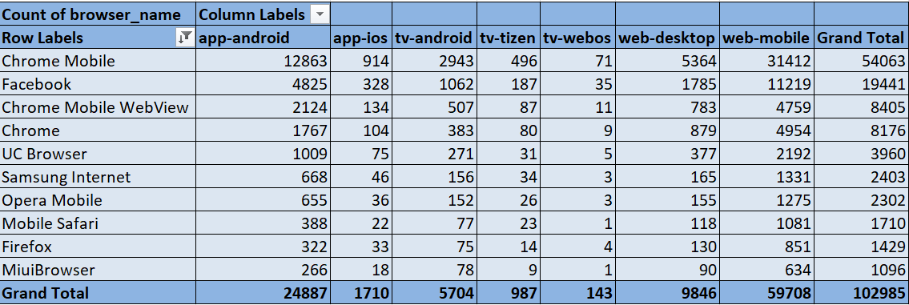
Comparison of browser_name with platform: Chrome Mobile was browser and platform was web-mobile.

Slide 12
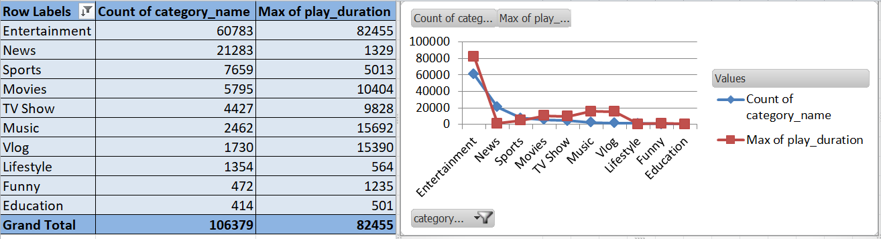
Comparison of category_name with play_duration: Entertainment was watched highest

Slide 13
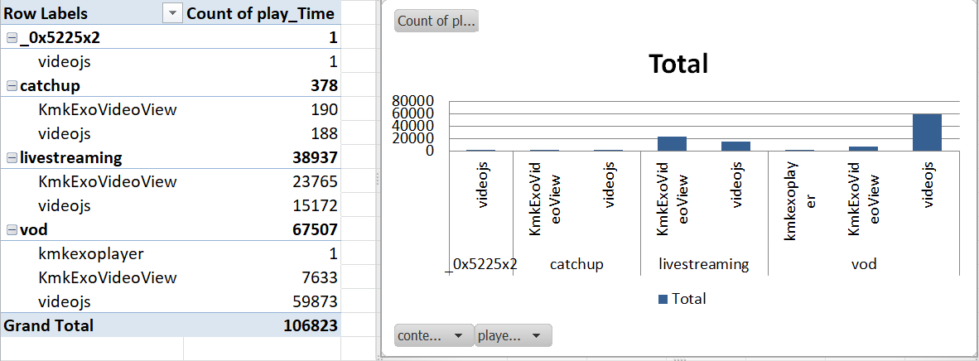
Comparison of play_time with content_type: vod being the highest.

Slide 14
Data set details:
Number of rows:106823
Number of rows: 46

Slide 15
Number of missing values:
hash_film_id - 101001
Referrer – 5761
average_bitrate – 4946
completed – 38937
utm_source - 106736
utm_medium - 106736
utm_campaign – 106785
player_name – 3268
flash_version – 34857
os_name – 33732
os_version – 405
browser_name – 33673
browser_version – 36045
autoplay – 38960
app_version - 72133
city - 106822
stream_type – 67885
category_name – 38937
film_title - 100995
season_name - 101000
genre_name - 101594
Unnamed: 41 - 106818
Unnamed: 42 - 106822
Unnamed: 43 - 106823
Unnamed: 44 - 106822
Unnamed: 45 - 106822

Slide 16
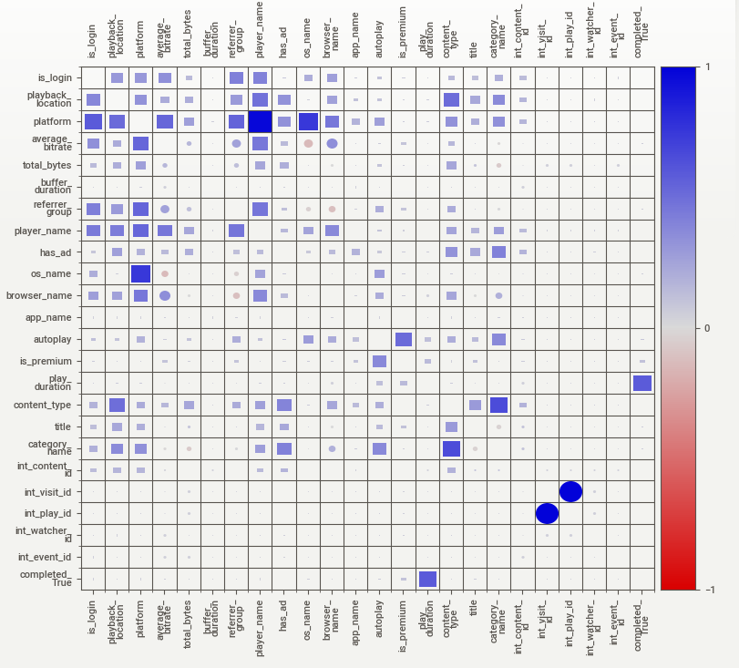
Exploratory Data Analysis (EDA):

Slide 17
From the Correlation map shown above we see the is_login (target) has high correlation with playback_location, platform, average_bitrate, referrer_group, player_name, os_name, browser_name, content_type,title, category_name.

Slide 18
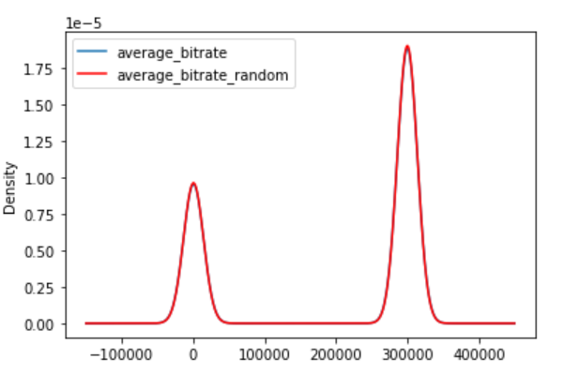
Feature Engineering:
Treating NAN in numeric values : average_bitrate = 4946 na
Treated using random sample imputation
Average_bitrate and average_bitrate_random both follows the same standard distribution as below.

Slide 19
Treating missing values in categorical features:
Missing values in categorical features were: ‘Completed’,'player_name','os_name','browser_name','autoplay','category_name’.
Frequent category imputation was used to treat the missing values.

Slide 20
Label Encoding for player_name, os_name, browser_name, autoplay, category_name.
Dummy values for completed.

Slide 21
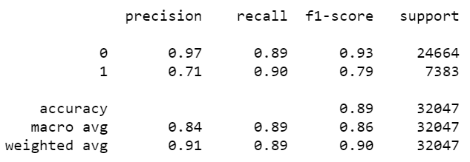
Model Building and Model Prediction:
Logistic regression Algorithm:
Accuracy = 89%
Kappa score = 0.72
Classification Report:

Slide 22
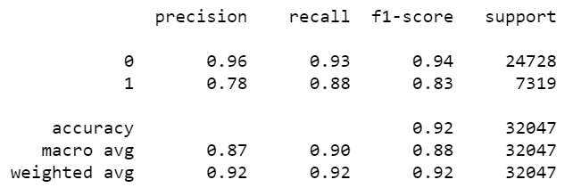
Random Forest:
Accuracy = 91%
Kappa score = 0.769
Classification Report:

Slide 23
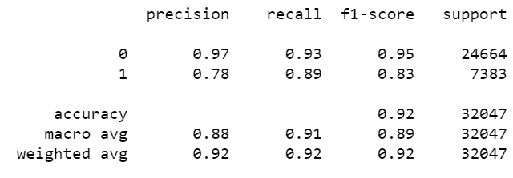
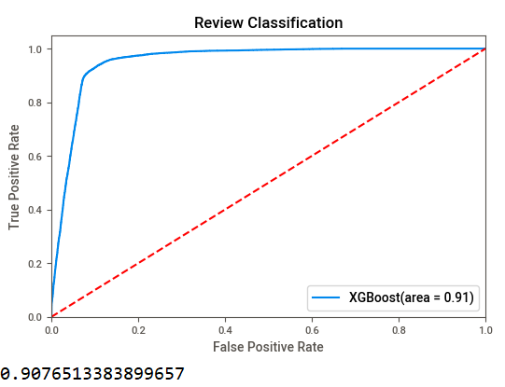
XGBOOST:
Accuracy = 92%
Kappa Score: 0.779
ROC-AUC Curve

Slide 24
Model Results:
XGBoost gave the best accuracy and precision and recall value so we can conclude that is_login was predicted 92% of times correctly.

Slide 25
Thank You

