Slide 1
Twitter And News Headlines Sentiment Analysis

Slide 2

Sowmya
Vijayakumar
Dhavala
Manjunath

Slide 3

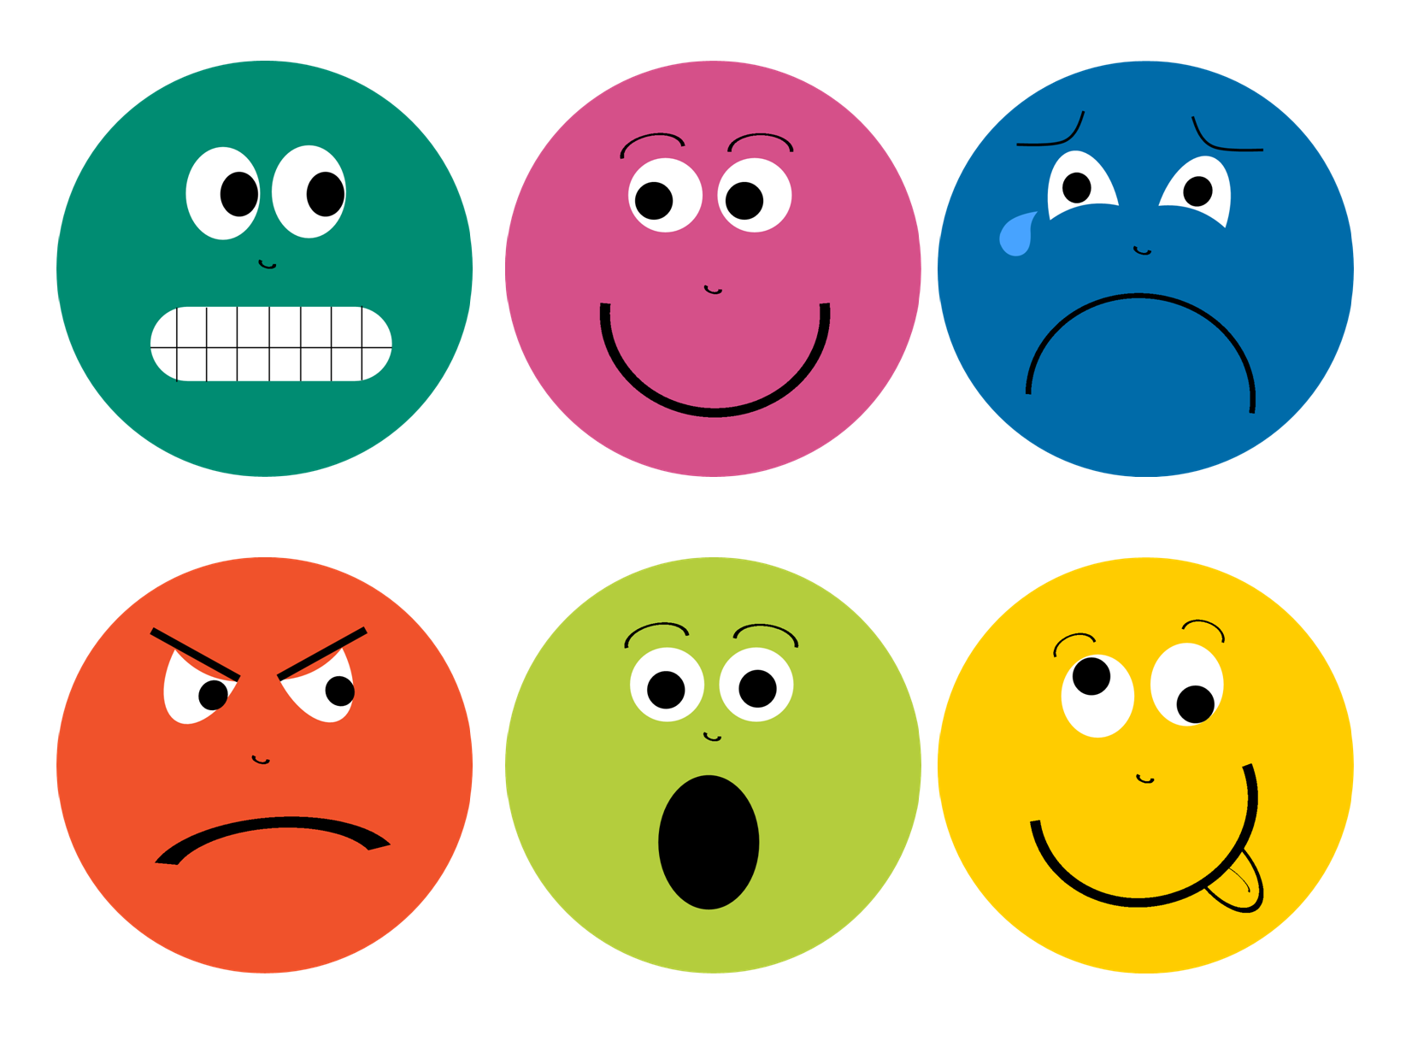


Slide 4
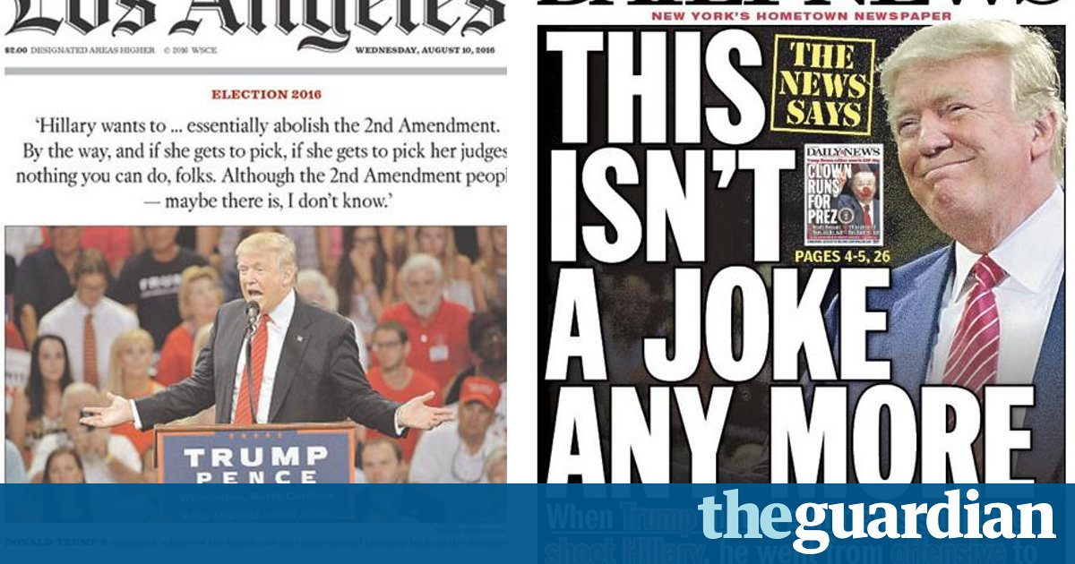
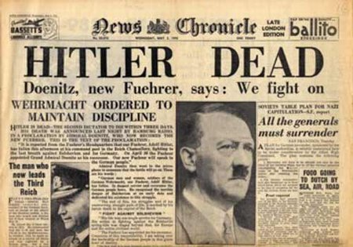

Slide 5
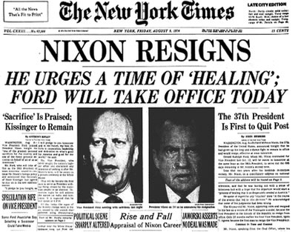

Slide 6
Data Collection

Slide 7

Tweets Collection

Slide 8

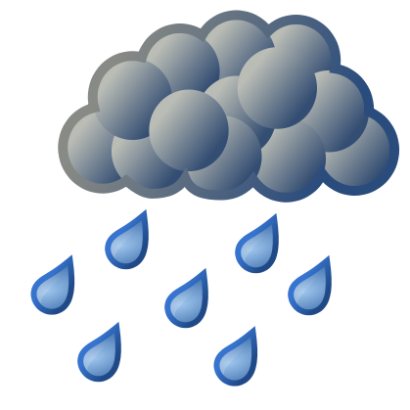
Weather Data Collection

Slide 9
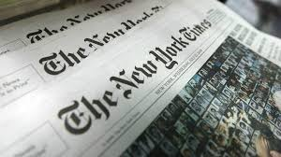

NY Times Headlines Collection

Slide 10
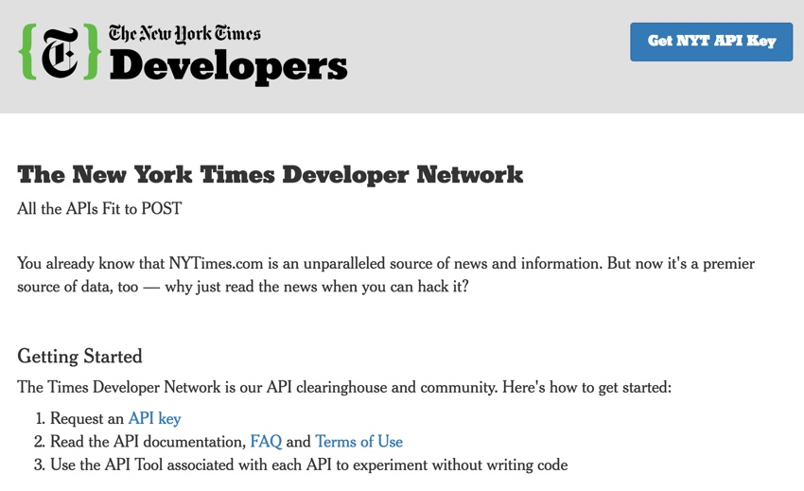
You can also split your content

Slide 11
Data Processing

Slide 12
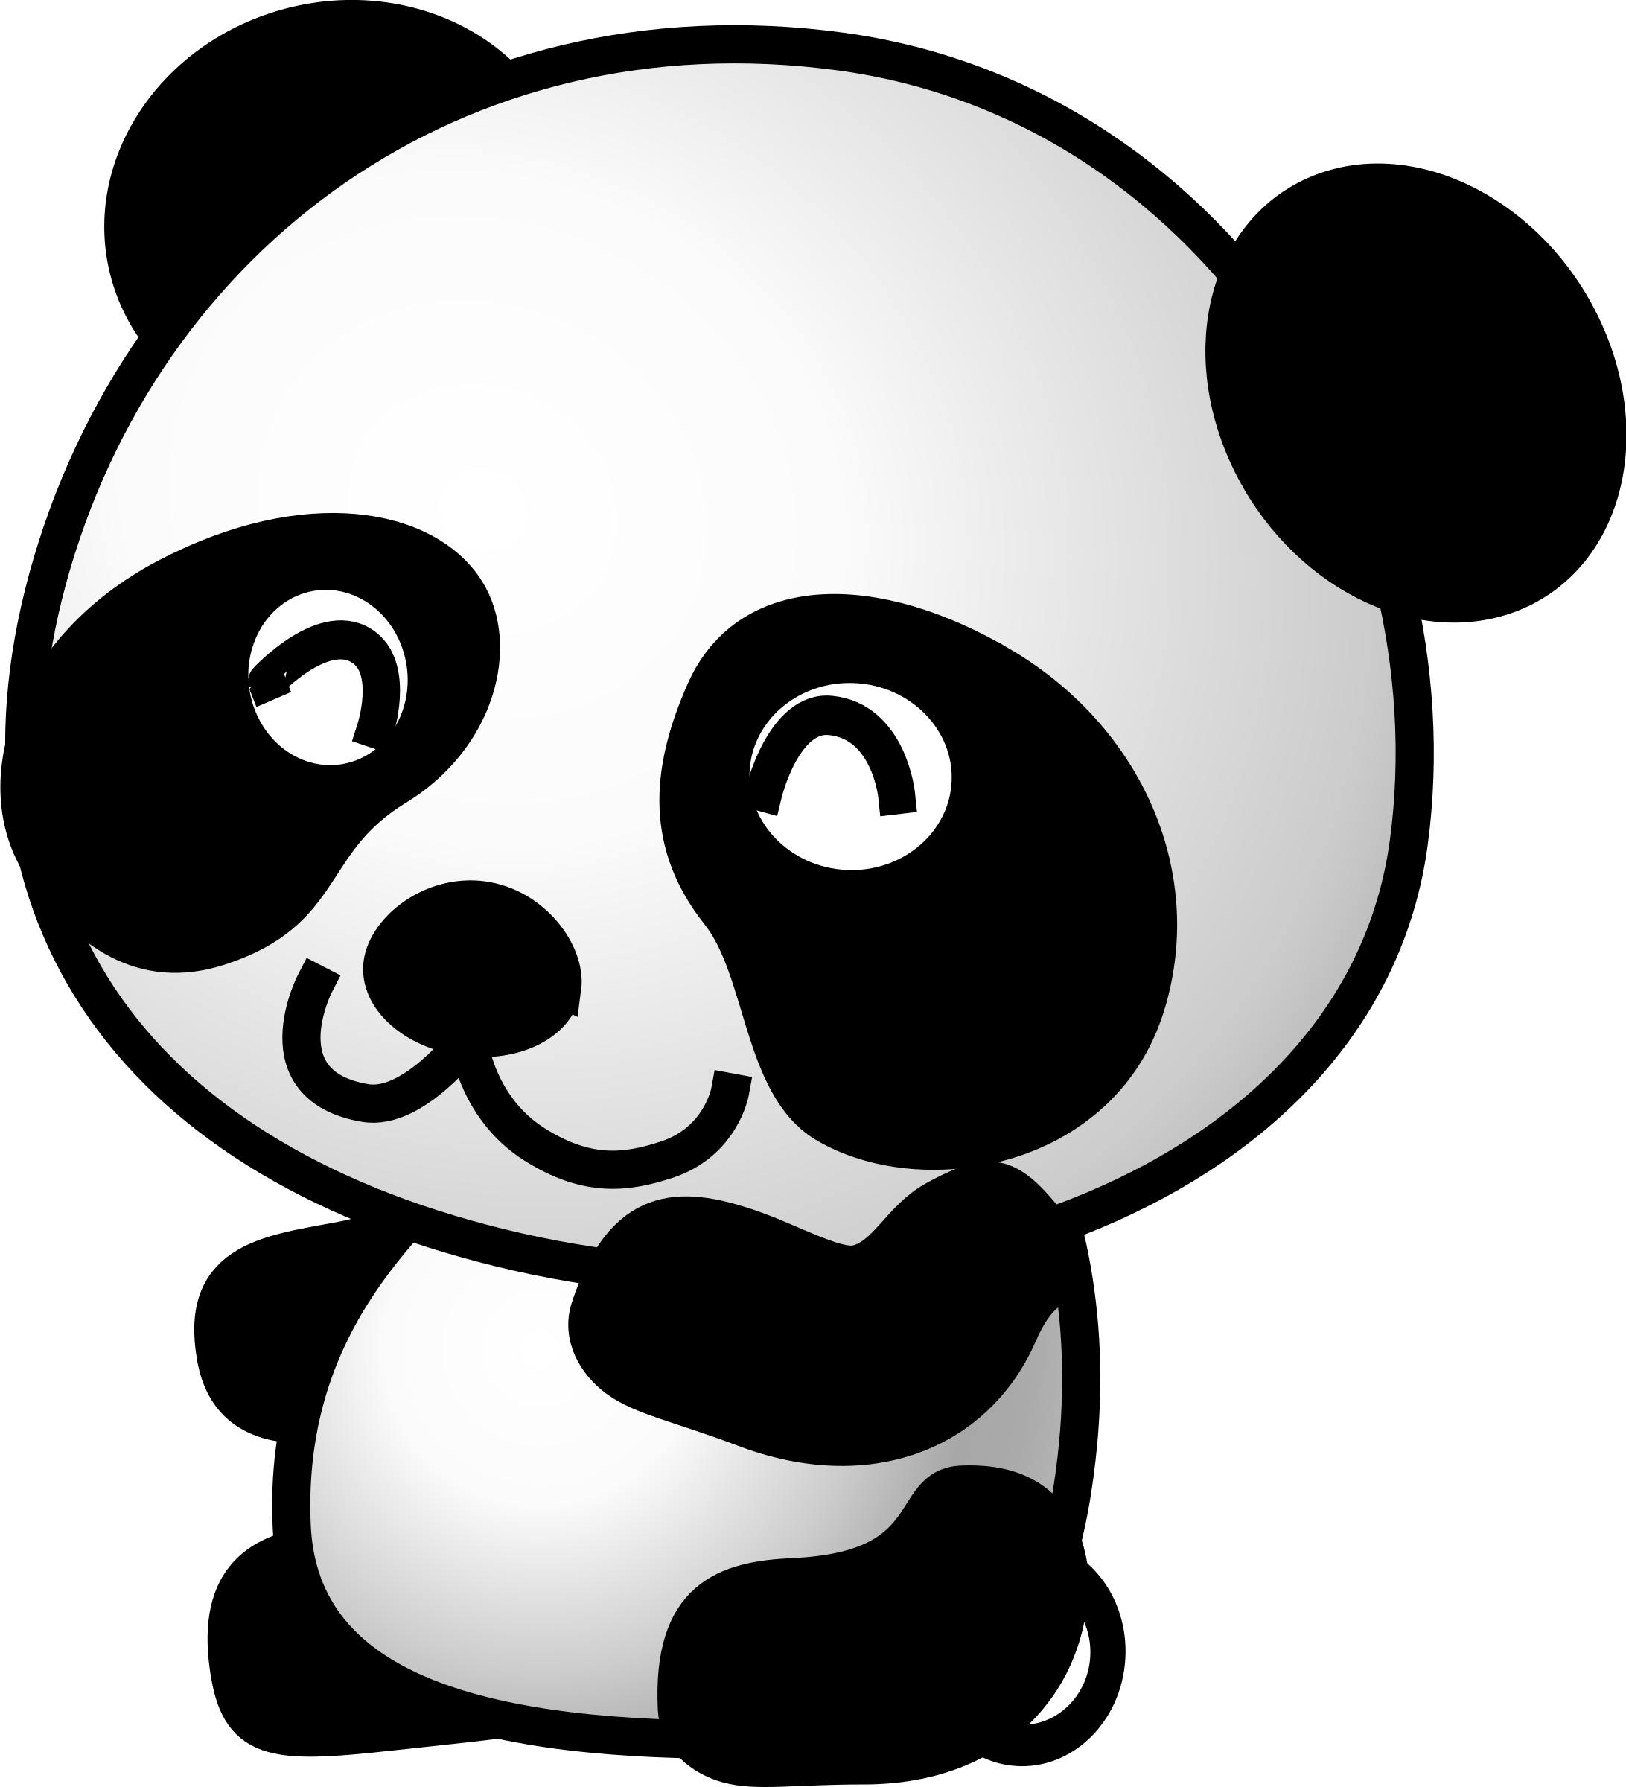
Python Pandas

Slide 13
Data Collection

Slide 14
In two or three columns
Yellow
Is the color of gold, butter and ripe lemons. In the spectrum of visible light, yellow is found between green and orange.
Blue
Is the colour of the clear sky and the deep sea. It is located between violet and green on the optical spectrum.
Red
Is the color of blood, and because of this it has historically been associated with sacrifice, danger and courage.

Slide 15
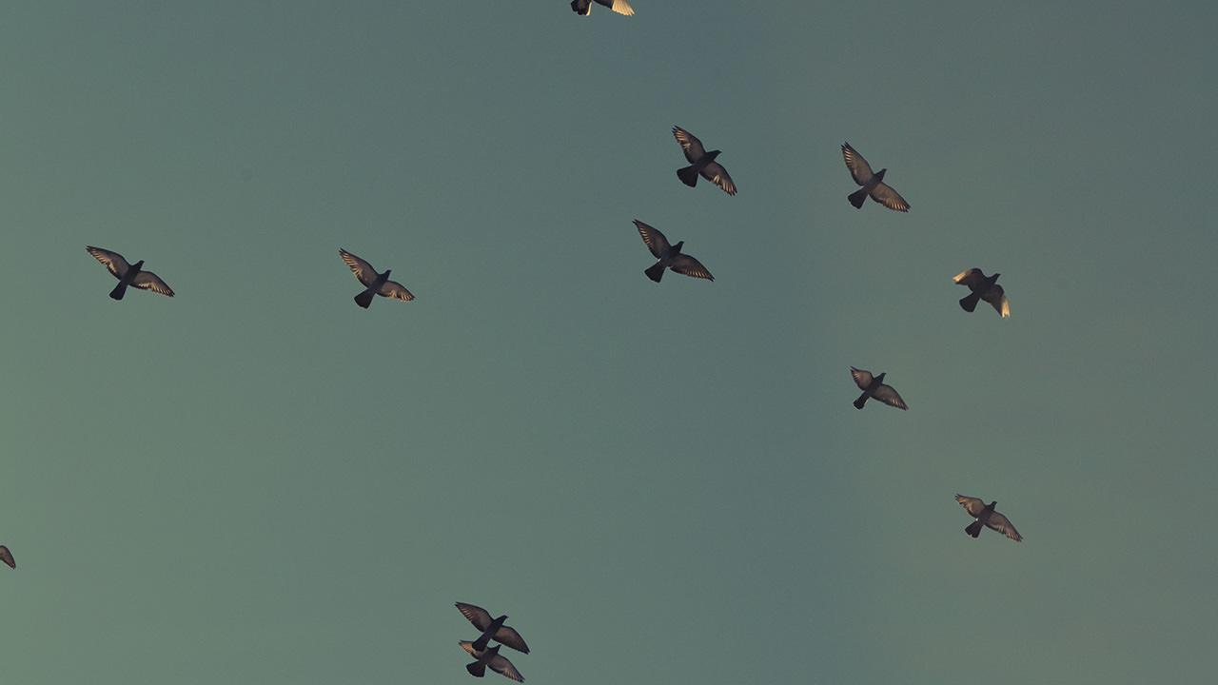
A picture is worth a thousand words
A complex idea can be conveyed with just a single still image, namely making it possible to absorb large amounts of data quickly.

Slide 16
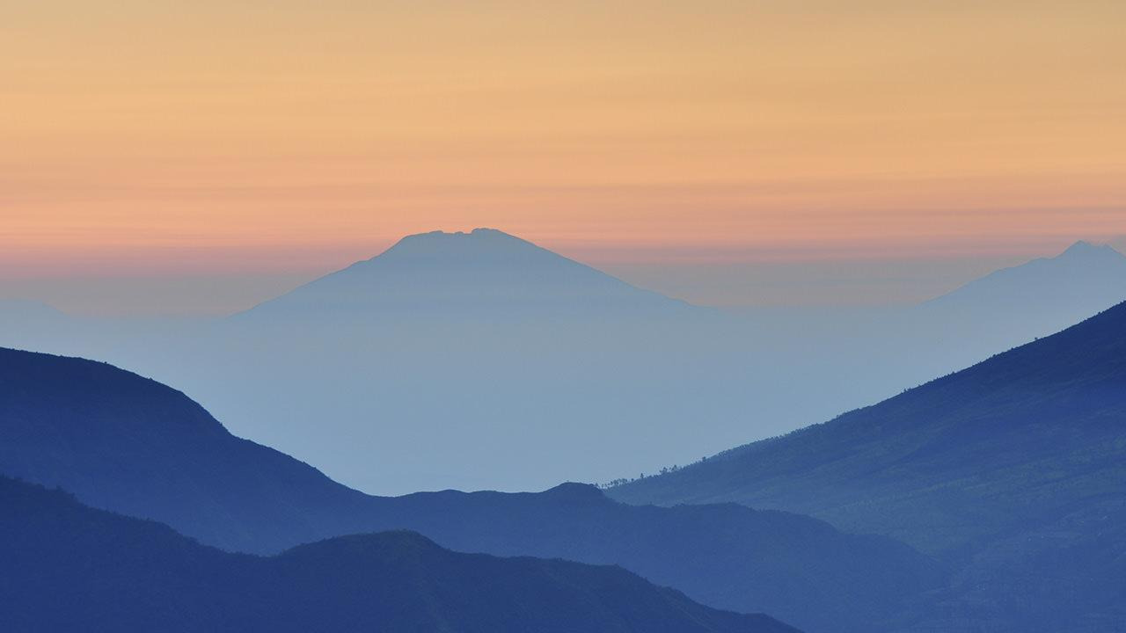
Want big impact?
Use big image.

Slide 17
Use charts to explain your ideas
White
Gray
Black

Slide 18
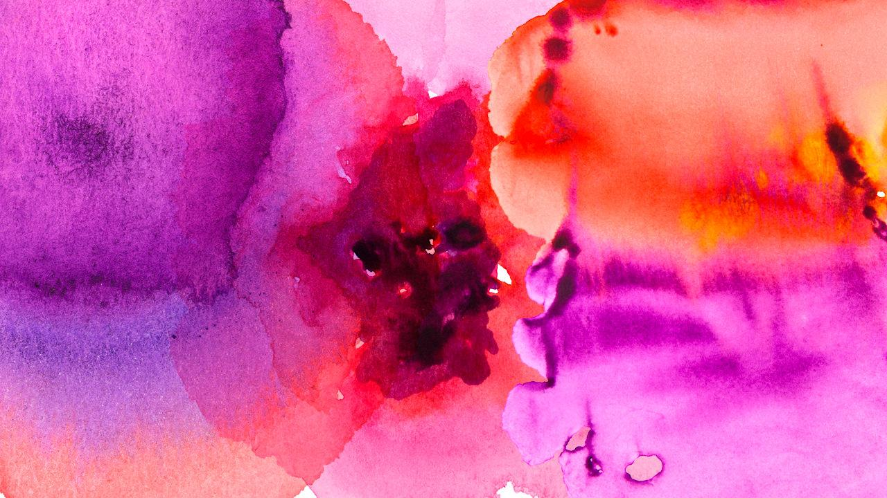
And tables to compare data
 | A | B | C
Yellow | 10 | 20 | 7
Blue | 30 | 15 | 10
Orange | 5 | 24 | 16

Slide 19
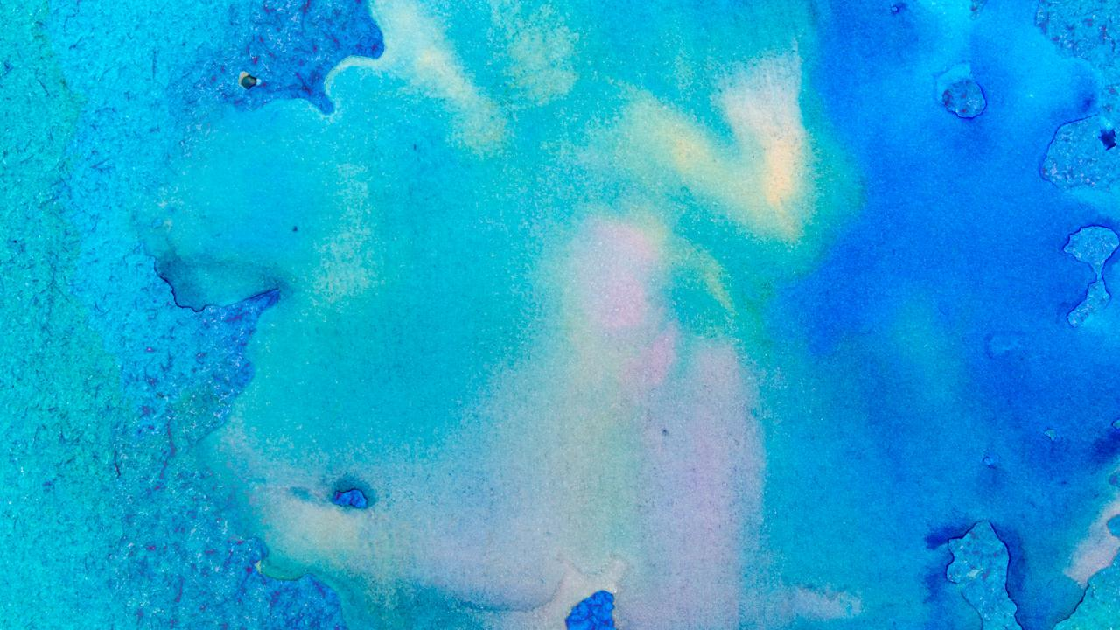
Maps
our office

Slide 20
89,526,124
Whoa! That’s a big number, aren’t you proud?

Slide 21
89,526,124$
185,244 users
100%
That’s a lot of money
And a lot of users
Total success!

Slide 22
Our process is easy
first
second
last

Slide 23
Let’s review some concepts
Yellow
Is the color of gold, butter and ripe lemons. In the spectrum of visible light, yellow is found between green and orange.
Blue
Is the colour of the clear sky and the deep sea. It is located between violet and green on the optical spectrum.
Red
Is the color of blood, and because of this it has historically been associated with sacrifice, danger and courage.
Yellow
Is the color of gold, butter and ripe lemons. In the spectrum of visible light, yellow is found between green and orange.
Blue
Is the colour of the clear sky and the deep sea. It is located between violet and green on the optical spectrum.
Red
Is the color of blood, and because of this it has historically been associated with sacrifice, danger and courage.

Slide 24
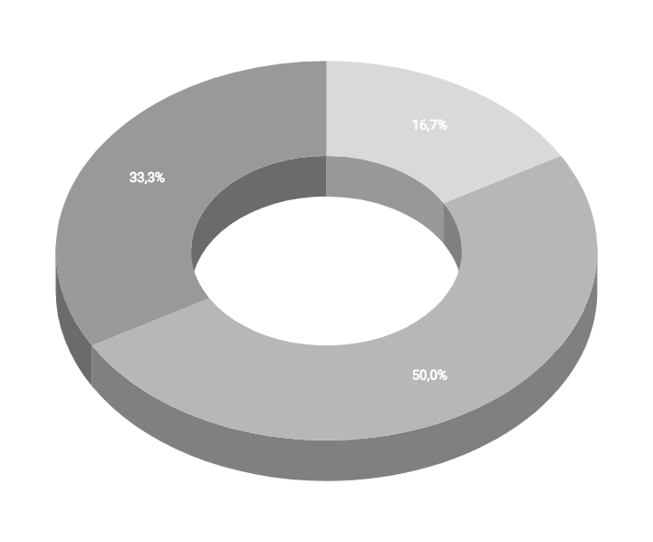
You can insert graphs from Google Sheets

Slide 25
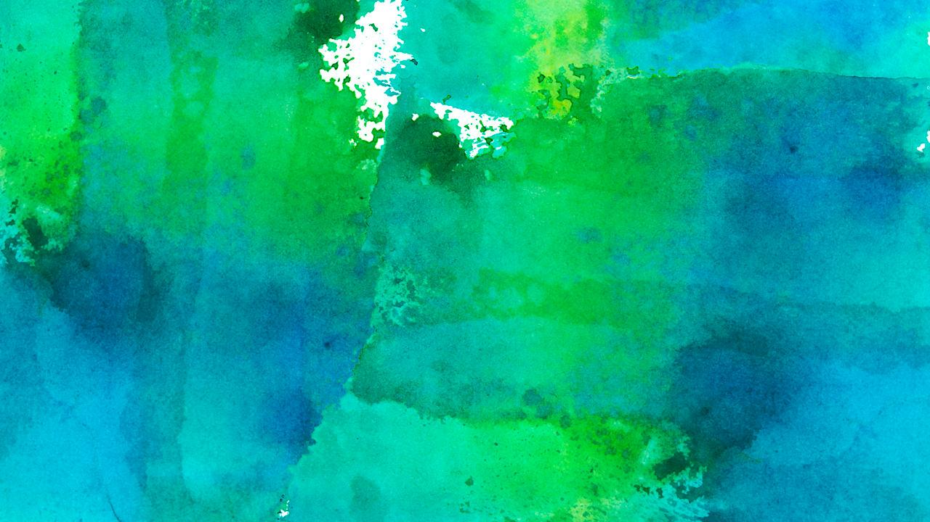
Android project
Show and explain your web, app or software projects using these gadget templates.
Place your screenshot here

Slide 26
iPhone project
Show and explain your web, app or software projects using these gadget templates.
Place your screenshot here

Slide 27
Tablet project
Show and explain your web, app or software projects using these gadget templates.
Place your screenshot here

Slide 28
Desktop project
Show and explain your web, app or software projects using these gadget templates.
Place your screenshot here

Slide 29
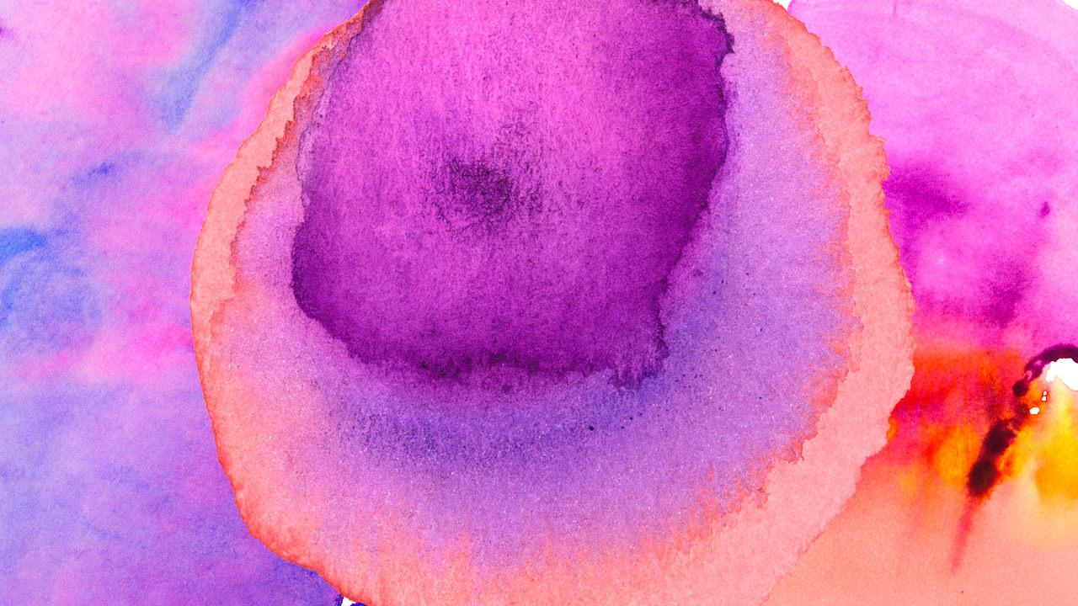
Thanks!
Any questions?
You can find me at:
@username
user@mail.me

Slide 30
Credits
Special thanks to all the people who made and released these awesome resources for free:
Presentation template by SlidesCarnival
Photographs by Unsplash
Watercolor textures by GraphicBurguer

Slide 31
Presentation design
This presentation uses the following typographies and colors:
Titles: Lato Thin
Body copy: Lato Light
You can download the fonts on this page:
http://www.latofonts.com/lato-free-fonts/
You don’t need to keep this slide in your presentation. It’s only here to serve you as a design guide if you need to create new slides or download the fonts to edit the presentation in PowerPoint®

Slide 32
SlidesCarnival icons are editable shapes.
This means that you can:
Resize them without losing quality.
Change fill color and opacity.
Isn’t that nice? :)
Examples:

Slide 33
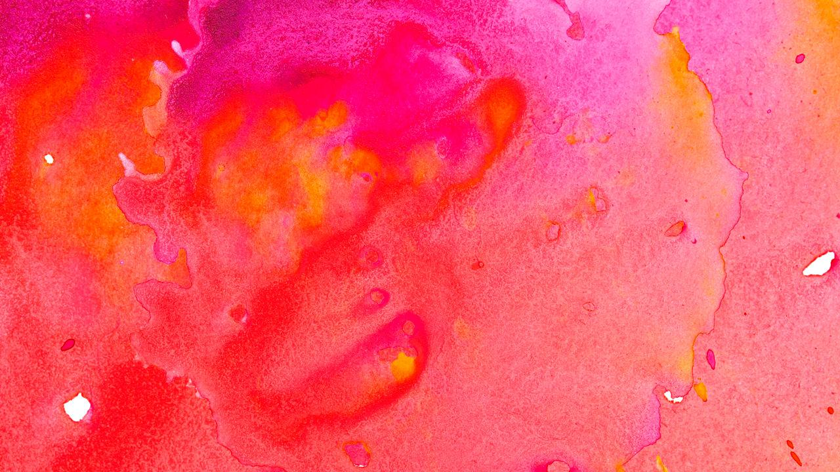
😉
Now you can use any emoji as an icon!
And of course it resizes without losing quality and you can change the color.
How? Follow Google instructions https://twitter.com/googledocs/status/730087240156643328
✋👆👉👍👤👦👧👨👩👪💃🏃💑❤😂😉😋😒😭👶😸🐟🍒🍔💣📌📖🔨🎃🎈🎨🏈🏰🌏🔌🔑 and many more...

