Slide 1
Serverless IoT Data Processing
Integrating ML Models for Automation and Decision-making
Prepared By : POOJA M

Slide 2
Innovation: Enhanced Automation
Adaptive Environments based on User Behavior:
Tailoring settings based on user behavior for a personalized experience.
For example, adjusting lighting and temperature preferences based on daily routines.
Energy Optimization to Reduce Costs:
Smart energy use by analyzing patterns, reducing costs, and consumption.
For instance, optimizing heating and cooling schedules to minimize energy waste.
Predictive Maintenance for Device Longevity:
Predicting device maintenance needs for longevity and reliability.
Such as identifying when a smart appliance requires maintenance before it malfunctions.
Benefits:
Personalized User Experience:
Individualized smart home experience meeting specific preferences and adapting to changing habits.
E.g., adjusting settings in real-time as habits evolve.
Increased Energy Efficiency:
Optimized energy use for cost savings and sustainability.
Leading to reduced energy bills and a more eco-friendly household.

Slide 3
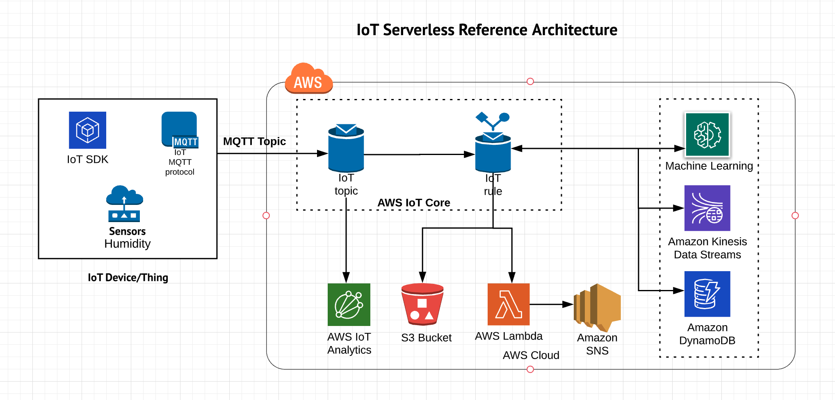
ARCHITECTURE
ARCHITECTURE

Slide 4
Innovative Solutions for Serverless IoT Applications
Serverless Autoscaling: Dynamically adjust function resources based on IoT data traffic, optimizing performance using machine learning models.
Serverless IoT Edge: Combine serverless and edge computing for closer compute resources, reducing latency and data transfer costs.
IoT State Management as a Service: Develop a dedicated serverless state management service for real-time synchronization and scalability in IoT applications.
Serverless Security Middleware: Integrate a serverless security middleware layer for authentication, authorization, and encryption in IoT applications.
Multi-Cloud Serverless: Create an abstraction layer for running IoT applications on multiple serverless platforms, ensuring vendor flexibility and failover.
Real-time Monitoring and Anomaly Detection: Implement AI-driven anomaly detection for real-time monitoring in serverless IoT applications, enhancing system stability.
Federated Learning for IoT: Apply federated learning to process IoT data locally on devices while preserving privacy and enabling global insights.
Hybrid Serverless-IoT Platforms: Seamlessly integrate serverless and IoT capabilities into a unified platform for efficient application development.

Slide 5
Innovation: Intelligent Decision-making
Augmented Security through Behavioral Analysis:
Utilizing behavioral analysis to enhance security measures.
For example, detecting unusual patterns and potential security threats.
Health Monitoring and Assistance:
Providing health monitoring and immediate assistance through connected devices.
Such as monitoring vital signs and detecting emergencies, triggering appropriate responses.
Benefits:
Enhanced Safety and Security:
Proactive security measures based on behavioral analysis, ensuring a secure living environment.
E.g., immediate alerts for unusual activities enhancing overall safety.
Proactive Health Monitoring and Assistance:
Continuous health monitoring, ensuring timely responses to potential health issues.
Leading to a more proactive approach to healthcare within the home.

Slide 6
Challenges, Benefits, and Future Prospects
Challenges:
Data Privacy and Security:
Safeguarding sensitive user data from potential breaches.
Ensuring compliance with privacy regulations and standards.
Algorithmic Accuracy and Robustness:
Enhancing accuracy and robustness of machine learning algorithms.
Mitigating false positives/negatives for reliable automation.
Interoperability and Integration:
Ensuring seamless integration of diverse devices and platforms.
Promoting interoperability for a cohesive smart home ecosystem.
Benefits and Future Prospects:
Improved Efficiency and Sustainability:
Optimizing resource usage and energy consumption for a greener footprint.
Streamlining routines and device usage for overall improved efficiency.
Resource Optimization:
Smartly allocating resources based on usage patterns and real-time needs.
Reducing wastage and enhancing the lifecycle of devices.

Slide 7
Conclusion: Powering the Future of IoT with Innovation
Integration of Innovations: By blending machine learning, edge computing, blockchain, and AI, we unlock immense potential to revolutionize serverless IoT applications.
Overcoming Challenges: These innovations address critical challenges, including latency, security, scalability, and cost, paving the way for robust IoT ecosystems.
Tailored Solutions: Depending on specific use cases, adopting one or more of these solutions can optimize operations, enhance security, and ensure efficient resource allocation.
Future Prospects: The future of IoT lies in continued exploration and integration of emerging technologies, pushing the boundaries of what's possible in the connected world.
Collaboration and Growth: Collaborative efforts and an open mindset towards innovation will drive the evolution of IoT, creating a smarter, more connected, and sustainable future.

