Slide 1
Secure Data Hiding in Image Using Steganography
Presented By:
Student Name : SOWNDARYA S
College Name & Department :SRI KRISHNA ARTS AND SCIENCE COLLEGE

Slide 2
OUTLINE
Problem Statement
Technology used
Wow factor
End users
Result
Conclusion
Git-hub Link
Future scope

Slide 3

Problem Statement
Data privacy is becoming increasingly important in digital communication.
Conventional encryption techniques work well but are easily discovered.
Steganography makes it possible to conceal encrypted data inside pictures, protecting privacy and lowering the possibility of detection.
Securing data transfer is essential because cybercriminals employ sophisticated methods to intercept private information.

Slide 4
Technology used
Programming Language: Python IDLE
Operating System: Windows 11
Libraries Used:
OpenCV – Image processing and manipulation
NumPy – Handling binary and pixel data efficiently
Pillow (PIL) – Image handling and conversion
Cryptography – for encrypting and securing hidden pages

Slide 5

Wow factors
Dual Security: AES encryption before embedding ensures confidentiality.
Highly Imperceptible: No visible changes in the image after embedding.
Resistant to Steganalysis: Prevents detection by attackers.
Scalability: Can be extended to audio/video steganography.

Slide 6

End users
🔹Government Agencies – Secure confidential communication.
🔹Cybersecurity Professionals – Research & implementation.
🔹Companies – Protect sensitive business data.
🔹Individuals – Private messaging with hidden encryption.

Slide 7
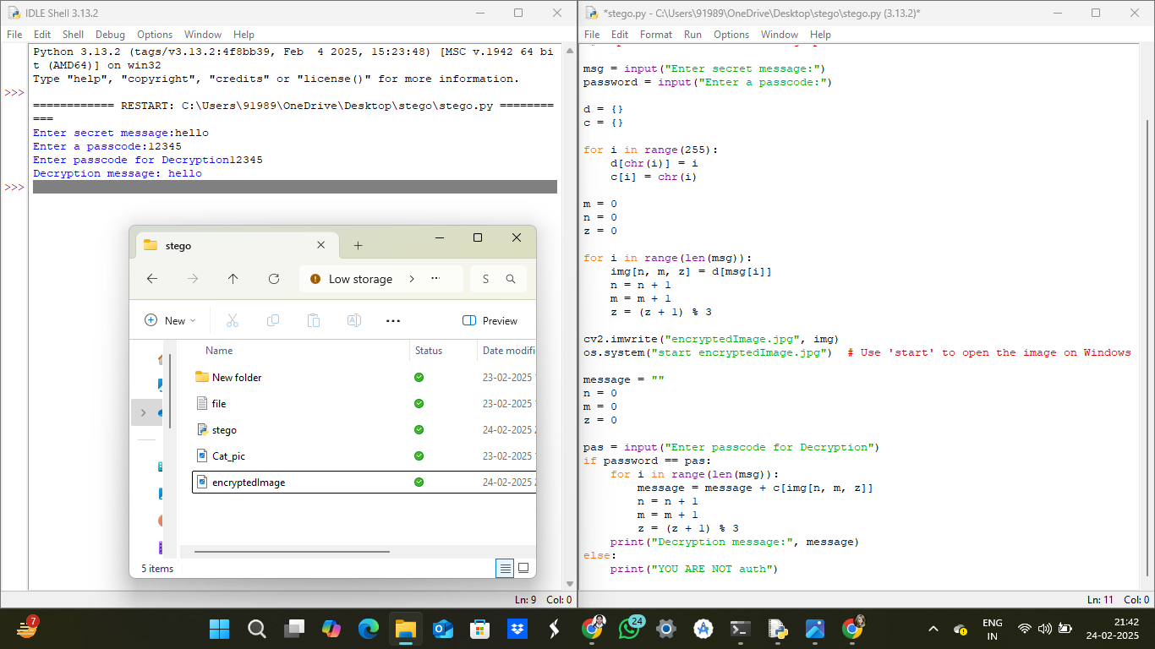
Results

Slide 8

Conclusion
Successfully implemented AES-encrypted LSB steganography.
Ensures secure data hiding with minimal visual distortion.
Offers strong security against unauthorized access.
Can be extended to other media types for enhanced protection

Slide 9
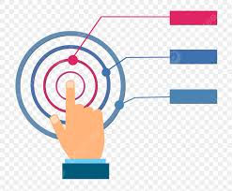
GitHub Link
https://github.com/sowndarya8saravanan/sowndarya.git

Slide 10

Future scope(optional)
Implement AI-based steganography for adaptive security.
Extend the project to video & audio steganography.
Develop a mobile app for secure steganographic messaging.

Slide 11
THANK YOU

