Slide 1
Short circuit code for boolean expressions:
    Boolean expressions are typically used in the flow of control statements, such as if, while and for statements, the effect of such boolean expression can be represented by the position of the program after the expression is evaluated.
    Jump code can be directly generated without evaluating the expressions explicitly.
    The value of a boolean expression can sometimes be determined without evaluating the whole expression.
    Example:
      if (p && (p->next)) { p = p->next;}

Slide 2
Code generation for flow of control statements:
      S->if E then S
      S->if E then S else S
      S->while E do S
  S -> if E then S1
    Evaluate E into t
    If (t = true) goto ETRUE
    goto EFALSE
    ETRUE:
    code for S1
    EFLASE:

Slide 3
Code generation for flow of control statements:
  S -> if E then S1 else S2 ???
  S -> While E DO S1 ???
  How about these two?
    S -> Repeat S until E
    S -> For id := E1 to E2 do S1 endfor

Slide 4
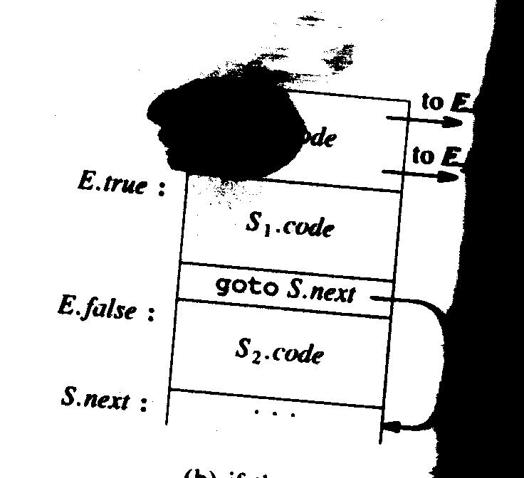
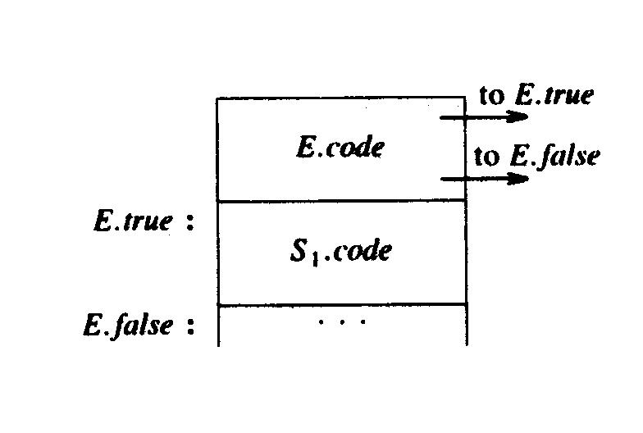
Short circuit code for the control flow statements
If E then S1
If E then S1 else S2

Slide 5
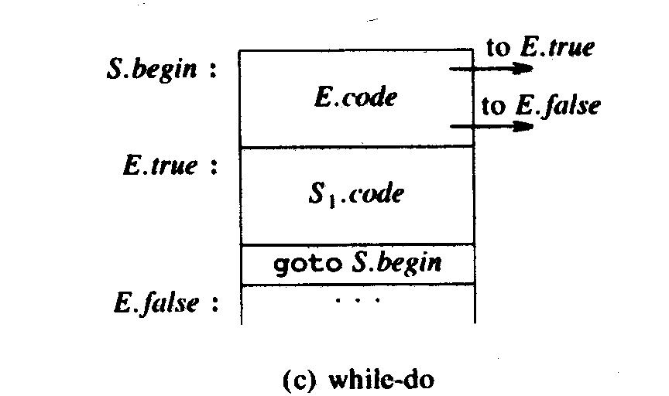
Short circuit code for the control flow statements

Slide 6
Code generation for flow of control statements:
  S->if E then S
  S->if E then S else S
  S->while E do S
  Attributes:
  E.true: the label to which control flows if E is true.
  E.false: the label to while control flows if E is false
  E/S.code: three-address code for E/S
  S.next: the next three-address code following the three address code of S.
  Functions to be used: || concatenate three address code

Slide 7
  S->if E then S1 { E.true = newlabel; E.false = S.next;
  S1.next = S.next; S.code = E.code || gen(E.true, “:”) || S1.code;
  }
  S->if E then S1 else S2 {
  E.true = newlabel; E.false =newlabel;S1.next = S.next;
  S2.next = S.next;
  S.code = E.code || gen(E.true, “:”) ||S1.code|| gen(“goto” S.next) || gen(E.false ‘:’) || S2.code;
  }
  S->while E do S1 {
  S.begin = newlabel; E.true := newlabel;
  E.false = S.next; S1.next = S.begin;
  S.code = gen(S.begin ‘:’) || E.code || gen(E.true, ‘:’)
  || S1.code || gen(‘goto’ S.begin);
  }

Slide 8
  Control flow translation of boolean expressions:
    Basic idea: generate the jumping code without evaluating the whole boolean expression.
    Example:
      Let E = a < b, we will generate the code as
      (1) If a < b then goto E.true
      (2) Goto T.false
  Grammar:
  E->E or E | E and E | not E | (E) | id relop id | true | false.

Slide 9
  E -> E1 or E2 { E1.true = E.true; E1.false = newlabel; E2.true = E.true; E2.false = E.false;
  E.code = E1.code || gen(E1.false ‘:’) || E2.code}
  E->E1 and E2 {E1.true = newlabel; E1.false = E.false;
  E2.true = E.true; E2.false = E.false;
  E.code = E1.code || gen(E1.true ‘:’) || E2.code}
  E->not E {E1.true = E.false; E1.false = E.true; E.code = E1.code}
  E->(E1) {E1.true = E.true; E1.false = E.false; E.code = E1.code;}
  E->id1 relop id2 {E.code = gen(‘if’ id1.place relop.op id2.place ‘goto’ E.true); gen (‘goto’ E.false);}
  E->true {gen(‘goto’ E.true);}
  E->false{gen(‘goto’ E.false);}

Slide 10
  Example: a < b or (c < d and e < f)
  Example: while a< b do
  if c < d then
  x := y + z;
  else
  x: = y – z;

