Slide 1

SWP391: Final Project Presentation
Gas Store Management System-GSMS
SE1715-Group 4

Slide 2
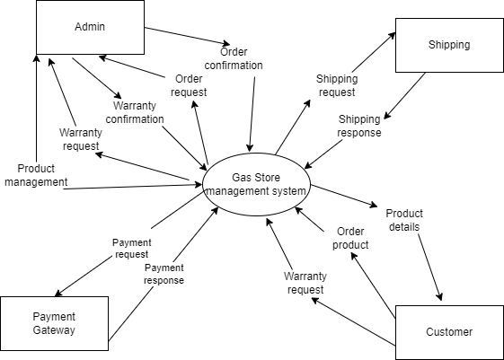
Project Overview
The GSMS (gas store management system) will give people the help people find and access information of gas and related products at ease, giving them various payment methods including online and offline payment.
The system aims to automate manual processes, reducing the time and effort required for tasks such as inventory management and order processing.

Slide 3
Project Overview
Supervision: Nguyễn Thành Ý
Team members
Đào Văn Sơn – HE164023
Nguyễn Tuấn Cường-HE171665
Hoàng Minh Tuấn-HE171801
Nguyễn Xuân Hậu-HE170950
Trịnh Hoàng Dũng- HE17035

Slide 4




Project Overview
Project Communication:
Project issue tracking

Slide 5
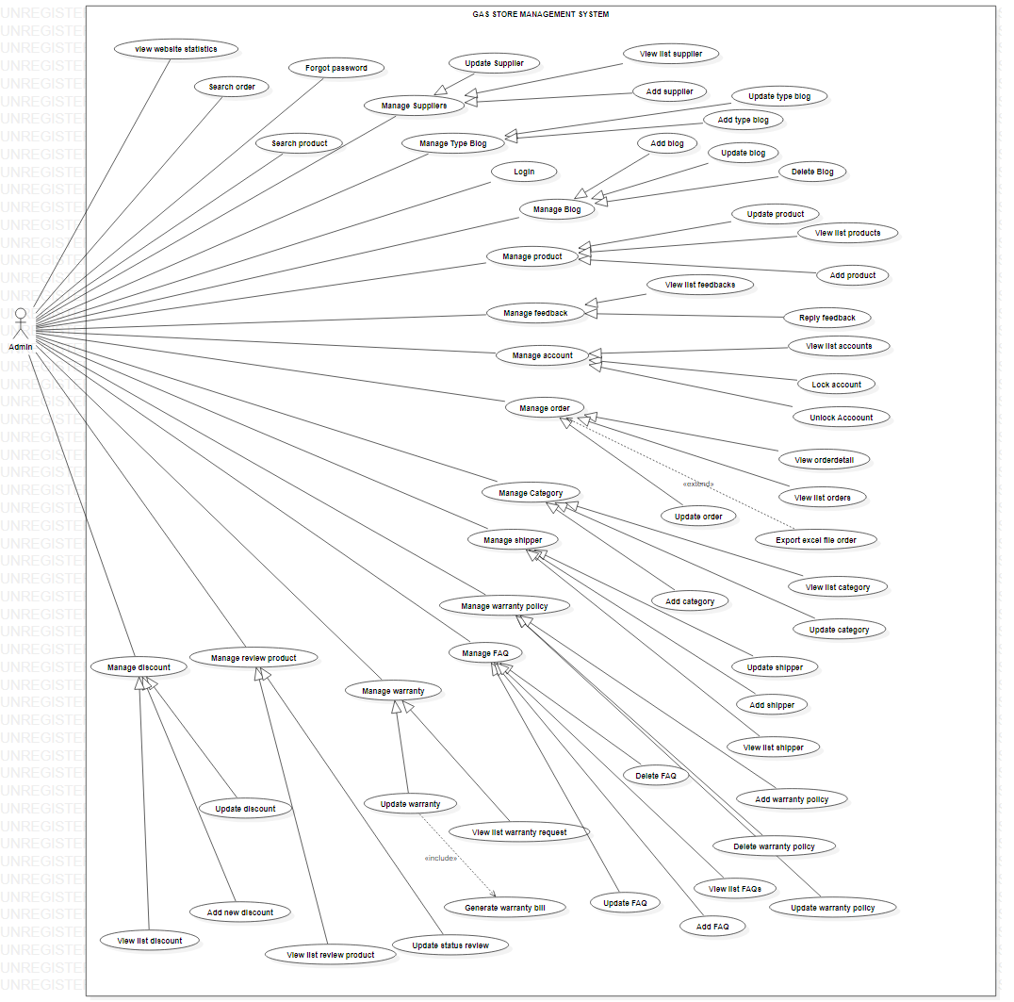
Product Requirements Use Case Diagrams
Admin-Side

Slide 6
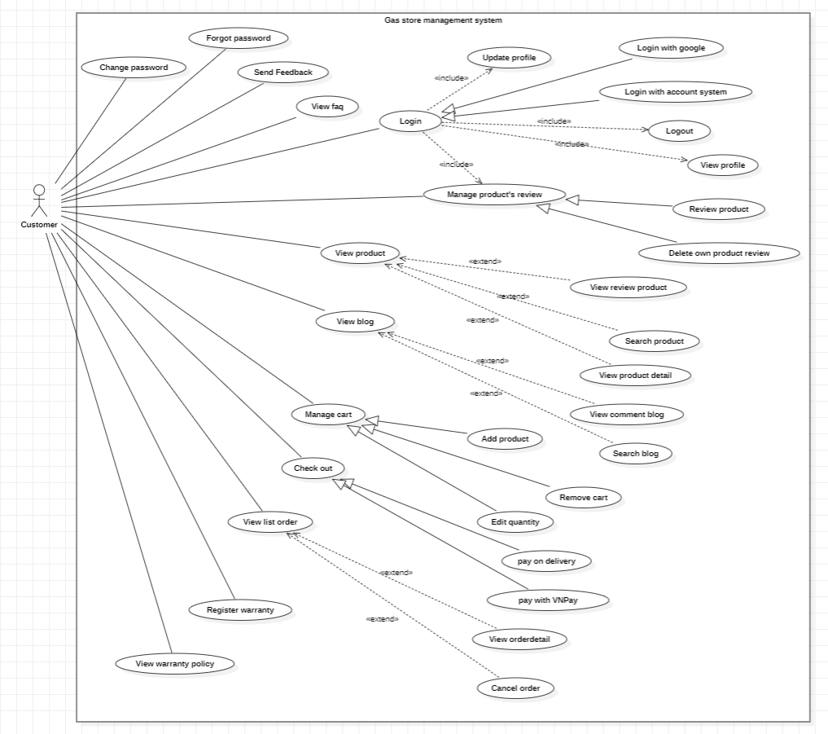
Product Requirements Use Case Diagrams
Client-side

Slide 7
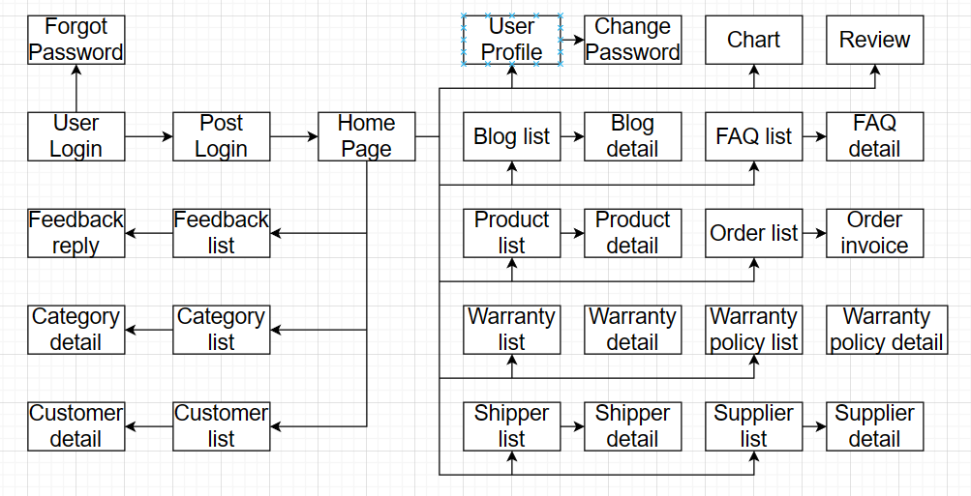
Product Requirements Screen Flow
Admin

Slide 8
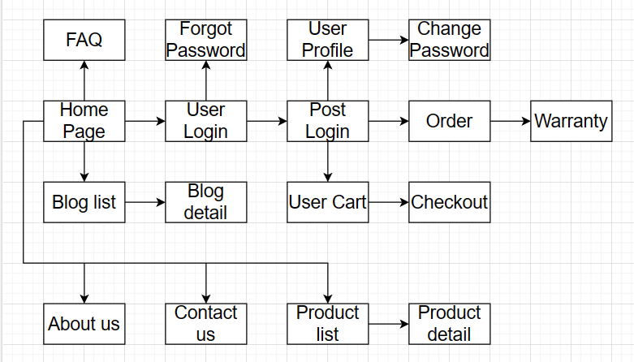
Product Requirements Screen Flow
Client

Slide 9
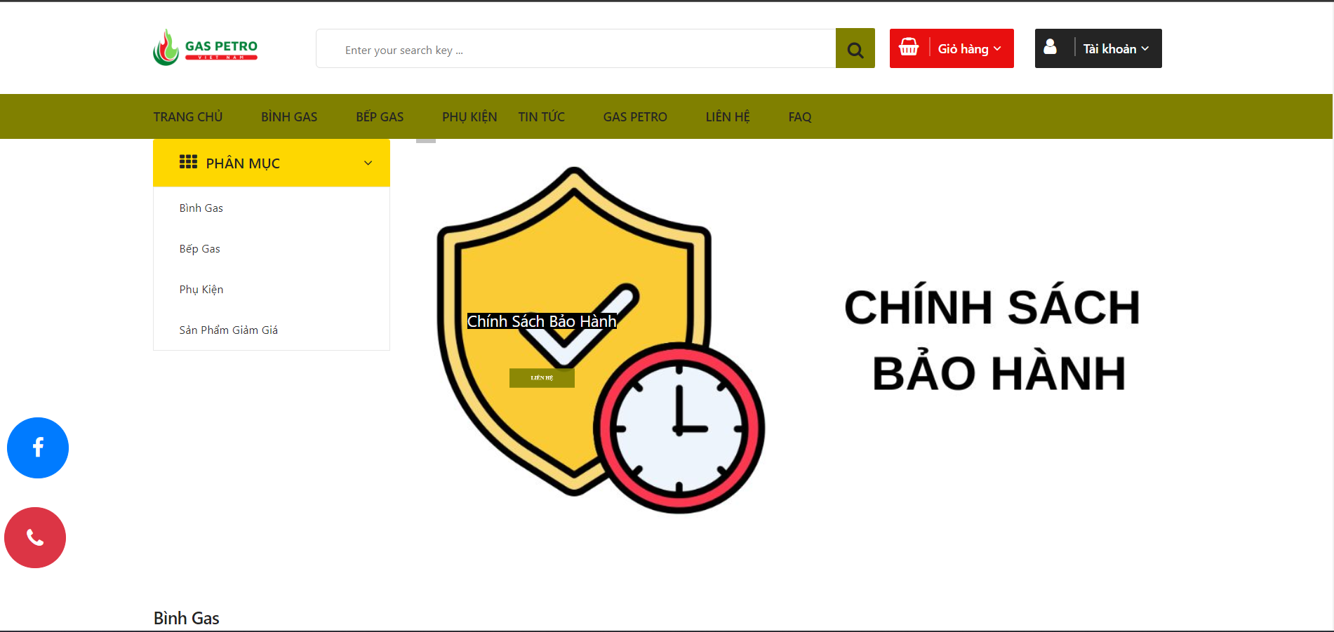
Product Requirements Main Screen UI Design
Client: Index

Slide 10
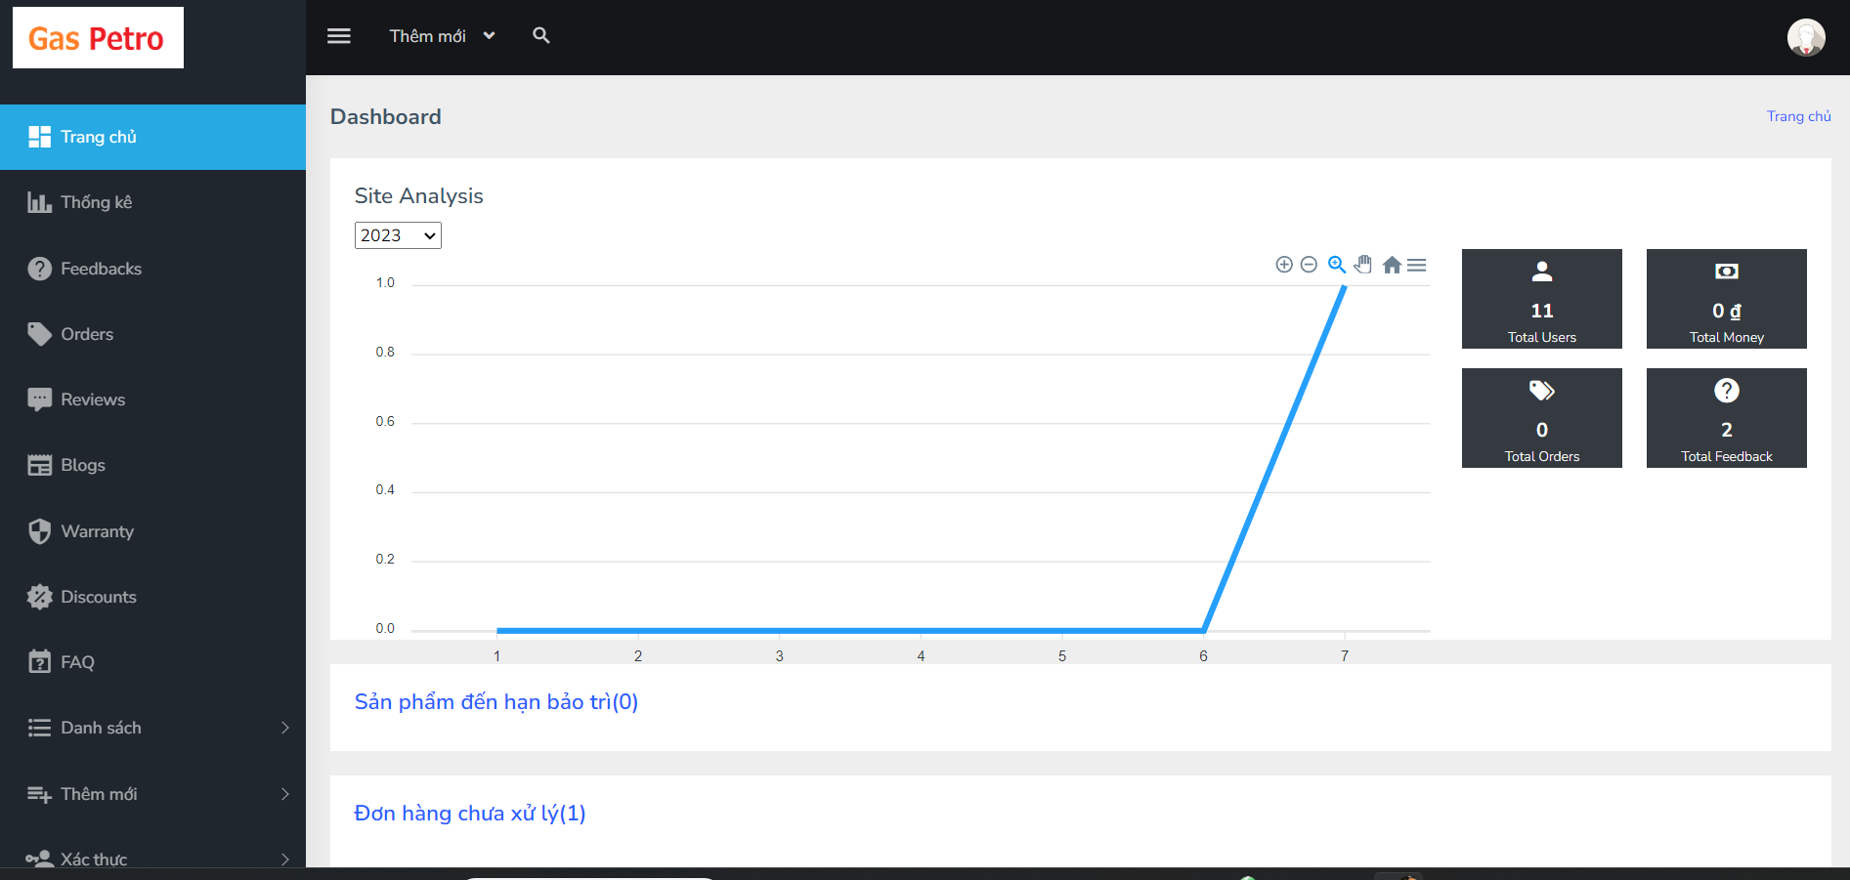
Product Requirements Main Screen UI Design
Admin: Dashboard

Slide 11
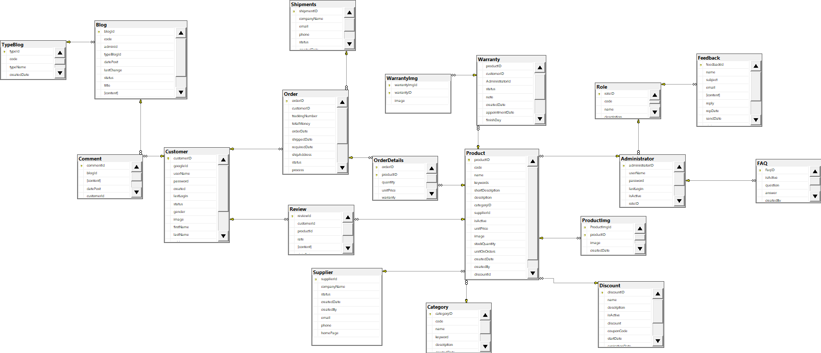
System Design Database Design

Slide 12
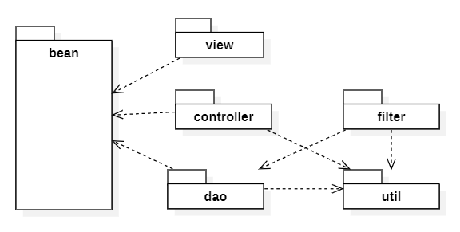
System Design Package Diagram

Slide 13
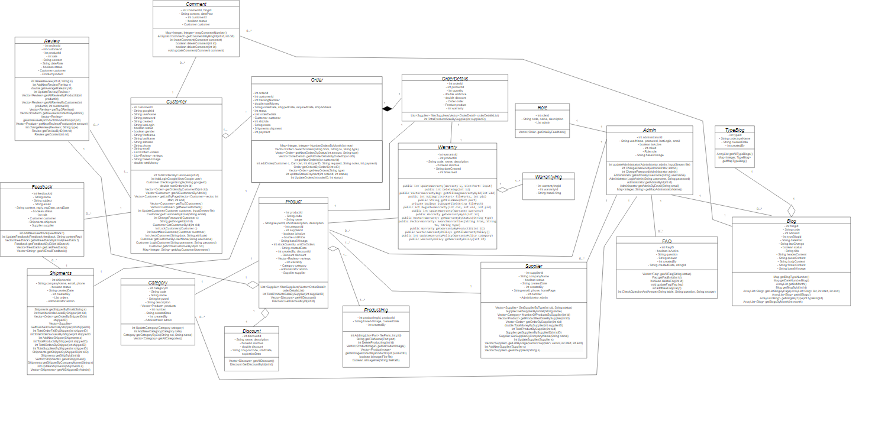
System Design Class Diagram

Slide 14
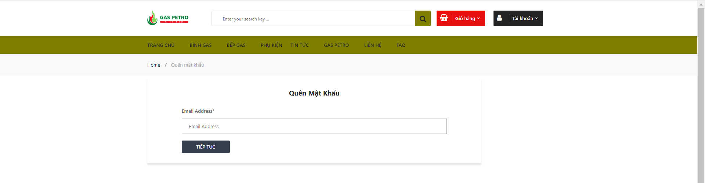

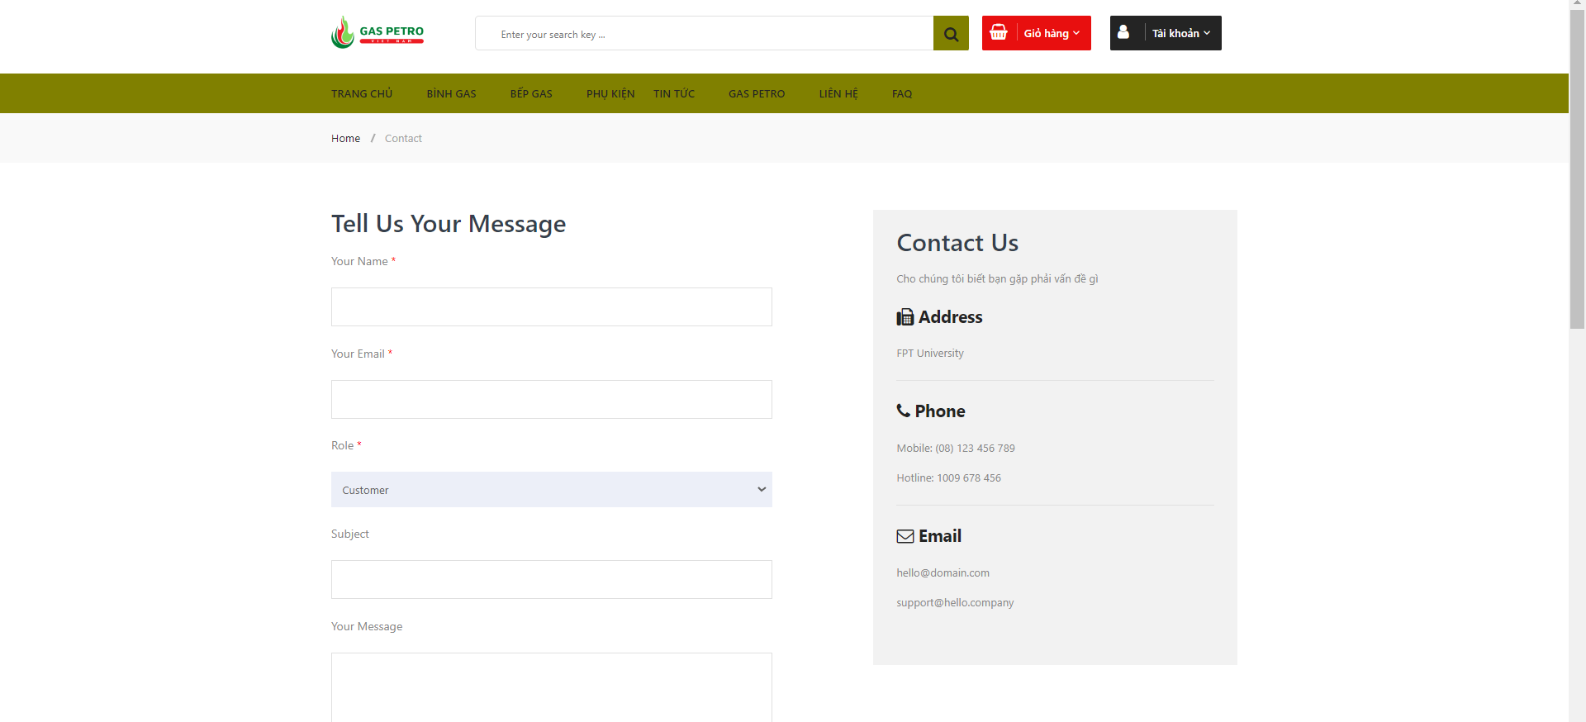
Outstanding Function
API jakarta Mail

Slide 15
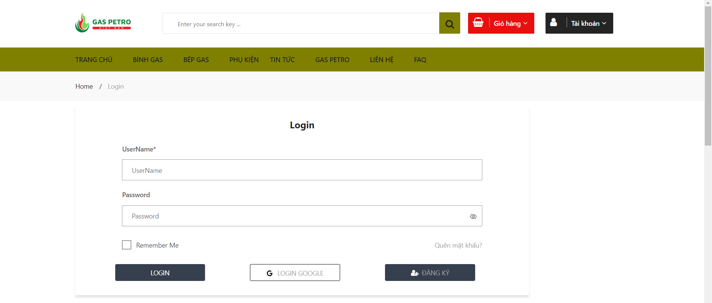


Outstanding Function
Login Google

Slide 16

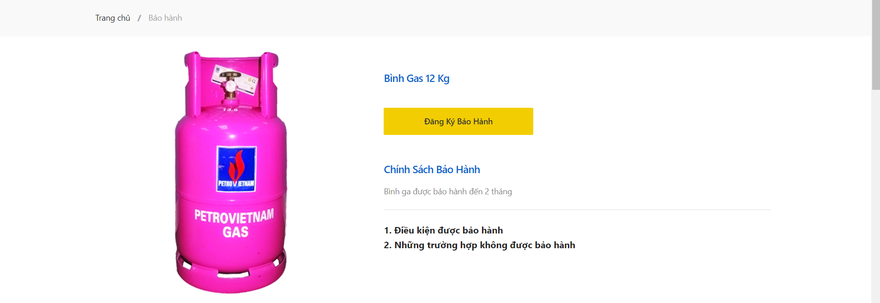
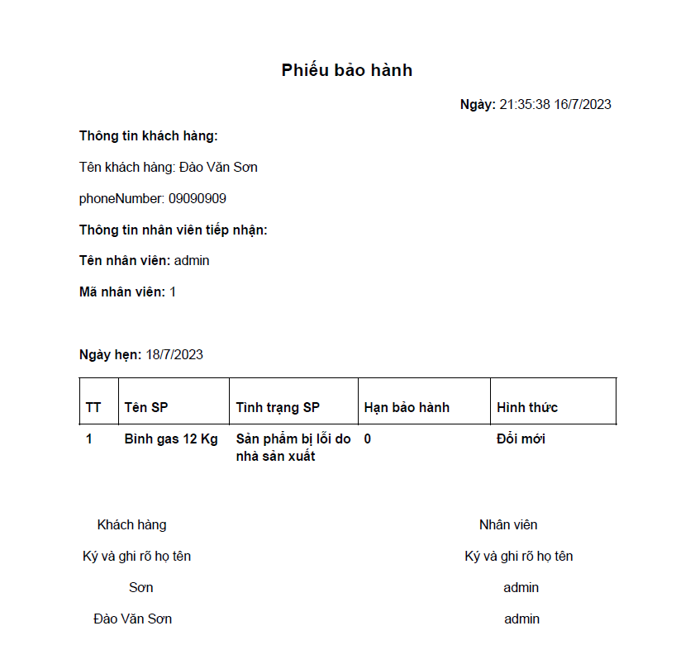
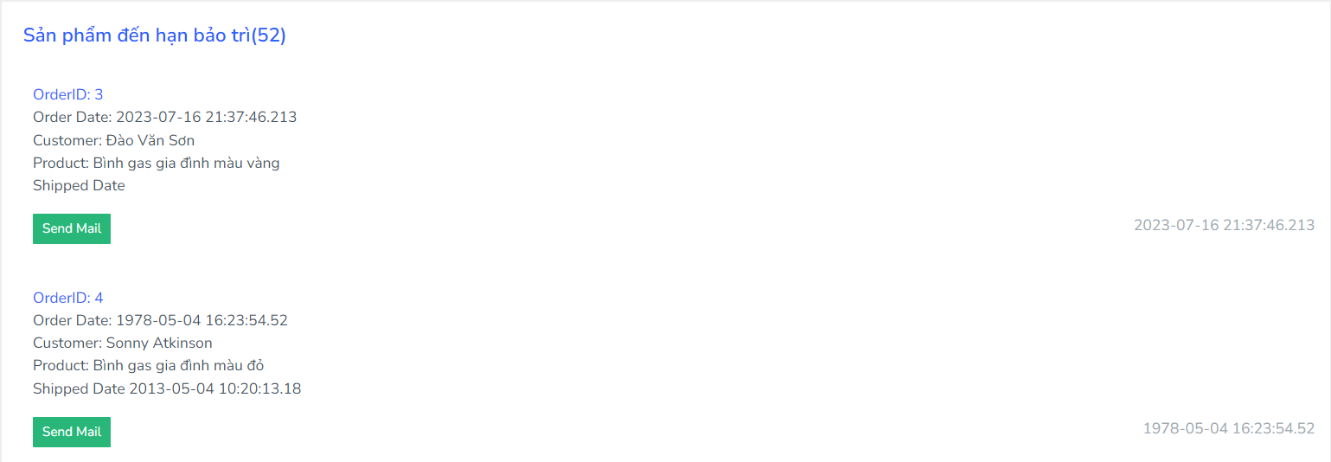
Outstanding Function
Warranty

Slide 17

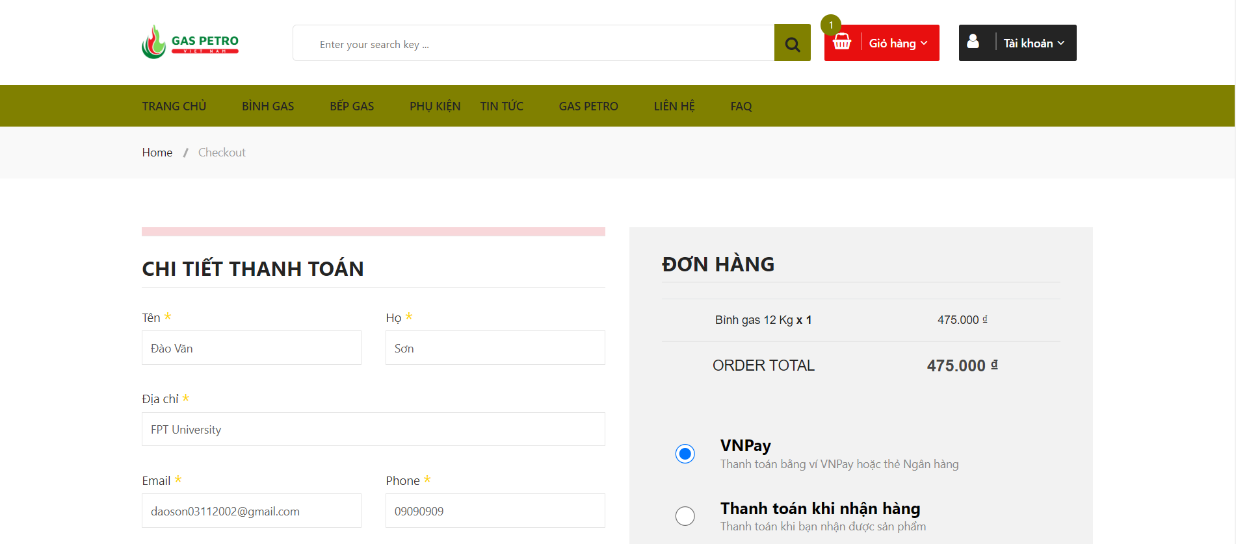
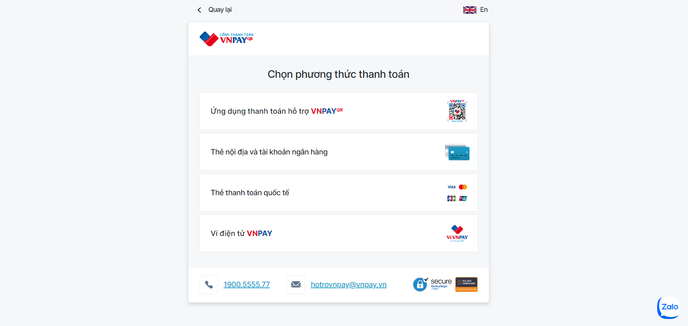
VNPay Sandbox

Slide 18


