Slide 1
w
Song Management System
Database(02)
1871007
Sowon Kim

Slide 2
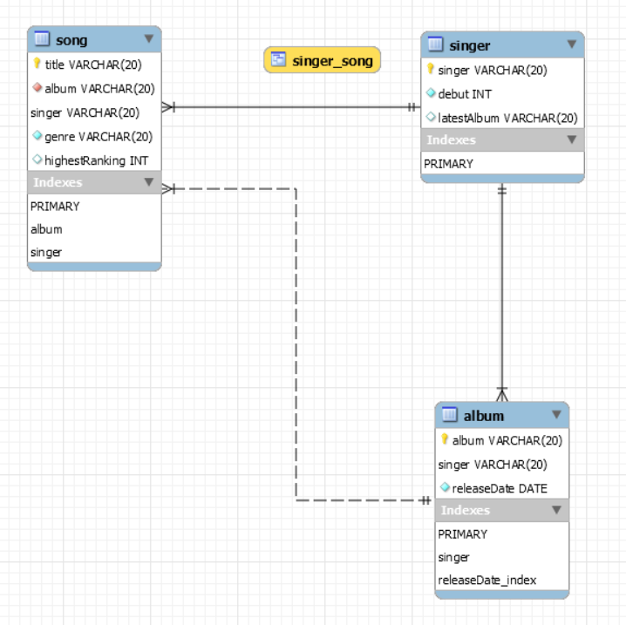
1. Diagram
Singer
singer
debut
latestAlbum
Album
singer
album
releaseDate
Song
title
genre
highestRanking
release
contain

Slide 3
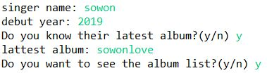



2. Program
sql="select singer, title from Song where genre=?";
sql="select Song.singer, Song.album, Album.releaseDate " +
"from Song, Album " +
"where Song.album=Album.album " +
"and Song.singer=Album.singer " +
"and Song.singer in(select singer from Singer where debut=?);";
create view singer_song as
select Song.title, Song.singer, Album.releaseDate, Singer.debut
from Song, Album, Singer
where Song.album=Album.album and
Song.singer=Album.singer and
Album.singer=Singer.singer;
2
1
4
5
6
3
sql="select title, singer, releaseDate, debut from singer_song where title=?";
sql="update Song set highestRanking=? where title=? and singer=?";
myConn.setAutoCommit(false);
sql="update album set album=? where album=? and singer=?";
sql="update singer set latestAlbum=? where latestAlbum=? and singer=?";
myConn.setAutoCommit(true);

