Slide 1
Migratory influx of young people into Catalunya:
a COVID pandemic insight
Analysis and Visualization of Big Data
MSc Physics of Complex Systems and Biophysics
Authors
1

Slide 2
MSc Physics of Complex Systems and Biophysics
Analysis and Visualization of Big Data – Final Presentation – Migration influx of young people into Catalunya
Abstract
Add a list of topics presented
2

Slide 3
MSc Physics of Complex Systems and Biophysics
Analysis and Visualization of Big Data – Final Presentation - Migration influx of young people into Catalunya
Data Management Plan
Data summary | The data collects all the new cases of migrant children and young people who have arrived in Catalonia since 2015 and hosted by “sistema català de protecció a la infància i l'adolescència”. The data contain the migrant birth date, the year of entry, the origin, the destination, and the gender.
FAIR data | We provide two datasets. The first one consists in the raw data. The second one has been cleaned up sorting up the ages and using a correct format to the dates. Both are freely available in pandas dataframe format. Data is not interoperable because it consists of migration from Marroc, Magreb, Africa subsahariana or Others towards Catalonia, the migration form different origins or to different destinations should differ.
Allocation resources | The infrastructure is organized from “sistema català de protecció a la infància i l'adolescència” through different groups such as police, schools, hospitals, psychologists, and families*. All financed by the Government of Catalonia.
Data security | The clean data should be useful for future investigations and migration comparisons. It is stored in a github repository and in different hard disks. There is no personal information in the clean data. The raw data is stored locally in our devices.
Ethical aspects | Each child has an ID number that is not related to any personal information, is just a control parameter. The exact destination and origin of the migrant remains unknown both in raw data and clean data.

Slide 4
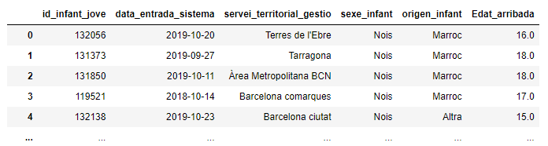
MSc Physics of Complex Systems and Biophysics
Analysis and Visualization of Big Data – Final Presentation - Migration influx of young people into Catalunya
Data Management Plan: data analysis
- Unusual territorial division
> Mismatched regions
- Great influx to regions with Capital cities
- Connecting regions with more migrants Rural areas with less influx

Slide 5
MSc Physics of Complex Systems and Biophysics
Analysis and Visualization of Big Data – Final Presentation – Migratory influx of young people into Catalunya
Time-evolution graphics
- Unusual territorial division
> Mismatched regions
- Great influx to regions with Capital cities
- Connecting regions with more migrants
- Rural areas with less influx

Slide 6
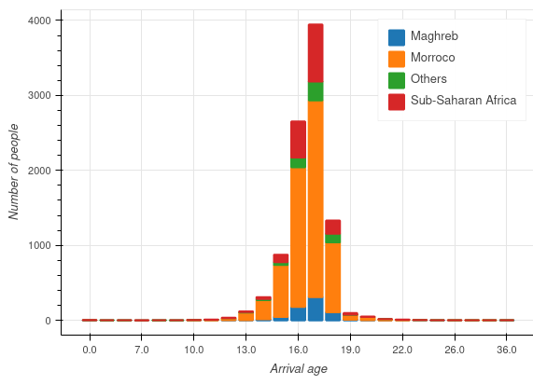
MSc Physics of Complex Systems and Biophysics
Analysis and Visualization of Big Data – Final Presentation - Migration influx of young people into Catalunya
Histograms
- Unusual territorial division
> Mismatched regions
- Great influx to regions with Capital cities
- Connecting regions with more migrants
- Rural areas with less influx

Slide 7
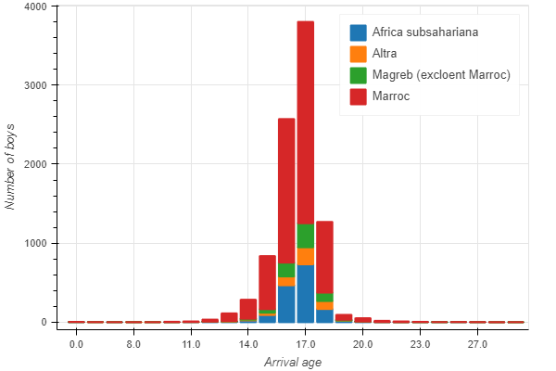
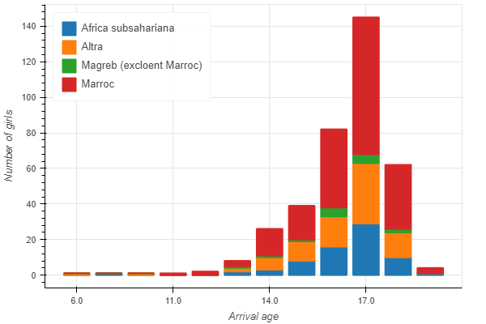
MSc Physics of Complex Systems and Biophysics
Analysis and Visualization of Big Data – Final Presentation - Migration influx of young people into Catalunya
Histograms
Freedman, J. (2012). Analysing the gendered insecurities of migration: a case study of female Sub-Saharan African migrants in Morocco. International Feminist Journal of Politics, 14(1), 36-55.

Slide 8
MSc Physics of Complex Systems and Biophysics
Analysis and Visualization of Big Data – Final Presentation – Migratory influx of young people into Calaunya
Origin pie chart
- Unusual territorial division
> Mismatched regions
- Great influx to regions with Capital cities
- Connecting regions with more migrants
- Rural areas with less influx

Slide 9
MSc Physics of Complex Systems and Biophysics
Analysis and Visualization of Big Data – Final Presentation - Migration influx of young people into Catalunya
Origin-destination relations

Slide 10
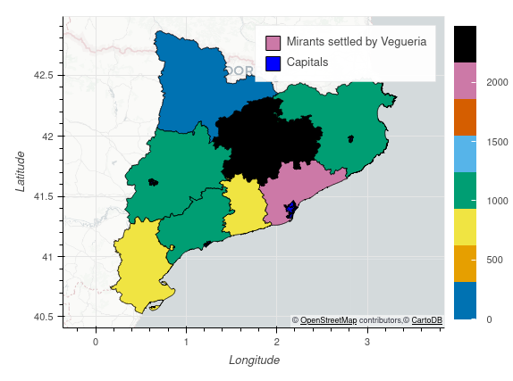
MSc Physics of Complex Systems and Biophysics
Analysis and Visualization of Big Data – Final Presentation - Migration influx of young people into Catalunya
Geographic distribution of migrants
- Unusual territorial division
> Mismatched regions
- Great influx to regions with Capital cities
- Connecting regions with more migrants
- Rural areas with less influx
Figure: Catalunya’s map according to Vaguerie’s territorial division. The color code shows the influx amiunt of migrants received since 2015.

Slide 11
MSc Physics of Complex Systems and Biophysics
Analysis and Visualization of Big Data – Final Presentation - Migration influx of young people into Catalunya
Author contributions - CRediT Contributor Roles Taxonomy
https://www.elsevier.com/authors/policies-and-guidelines/credit-author-statement
Term | Definition
Conceptualization | Ideas; formulation or evolution of overarching research goals and aims
Methodology | Development or design of methodology; creation of models
Software | Programming, software development; designing computer programs; implementation of the computer code and supporting algorithms; testing of existing code components
Validation | Verification, whether as a part of the activity or separate, of the overall replication/ reproducibility of results/experiments and other research outputs
Formal analysis | Application of statistical, mathematical, computational, or other formal techniques to analyze or synthesize study data
Investigation | Conducting a research and investigation process, specifically performing the experiments, or data/evidence collection
Resources | Provision of study materials, reagents, materials, patients, laboratory samples, animals, instrumentation, computing resources, or other analysis tools
Data Curation | Management activities to annotate (produce metadata), scrub data and maintain research data (including software code, where it is necessary for interpreting the data itself) for initial use and later reuse
Writing - Original Draft | Preparation, creation and/or presentation of the published work, specifically writing the initial draft (including substantive translation)
Writing - Review & Editing | Preparation, creation and/or presentation of the published work by those from the original research group, specifically critical review, commentary or revision – including pre-or postpublication stages
Visualization | Preparation, creation and/or presentation of the published work, specifically visualization/ data presentation
Supervision | Oversight and leadership responsibility for the research activity planning and execution, including mentorship external to the core team
11

Slide 12
MSc Physics of Complex Systems and Biophysics
Analysis and Visualization of Big Data – Final Presentation - Migration influx of young people into Catalunya
Author contributions
Author | Aleix | Martina | Victor | Roger
Conceptualization | x | x | x | x
Methodology | x |  | x
Software |  | x |  | x
Validation | x |  | x
Formal analysis |  | x |  | x
Investigation | x
Resources | x | x | x
Data Curation |  | x |  | x
Writing - Original Draft |  |  | x
Writing - Review & Editing | x | x | x | x
Visualization |  |  |  | x
Supervision | x | x | x | x
12

Slide 13
MSc Physics of Complex Systems and Biophysics
Analysis and Visualization of Big Data – Final Presentation - Migration influx of young people into Catalunya
Author contributions
- Time-evolution graphics, origin-destination graphics: Martina
- Origin pie charts: Aleix
- Histograms: Victor
- Geographic map and streamlit dashboard: Roger

