Slide 1
Migratory influx of young people into Catalunya:
a COVID pandemic insight
Analysis and Visualization of Big Data
MSc Physics of Complex Systems and Biophysics
Aleix Abadia, Víctor Rodríguez, Martina Cortada, Roger Bellido
<número>

Slide 2
MSc Physics of Complex Systems and Biophysics
Analysis and Visualization of Big Data – Final Presentation – Migration influx of young people into Catalunya
Abstract
Migration has been present amongst humanity since the beginning of the times. Seeking abroad new and better opportunities is a an ambition everyone can relate to. Nowadays, a great migratory influx is observed towards our territory, and it will be our aim to study it, as the COVID pandemic had an effect over it. Here we show some of the migratory peaks in the recent years as well as the consequence of the ongoing pandemic and the first lockdown.
We found that the migration peaks can be related to geopolitical phenomena in the place of origin of the migrants.
Also, we could relate the beginning of the pandemic with a valley in the migratory influx in 2020.
<número>

Slide 3
MSc Physics of Complex Systems and Biophysics
Analysis and Visualization of Big Data – Final Presentation - Migration influx of young people into Catalunya
Data Management Plan
Data summary | The data collects all the new cases of migrant children and young people who have arrived in Catalonia since 2015 and hosted by “sistema català de protecció a la infància i l'adolescència”. The data contain the migrant birth date, the year of entry, the origin, the destination, and the gender.
FAIR data | We provide two datasets. The first one consists in the raw data. The second one has been cleaned up sorting up the ages and using a correct format to the dates. Both are freely available in pandas dataframe format. Data is not interoperable because it consists of migration from Marroc, Magreb, Africa subsahariana or Others towards Catalonia, the migration form different origins or to different destinations should differ.
Allocation resources | The infrastructure is organized from “sistema català de protecció a la infància i l'adolescència” through different groups such as police, schools, hospitals, psychologists, and families*. All financed by the Government of Catalonia.
Data security | The clean data should be useful for future investigations and migration comparisons. It is stored in a github repository and in different hard disks. There is no personal information in the clean data. The raw data is stored locally in our devices.
Ethical aspects | Each child has an ID number that is not related to any personal information, is just a control parameter. The exact destination and origin of the migrant remains unknown both in raw data and clean data.

Slide 4
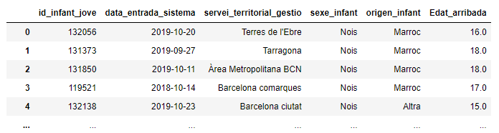
MSc Physics of Complex Systems and Biophysics
Analysis and Visualization of Big Data – Final Presentation - Migration influx of young people into Catalunya
Data Management Plan: data base
- Catalunya Open Data
- Possible bias

Slide 5
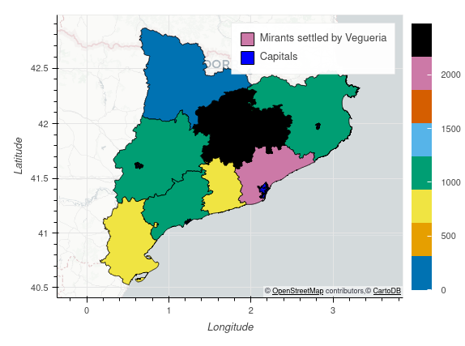
MSc Physics of Complex Systems and Biophysics
Analysis and Visualization of Big Data – Final Presentation - Migration influx of young people into Catalunya
How we can see migration in Catalunya?
- Great influx to regions with Capital cities
- Connecting regions with more migrants
- Rural areas with less influx
- Unusual territorial division
> Mismatched regions
Figure: Catalunya’s map according to Vaguerie’s territorial division. The color code shows the influx amiunt of migrants received since 2015.

Slide 6
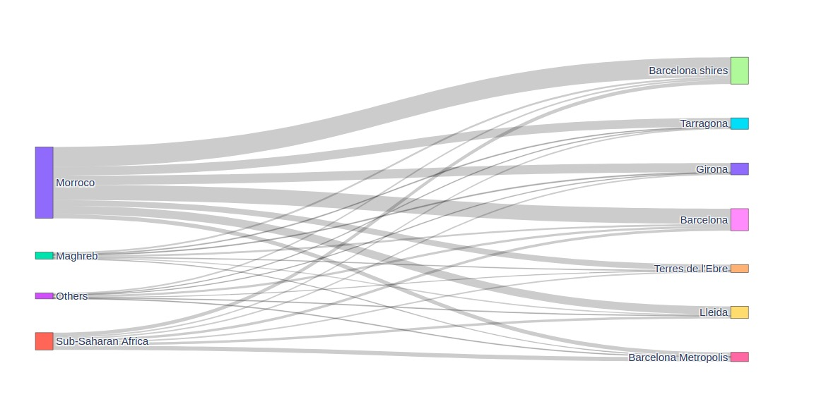
MSc Physics of Complex Systems and Biophysics
Analysis and Visualization of Big Data – Final Presentation - Migration influx of young people into Catalunya
How we can see migration in Catalunya?

Slide 7
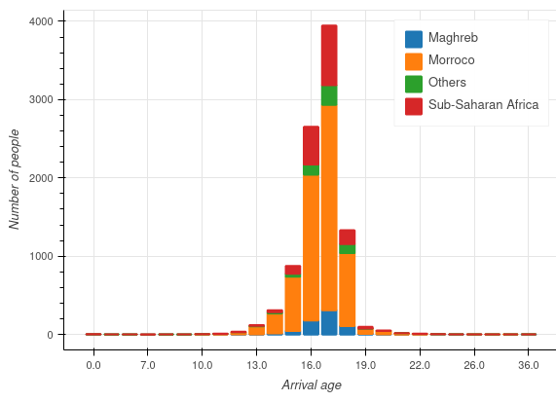
MSc Physics of Complex Systems and Biophysics
Analysis and Visualization of Big Data – Final Presentation - Migration influx of young people into Catalunya
How is this data distributed?
- Unusual territorial division
> Mismatched regions
- Great influx to regions with Capital cities
- Connecting regions with more migrants
- Rural areas with less influx

Slide 8
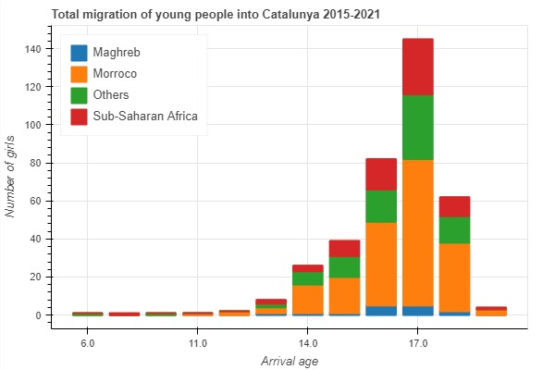
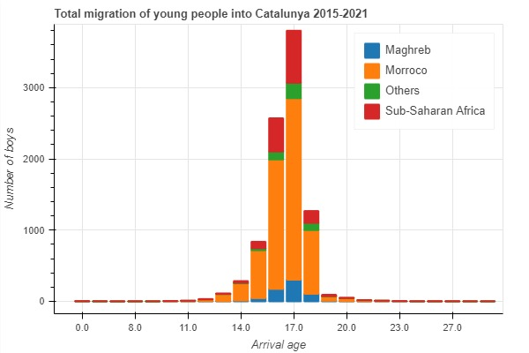
MSc Physics of Complex Systems and Biophysics
Analysis and Visualization of Big Data – Final Presentation - Migration influx of young people into Catalunya
Distribution by age and gender
1. Heering, L., Van Der Erf, R., & Van Wissen, L. (2004). The role of family networks and migration culture in the continuation of Moroccan emigration: A gender perspective. Journal of Ethnic and Migration Studies, 30(2), 323-337.

Slide 9
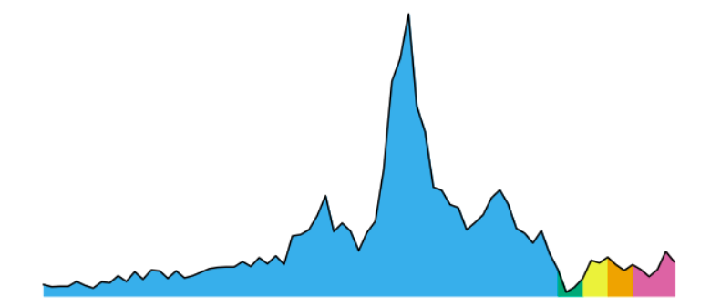
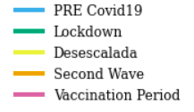
MSc Physics of Complex Systems and Biophysics
Analysis and Visualization of Big Data – Final Presentation – Migratory influx of young people into Catalunya
How do the data look in time?
PRE Covid19: 2015-March 2020
Lockdown: March-May 2020
Desescalada: May-August 2020
Second Wave : August-December 2020
Vaccination Period : December 2020 - Today

Slide 10
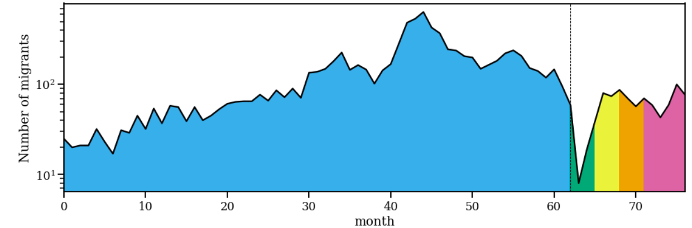
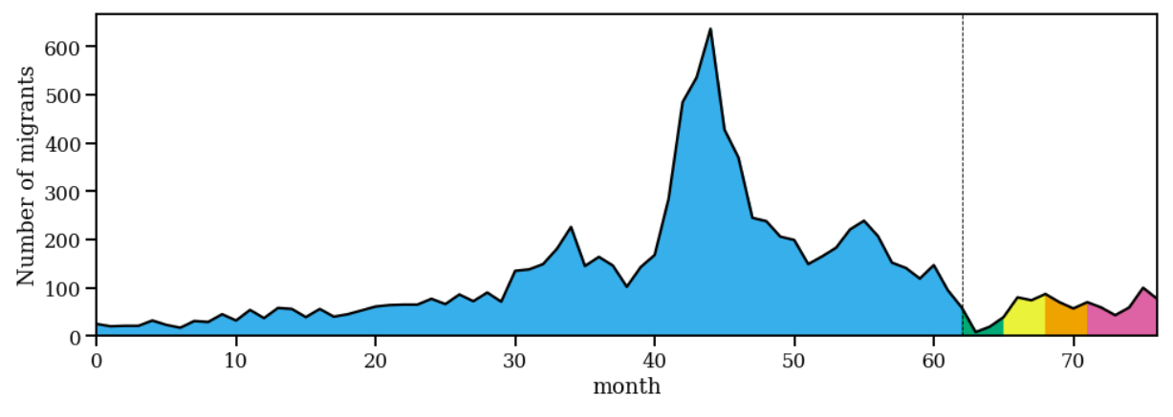
MSc Physics of Complex Systems and Biophysics
Analysis and Visualization of Big Data – Final Presentation – Migratory influx of young people into Catalunya
September 2018

Slide 11
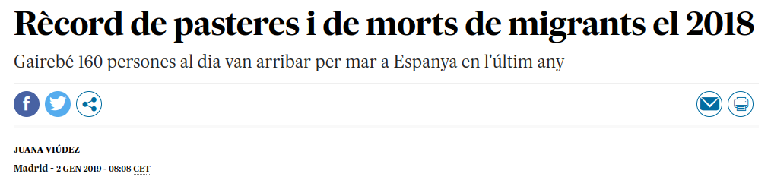
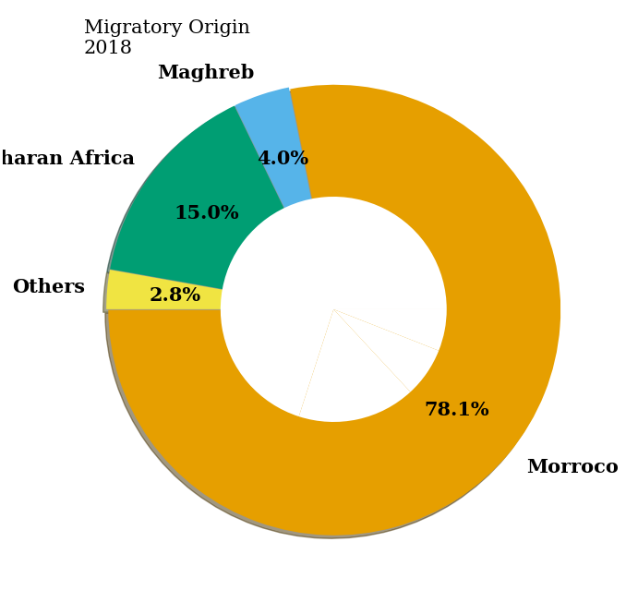
MSc Physics of Complex Systems and Biophysics
Analysis and Visualization of Big Data – Final Presentation – Migratory influx of young people into Catalunya
What happened in 2018?

Slide 12
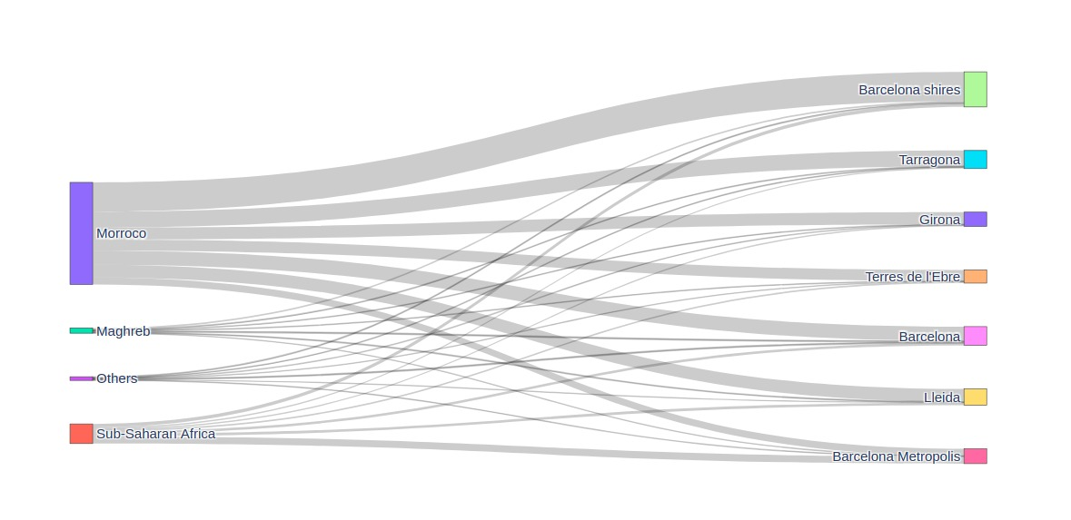
MSc Physics of Complex Systems and Biophysics
Analysis and Visualization of Big Data – Final Presentation – Migratory influx of young people into Catalunya
What happened in 2018?

Slide 13
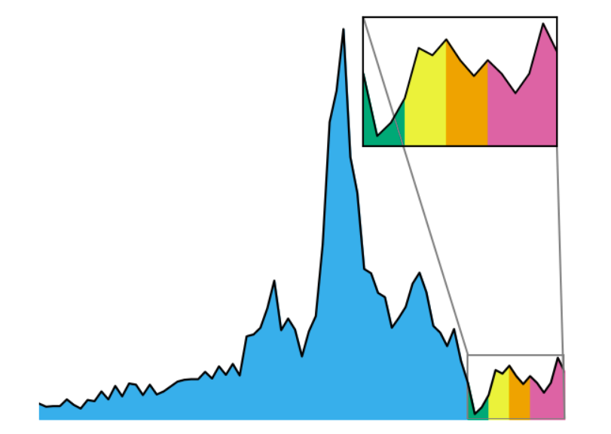
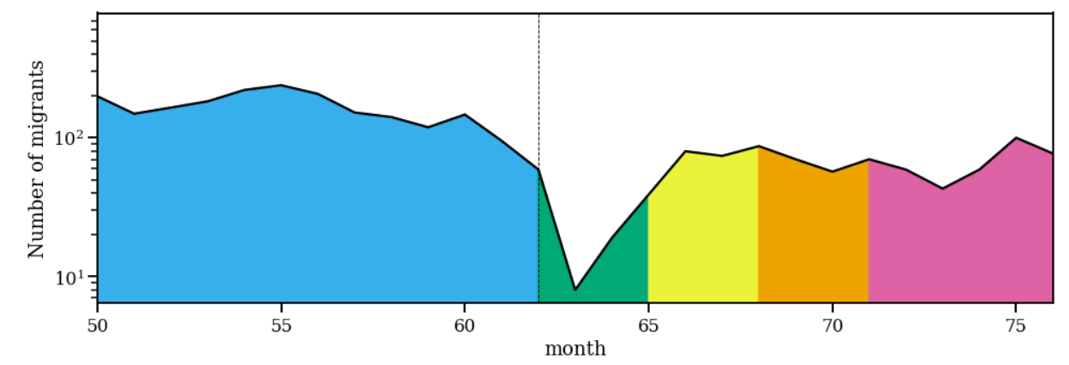
MSc Physics of Complex Systems and Biophysics
Analysis and Visualization of Big Data – Final Presentation – Migratory influx of young people into Catalunya
Let’s take a look at the pandemic period:

Slide 14
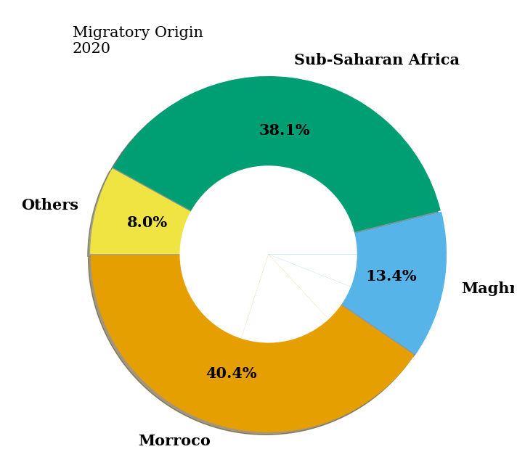

MSc Physics of Complex Systems and Biophysics
Analysis and Visualization of Big Data – Final Presentation – Migratory influx of young people into Calaunya
Forward to 2020: the COVID pandemic
- Video

Slide 15
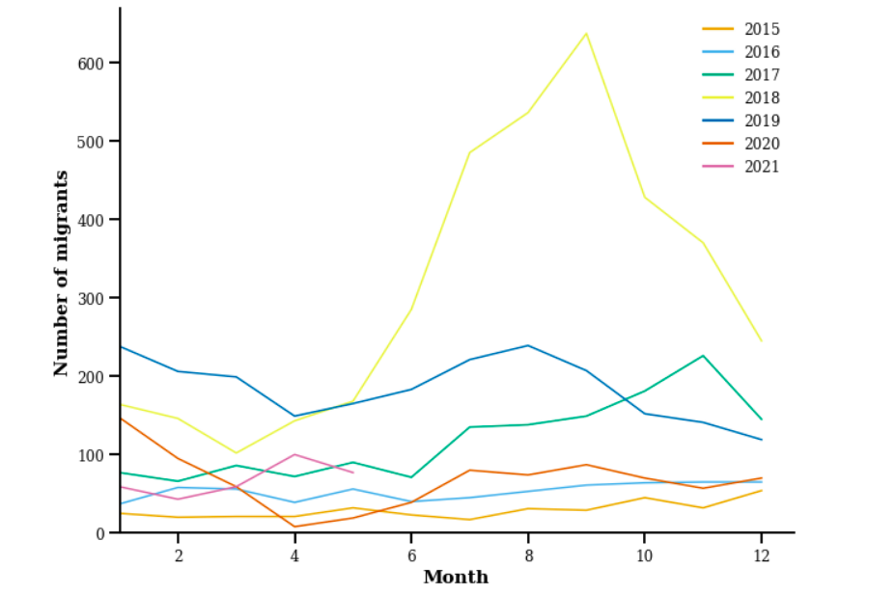
MSc Physics of Complex Systems and Biophysics
Analysis and Visualization of Big Data – Final Presentation – Migratory influx of young people into Calaunya
Is there a trend emerging from the data?

Slide 16
MSc Physics of Complex Systems and Biophysics
Analysis and Visualization of Big Data – Final Presentation – Migratory influx of young people into Calaunya
Ongoing or proposed questions and future directions :
- How are the results of Catalunya compared to Spain? And Europe?
- Project introducing citizen science
- What would the results look like if we include migrations not only from Africa?
- Gender study
- Are there differences with by sea or by land migrations?

Slide 17
MSc Physics of Complex Systems and Biophysics
Analysis and Visualization of Big Data – Final Presentation - Migration influx of young people into Catalunya
Author contributions - CRediT Contributor Roles Taxonomy
https://www.elsevier.com/authors/policies-and-guidelines/credit-author-statement
Term | Definition
Conceptualization | Ideas; formulation or evolution of overarching research goals and aims
Methodology | Development or design of methodology; creation of models
Software | Programming, software development; designing computer programs; implementation of the computer code and supporting algorithms; testing of existing code components
Validation | Verification, whether as a part of the activity or separate, of the overall replication/ reproducibility of results/experiments and other research outputs
Formal analysis | Application of statistical, mathematical, computational, or other formal techniques to analyze or synthesize study data
Investigation | Conducting a research and investigation process, specifically performing the experiments, or data/evidence collection
Resources | Provision of study materials, reagents, materials, patients, laboratory samples, animals, instrumentation, computing resources, or other analysis tools
Data Curation | Management activities to annotate (produce metadata), scrub data and maintain research data (including software code, where it is necessary for interpreting the data itself) for initial use and later reuse
Writing - Original Draft | Preparation, creation and/or presentation of the published work, specifically writing the initial draft (including substantive translation)
Writing - Review & Editing | Preparation, creation and/or presentation of the published work by those from the original research group, specifically critical review, commentary or revision – including pre-or postpublication stages
Visualization | Preparation, creation and/or presentation of the published work, specifically visualization/ data presentation
Supervision | Oversight and leadership responsibility for the research activity planning and execution, including mentorship external to the core team
<número>

Slide 18
MSc Physics of Complex Systems and Biophysics
Analysis and Visualization of Big Data – Final Presentation - Migration influx of young people into Catalunya
Author contributions
Author | Aleix | Martina | Victor | Roger
Conceptualization | x | x | x | x
Methodology | x |  | x
Software |  | x |  | x
Validation | x |  | x
Formal analysis |  | x |  | x
Investigation | x
Resources | x | x | x
Data Curation |  | x |  | x
Writing - Original Draft |  |  | x
Writing - Review & Editing | x | x | x | x
Visualization |  |  |  | x
Supervision | x | x | x | x
<número>

Slide 19
MSc Physics of Complex Systems and Biophysics
Analysis and Visualization of Big Data – Final Presentation - Migration influx of young people into Catalunya
Author contributions
- Time-evolution graphics, sankey plot and dashboard: Martina
- Pie charts, reference search, contextualization: Aleix
- Histograms, DMP: Victor
- Geographic map, abstract and presentation: Roger

Slide 20
MSc Physics of Complex Systems and Biophysics
Analysis and Visualization of Big Data – Final Presentation - Migration influx of young people into Catalunya
Course opinion and critics:
- A huge thank you to Franziska and Josep for their help and dedication
- Useful but too packed
- The nature of the classes makes it very manageable
- The amount of overall work does not match 3 ECTS
- The idea is good, but there were not enough resources

