Slide 1


Effects of weather on retail sales
Saha, Pratik (13-23318-1)
Sarker, Sowrozit (13-23204-1)
Akhter, Rubina (13-23283-1)
Mostabi, Nabila (12-21878-2)

Slide 2
Introduction
Scope
Data mining using weather data and sales data of a retail store
Goal
Predict the quantity of a production a retail store should have in store at a particular period of time
Results
An equation for measuring product quantity

Slide 3
Background
Primary reason behind choosing this topic was the innate desire to contribute to the field of data mining and forecasting.
After finalising the field, we decided to brainstorm and study for selecting a particular topic for research.
After studying some literatures and consulting with our supervisor, we decided to research on the effects of weather on retail sales

Slide 4
Motivation
The main motivation for choosing this topic was that there has not been many studies on this topic. The retails stores in our country still depend on their own understanding for maintaining inventory.
Applying data mining and forecasting can bring huge revolution in this sector. So, we wanted to leave our footprints in this area.

Slide 5

The Problem
Generate an equation for predicting the quantity of a product (X) that needs to be in the inventory based on sales and weather data of Y number of years.

Slide 6
Dataset
The initial goal was to gather a retail dataset and relevant weather dataset for any retail store of Bangladesh. We managed weather dataset, but due some circumstances we were unable to gather any local retail dataset.
After rigorous searching we were able to find dataset of walmart, a worldwide famous store.
Walmart operates 11,450 stores in 27 countries, managing inventory across varying climates and cultures. Extreme weather events, like hurricanes, blizzards, and floods, can have a huge impact on sales at the store and product level.

Slide 7
Dataset (cont...)
Walmart organizes a competition in which they participants to accurately predict the sales of 111 potentially weather-sensitive products (like umbrellas, bread, and milk) around the time of major weather events at 45 of their retail locations.
This was the source of our dataset. They also included weather dataset for the weather stations near to each store.

Slide 8
Approach
Dataset
Pre-processing
Storage
Final
processed
Data
Data mining
Tool
Final Equation

Slide 9
Approach (cont…)
Dataset
Retail sales and weather data collected from walmart
Pre-processing
Python
Shell
Storage
RDBMS
CSV File

Slide 10

Approach (cont…)
Final processed file
Converted to .arff file
Data mining tool
Weka

Slide 11
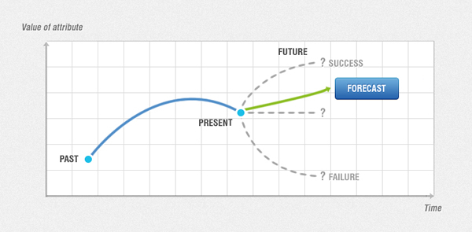
Forecasting Algorithm
What is Forecasting?

Slide 12
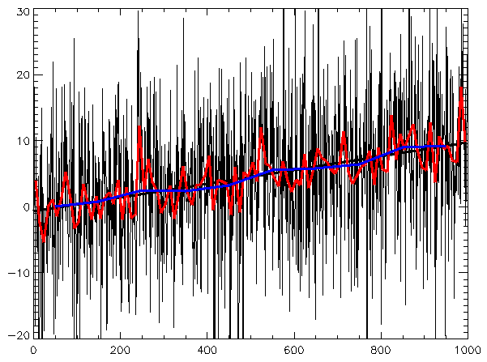
What is Time Series Analysis?
Time series analysis is the process of using statistical techniques to model and explain a time-dependent series of data points. Time series forecasting is the process of using a model to generate predictions (forecasts) for future events based on known past events. Time series data has a natural temporal ordering - this differs from typical data mining/machine learning applications where each data point is an independent example of the concept to be learned, and the ordering of data points within a data set does not matter. Examples of time series applications include capacity planning, inventory replenishment, sales forecasting and future staffing levels.

Slide 13
What is Regression?
Regression is a data mining function that predicts a number. Age, weight, distance, temperature, income, or sales could all be predicted using regression techniques. For example, a regression model could be used to predict children's height, given their age, weight, and other factors.
Regression modeling has many applications in trend analysis, business planning, marketing, financial forecasting, time series prediction, biomedical and drug response modeling, and environmental modeling.
Common Applications of Regression
Regression modeling has many applications in trend analysis, business planning, marketing, financial forecasting, time series prediction, biomedical and drug response modeling, and environmental modeling.

Slide 14
Testing a Regression Model
The Root Mean Squared Error and the Mean Absolute Error are statistics for evaluating the overall quality of a regression model.
Root Mean Squared Error
The Root Mean Squared Error (RMSE) is the square root of the average squared distance of a data point from the fitted line.
Mean Absolute Error
The Mean Absolute Error (MAE) is the average of the absolute value of the residuals. The MAE is very similar to the RMSE but is less sensitive to large errors.
The relative measures give an indication of how the well forecaster's predictions are doing compared to just using the last known target value as the prediction. They are expressed as a percentage, and lower values indicate that the forecasted values are better predictions than just using the last known target value. A score of >=100 indicates that the forecaster is doing no better (or even worse) than predicting the last known target value. Note that the last known target value is relative to the step at which the forecast is being made - e.g. a 12-step-ahead prediction is compared relative to using the target value 12 time steps prior as the prediction (since this is the last "known" actual target value).

Slide 15
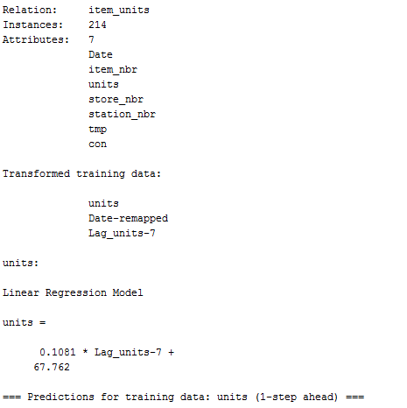
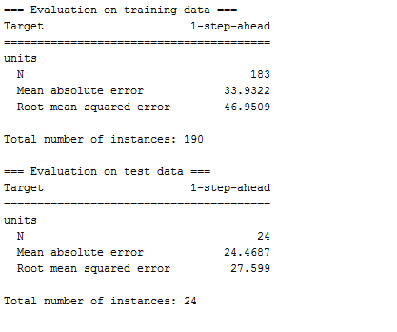
Regression Result For One Step Monthly

Slide 16
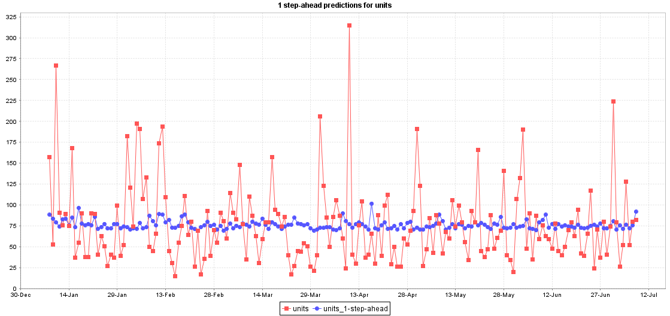
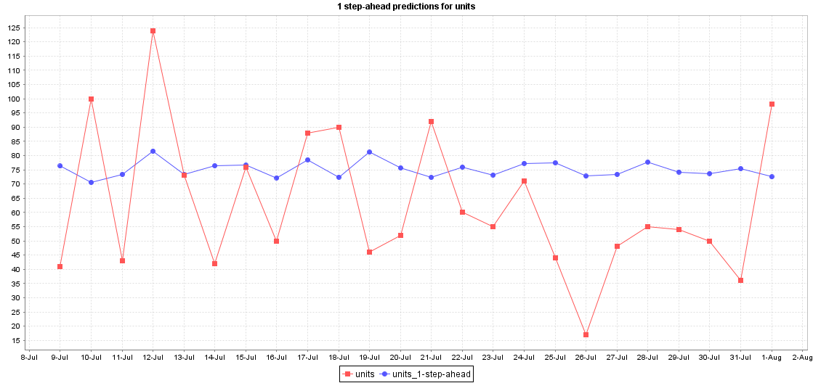
Regression Graph For One Step Monthly Train and Test Prediction

Slide 17
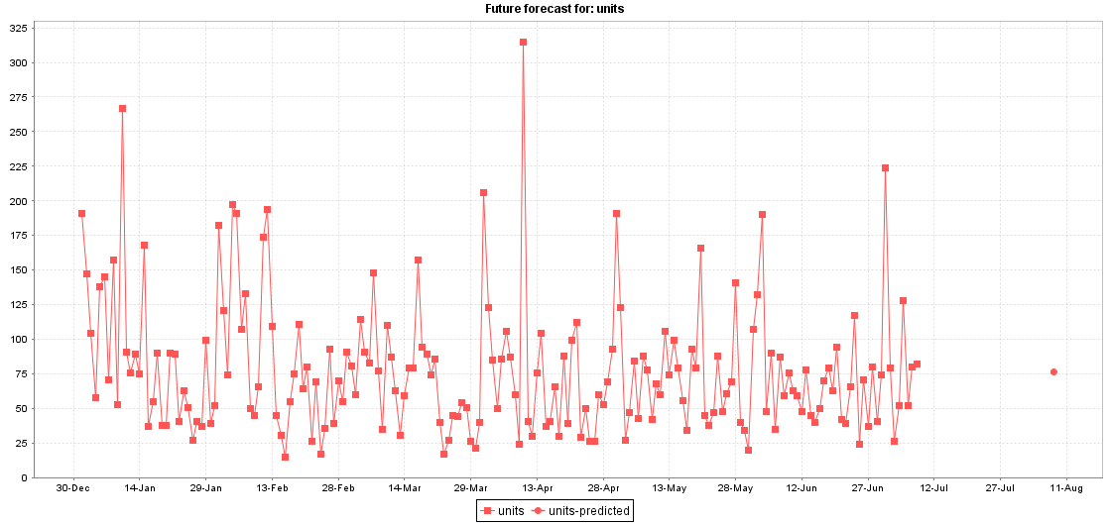
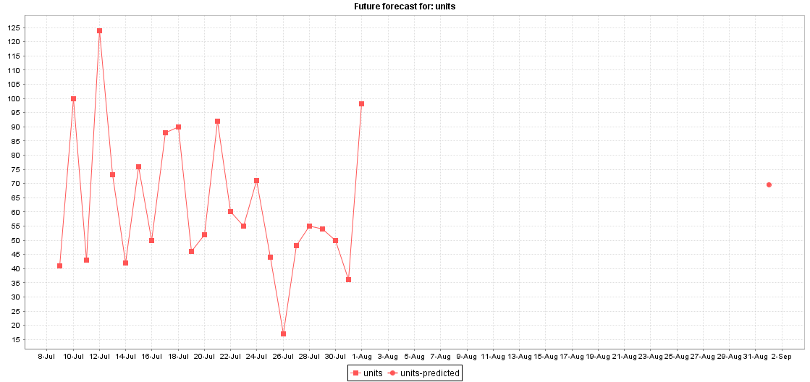
Regression Graph For One Step Monthly Train and Test for Future Prediction

Slide 18
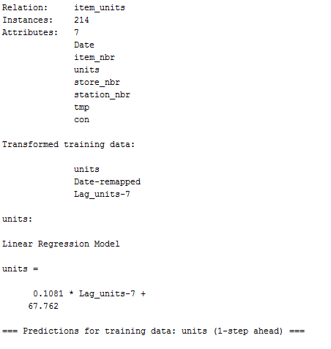
Regression Result For Seven Step Monthly

Slide 19
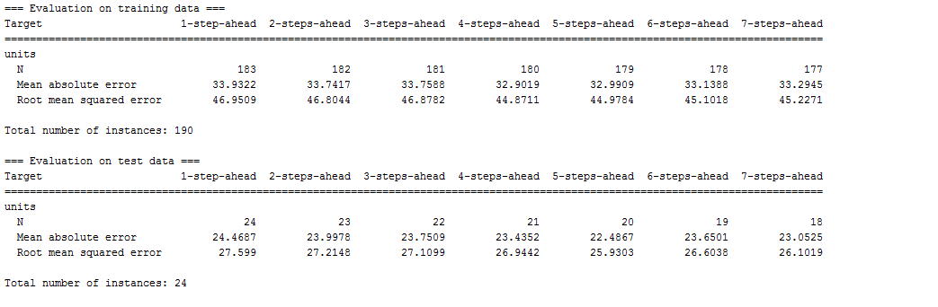
Regression Result For Seven Step Monthly

Slide 20
Regression Result For Seven Step Monthly Train and Test Predict at Steps

Slide 21
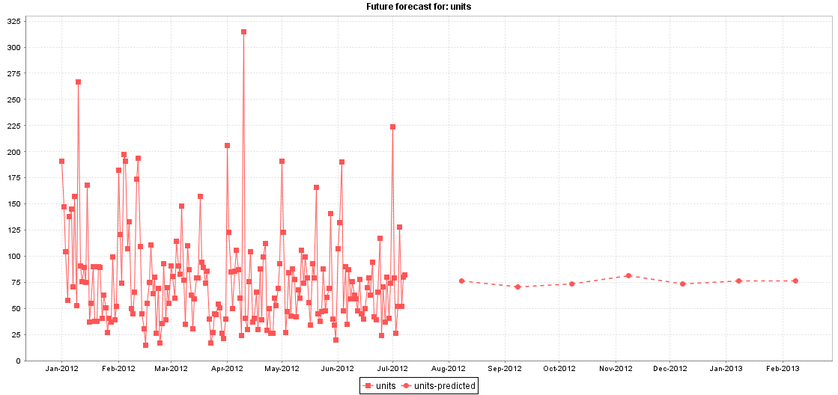
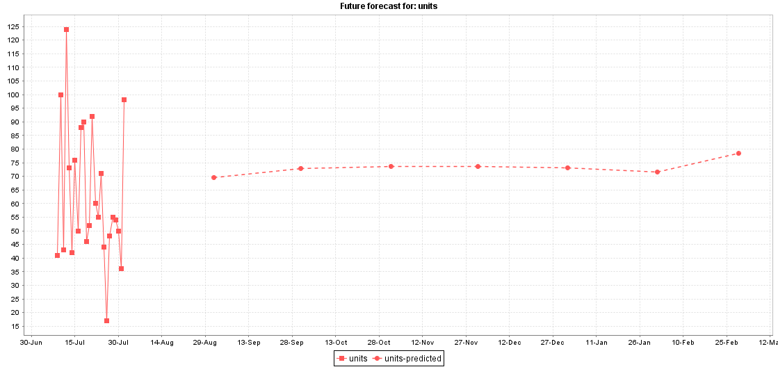
Regression Result For Seven Step Monthly Train and Test Predict at Steps

Slide 22
Regression Result For Seven Step Weekly Train and Test Predict at Steps

Slide 23
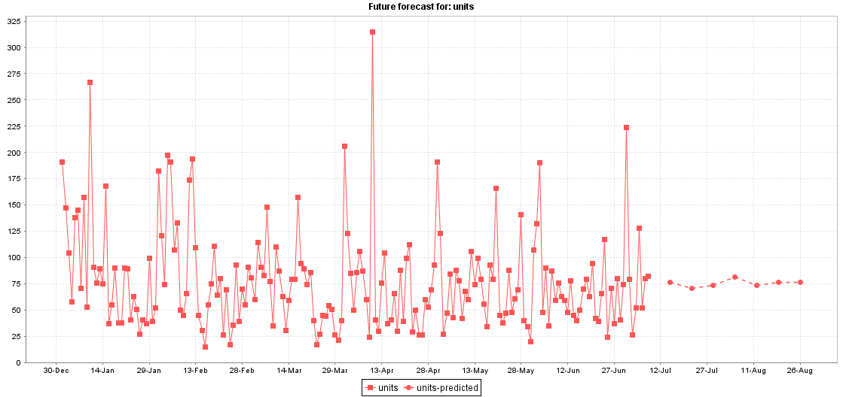
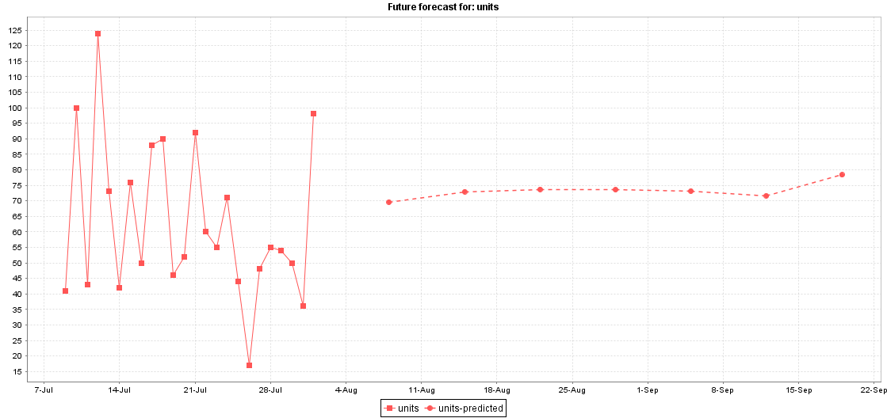
Regression Result For Seven Step Weekly Train and Test Future Predict

Slide 24
So Here is Our Final Equation….
units = 0.1081 * Lag_units-7 + 67.762
Here,
Lagged variables are the main mechanism by which the relationship between past and current values of a series can be captured by propositional learning algorithms.

