Slide 1









MARS
A Brief Introduction
Computer Organization

Slide 2








Outline
Download and Install
The Interface of MARS
MIPS assembly instructions
System calls
A Simple Example

Slide 3
Download and Install MARS
Where to download
https://courses.missouristate.edu/KenVollmar/mars/MARS_4_5_Aug2014/Mars4_5.jar
We use MARS as our MIPS simulator
Cross-platform: Linux, Mac OS X, or Windows

Slide 4
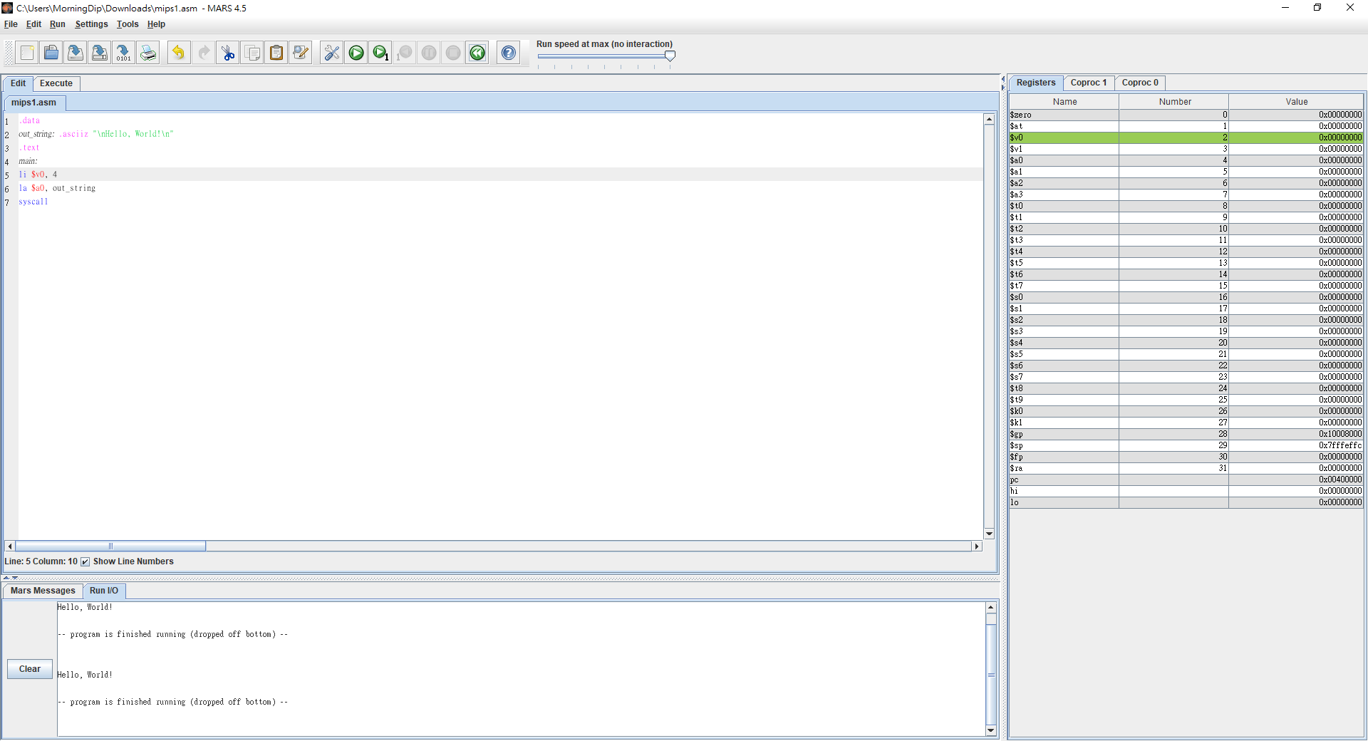






Interface of MARS
Text
Messages
Registers

Slide 5
Window Interface
Registers
Display all the values stored in the available registers of a
MIPS CPU
Text
Show instructions and addresses
Including system subroutine and the code
Messages
Show messages (including error messages)

Slide 6
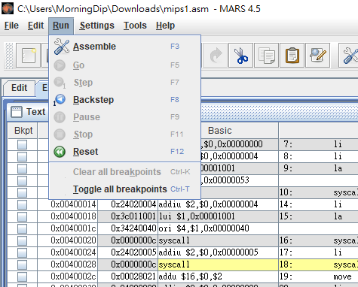
Simulator Functions

Slide 7
Basic MIPS Instruction Set
MIPS instructions
Name
MIPS instructions
Name
Add
add
Jump
j
Subtract
sub
Jump register
jr
Add immediately
addi
Jump and link
jal
Load word
lw
Move
move
Store word
sw
Multiply
mult
Load byte
lb
Multiply immediately
multi
Store byte
sb
Load immediately
li
Load upper immediately
lui
Branch less than
blt
Branch on equal
beq
Branch less than or equal ble
Branch on not equal
bne
Branch greater than
bgt
Set less than
slt
Branch greater than or equal
bge
Set less than immediately
slti

Slide 8
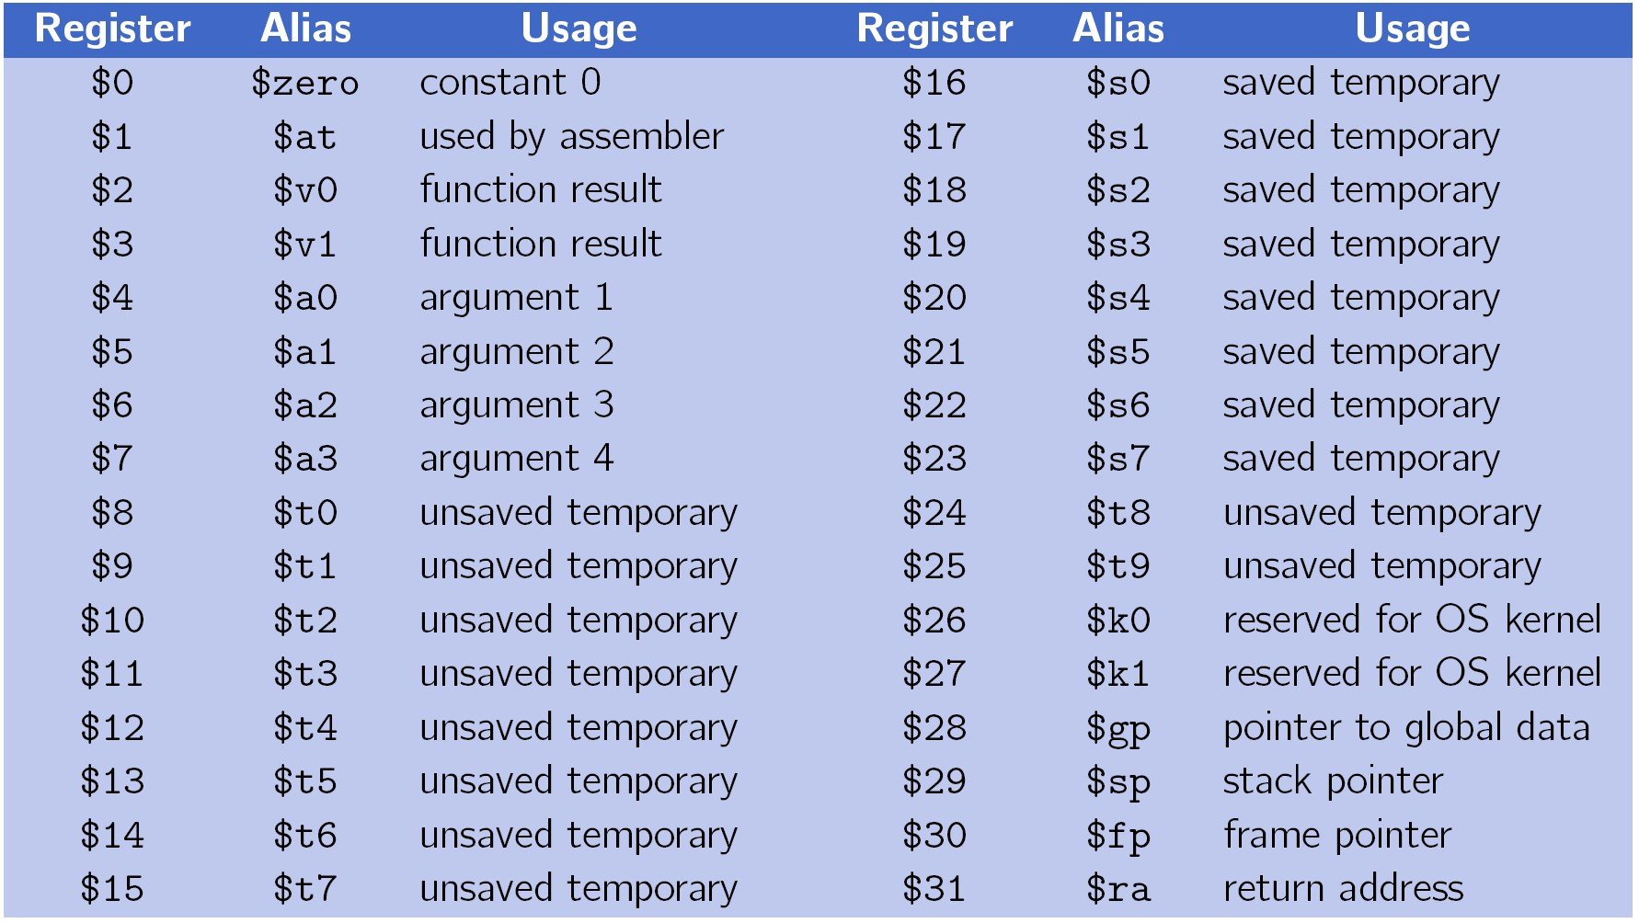
MIPS Register Table

Slide 9
MIPS Register Table
Type | Name | Number | Usage
Assembler related | $at | $1 | Preserved for assembler
OS related | $k0 - $k1 | $26 - $27 | Preserved for OS
Procedure call | $v0 - $v1 $a0 - $a3 $ra | $2 - $3 $4 - $7 $31 | Values for results Arguments Return address
Memory management | $gp $sp $fp | $28 $29 $30 | Global pointer Stack pointer Frame pointer
Variables / constants | $s0 - $s7 $t0 - $t7 $t8 - $t9 $zero | $16 - $23 $8 - $15 $24 - $25 $0 | Saved Temporaries More temporaries The constant value 0

Slide 10


System Services Table (part)
Service | System Call Code | Arguments | Result
print_int | 1 | $a0 = integer
print_float | 2 | $f12 = float
print_double | 3 | $f12 = double
print_string | 4 | $a0 = string
read_int | 5 |  | integer (in $v0)
read_float | 6 |  | float (in $f0)
read_double | 7 |  | double (in $f0)
read_string | 8 | $a0 = buffer, $a1 = length
sbrk | 9 | $a0 = amount | address (in $v0)
exit | 10
print_character | 11 | $a0 = character
read_character | 12 |  | character (in $v0)

Slide 11
System Call
Example
– Read an integer (user input)
li $v0, 5
syscall
– Print a string
#assign a system call type
#execute system call
# assume that ‘msg’ represents a string
li $v0, | 4 | # | system call code for print_str
la $a0, | msg | # | load address of ‘msg’ into $a0
syscall |  | # | print the string

Slide 12
Data Types
Data Types
.word, .half - 32/16 bits integer
.byte - 8 bits integer (similar to ‘char’ type in C)
.ascii and .asciiz - string (asciiz is null-terminated)
.asciiz is preferable (for C-based machines)
Strings are enclosed in double-quotas(”)
Special characters in strings follow the C conventions
– newline(\n), tab(\t), quote(\”)
.double, .float - floating point

Slide 13
MIPS Assembler Directives
Other Directives
.text - Indicates that following items are stored in
the user text segment
Code zone!
.data - Indicates that following data items are
stored in the data segment

Slide 14
MIPS Assembly Layout
Program layout
.text # code section main: # user program code
.data # data section Label_1: .data_type list_of_data # data loc + data type + data
.text # code section Label_2: # function label # user functions

Slide 15
Example for data
Initialize data
.data
i: .word 10 # initialize a word
a: .word 0, 0, 0 # initialize an array
b: .word 0:3 # the same as array1
.text
lw $t0, i

Slide 16
Call Function (jal)
Call function
main: # main function
… # code
jal function_label # call a function
…
function_label:
… # code
jr $ra # back to main

Slide 17
Call Function (bne , beq…)
Call function
main: # main function
… # code
beq $s0,$zero function_label
# call a function if $s0 = 0
…
function_label:
… # code
jr $ra # back to main

Slide 18
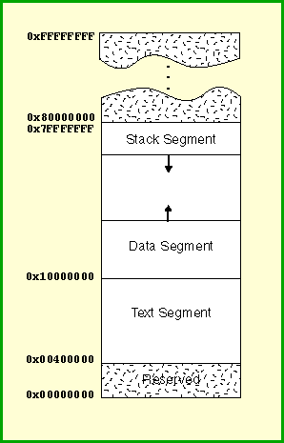
The Stack
The stack grows from high addresses to low addresses
Stack Pointer ($sp)

Slide 19
The Stack
push: addi $sp, $sp, -4
# Decrement stack pointer by 4
sw $t0, 0($sp)
# Save $t0 to stack
pop: lw $t0, 0($sp)
# Copy from stack to $t0
addi $sp, $sp, 4
# Increment stack pointer by 4

Slide 20

Demo

Slide 21

Thank you for your attention

