Slide 1
演算法期中考檢討
2019/04/16

Slide 2
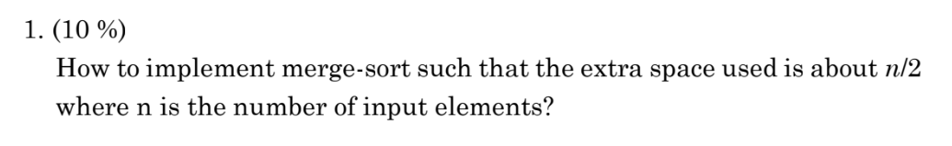

Slide 3

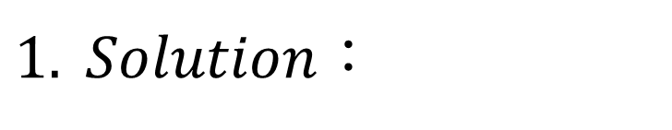
$1. Solution$：
$左邊那塊$塞到額外空間，從左邊開始做Merge

Slide 4
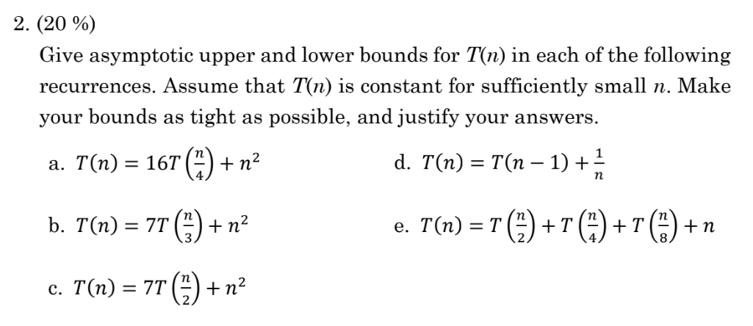

Slide 5
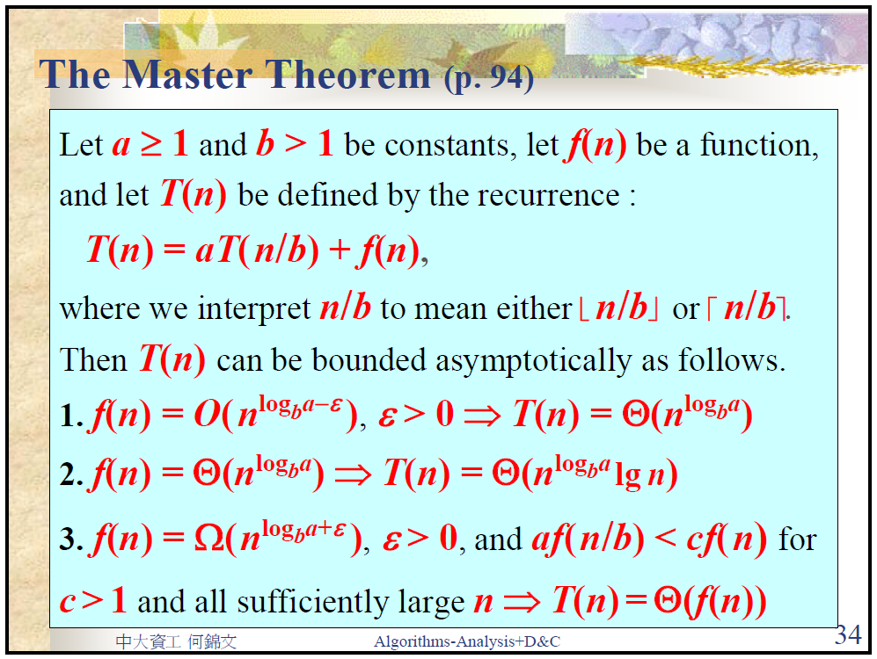

Slide 6
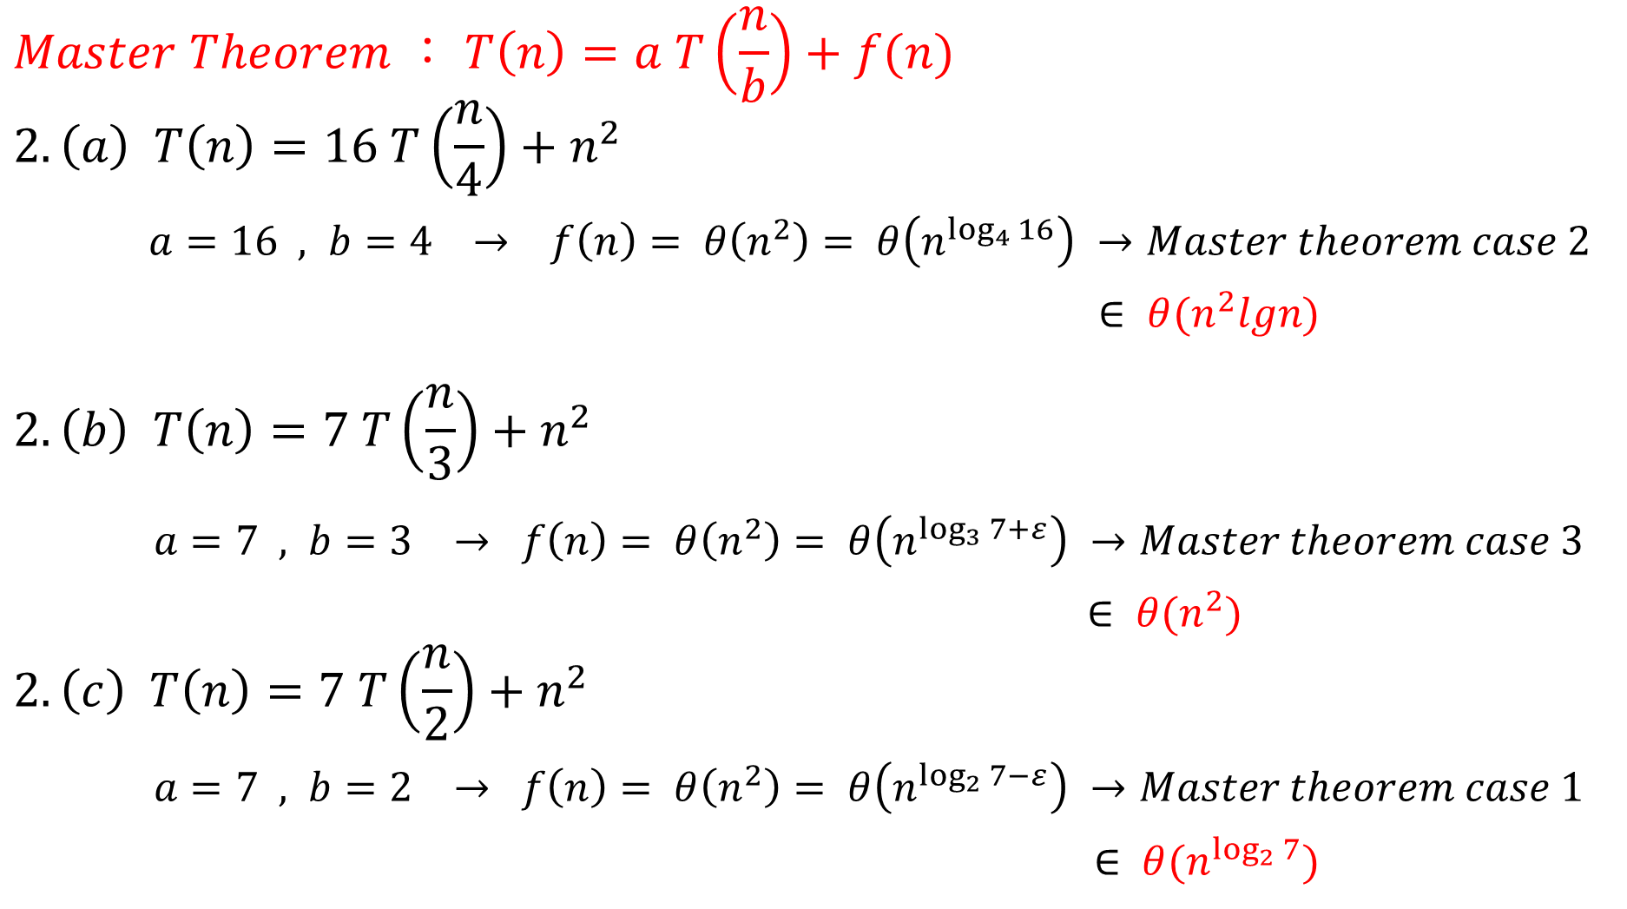
$$Master Theorem ： T\left(n\right)=a T\left(\frac{n}{b}\right)+f(n)$$
$$2.\left(a\right) T\left(n\right)=16 T\left(\frac{n}{4}\right)+n^{2}$$
$a=16 , b=4 → f\left(n\right)= θ\left(n^{2}\right)= θ\left(n^{\log_{4}{16}}\right) →Master theorem case 2$
$∈ θ(n^{2}lgn)$
$$2.\left(b\right) T\left(n\right)=7 T\left(\frac{n}{3}\right)+n^{2}$$
$a=7 , b=3 → f\left(n\right)= θ\left(n^{2}\right)= θ\left(n^{\log_{3}{7}+ε}\right) →Master theorem case 3$
$∈ θ(n^{2})$
$$2.\left(c\right) T\left(n\right)=7 T\left(\frac{n}{2}\right)+n^{2}$$
$a=7 , b=2 → f\left(n\right)= θ\left(n^{2}\right)= θ\left(n^{\log_{2}{7}−ε}\right) →Master theorem case 1$
$∈ θ(n^{\log_{2}{7}})$

Slide 7
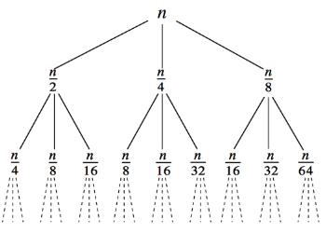
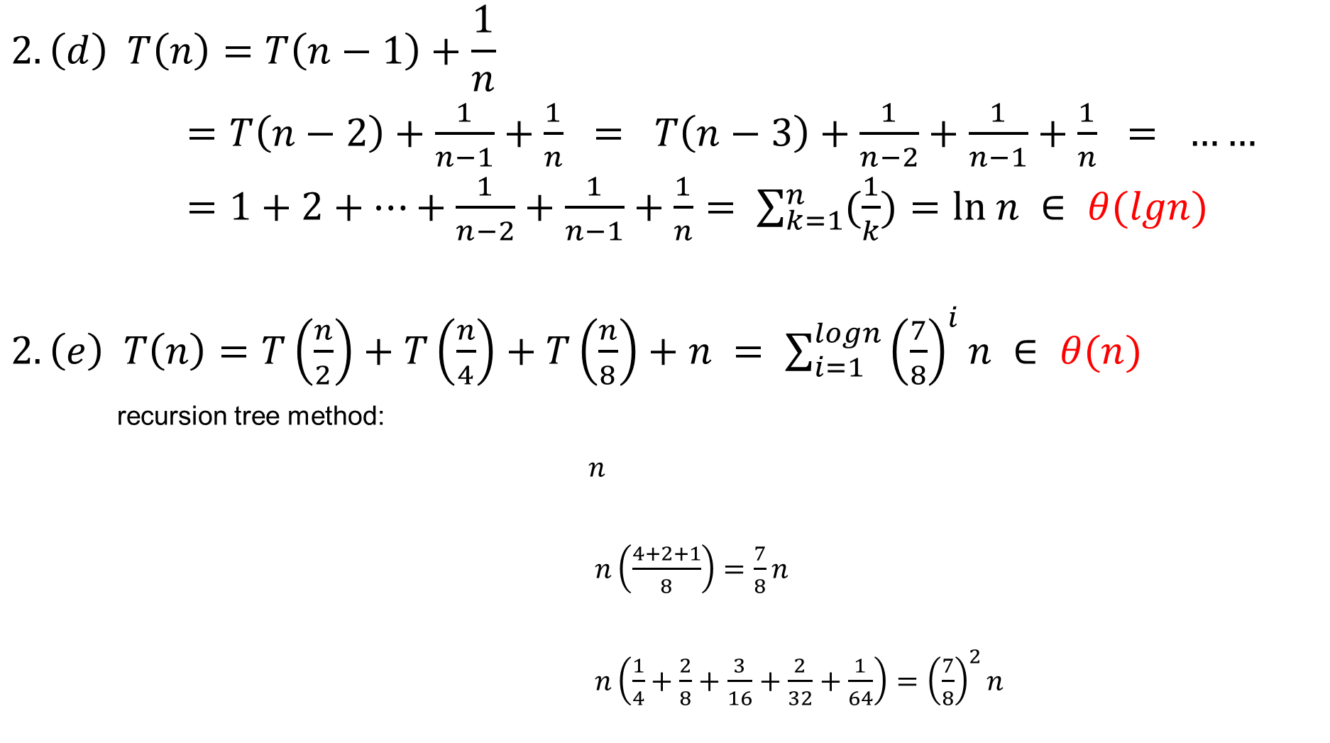
$$2.\left(d\right) T\left(n\right)=T\left(n−1\right)+\frac{1}{n}$$
$=T\left(n−2\right)+\frac{1}{n−1}+\frac{1}{n} = T\left(n−3\right)+\frac{1}{n−2}+\frac{1}{n−1}+\frac{1}{n} = ……$
$=1+2+…+\frac{1}{n−2}+\frac{1}{n−1}+\frac{1}{n}= \sum_{k=1}^{n}{(\frac{1}{k})=ln n ∈ θ(lgn)}$
$2. \left(e\right) T\left(n\right)=T\left(\frac{n}{2}\right)+T\left(\frac{n}{4}\right)+T\left(\frac{n}{8}\right)+n = \sum_{i=1}^{logn}{{\left(\frac{7}{8}\right)}^{i}n ∈ θ(n)}$
recursion tree method:
$n$
$n\left(\frac{4+2+1}{8}\right)=\frac{7}{8}n$
$n\left(\frac{1}{4}+\frac{2}{8}+\frac{3}{16}+\frac{2}{32}+\frac{1}{64}\right)={\left(\frac{7}{8}\right)}^{2}n$

Slide 8
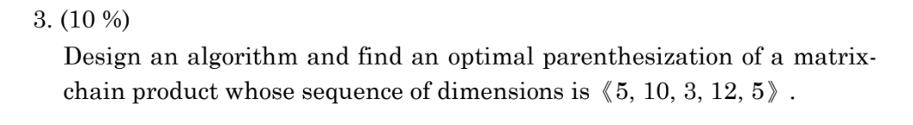
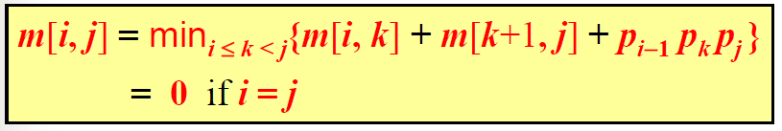

Slide 9
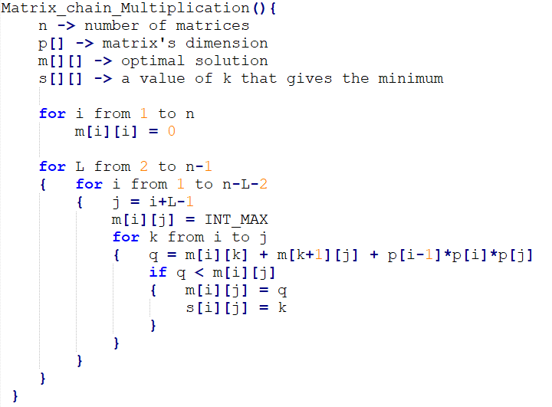


$3. Pseudo code$：
$$Time complexity=O(n^{3})$$

Slide 10






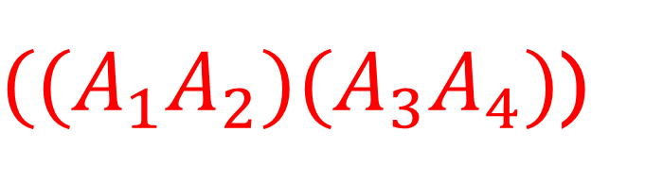


$3. Answer$：
$((A_{1}A_{2})(A_{3}A_{4})$)
m[][] | 1 | 2 | 3 | 4
1 | 0 | 150 | 330 | 405
2 |  | 0 | 360 | 330
3 |  |  | 0 | 180
4 |  |  |  | 0
s[][] | 1 | 2 | 3 | 4
1 |  | 1 | 2 | 2
2 |  |  | 2 | 2
3 |  |  |  | 3
4
$$[1,4]$$
$$[1,2]$$
$$[3,4]$$
$$A_{1}$$
$$A_{2}$$
$$A_{3}$$
$$A_{4}$$

Slide 11
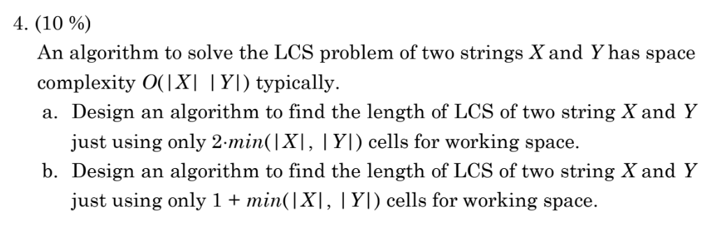

Slide 12
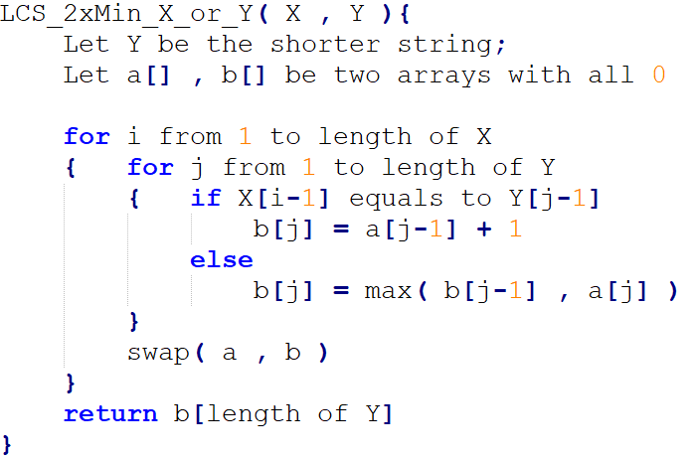

$$4.(a) 2∗\min\left(\left|X\right|,\left|Y\right|\right)$$
$pseudo code$：
j-1 j
a
b
$$Time complexity=O(m∗n)$$

Slide 13
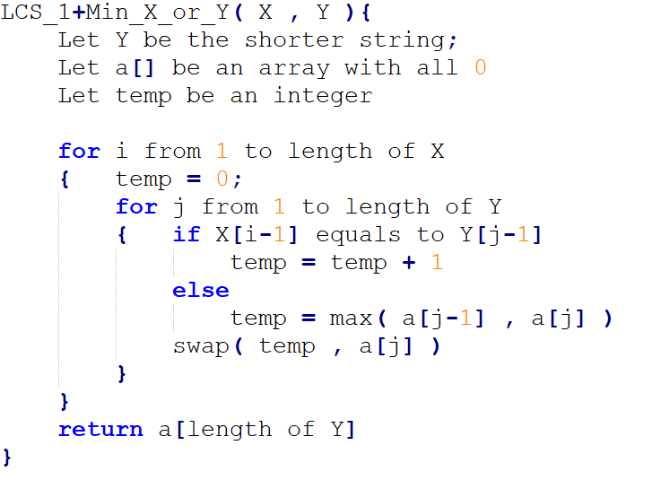

$$4. (b) 1+\min\left(\left|X\right|,\left|Y\right|\right)$$
$pseudo code$：
$$Time complexity=O(m∗n)$$
temp
j-1 j
a
j
a
a[j] = temp+1
X
O
j
a
temp

Slide 14

$$4. (b) Continue$$
j
a
temp
j-1 j
a
temp
temp
j
a

Slide 15
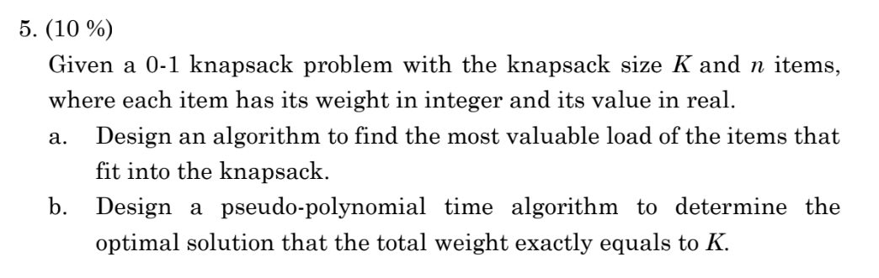

Slide 16
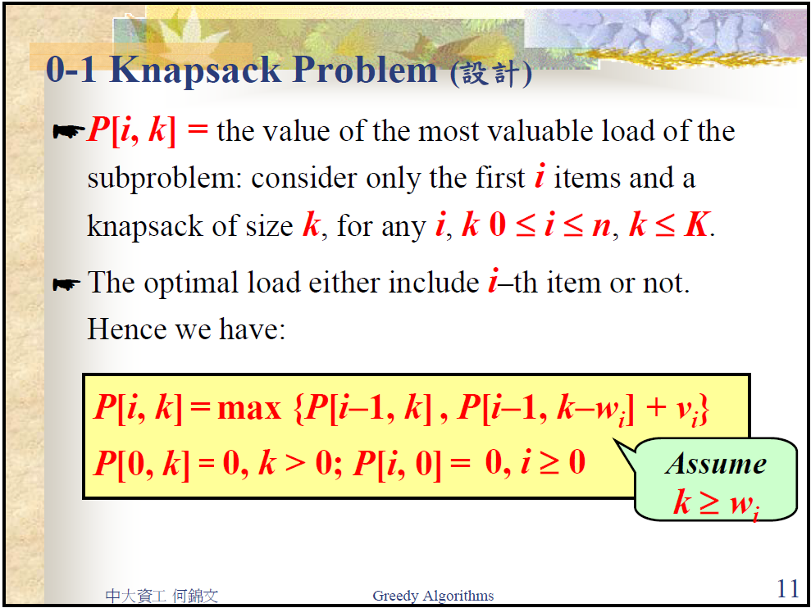
$$5. \left(a\right) 遞迴式 −找出最佳解$$

Slide 17
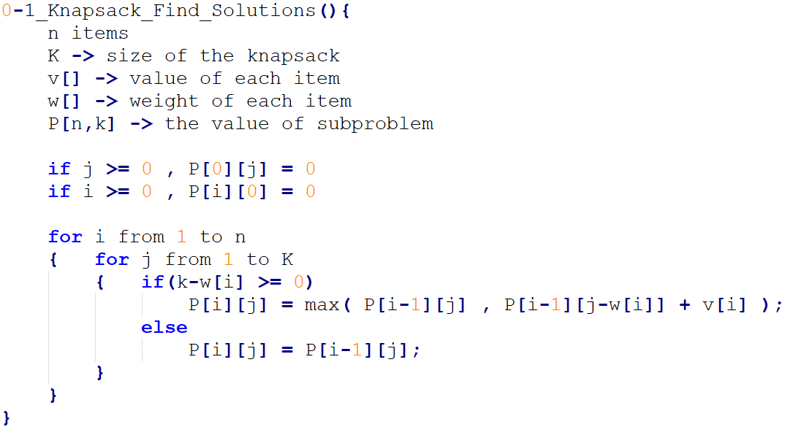
$$5. \left(a\right) pseudo code (Part 1. 填表格)$$

Slide 18
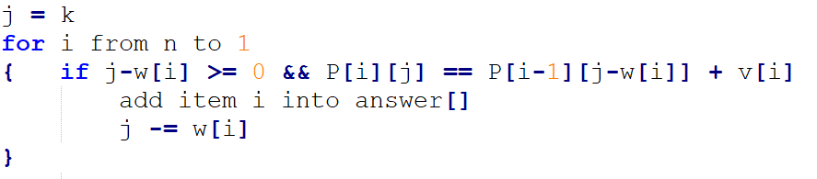
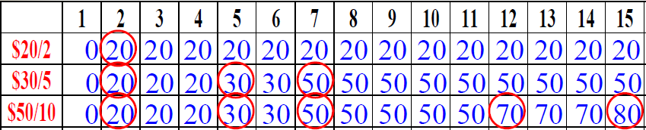
$5. \left(a\right) pseudo code$($Part 2.\text{根據表格找拿了哪些物品}$)
$$Time complexity=O(nK)$$
$$The items are \$30/5 and \$50/10$$

Slide 19
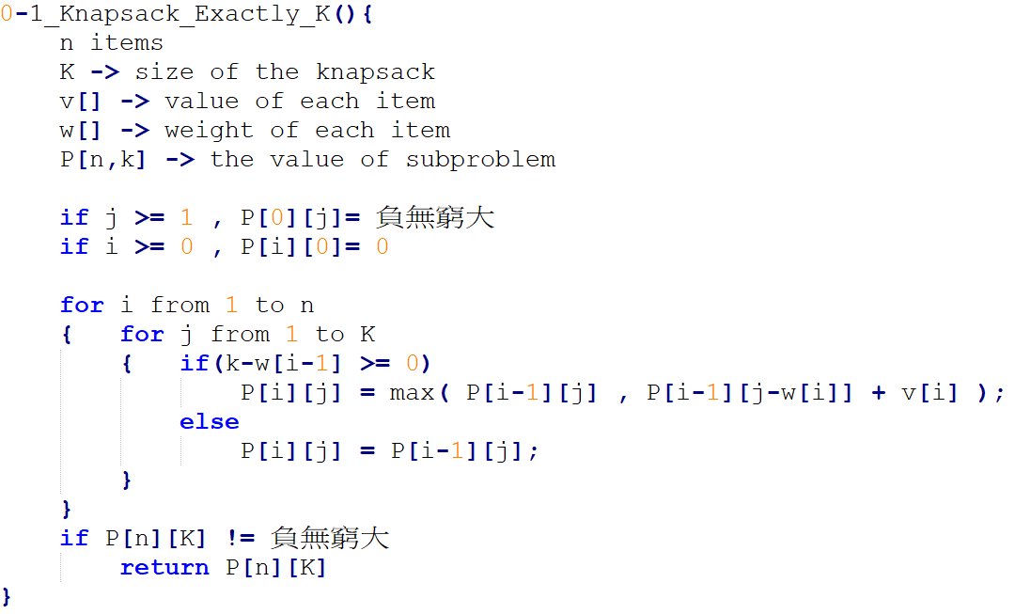
$$5. \left(b\right) pseudo code$$
$$Time complexity=O(nK)$$

Slide 20
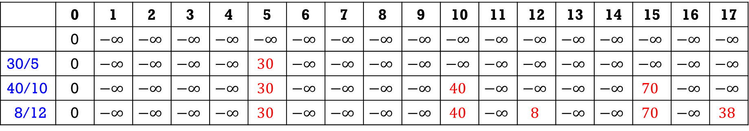
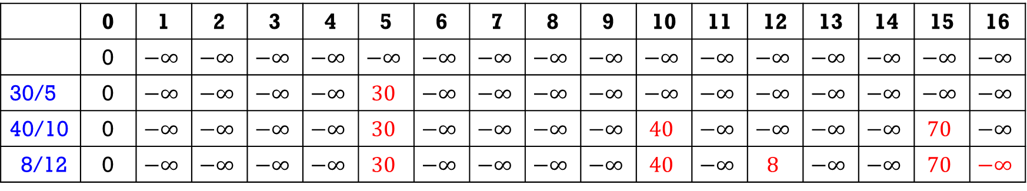
$$5. \left(b\right) examples$$
 | 0 | 1 | 2 | 3 | 4 | 5 | 6 | 7 | 8 | 9 | 10 | 11 | 12 | 13 | 14 | 15 | 16 | 17
 | 0 | $$−∞$$ | $$−∞$$ | $$−∞$$ | $$−∞$$ | $$−∞$$ | $$−∞$$ | $$−∞$$ | $$−∞$$ | $$−∞$$ | $$−∞$$ | $$−∞$$ | $$−∞$$ | $$−∞$$ | $$−∞$$ | $$−∞$$ | $$−∞$$ | $$−∞$$
30/5 | 0 | $$−∞$$ | $$−∞$$ | $$−∞$$ | $$−∞$$ | $$30$$ | $$−∞$$ | $$−∞$$ | $$−∞$$ | $$−∞$$ | $$−∞$$ | $$−∞$$ | $$−∞$$ | $$−∞$$ | $$−∞$$ | $$−∞$$ | $$−∞$$ | $$−∞$$
40/10 | 0 | $$−∞$$ | $$−∞$$ | $$−∞$$ | $$−∞$$ | $$30$$ | $$−∞$$ | $$−∞$$ | $$−∞$$ | $$−∞$$ | $$40$$ | $$−∞$$ | $$−∞$$ | $$−∞$$ | $$−∞$$ | $$70$$ | $$−∞$$ | $$−∞$$
8/12 | 0 | $$−∞$$ | $$−∞$$ | $$−∞$$ | $$−∞$$ | $$30$$ | $$−∞$$ | $$−∞$$ | $$−∞$$ | $$−∞$$ | $$40$$ | $$−∞$$ | $$8$$ | $$−∞$$ | $$−∞$$ | $$70$$ | $$−∞$$ | $$38$$
Optimal solution equals to K is 38
 | 0 | 1 | 2 | 3 | 4 | 5 | 6 | 7 | 8 | 9 | 10 | 11 | 12 | 13 | 14 | 15 | 16
 | 0 | $$−∞$$ | $$−∞$$ | $$−∞$$ | $$−∞$$ | $$−∞$$ | $$−∞$$ | $$−∞$$ | $$−∞$$ | $$−∞$$ | $$−∞$$ | $$−∞$$ | $$−∞$$ | $$−∞$$ | $$−∞$$ | $$−∞$$ | $$−∞$$
30/5 | 0 | $$−∞$$ | $$−∞$$ | $$−∞$$ | $$−∞$$ | $$30$$ | $$−∞$$ | $$−∞$$ | $$−∞$$ | $$−∞$$ | $$−∞$$ | $$−∞$$ | $$−∞$$ | $$−∞$$ | $$−∞$$ | $$−∞$$ | $$−∞$$
40/10 | 0 | $$−∞$$ | $$−∞$$ | $$−∞$$ | $$−∞$$ | $$30$$ | $$−∞$$ | $$−∞$$ | $$−∞$$ | $$−∞$$ | $$40$$ | $$−∞$$ | $$−∞$$ | $$−∞$$ | $$−∞$$ | $$70$$ | $$−∞$$
8/12 | 0 | $$−∞$$ | $$−∞$$ | $$−∞$$ | $$−∞$$ | $$30$$ | $$−∞$$ | $$−∞$$ | $$−∞$$ | $$−∞$$ | $$40$$ | $$−∞$$ | $$8$$ | $$−∞$$ | $$−∞$$ | $$70$$ | $$−∞$$
No solution

Slide 21
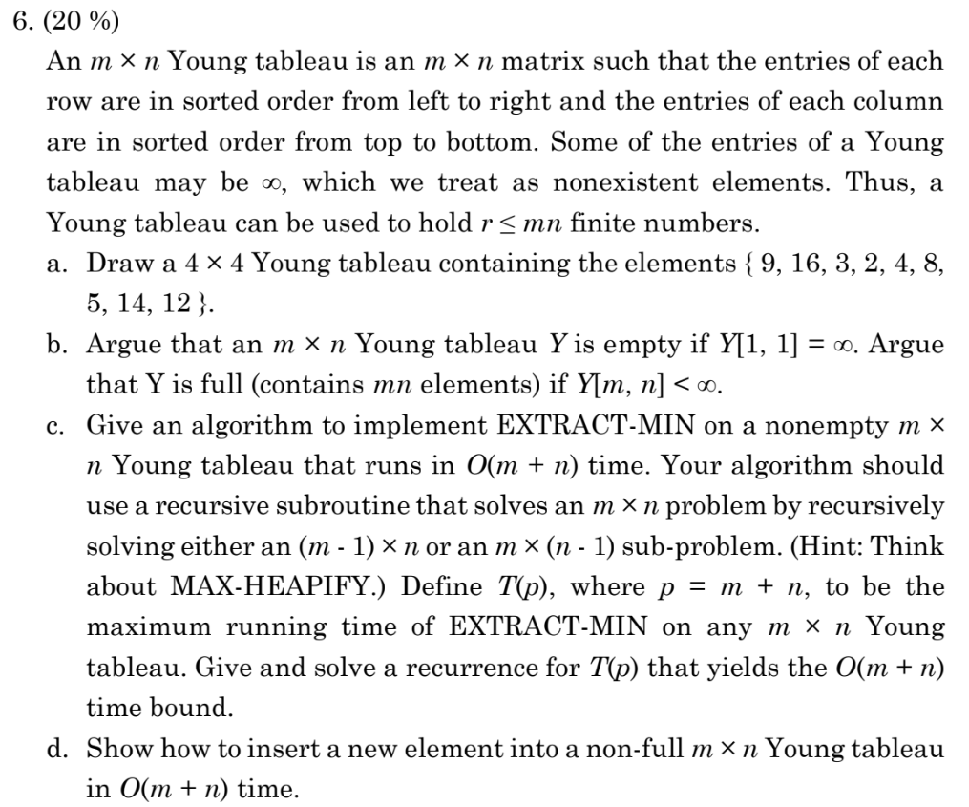

Slide 22
6-a. (4%)
2 | 3 | 4 | ∞
5 | 8 | 9 | ∞
12 | 14 | 16 | ∞
∞ | ∞ | ∞ | ∞

Slide 23
6-B. (4%)
若Y[1, 1]為∞，根據規則第一列、第一行都∞，故可推斷所有elements皆為∞，所以Y為空.
若Y[m, n] < ∞，根據規則第m列、第n行都小於∞，故可推斷所有elements皆小於∞，所以Y為滿.

Slide 24
6-c-1. (4%)
EXTRACT-MIN()
min = Y[1, 1];
Y[1, 1] = ∞;
i = j = 1;
while ( i <= m and j <= n and ( Y[i+1, j] < Y[i, j] or Y[i, j+1] < Y[i, j] ) )
if Y[i+1, j] < Y[i, j+1]
swap(Y[i+1, j], Y[i, j]);
i++;
else
swap(Y[i, j+1], Y[i, j]);
j++;
return min;

Slide 25
6-c. (4%)
T(p)=T(p−1)+O(1)
=T(p−2)+O(1)+O(1)
=…
=O(p) = O(m+n)

Slide 26
6-d. (4%)
INSERT (value)
Y[m, n] = value;
i = m;
j = n;
while ( i >= 1 and j >= 1 and ( Y[i-1, j] > Y[i, j] or Y[i, j-1] > Y[i, j] ) )
if Y[i-1, j] > Y[i, j-1]
swap(Y[i-1, j], Y[i, j]);
i--;
else
swap(Y[i, j-1], Y[i, j]);
j--;

Slide 28
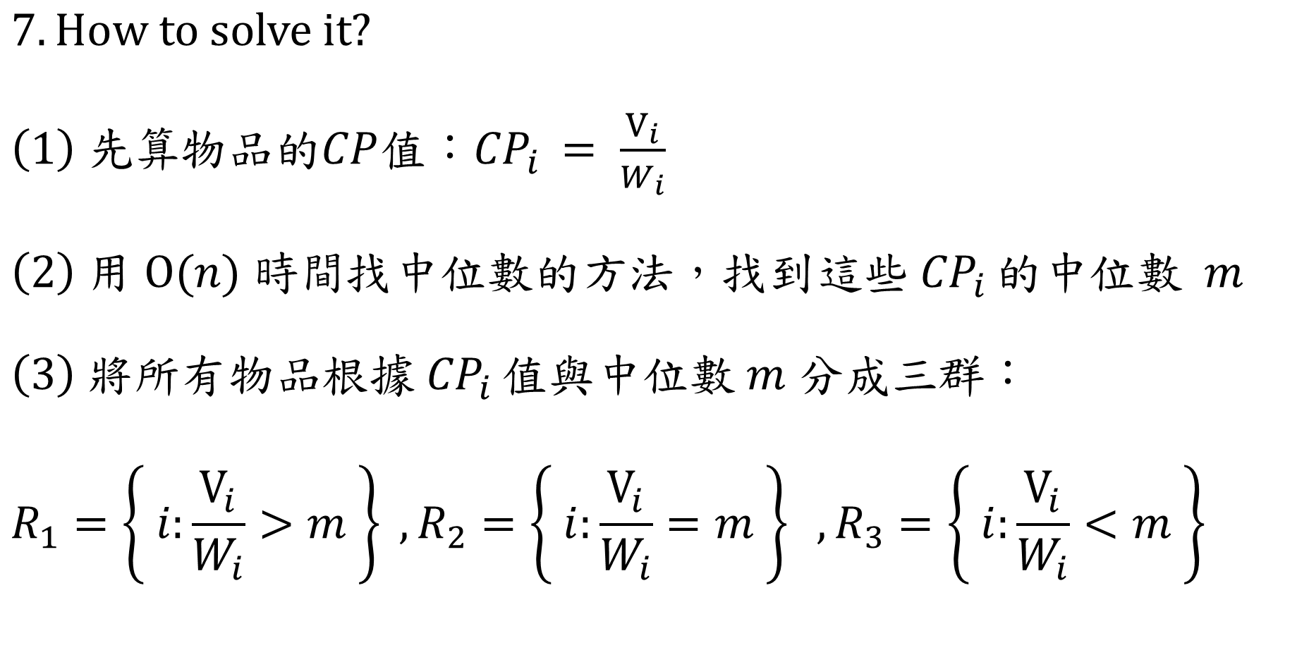
$$7. How to solve it?$$
$\left(1\right) 先算$物品的$CP$值：${CP}_{i }= \frac{V_{i}}{W_{i}}$
$\left(2\right) 用 O(n) 時間找中位數的方法$，找到這些${ CP}_{i }的中位數 m$
$\left(3\right) 將所有物品根據{ CP}_{i }值與中位數 m 分成三群$：
$$R_{1}=\left\{ i:\frac{V_{i}}{W_{i}}>m \right\} ,R_{2}=\left\{ i:\frac{V_{i}}{W_{i}}=m \right\} ,R_{3}=\left\{ i:\frac{V_{i}}{W_{i}}<m \right\}$$

Slide 29
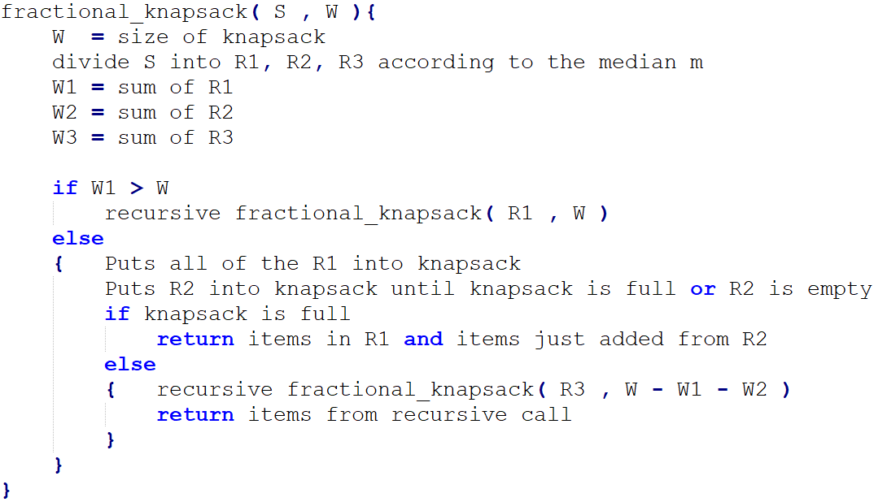

$7. pseudo code$：

Slide 30


$7. Time complexity$：
$\left(1\right) 用 O(n) 時間找中位數的方法$，找到這些${ CP}_{i }的中位數 m$
$$\left(2\right) 將所有物品根據{ CP}_{i }值與中位數 m 分成三群∈O(n)$$
$$\left(3\right) 放物品 T\left(n\right)=T\left(\frac{n}{2}\right)+O(n)$$
$$T\left(n\right)=T\left(\frac{n}{2}\right)+O\left(n\right)=Master theorem case 3 ∈ O(n)$$

Slide 31
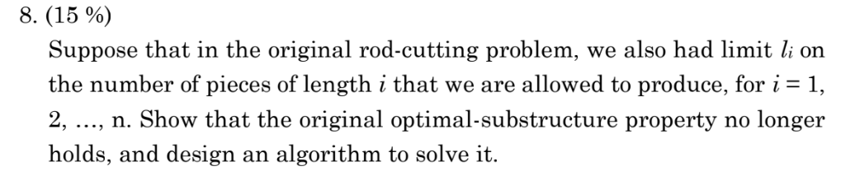

Slide 32
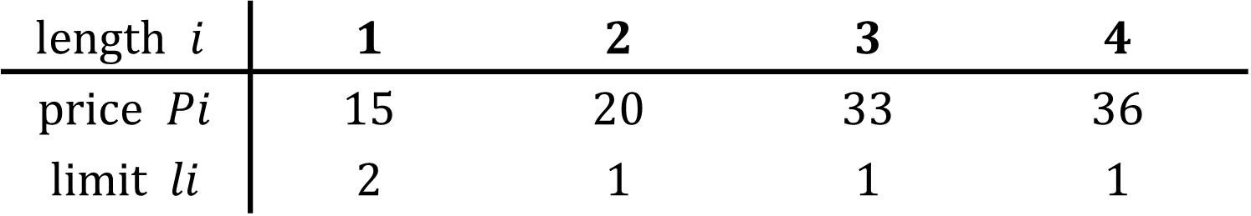
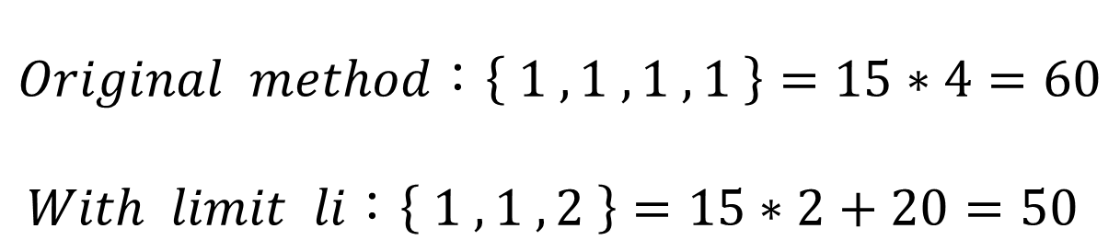
$$8. Show the counterexample$$
$$length i$$ | $$1$$ | $$2$$ | $$3$$ | $$4$$
$$price Pi$$ | $$15$$ | $$20$$ | $$33$$ | $$36$$
$$limit li$$ | $$2$$ | $$1$$ | $$1$$ | $$1$$
$$Original method：\left\{ 1 , 1 , 1 , 1 \right\}=15∗4=60$$
$With limit li：\left\{ 1 , 1 , 2 \right\}=15∗2+20=50$

Slide 33

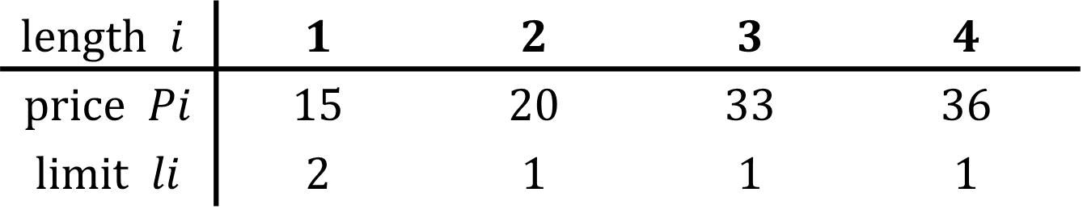





$$8. How to solve it?$$
$$length i$$ | $$1$$ | $$2$$ | $$3$$ | $$4$$
$$price Pi$$ | $$15$$ | $$20$$ | $$33$$ | $$36$$
$$limit li$$ | $$2$$ | $$1$$ | $$1$$ | $$1$$
$$15/1$$
$$The length of rod is n$$
$$15/1$$
有li的限制，表示最多只有sum of li根短棍子
可以去湊出長度為n的棍子
→ 剛好填滿背包的0-1背包問題!!
$$20/2$$
$$33/3$$
$$36/4$$

Slide 34
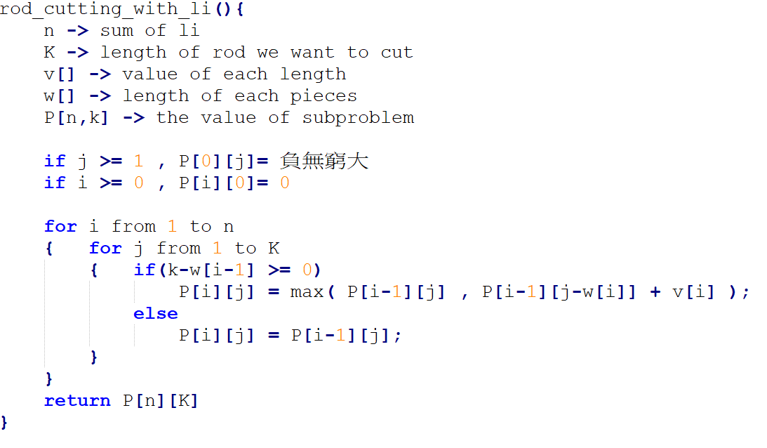
$$8. pseudo code (Like problem 5.b)$$

Slide 35
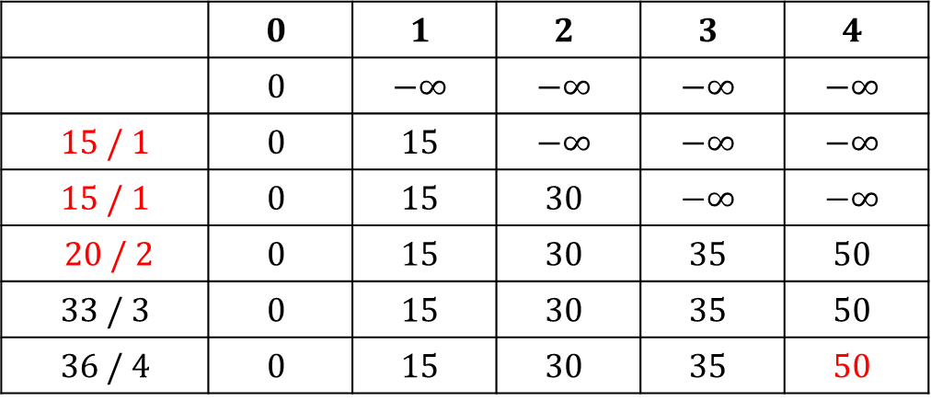
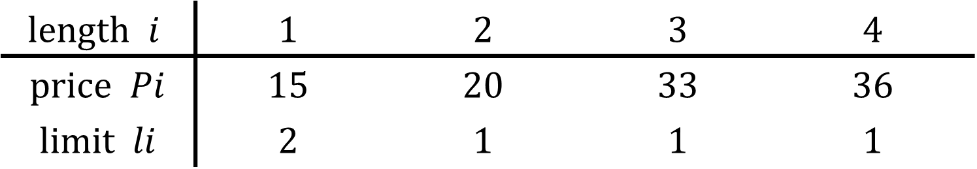
$$8. Solve the counterexample$$
$$length i$$ | $$1$$ | $$2$$ | $$3$$ | $$4$$
$$price Pi$$ | $$15$$ | $$20$$ | $$33$$ | $$36$$
$$limit li$$ | $$2$$ | $$1$$ | $$1$$ | $$1$$
 | $$0$$ | $$1$$ | $$2$$ | $$3$$ | $$4$$
 | $$0$$ | $$−∞$$ | $$−∞$$ | $$−∞$$ | $$−∞$$
$$15 / 1$$ | $$0$$ | $$15$$ | $$−∞$$ | $$−∞$$ | $$−∞$$
$$15 / 1$$ | $$0$$ | $$15$$ | $$30$$ | $$−∞$$ | $$−∞$$
$$20 / 2$$ | $$0$$ | $$15$$ | $$30$$ | $$35$$ | $$50$$
$$33 / 3$$ | $$0$$ | $$15$$ | $$30$$ | $$35$$ | $$50$$
$$36 / 4$$ | $$0$$ | $$15$$ | $$30$$ | $$35$$ | $$50$$

