Slide 1
Data Structures
Chapter 2 Arrays and Structures

Slide 2
Chapter 2 Arrays and Structures
The array as an Abstract Data Type
Structures and Unions
The polynomial Abstract Data Type
The Sparse Matrix Abstract Data Type
The Representation of Multidimensional Arrays

Slide 3
2.1 The array as an ADT (1/6)
Arrays
  Array: a set of pairs, <index, value>
  data structure
    For each index, there is a value associated with that index.
  representation (possible)
    Implemented by using consecutive memory.
    In mathematical terms, we call this a correspondence or a mapping.

Slide 4
2.1 The array as an ADT (2/6)
most languages provide only two standard operations for arrays,
    retrieves a value
    stores a value.

Slide 5
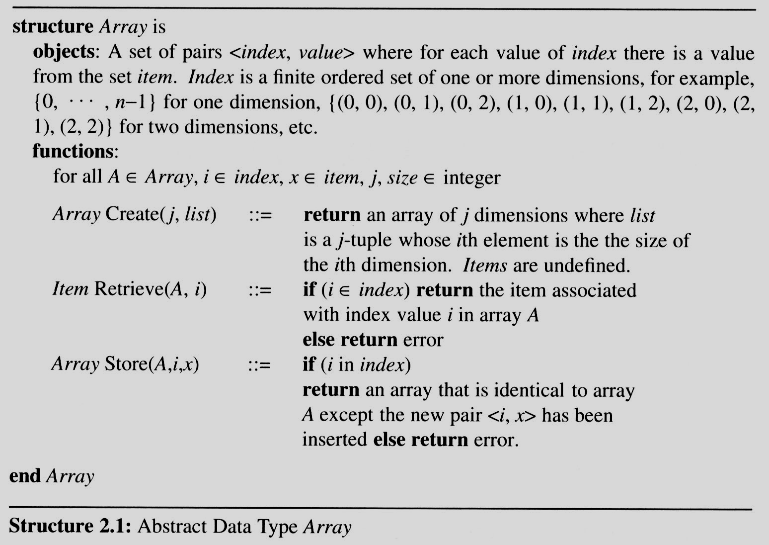
2.1 The array as an ADT (3/6)

Slide 6
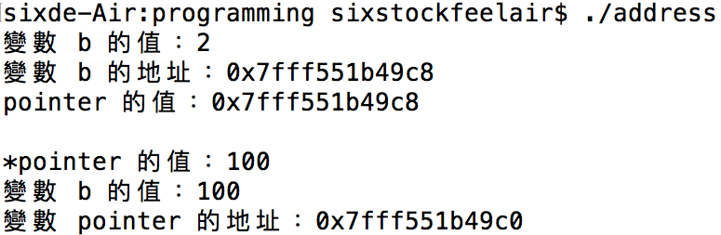
1 2 3 4 5 6 7 8 9 10 11 12 13 14 15 16 17 18 19 | #include <stdio.h> int main(void) { int b = 2; int* pointer = &b; printf("變數 b 的值：%d\n", b); printf("變數 b 的地址：%p\n", &b); printf("pointer 的值：%p\n", pointer); printf("\n"); //換行 *pointer = 100; printf("*pointer 的值：%d\n", *pointer); printf("變數 b 的值：%d\n", b); printf("變數 pointer 的地址：%p\n", &pointer); return 0; }執行這段程式碼的結果：
執行這段程式碼的結果：

Slide 7
2.1 The array as an ADT (4/6)
Arrays in C
  int list[5], *plist[5];
    list[5]: (five integers)
    list[0], list[1], list[2], list[3], list[4]
    *plist[5]: (five pointers to integers)
        plist[0], plist[1], plist[2], plist[3], plist[4]

Slide 8
2.1 The array as an ADT (4/6)
Arrays in C
  int list[5]
  implementation of 1-D array
  list[0] base address = α
  list[1] α + sizeof(int)
  list[2] α + 2*sizeof(int)
  list[3] α + 3*sizeof(int)
  list[4] α + 4*sizeof(int)

Slide 9
2.1 The array as an ADT (5/6)
Arrays in C (cont’d)
  Compare int *list1 and int list2[5] in C.
  Same: list1 and list2 are pointers.
  Difference: list2 reserves five locations.

Slide 10
2.1 The array as an ADT (5/6)
Arrays in C (cont’d)
  Compare int *list1 and int list2[5] in C.
  Same: list1 and list2 are pointers.
  Difference: list2 reserves five locations.
  Notations:
  list2 － a pointer to list2[0]
  (list2 + i) － a pointer to list2[i] (&list2[i])
  *(list2 + i) － list2[i]

Slide 11
2.1 The array (6/6)
Example:
1-dimension array addressing
  int one[] = {0, 1, 2, 3, 4};
  print1(one, 5);
  void print1(int *ptr, int rows) {
  int i;
  printf(“Address Contents\n”);
  for (i=0; i < rows; i++)
  printf(“%8u%5d\n”, ptr+i, *(ptr+i) );
  printf(“\n”);
  }

Slide 12
2.1 The array (6/6)
Example:
1-dimension array addressing
  int one[] = {0, 1, 2, 3, 4};
  print1(one, 5);
  void print1(int *ptr, int rows) {
  int i;
  printf(“Address Contents\n”);
  for (i=0; i < rows; i++)
  printf(“%8u%5d\n”, ptr+i, *(ptr+i) );
  printf(“\n”);
  }

Slide 13
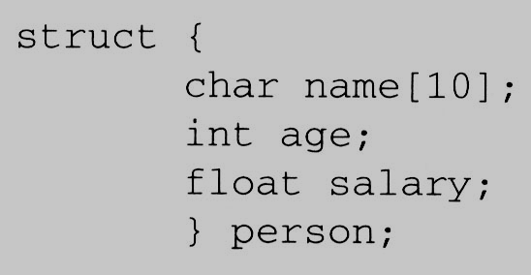
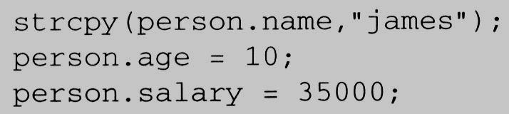
2.2 Structures and Unions (1/6)
2.2.1 Structures (Records)
  Arrays are collections of data of the same type. In C there is an alternate way of grouping data that permit the data to vary in type.
    This mechanism is called the struct, short for structure.

Slide 14
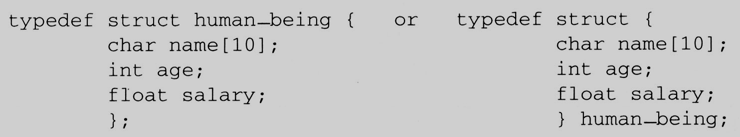
2.2 Structures and Unions (2/6)
Create structure data type
  We can create our own structure data types by using the typedef statement as below:
typedef struct person {
char name[10];
int age;
float salary;
} human_being;

Slide 15
2.2 Structures and Unions (2/6)
Create structure data type
  We can create our own structure data types by using the typedef statement as below:
    This says that human_being is the name of the type defined by the structure definition, and we may follow this definition with declarations of variables such as:
    human_being person1, person2;

Slide 16
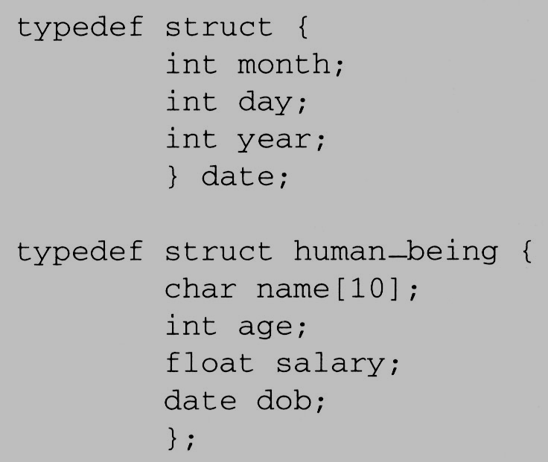
2.2 Structures and Unions (3/6)
Memory Layout
char name[10]
Memory Layout
human_being
int age
int month
date
float salary
int day
int month
int year
date
int day
int year
Padding [2]

Slide 17
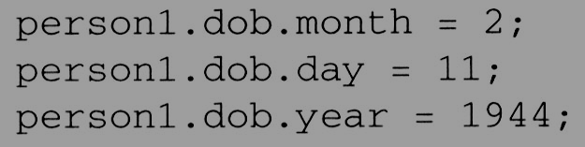
2.2 Structures and Unions (3/6)
Memory Layout
    human_being person1;
char name[10]
Memory Layout
human_being
int age
int month
date
float salary
int day
int month
int year
date
int day
int year
Padding [2]

Slide 18
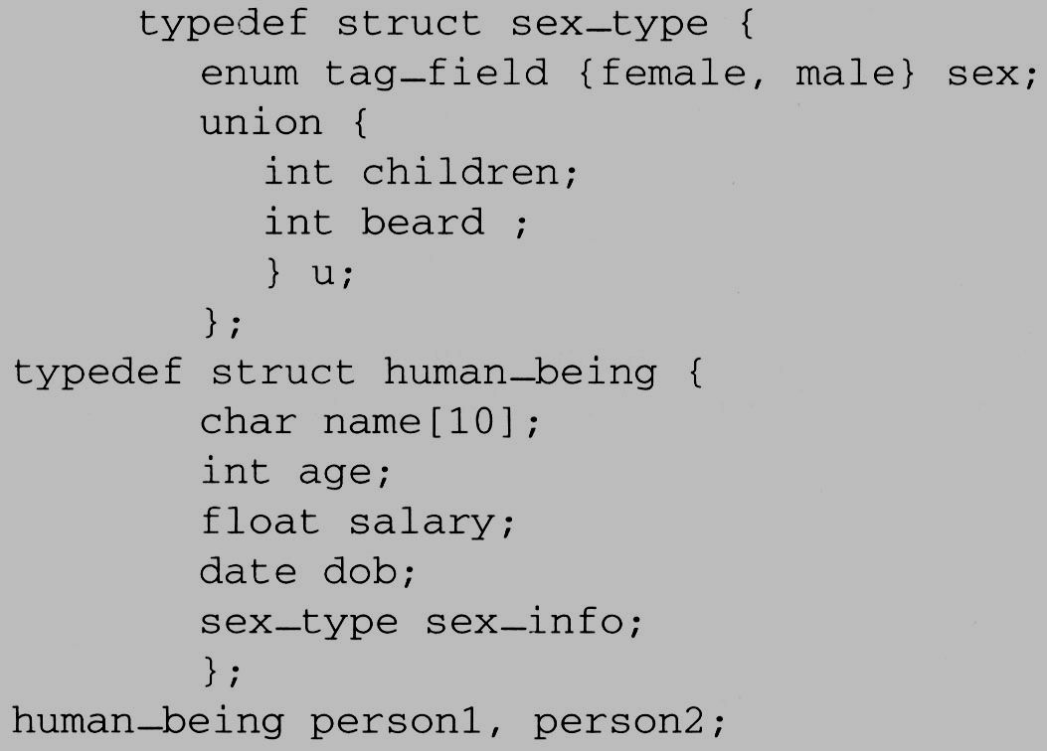
2.2 Structures and Unions (4/6)
2.2.2 Unions
  The fields of a union must share their memory space.
  Only one field of the union is “active” at any given time

Slide 19
2.2 Structures and Unions (4/6)
2.2.2 Unions
  The fields of a union must share their memory space.
  Only one field of the union is “active” at any given time

Slide 20
在C/C++中所謂列舉（Enumeration）型別，就是以關鍵字enum開始加上一個列舉名稱，並以大括號括住要群組管理的常數，例如：
enum Action{stop, sit, stand, walk, run};
上例中宣告一個列舉型態Actions，大括號中每一個元素稱為列舉元（enumerator），預設上列舉元從第一個開始的實際數值是0，然後依次遞 增，以上例而言，stop為0、sit為1、stand為2、walk為3、run為4，
宣告列舉之後，您可以用它來宣告列舉變數，例如：
Action action = stop;
上例中action只接受來自Action中規定的列舉元，雖然實際上列舉元對應一個數值，但您不可以這麼指定數值給列舉：
Action action = 1; // error, invalid conversion from `int' to `Actions'

Slide 21
2.2 Structures and Unions (4/6)
2.2.2 Unions
  The fields of a union must share their memory space.
  Only one field of the union is “active” at any given time
Memory Layout
sex_type
enum tag_field
u
int children
int beard
person1.sex_info.sex = male;
person1.sex_info.u.beard = FALSE;
and
person2.sex_info.sex = female;
person2.sex_info.u.children = 4;

Slide 22
2.2 Structures and Unions (5/6)
2.2.3 Internal implementation of structures
  The fields of a structure in memory will be stored in the same way using increasing address locations in the order specified in the structure definition.
  Holes or padding may actually occur
    Within a structure to permit two consecutive components to be properly aligned within memory
  The size of an object of a struct or union type is the amount of storage necessary to represent the largest component, including any padding that may be required.

Slide 23
2.2 Structures and Unions (6/6)
2.2.4 Self-Referential Structures
  One or more of its components is a pointer to itself.
  typedef struct list {
  char data;
  list *link;
  }

Slide 24
2.2 Structures and Unions (6/6)
2.2.4 Self-Referential Structures
  One or more of its components is a pointer to itself.
  typedef struct list {
  char data;
  list *link;
  }
  list item1, item2, item3;
  item1.data=‘a’;
  item2.data=‘b’;
  item3.data=‘c’;
  item1.link=item2.link=item3.link=NULL;

Slide 25
2.2 Structures and Unions (6/6)
2.2.4 Self-Referential Structures
  One or more of its components is a pointer to itself.
  typedef struct list {
  char data;
  list *link;
  }
  list item1, item2, item3;
  item1.data=‘a’;
  item2.data=‘b’;
  item3.data=‘c’;
  item1.link=item2.link=item3.link=NULL;
Construct a list with three nodes
item1.link=&item2;
item2.link=&item3;
a
b
c

