Slide 1
Data Structures
Chapter 4 Lists

Slide 2
Chapter 4 Lists
Pointers
Singly Linked Lists
Dynamically Linked Stacks and Queues
Polynomials
Chain
Circularly Linked Lists
Equivalence Relations
Doubly Linked Lists

Slide 3
Pointers (1/5)
Consider the following alphabetized list of three letter English words ending in at:
(bat, cat, sat, vat)
If we store this list in an array
  Add the word mat to this list
    move sat and vat one position to the right before we insert mat.
  Remove the word cat from the list
    move sat and vat one position to the left
Problems of a sequence representation (ordered list)
  Arbitrary insertion and deletion from arrays can be very time-consuming
  Waste storage

Slide 4
Pointers (2/5)
An elegant solution: using linked representation
  Items may be placed anywhere in memory.
  In a sequential representation the order of elements is the same as in the ordered list, while in a linked representation these two sequences need not be the same.
  Store the address, or location, of the next element in that list for accessing elements in the correct order with each element.
  Thus, associated with each list element is a node which contains both a data component and a pointer to the next item in the list. The pointers are often called links.

Slide 5
Pointers (3/5)
C provides extensive supports for pointers.
  Two most important operators used with the pointer type :
    & the address operator
    * the dereferencing (or indirection) operator
    Example:
    If we have the declaration:
      int i, *pi;
    then i is an integer variable and pi is a pointer to an integer.
    If we say:
      pi = &i;
    then &i returns the address of i and assigns it as the value of pi.
    To assign a value to i we can say:
      i = 10; or *pi = 10;

Slide 6
Pointers (4/5)
Pointers can be dangerous
  Using pointers: high degree of flexibility and efficiency, but dangerous as well.
    It is a wise practice to set all pointers to NULL when they are not actually pointing to an object.
    Another: using explicit type cast when converting between pointer types.
    Example:
    pi = malloc(sizeof(int));
    /*assign to pi a pointer to int*/
    *** malloc( pi, sizeof(int));
    pf = (float *)pi;
    /*casts int pointer to float pointer*/

Slide 7
Pointers (4/5)
Pointers can be dangerous
    In many systems, pointers have the same size as type int.
      The return type defaults to int which can later be interpreted as a pointer.

Slide 8
Pointers (5/5)
Using dynamically allocated storage
  When programming, you may not know how much space you will need, nor do you wish to allocate some vary large area that may never be required.

Slide 9
Pointers (5/5)
Using dynamically allocated storage
    You may call a function, malloc, and request the amount of memory you need.
    When you no longer need an area of memory, you may free it by calling another function, free, and return the area of memory to the system.

Slide 10
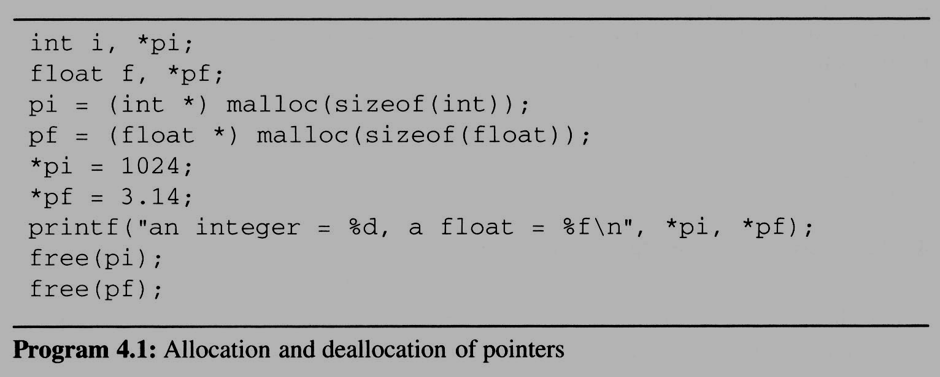
Pointers (5/5)
Using dynamically allocated storage
Request memory
Free memory

Slide 11
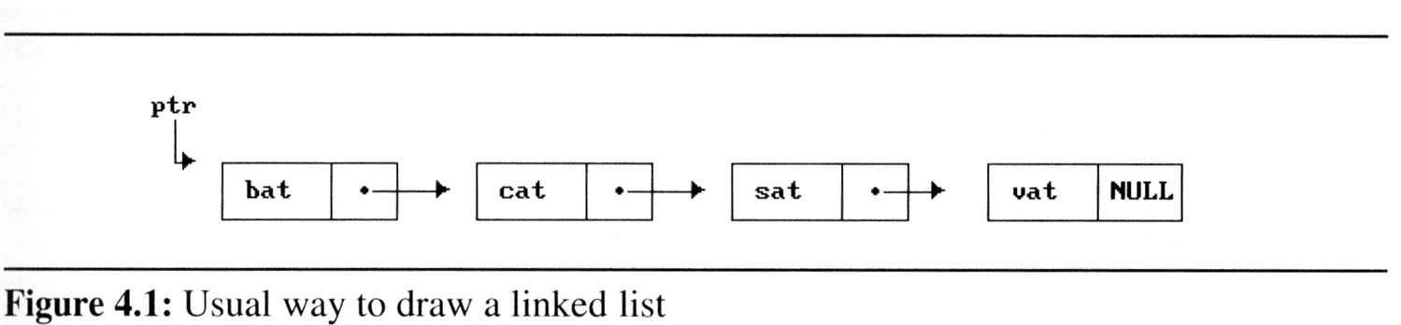
Singly Linked Lists (1/15)
Linked lists are drawn as an order sequence of nodes with links represented as arrows
The name of the pointer to the first node in the list is the name of the list. (the list of Figure 4.1 is called ptr.)

Slide 12
Singly Linked Lists (2/15)
The nodes do not resident in sequential locations
ptr
. . .
Null
Link Field
Node
Data Field
chain

Slide 13
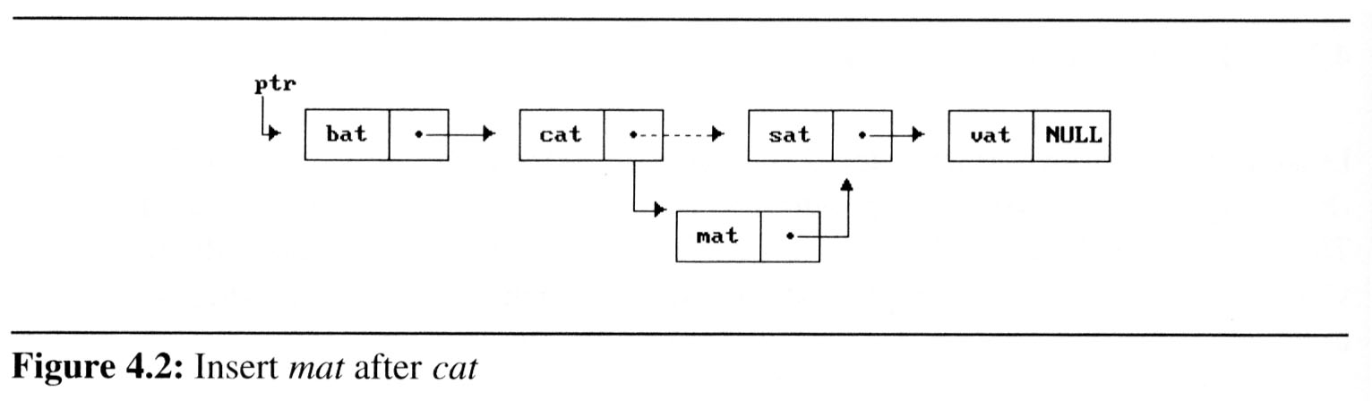
Singly Linked Lists (3/15)
Why it is easier to make arbitrary insertions and deletions using a linked list?
  To insert the word mat between cat and sat, we must:
    Get a node that is currently unused; let its address be paddr.
    Set the data field of this node to mat.
    Set paddr’s link field to point to the address found in the link field of the node containing cat.
    Set the link field of the node containing cat to point to paddr.
2
1

Slide 14
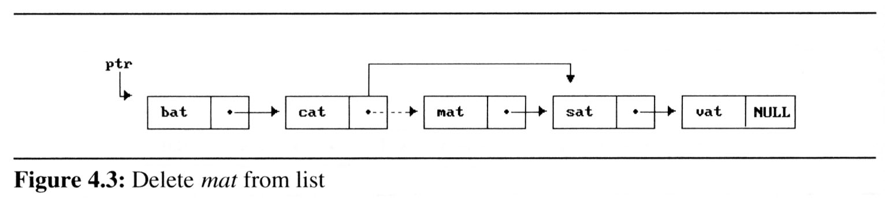
Singly Linked Lists (4/15)
Delete mat from the list:
  We only need to find the element that immediately precedes mat, which is cat, and set its link field to point to mat’s link (Figure 4.3).
  We have not moved any data, and although the link field of mat still points to sat, mat is no longer in the list.
1

Slide 15
Singly Linked Lists (5/15)
We need the following capabilities to make linked representations possible:
  Defining a node’s structure, that is, the fields it contains. We use self-referential structures, discussed in Section 2.2 to do this.
  Create new nodes when we need them. (malloc)
  Remove nodes that we no longer need. (free)

Slide 16
Singly Linked Lists (6/15)
2.2.4 Self-Referential Structures
  One or more of its components is a pointer to itself.
  typedef struct list {
  char data;
  list *link;
  }
  list item1, item2, item3;
  item1.data=‘a’;
  item2.data=‘b’;
  item3.data=‘c’;
  item1.link=item2.link=item3.link=NULL;
a
b
c
Construct a list with three nodes
item1.link=&item2;
item2.link=&item3;

Slide 17
Singly Linked Lists (7/15)
Example 4.1 [List of words ending in at]:
  Declaration
    typedef struct list_node, *list_pointer;
    typedef struct list_node {
    char data [4];
    list_pointer link;
    }
    Creation
    list_pointer ptr;
  typedef struct list_node {
  int data;
  list_node *link;
  }
  list_node *ptr;

Slide 18
Singly Linked Lists (7/15)
Example 4.1 [List of words ending in at]:
  Testing
    #define IS_EMPTY(ptr) (!(ptr))
  Allocation
    ptr=(list_pointer) malloc (sizeof(list_node));
  Return the spaces:
    free(ptr);

Slide 19
1 2 3 4 5 6 7 8 9 10 11 12 13 14 | #include <stdio.h> struct student{ int age; char name[10]; }; int main(){ student lynn = {23, {'l', 'y', 'n', 'n', '\0'}}; student *one = &lynn; printf("%d \n", (*one).age); printf("%s \n", (*one).name); return 0; }
1 2 | printf("%d \n", (*one).age); printf("%s \n", (*one).name);
| |
1 2 | printf("%d", one -> age); printf("%d", one -> name);

Slide 20
Singly Linked Lists (8/15)
strcpy(ptr -> data, “bat”);
ptr -> link = NULL;
address of
first node
ptr data
ptr link
•
b a t \0 NULL
ptr

Slide 21
Singly Linked Lists (9/15)
Example 4.2 [Two-node linked list]:
  typedef struct list_node *list_pointer;
  typedef struct list_node {
  int data;
  list_pointer link;
  }
  list_pointer ptr;
  }
ptr
10
•
20
NULL

Slide 22
Singly Linked Lists (9/15)
Program 4.2: Create a two-node list
  list_pointer create2( )
  {
  /* create a linked list with two nodes */
  list_pointer first, second;
  first = (list_pointer) malloc(sizeof(list_node));
  second = (list_pointer) malloc(sizeof(list_node));
  second -> link = NULL;
  second -> data = 20;
  first -> data = 10;
  first ->link = second;
  return first;
  }
ptr
10
•
20
NULL

Slide 23
Singly Linked Lists (10/15)
Insertion
  Observation
    insert a new node with data = 50 into the list ptr after node
ptr
10
20
NULL
node
3
2
50
1
temp

Slide 24
複習
void swap (int *c , int *d){
int temp=*c;
*c=*d;
*d=temp;
}
int main(){
int a=5,b=10;
swap(&a,&b);
printf(" %d %d ", a,b);
}

Slide 25
複習
void swap (int *c , int *d){//c是指向a的指標
int temp=*c;
*c=*d; //等同於在main執行 a=b
*d=temp; //等同於在main執行 b=a
}
int main(){
int a=5,b=10;
swap(&a,&b);
printf(" %d %d ", a,b);
}

Slide 26
Singly Linked Lists (11/15)
Implement Insertion:
  void insert(list_pointer *ptr, list_pointer node)
  {
  /* insert a new node with data = 50 into the list ptr after node */
  list_pointer temp;
  temp=malloc(sizeof(list_node));
  if(IS_FULL(temp)){
  fprintf(stderr, “The memory is full\n”);
  exit(1);
  }
  temp->data=50;
temp
50

Slide 27
Singly Linked Lists (12/15)
if(*ptr){ //nonempty list
temp->link = node->link;
node->link = temp;
}
else{ //empty list
temp->link = NULL;
*ptr = temp;
}
}
ptr
10
20
NULL
node
50
temp

Slide 28
Singly Linked Lists (13/15)
Deletion
  Observation: delete node from the list
ptr trial node
10
50
20
NULL
ptr trial node
10
50
20
NULL
ptr
10
20
NULL

Slide 29
Singly Linked Lists (14/15)
Implement Deletion:
  void delete(list_pointer *ptr, list_pointer trail, list_pointer node)
  {
  /* delete node from the list, trail is the preceding node ptr is the head of the list */
  if(trail)
  trail->link = node->link;
  else
  *ptr = (*ptr)->link;
  free(node);
  }
ptr trial node
10
50
20
NULL

Slide 30
Singly Linked Lists (15/15)
Print out a list (traverse a list)
  Program 4.5: Printing a list
    void print_list(list_pointer ptr)
    {
    printf(“The list contains: “);
    for ( ; ptr; ptr = ptr->link)
    printf(“%4d”, ptr->data);
    printf(“\n”);
    }

