Slide 1

CS235102
Data Structures
Chapter 5 Trees

Slide 2
Chapter 5 Trees: Outline
Introduction
  Representation Of Trees
Binary Trees
Binary Tree Traversals
Additional Binary Tree Operations
Threaded Binary Trees
Heaps
Binary Search Trees
Selection Trees
Forests

Slide 3
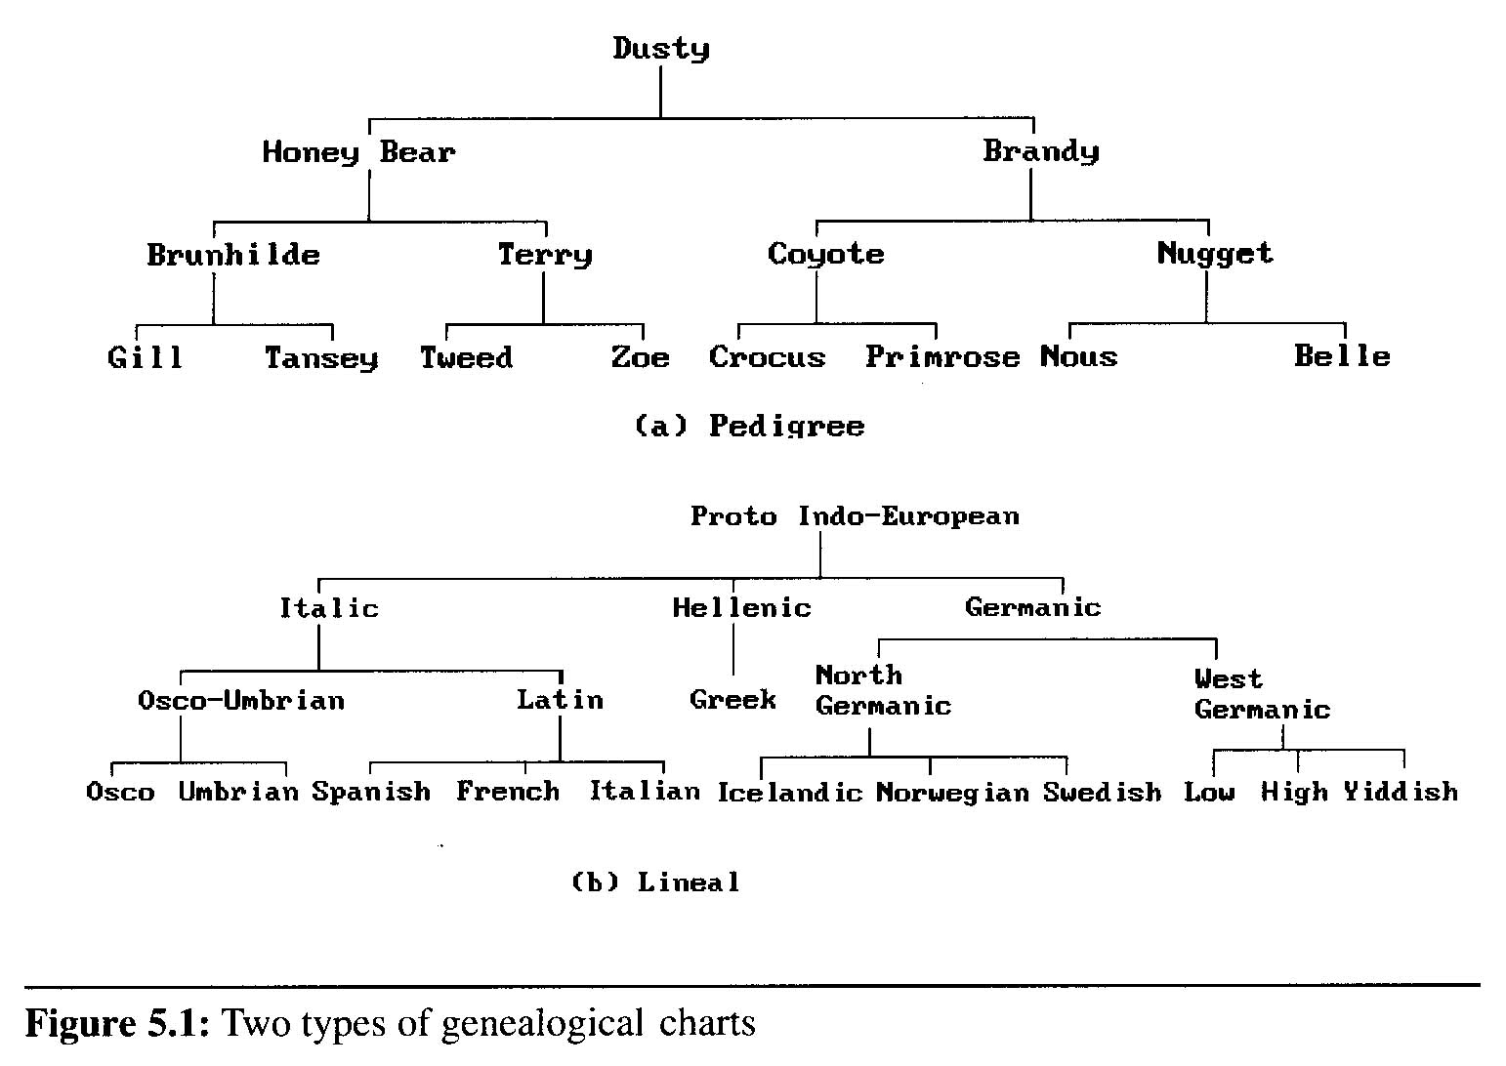
Introduction (1/8)
A tree structure means that the data are organized so that items of information are related by branches
Examples:

Slide 4
Introduction (2/8)
Definition (recursively): A tree is a finite set of one or more nodes such that
  There is a specially designated node called root.
  The remaining nodes are partitioned into n>=0 disjoint set T₁,…,T_{n}, where each of these sets is a tree. T₁,…,T_{n} are called the subtrees of the root.
Every node in the tree is the root of some subtree

Slide 5
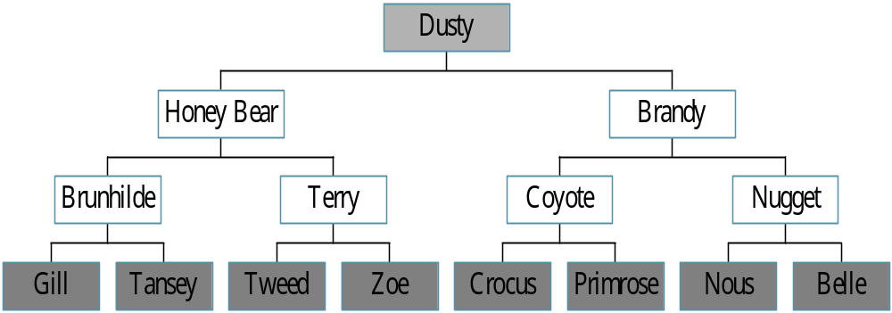
Trees
Root
leaf
CHAPTER 5

Slide 6
Introduction (3/8)
Some Terminology
  node: the item of information plus the branches to each node.
  degree: the number of subtrees of a node
  degree of a tree: the maximum of the degree of the nodes in the tree.
  terminal nodes (or leaf): nodes that have degree zero
  nonterminal nodes: nodes that don’t belong to terminal nodes.
  children: the roots of the subtrees of a node X are the children of X
  parent: X is the parent of its children.

Slide 7
Introduction (4/8)
Some Terminology (cont’d)
  siblings: children of the same parent are said to be siblings.
  Ancestors of a node: all the nodes along the path from the root to that node.
  The level of a node: defined by letting the root be at level one. If a node is at level l, then it children are at level l+1.
  Height (or depth): the maximum level of any node in the tree

Slide 8
Introduction (5/8)
Example
  A is the root node
  B is the parent of D and E
  C is the sibling of B
  D and E are the children of B
  D, E, F, G, I are external nodes, or leaves
  A, B, C, H are internal nodes
  The level of E is 3
  The height (depth) of the tree is 4
  The degree of node B is 2
  The degree of the tree is 3
  The ancestors of node I is A, C, H
  The descendants of node C is F, G, H, I
Property: (# edges) = (#nodes) - 1
Level
A
1
B
C
2
H
3
D
E
F
G
I
4

Slide 9
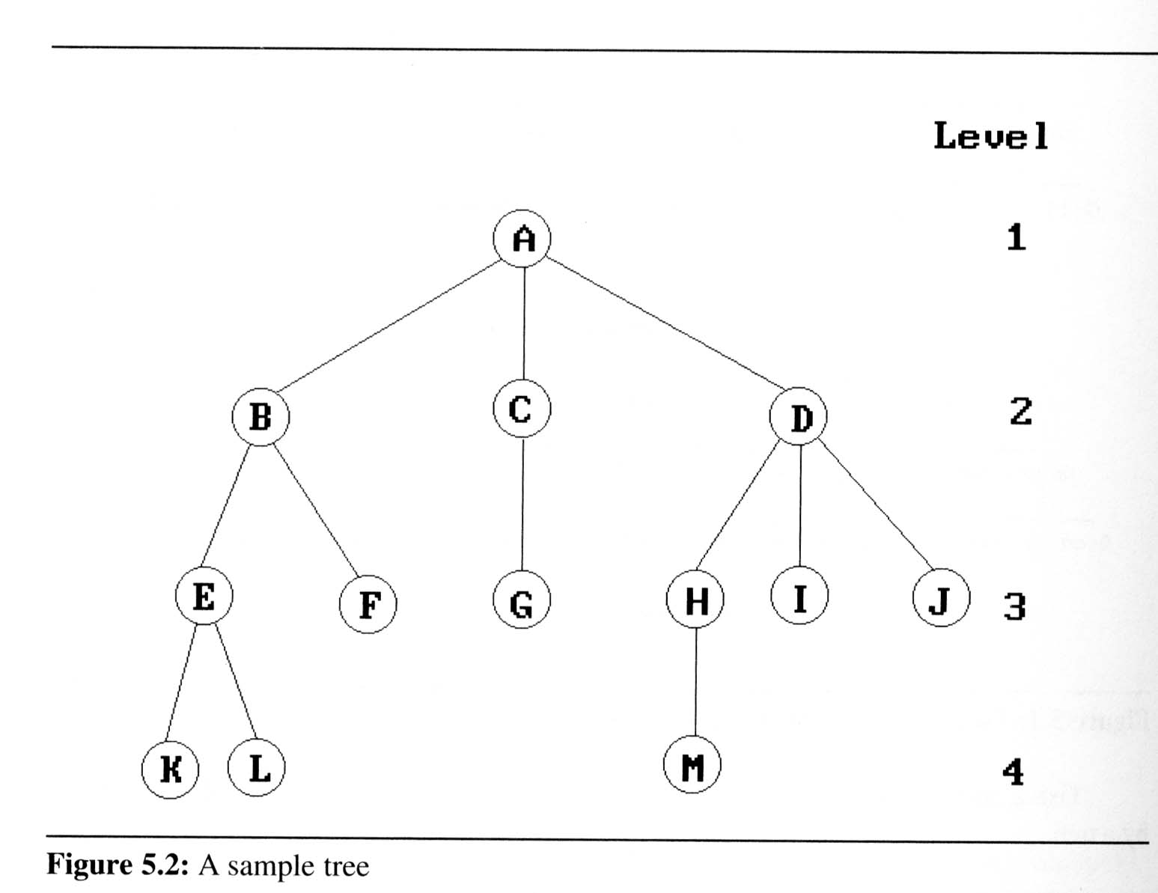
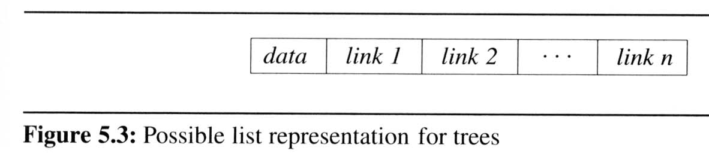
Introduction (6/8)
Representation Of Trees
  List Representation
    we can write of Figure 5.2 as a list in which each of the subtrees is also a list
  ( A ( B ( E ( K, L ), F ), C ( G ), D ( H ( M ), I, J ) ) )
    The root comes first,
    followed by a list of sub-trees

Slide 10
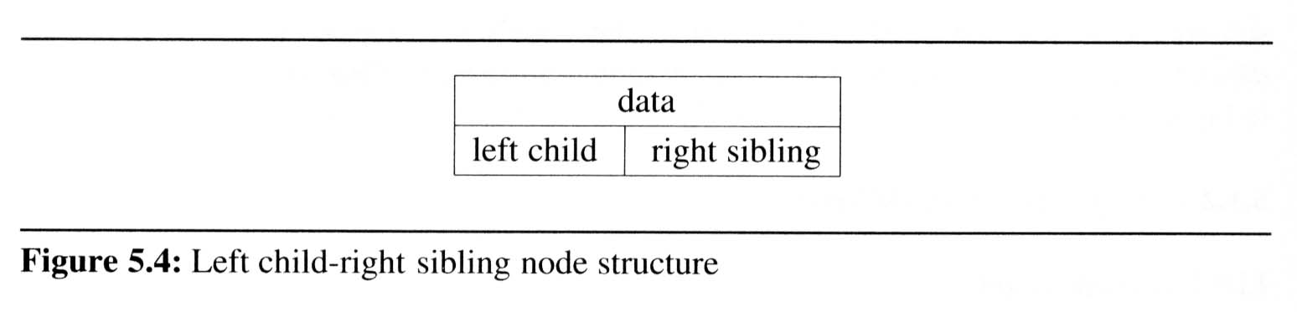
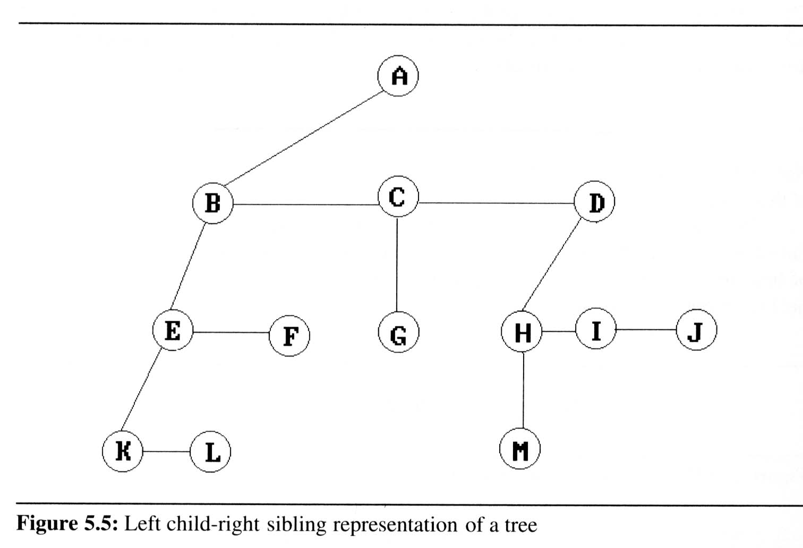
Introduction (7/8)
Representation Of
Trees (cont’d)
  Left Child-
  Right Sibling
  Representation

Slide 11
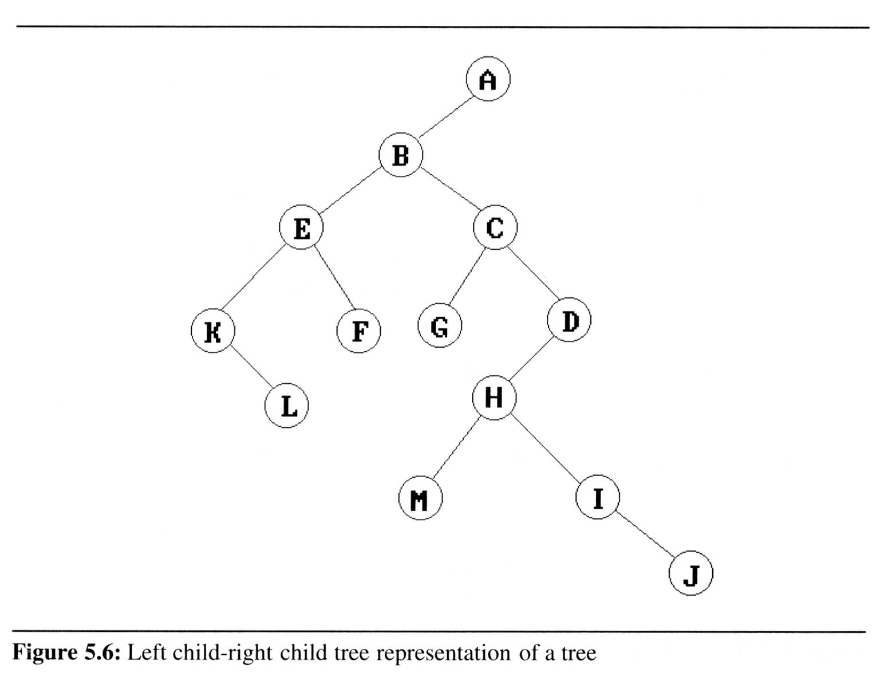
Introduction (8/8)
Representation Of Trees (cont’d)
  Representation
  As A Degree
  Two Tree

Slide 12
Binary Trees (1/9)
Binary trees are characterized by the fact that any node can have at most two branches
Definition (recursive):
  A binary tree is a finite set of nodes that is either empty or consists of a root and two disjoint binary trees called the left subtree and the right subtree

Slide 13
Binary Trees (1/9)
Thus the left subtree and the right subtree are distinguished
Any tree can be transformed into binary tree
  by left child-right sibling representation
A
A
B
B

Slide 14
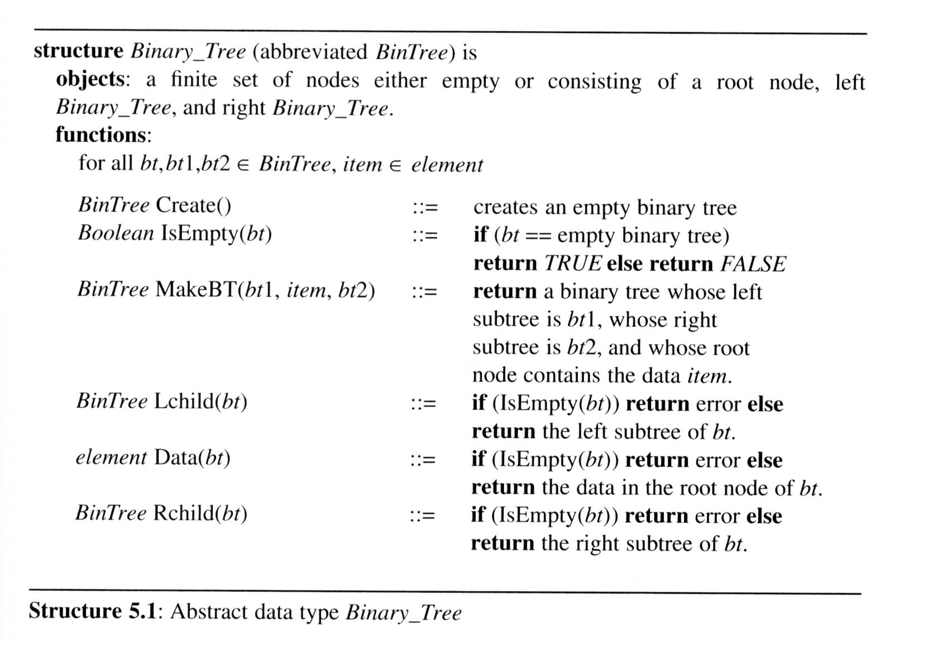
Binary Trees (2/9)
The abstract data type of binary tree

Slide 15
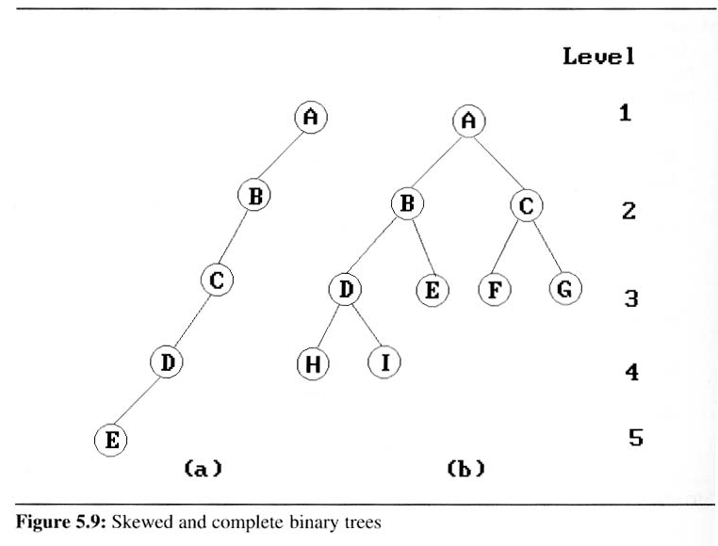
Binary Trees (3/9)
Two special kinds of binary trees:
(a) skewed tree, (b) complete binary tree
  The all leaf nodes of these trees are on two adjacent levels

Slide 16
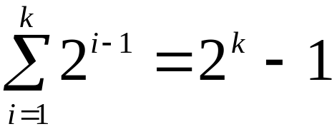
Binary Trees (4/9)
Properties of binary trees
  Lemma 5.1 [Maximum number of nodes]:
  The maximum number of nodes on level i of a binary tree is 2^{i-1}, i ≥1.
  The maximum number of nodes in a binary tree of depth k is 2^{k}-1, k≥1.
Level
Prove by induction.
A
1
B
C
2
H
3
D
E
G
I
4

Slide 17
Binary Trees (4/9)
Properties of binary trees
  Lemma 5.1 [Maximum number of nodes]:
  The maximum number of nodes on level i of a binary tree is 2^{i-1}, i ≥1.
  The maximum number of nodes in a binary tree of depth k is 2^{k}-1, k≥1.

Slide 18
Binary Trees (4/9)
  Lemma 5.2 [Relation between number of leaf nodes and degree-2 nodes]:
  For any nonempty binary tree, T, if n₀ is the number of leaf nodes and n₂ is the number of nodes of degree 2, then n₀ = n₂ + 1.
These lemmas allow us to define full and complete binary trees

Slide 19
Relations between Number of
Leaf Nodes and Nodes of Degree 2
For any nonempty binary tree, T, if n0 is the
number of leaf nodes and n2 the number of nodes
of degree 2, then n0=n2+1
proof:
CHAPTER 5

Slide 20
For any nonempty binary tree, T, if n0 is the
number of leaf nodes and n2 the number of nodes
of degree 2, then n0=n2+1
proof:
Let n and B denote the total number of nodes &
branches in T.
Let n0, n1, n2 represent the nodes with no children,
single child, and two children respectively.
B+1=n, B=n1+2n2 ==> n1+2n2+1= n,
n= n0+n1+n2, n1+2n2+1= n0+n1+n2 ==> n0=n2+1

Slide 21
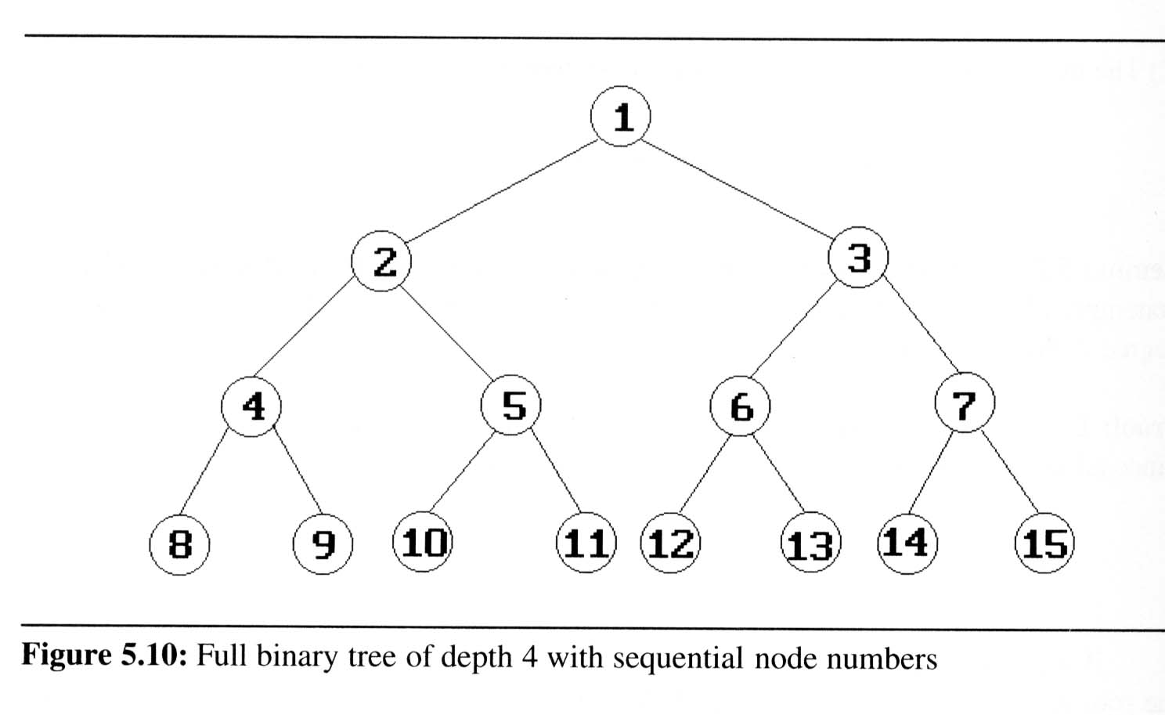
Binary Trees (5/9)
Definition:
  A full binary tree of depth k is a binary tree of death k having 2^{k}-1 nodes, k ≥ 0.
  A binary tree with n nodes and depth k is complete iff its nodes correspond to the nodes numbered from 1 to n in the full binary tree of depth k.
  From Lemma 5.1, the
  height of a complete
  binary tree with n nodes
  is ⎡log₂(n+1)⎤

Slide 22
Binary Trees (6/9)
Binary tree representations (using array)
  Lemma 5.3: If a complete binary tree with n nodes is represented sequentially, then for any node with index i, 1 ≤ i ≤ n, we have
  parent(i) is at ⎣i /2⎦ if i ≠ 1.
  If i = 1, i is at the root and has no parent.
  LeftChild(i) is at 2i if 2i ≤ n.
  If 2i > n, then i has no left child.
  RightChild(i) is at 2i+1 if 2i+1 ≤ n.
  If 2i +1 > n, then i has no left child
A
1
[1]
[2]
[3]
[4]
[5]
[6]
[7]
B
2
C
3
A B C — D — E
Level 1
D
E
Level 2
Level 3
4
5
6
7

Slide 23
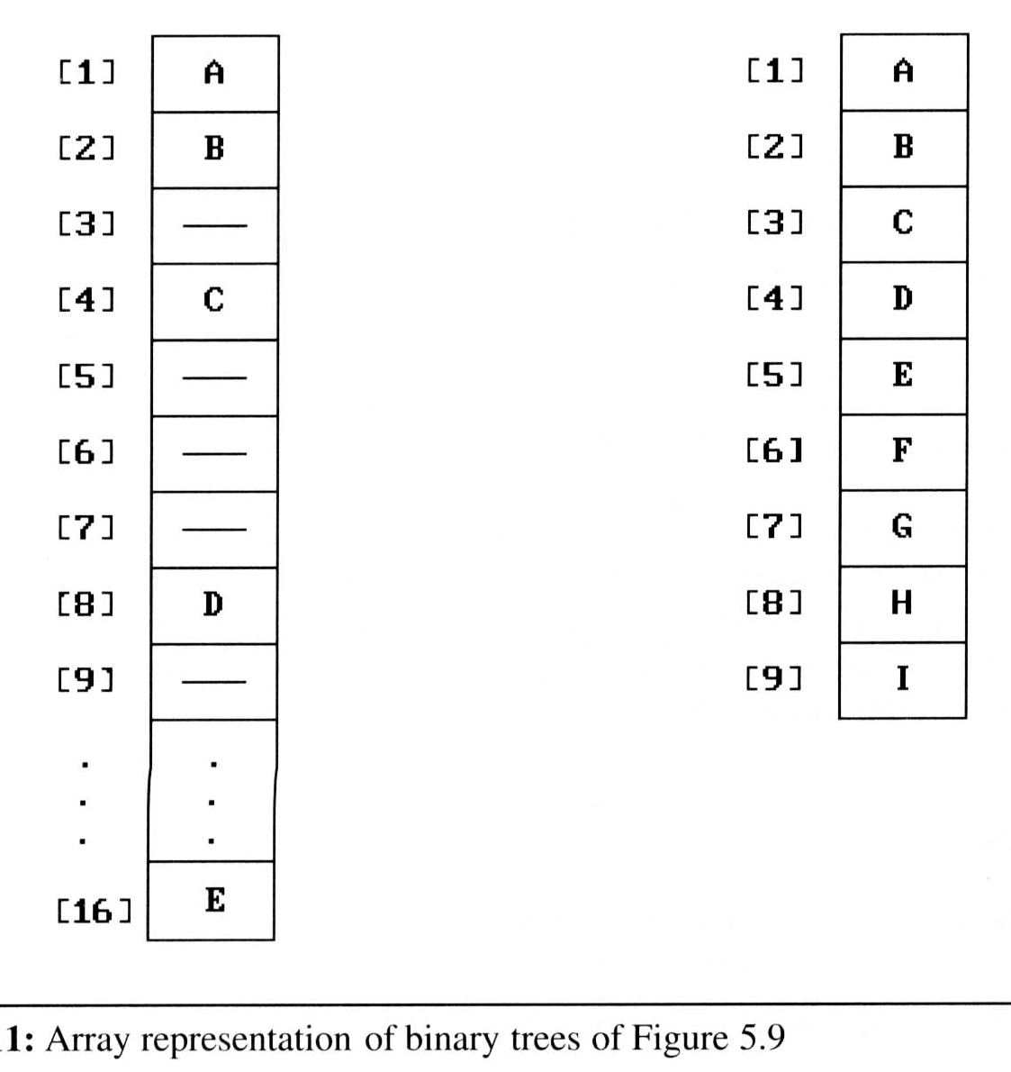
Binary Trees (7/9)
Binary tree representations (using array)
  Waste spaces: in the worst case, a skewed tree of depth k requires 2^{k}-1 spaces. Of these, only k spaces will be occupied
  Insertion or deletion
  of nodes from the
  middle of a tree
  requires the
  movement of
  potentially many nodes
  to reflect the change in
  the level of these nodes

Slide 24
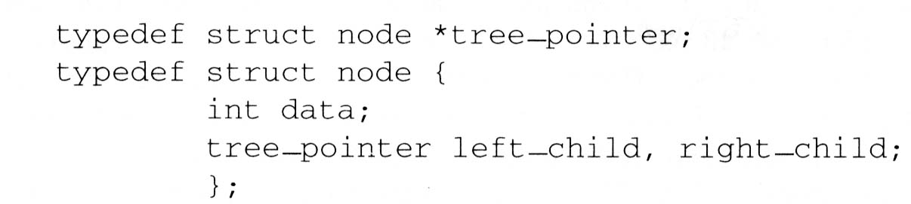
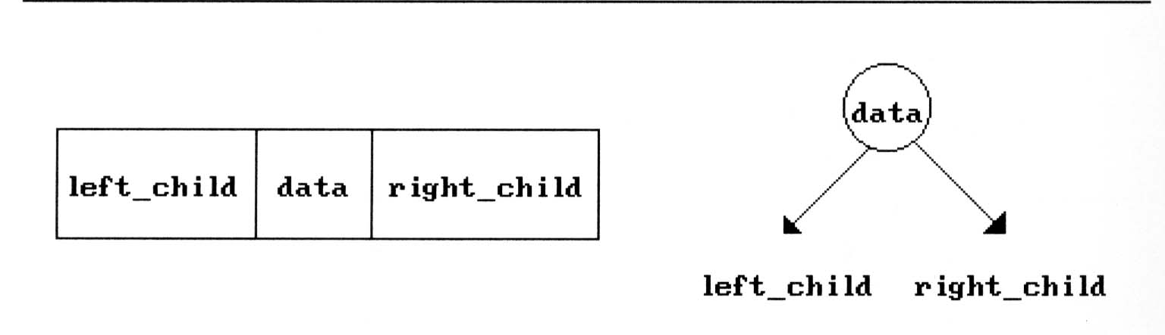
Binary Trees (8/9)
Binary tree representations (using link)

Slide 25
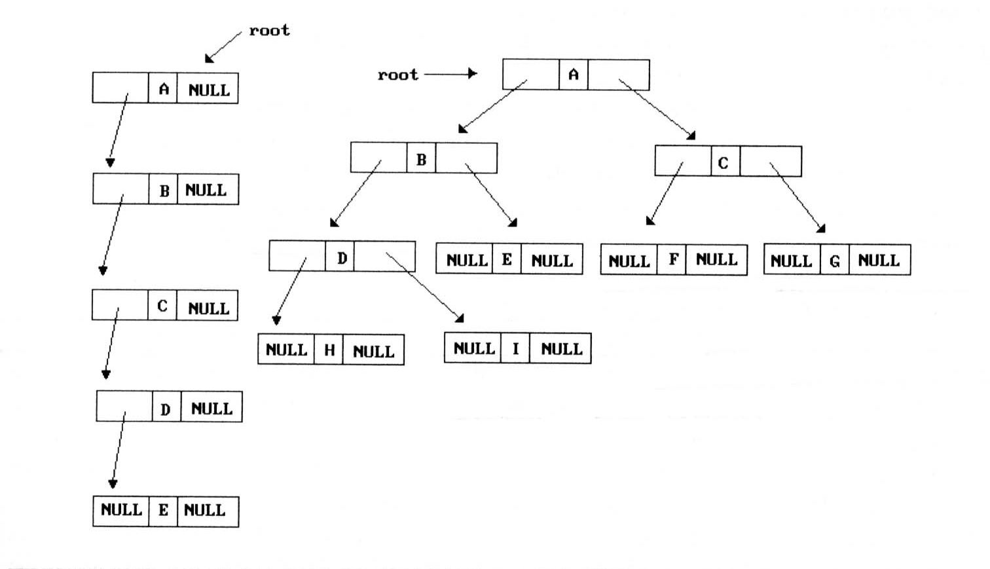
Binary Trees (9/9)
Binary tree representations (using link)

Slide 26
Binary Tree Traversals (1/9)
How to traverse a tree or visit each node in the tree exactly once?
  There are six possible combinations of traversal
LVR, LRV, VLR, VRL, RVL, RLV
  Adopt convention that we traverse left before
  right, only 3 traversals remain
LVR (inorder), LRV (postorder), VLR (preorder)
left_child
data
right_child
V
:
visiting
node
L: moving left
R: moving right

Slide 27
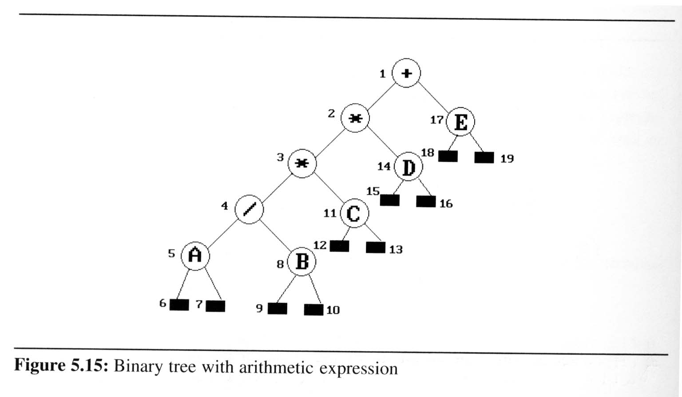
Binary Tree Traversals (2/9)
Arithmetic Expression using binary tree
  inorder traversal (infix expression)
  A / B * C * D + E
  preorder traversal (prefix expression)
  + * * / A B C D E
  postorder traversal
  (postfix expression)
  A B / C * D * E +
  level order traversal
  + * E * D / C A B

Slide 28
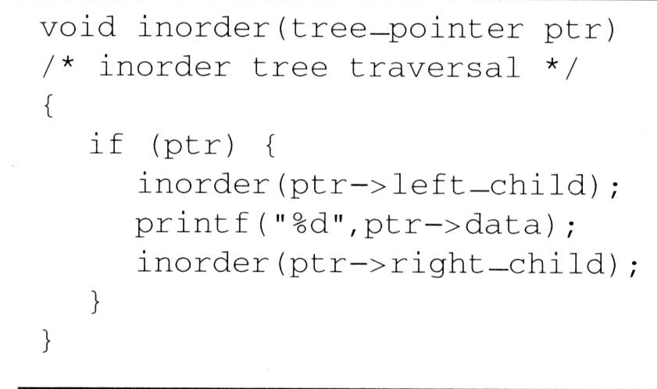
Binary Tree Traversals (3/9)
Inorder traversal (LVR) (recursive version)
output:
A
/
B
*
C
*
D
+
E
ptr
L
V
R

Slide 29
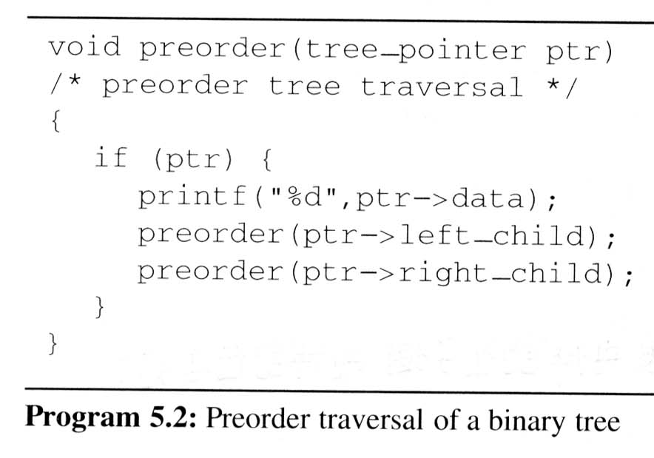
Binary Tree Traversals (4/9)
Preorder traversal (VLR) (recursive version)
output:
+
*
*
/
A
B
C
D
E
V
L
R

Slide 30
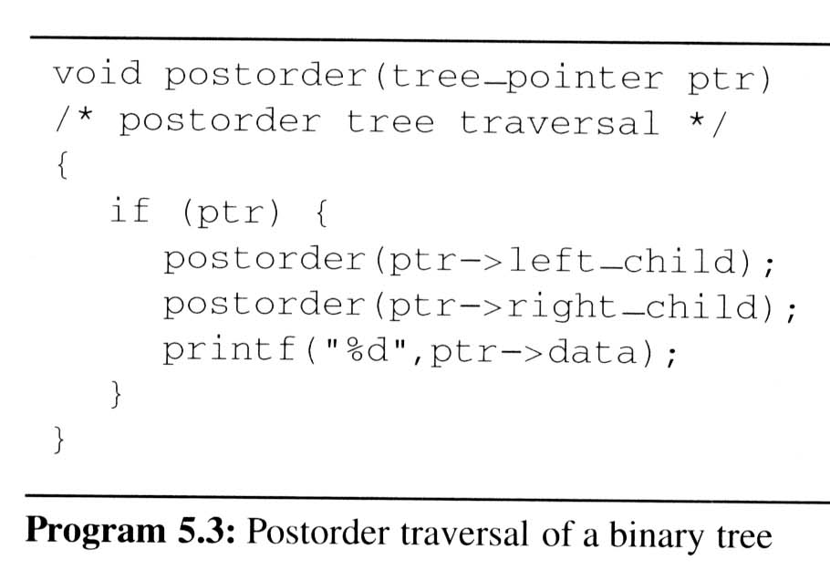
Binary Tree Traversals (5/9)
Postorder traversal (LRV) (recursive version)
output:
A
B
/
C
*
D
*
E
+
L
R
V

Slide 31
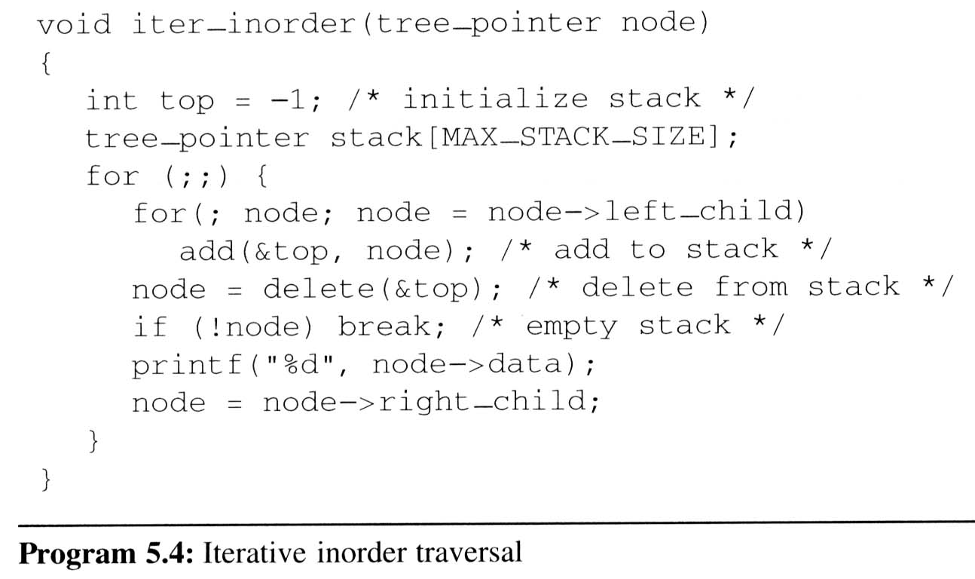
Binary Tree Traversals (6/9)
Iterative inorder traversal
  we use a stack to simulate recursion
5
4
8
11
3
14
2
17
1
A
/
B
*
C
D
*
E
+
L
V
R
output:
A
/
B
*
C
*
D
+
E
node

Slide 32
Binary Tree Traversals (7/9)
Analysis of inorder2 (Non-recursive Inorder traversal)
  Let n be the number of nodes in the tree
  Time complexity: O(n)
    Every node of the tree is placed on and removed
    from the stack exactly once
  Space complexity: O(n)
    equal to the depth of the tree which
    (skewed tree is the worst case)

Slide 33
Binary Tree Traversals (8/9)
Level-order traversal
  method:
    We visit the root first, then the root’s left child, followed by the root’s right child.
    We continue in this manner, visiting the nodes at each new level from the leftmost node to the rightmost nodes
  This traversal requires a queue to implement

Slide 34
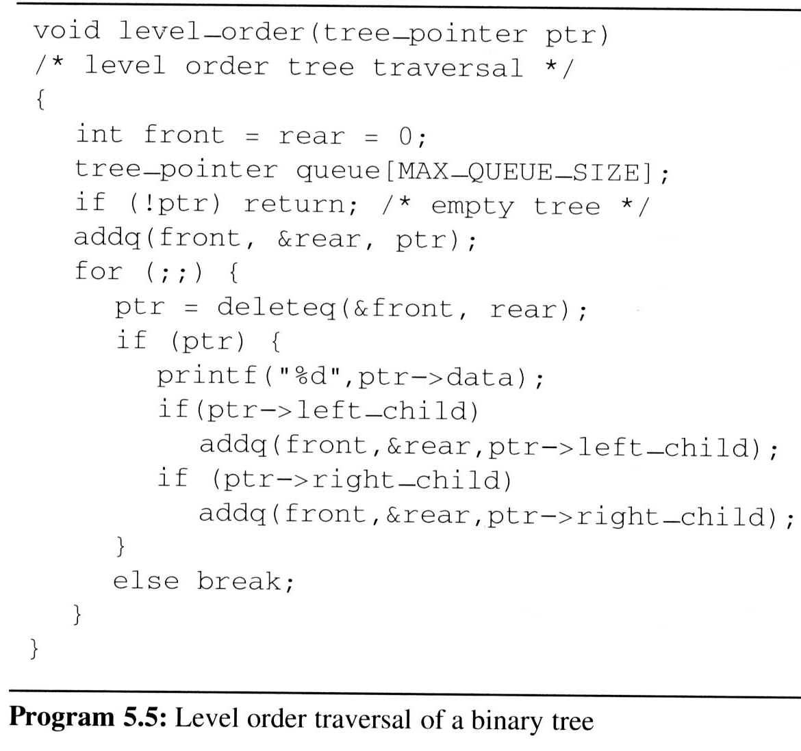
Binary Tree Traversals (9/9)
Level-order traversal (using queue)
output:
+
*
E
*
D
/
C
A
B
1
2
17
3
14
4
11
5
8
+
*
E
*
D
/
C
A
B
FIFO
ptr

