Slide 1
Basics of Data Structures and Algorithms
Jyh-Shing Roger Jang (張智星)
CSIE Dept, National Taiwan University

Slide 2
Programming != Coding
Programming ➔ Building a house
Requirements: purpose, input/output ➔需求為何、投入多少資金、產出什麼品質的房子
Analysis
Bottom-up: small pieces to ultimate goal ➔ 把每一面牆、每一塊磚設計好，再想辦法拼起來
Top-down: ultimate goal to small pieces ➔ 先考慮整體的需求，在思考每一面牆、每一塊磚如何完成
Design: choices of data structures and algorithms ➔ 建材和工法的選定
Coding and refinement: actual implementation ➔ 施工
Verification
Proof (in math) ➔ 確認是否符合設計圖，例如載重度或耐震度
Test and debug (on machines) ➔ 工地現場的牢固度測試、監工等

Slide 3
From Coding to Programming
Comparison of DSA with “Intro to C”
 | Intro to C | DSA
Requirements | * | *
Analysis & Design | * | ***
Coding | *** | ***
Proof in Math | 0 | ***
Test & Debugging | ** | ***

Slide 4
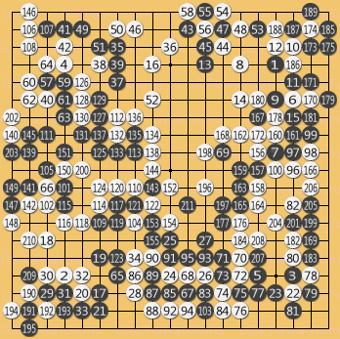
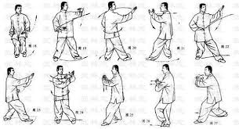

What Are Algorithms?
Algorithms can be viewed as “程式譜”
How to solve computation problems correctly and efficiently
Similar terms
食譜 (recipes)、樂譜 (sheet music)、劍譜、棋譜、拳譜
臉譜、族譜、光譜、頻譜
Methods
Data, or example based

Slide 5
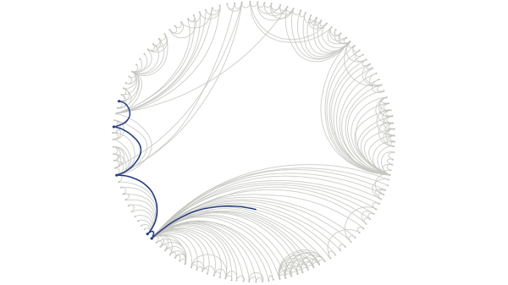
What Are Data Structures?
Data structures can be viewed as “everything about data”
How to map the real world to the abstract representation?
How to use memory effectively?
Example
Six Degrees of Separation (Stanley Milgram, 1960)
Facebook users = 1.59 B, DOS=3.57 (link)
So…
食譜 + 食材 = 菜 (Recipes + Ingredients = Dishes)
樂譜 + 樂器 = 音樂 (Sheet music + Instruments = Music)
劍譜 + 寶劍 = 天下無雙
➔ Algorithms + Data Structures = Programs

Slide 6
Why Data Structures and Algorithms?
A good program needs to leverage two types of resources on computers
Computing units: CPU, FPU, GPU, etc. ➔ Time
Storage units: memory, disks, networks, etc. ➔ Space
Programs = Algorithms + Data Structures
Algorithms focus on computation issues, but needs to be accompanied by proper data structures
Data structures focus on storage management, but needs to be accompanied by proper algorithms
DSA helps you write better programs!

Slide 7
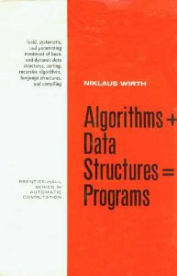
Algorithms & Data Structures
Algorithms + Data Structures = Programs
A famous book published in 1976
The textbook for my DSA course
Algorithms (演算法)
How to do computation? ➔ Efficient use of CPU
Data structures (資料結構)
How to arrange data? ➔ Effective use of storage
Trade-offs between computation and storage
You’ll learn how to trade space with time, or vice versa.

Slide 8
About Algorithms
Quiz!
Five basic criteria of algorithms (by Knuth)
Input: Zero or more quantities are externally supplied
Output: At least one quantity is produced
Definiteness: Each instruction is clear and unambiguous
Finiteness: The procedure terminates after a finite number of steps
Effectiveness: Each instruction is basic and feasible (do-able by computers)
How to describe an algorithm
English: Description in a natural language
Graphic representation: Flow chart
Pseudo code: Program-like description in English
Programs: C/C++ combined with comments

Slide 9
Five Criteria of 食譜
食材
番茄、蛋、蔥、薑、太白粉水、鹽、糖
食譜：番茄炒蛋
蔥切花、薑切末備用。
番茄去除蒂頭，劃十字刀，下鍋汆燙後去皮。
蛋液打勻，加少許鹽。
番茄切成小塊備用。
太白粉加水備用(1：3.5)。
起油鍋爆香少許薑末，加入番茄、3大匙水、鹽、糖炒勻且湯汁稍微收乾。
加入少許太白粉水勾芡。
再加入蛋液輕輕翻炒。
起鍋前灑上蔥花。
Criteria
Input
食材
Output
菜
Definiteness
清楚的指令
Finiteness
一定可以做完
Effectiveness
可行的指令（電腦可完成）

Slide 10
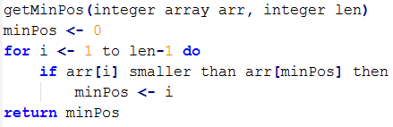
Five Criteria of Algorithms
Pseudo code for finding the index of the smallest number in an array: getMinPos()
Criteria
Input
An array
Output
Index of the smallest element in an array
Definiteness
Clear steps
Finiteness
Will terminate
Effectiveness
Achievable by computers
Assignment

Slide 11
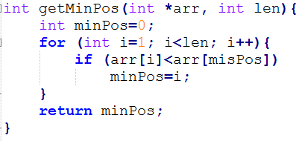
Pseudo Code vs. Real Code
Pseudo code:
Code in C++:
How to prove the correctness of getMinPos()
Claim: arr[minPos]<=arr[j] for j=0, 1, …, len-1
Claim 2: After iteration i, arr[minPos]<=arr[j] for j=0, 1, …, i
Proof by mathematical induction (數學歸納法)
Claim 2 holds when i=1
Assume claim 2 holds when i=k ➔ Show that claim 2 holds when i=k+1.
Claim 2 is often called Invariance property
of loops

Slide 12
Selection Sort
Animation
Flash, YouTube, HTML
Wiki about selection sort
Pseudo code
Input: an integer array of length n
Output: an in-place sorted array
For i from 0 to n-1
Let s_{id} be the index of the smallest number from list[i] to list[n-1]
Interchange list[i] and list[s_{id}]
Step 1 can be achieved by getMinPos().
Step 2 can be done by the computer easily.
Important!

Slide 13
Sample Quiz for Selection Sort
Please show each step of selection sort on the vector:
3 5 1 4 2 7 9 6 8

Slide 14
Correctness of Selection Sort
Theorem
After the loop of i=q, for any j>q, we have
list[0]<list[1]<list[2] … < list[q] < list[j]
Proof by mathematical induction
When q=0, the statement is true
Assume statement is true when q=t; then when q = t+1…

