Slide 1

Deep Learning-Based Credit Card
Fraud Detection in Federated Learning
A privacy-preserving AI approach for collaborative financial fraud detection
Authors: Vadisena Venkata Krishna Reddy, Radha Vijaya Kumar Reddy, Masthan Siva Krishna Munaga, Balaji Karnam, Suresh Kumar Maddila, Chandra Sekhar Kolli
Expert Systems With Applications (Elsevier) · Vol. 255 · Article 124493 · June 2024
DOI: 10.1016/j.eswa.2024.124493 · Q1 · SJR 1.939 · h-index 315
Presented by: Hayam (莫桃) · 26213050559

Slide 2
Contents
The problem
1
Rare fraud, private data
Proposed method
2
JNBO-SpinalNet
Federated architecture
3
Only model weights travel
The paper’s results
4
Promising, but incomplete
My Kaggle demo
5
Simplified reproduction and results

Slide 3
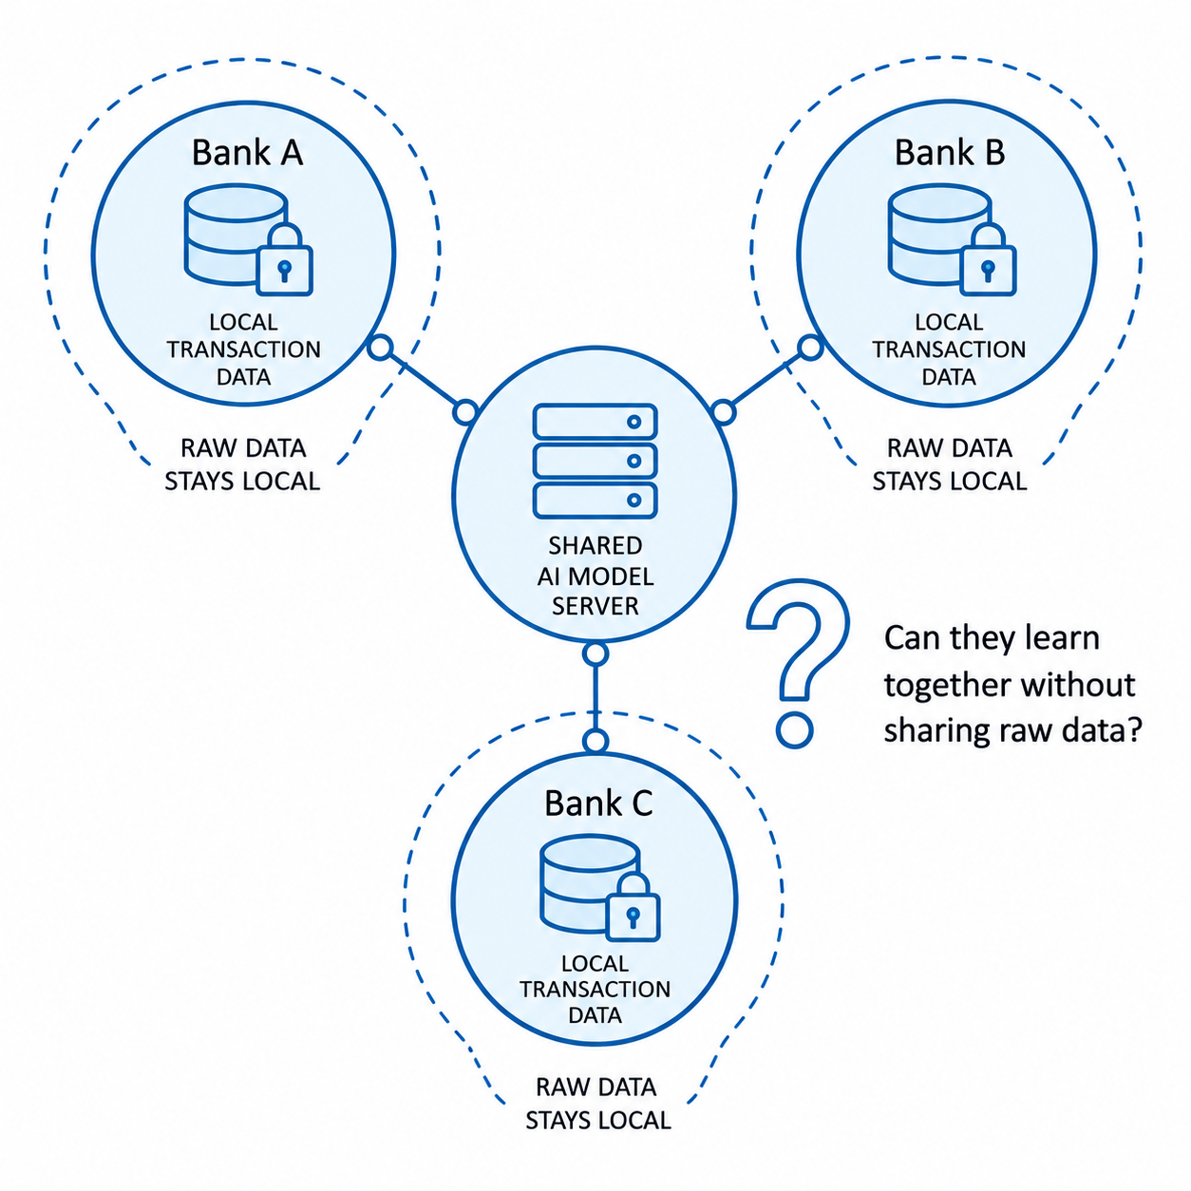
Why Fraud Detection Needs Federated Learning?
The Core Challenge
Credit card fraud causes billions in annual losses globally
Fraud is extremely rare: only 492 of 284,807 transactions (0.17%)
Raw customer data cannot be pooled across institutions due to privacy and regulation
Key question: can banks train one fraud detector together without ever sharing raw data?

Slide 4
Proposed AI Method: JNBO-SpinalNet
Data preprocessing
Quantile normalization
Bootstrap resampling
01
02
03
04
Feature selection
(Fisher + Bray-Curtis + Jeffrey divergence)
SpinalNet classifier
SpinalNet = the classifier
Processes input features in chunked segments rather than full-batch, enabling efficient gradient flow and reduced overfitting on imbalanced data.
JNBO = the optimizer (JNBO = JSO + NBO)
JSO (Jellyfish Search Optimization): exploration of the search space
NBO (Namib Beetle Optimization): exploitation of promising regions
Together they tune SpinalNet's for optimal fraud detection performance.

Slide 5
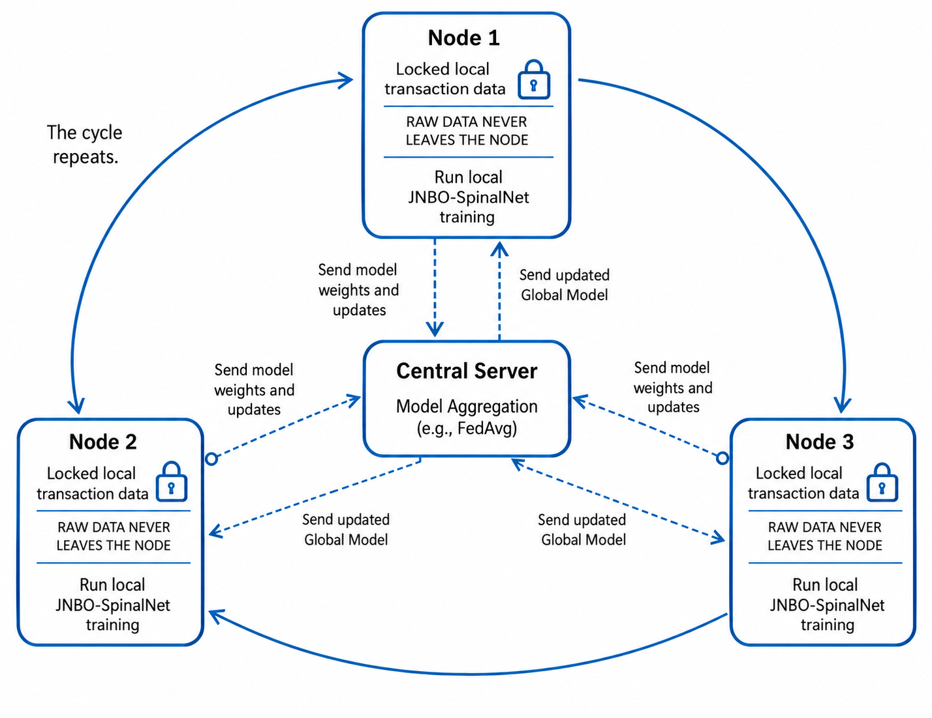
Federated Learning: Train Together, Keep Data Local
Local training
Each node trains on its own private data
Weight sharing
Only model updates (not raw data) are transmitted
Aggregation
Server aggregates local models into a global mode
Iteration
Global model returns to nodes; cycle repeats
Paper limitation
The number of clients, exact data split, and communication rounds are not clearly specified in the original paper.

Slide 6
Reported Results: Promising but incomplete
Read with care
No precision, recall, F1 or AUC reported
No ablation: JNBO's own gain is untested
Clients, rounds and data split not specified
No public code available

Slide 7
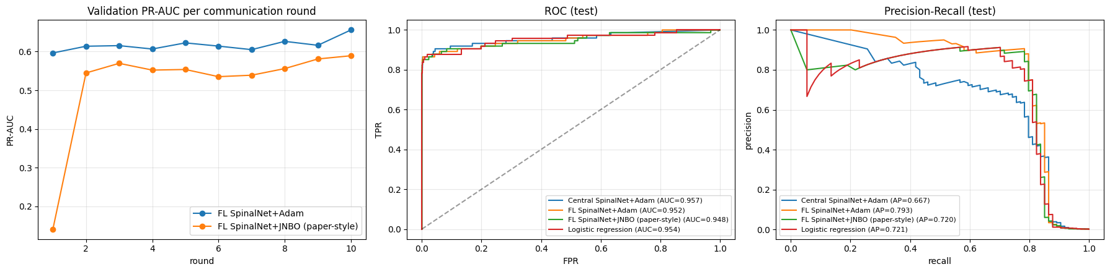
From Paper to Practice: My Demo
Model (test set: 74 frauds) | Precision | Recall | F1 | Frauds caught | False alarms
Federated SpinalNet + JNBO (paper-style) | 0.891 | 0.770 | 0.826 | 57 / 74 | 7
Federated SpinalNet + Adam (reference) | 0.881 | 0.797 | 0.837 | 59 / 74 | 8
Logistic regression (reference) | 0.844 | 0.730 | 0.783 | 54 / 74 | 10
Centralized SpinalNet + Adam (reference) | 0.684 | 0.730 | 0.706 | 54 / 74 | 25

Slide 8
Thank you for your attention

