Slide 1
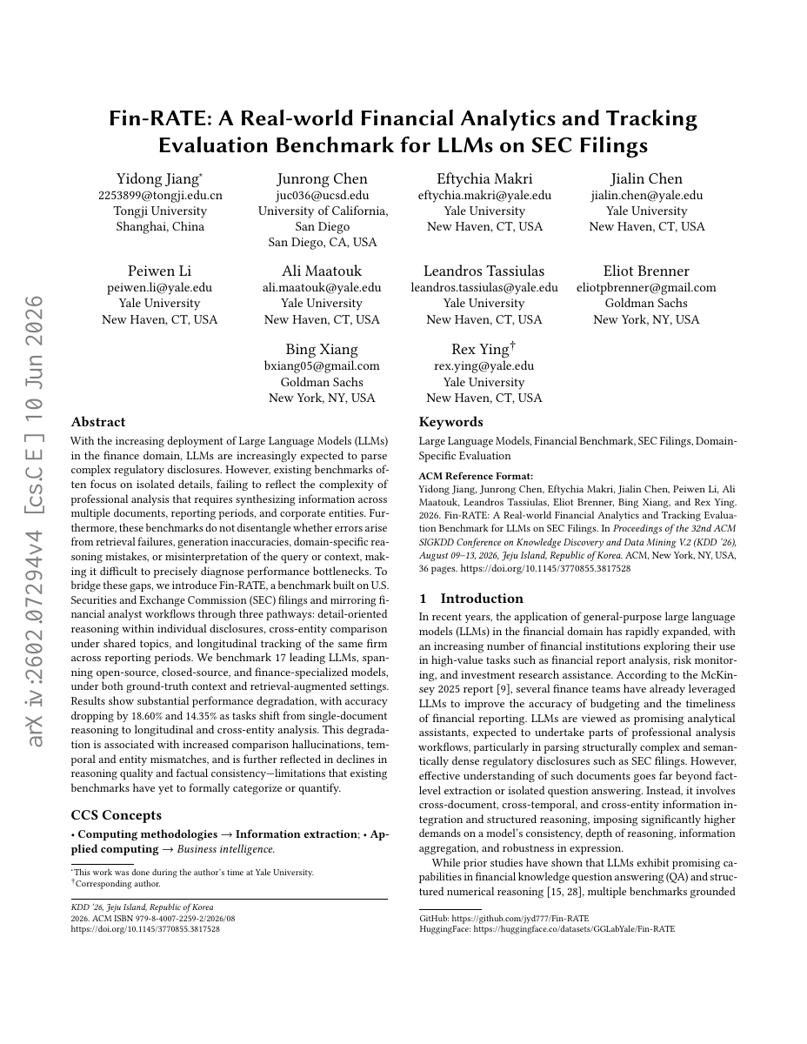
Fin-RATE
Can LLMs reliably analyze
financial reports?
Yidong Jiang et al.
KDD 2026
汇报人：顾希晨
汇报时间：2026-10-8
01

Slide 2
Three tasks in Fin-RATE
7,500 questions across 43 companies
Task | Evidence scope | Main challenge
Detail and reasoning | One document chunk | Interpret local evidence
Enterprise comparison | Different companies | Keep entities separate
Longitudinal tracking | Same company over time | Align reporting periods
SEC filings 2020–2025: 2,472 filings, 15,311 chunks, 43 companies, 36 industries. Each task: 2,500 questions.
02

Slide 3
How Fin-RATE differs from prior benchmarks
Only benchmark combining cross-company, cross-year, and multi-document reasoning
Benchmark | Cross-Comp. | Cross-Year | Multi-Doc | Analytic | Fine-grained Eval. | Data Sources
FinQA | × | × | × | × | × | Annual report
FinanceBench | × | × | × | ✓ | × | 10-K, 10-Q, 8-K
SEC-QA | ✓ | ✓ | ✓ | × | × | 10-K, 10-Q, 8-K
Fin-RATE (Ours) | ✓ | ✓ | ✓ | ✓ | ✓ | 10-K, 10-Q, 8-K, 6-K...
Fine-grained error diagnosis goes beyond accuracy-only evaluation.
03

Slide 4
Two evidence settings
Gold context
Retrieved context
The model receives
the reference evidence
A retriever selects passages
before the model answers
Tests reasoning with
relevant context available
Tests evidence retrieval
and answer generation
17 models tested. Best retriever: R@10=44.8% on DR-QA, but only 5.9% on EC-QA — cross-company retrieval is very hard.
04

Slide 5
Performance depends on the task
System | Detail reasoning | Company comparison | Time tracking
Fin-R1 | 57.48% | 3.32% | 9.72%
GPT-5-websearch | 42.96% | 43.64% | 43.52%
Human experts | 92.40% | 82.68% | 85.88%
Finance-specialized models excel at local detail, but lag far behind
general models on cross-company and longitudinal reasoning
05

Slide 6
A wrong year can reverse the conclusion
The model recalls the numbers but swaps their years
Year | Correct assignment | Model assignment
2022 | 70% | 65%
2023 | 65% | 70%
Conclusion | Decrease | Increase
Other common errors: entity omission (miss one company), incomplete comparison, and evidence retrieval failures (RAG accuracy < 27%).
06

Slide 7
Implications and limitations
Contribution
Limitations
Realistic financial tasks
with specific error diagnosis
Limited company & industry coverage
LLM-assisted evaluation
No investment return testing
RAG retrieval remains weak
Reliable financial AI must connect each
conclusion to the right evidence
07

