Slide 1

FinMem: A Performance-Enhanced LLM
Trading Agent with Layered Memory and Character Design
A simple look at how an AI agent remembers market information
Name: Yi Dong
Id: 26213050080
Data: 2026.10.15
01
Notes:
Title
Today I will introduce FinMem, an LLM trading agent with a design for remembering market information over time. I will focus on its problem, its main ideas, and what the full IEEE journal study reports.

Slide 2
1. Limitations: What is missing in earlier trading agents?
Too much information
Markets produce news, prices, and company reports every day. An agent must decide what matters now and what may matter later.
Hard to explain
Core question: How can an LLM remember the right market facts at the right time?
Some learning-based agents give limited reasons for their actions, and combining text with market numbers can be difficult.
Weak memory and timing
The paper’s goal
Many LLM trading systems treat inputs like a question-answering task. They may forget key events or treat short-term news like long-term facts.
Build an agent that can store different kinds of financial information for different lengths of time, then use it in a decision.
02
Notes:
Limitations
Financial markets produce many kinds of data. Earlier LLM agents often process them as separate question-and-answer tasks, so they can miss which facts are recent and which remain useful. Other trading systems may be hard to explain or may need much longer training. FinMem tries to address these issues with structured memory and an adaptive trading profile.

Slide 3
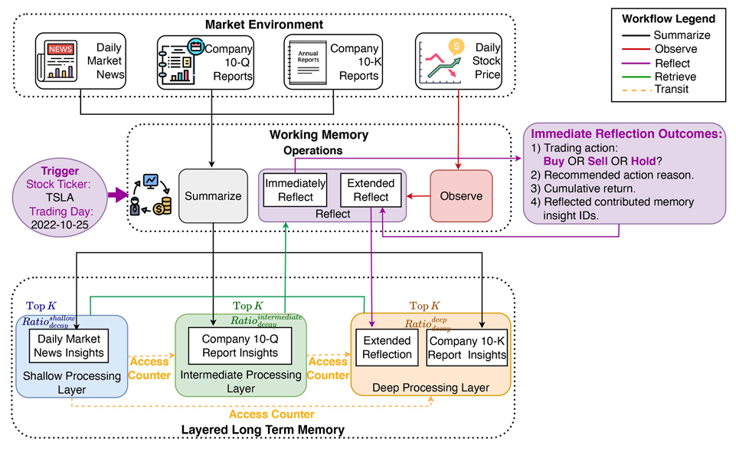
2. Innovation: What does FinMem add?
A trading profile
Memories are ranked by recency, relevance, and importance.
The agent has a professional role and a risk preference that can adapt to market conditions.
SHALLOW
Daily news · fades sooner
MIDDLE
Useful events · medium term
DEEP
Company reports · lasts longer
Layered memory
Short-term news goes into a shallow layer. Company reports can stay in a deeper layer for longer.
Reflection and action
Working memory summarizes and reviews events. The agent then combines useful memories with today’s market data.
03
Notes:
Innovation
//FinMem has three parts: a profile, memory, and decision-making. ///The profile gives the agent financial background and a risk style that can adapt. ///As for Layered memory, Short-term news goes into a shallow layer, company reports can stay in a deeper layer for longer.///Working memory summarizes and reviews events. The agent then combines useful memories with today's market data.

Slide 4
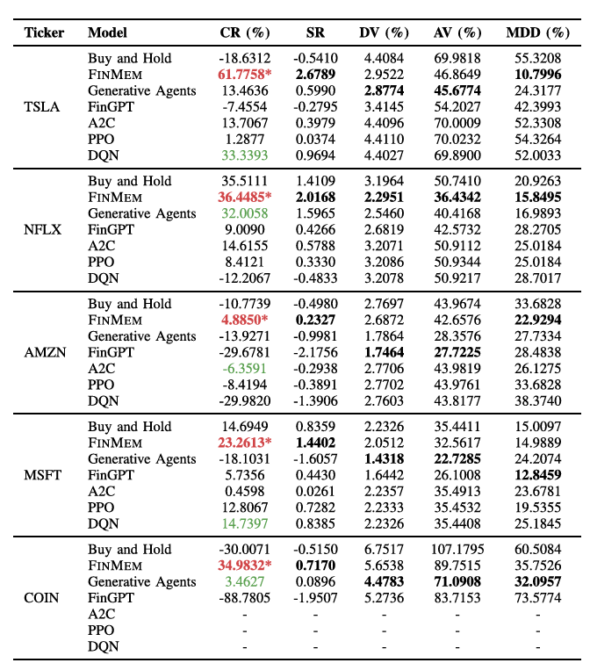
3. Experiments: How was FinMem tested?
Setup
Backtest on 5 stocks: TSLA, NFLX, AMZN, MSFT, and COIN.
Compare with seven methods: Buy & Hold, 3 deep-RL agents, and 2 LLM agents.
Main findings
FinMem led in cumulative return on all five stocks.
For TSLA and NFLX, return was above 35% and Sharpe ratio above 2. The paper reports the advantage over the second-best strategy as statistically significant.
These are historical backtests, so they do not promise future profit.
Limitations
04
Notes:
Experiments:这是五家公司的股票代码：
TSLA：Tesla（特斯拉）
NFLX：Netflix（奈飞）
AMZN：Amazon（亚马逊）
MSFT：Microsoft（微软）
COIN：Coinbase（加密货币交易平台 Coinbase）
“Backtest on 5 stocks”指的是：作者用历史数据模拟这套策略在这五只股票上的交易表现。
The journal paper tests five stocks and compares FinMem with Buy and Hold, three deep reinforcement learning agents, and two LLM agents. It reports the highest cumulative return on all five stocks. For Tesla and Netflix, returns exceeded 35 percent and Sharpe ratios exceeded 2. A statistical test found a significant advantage over the second-best strategy. These are historical backtests, so they do not promise future profit.

Slide 5
4. Conclusion
Main idea
FinMem gives an LLM a structured memory: fast-changing news is stored differently from lasting company information.
Main lesson
A strong trading agent needs more than a language model: it needs a way to remember and update information over time.
What matters
This makes the agent’s information use more time-aware and its decision process easier to inspect.
Thank you for your attention.
Source: Yu et al., IEEE Transactions on Big Data, 11(6), 3443–3459, 2025. DOI: 10.1109/TBDATA.2025.3593370.
05
Notes:
Conclusion
FinMem’s key idea is that a trading agent should remember information according to how long it stays useful, and adjust its risk style as conditions change. The tests are promising, but wider data and live-market studies are still needed. Thank you.

