Slide 1
Trade in Minutes!
ICLR 2026 · PAPER PRESENTATION · FINTECH × AI
Rationality-Driven Agentic System for Quantitative Financial Trading
Song et al. · Tongji University & Microsoft Research Asia
Presenter: ____Yifei Wang____
Notes:
[CUE] Intro · ICLR 2026 · the twist: the LLMs don't trade · ~15 s Hey everyone! Today I'm walking you through an ICLR 2026 paper called "Trade in Minutes!", from Tongji and Microsoft Research Asia. Short version: they built a team of LLM agents for quant trading — but here's the twist: none of those LLMs actually do the trading.

Slide 2
Where LLM trading agents fall short
01 · MOTIVATION
Emotional bias
Noisy inputs
Role-playing human traders brings human biases.
News and social media are noisy and lag the market.
Latency & cost
Rigid rules
An LLM call on every trade is slow and expensive.
Classic quant is fast but breaks when markets shift.
TiMi · ICLR 2026
02
Notes:
[CUE] 4 problems: bias · noisy inputs · latency/cost (the big one) · rigid rules · ~25 s So first, why do we even need this? Existing LLM trading agents, like FinMem or TradingAgents, have four big issues. They role-play human traders, so they pick up human biases. They lean on news and social media, which is noisy and usually late. And they call the LLM on every single trade, which is slow and pricey — and in a fast market, slow costs you money. Meanwhile, old-school rule-based quant is fast, but it kind of falls apart when the market shifts.

Slide 3

Think slowly offline.
Trade fast online.
02 · CORE IDEA
LLM agents · offline
Code bot · live
Analyze markets, design strategies, write the bot's code.
Plain code on a CPU. Zero LLM calls at runtime.
TiMi · ICLR 2026
03
Notes:
[CUE] Read the headline · LLMs work before going live · only code trades · ~15 s Their fix is actually pretty simple: think slowly offline, trade fast online. All the heavy LLM work — reading the market, building strategies, even writing the code — happens before anything goes live. What actually trades is just plain code running on a CPU, with zero LLM calls. So you get the brains of an LLM without the lag.

Slide 4
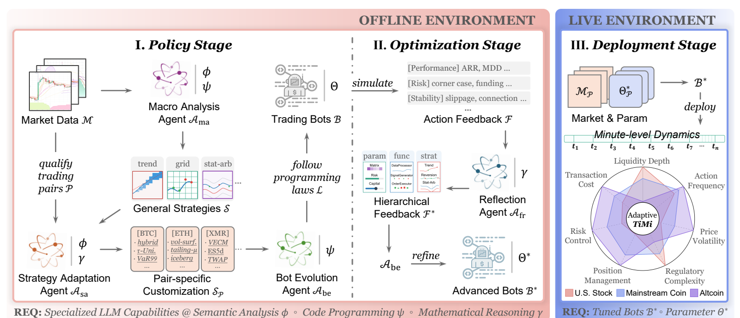
Policy → optimization → deployment
03 · ARCHITECTURE
Figure 1, Song et al. (ICLR 2026) · Backbones: DeepSeek-V3 · Qwen2.5-Coder-32B · DeepSeek-R1
04
Notes:
[CUE] Main figure · red = offline (stages I & II) · blue = live (stage III) · walk the arrows · ~25 s So how does it actually work? Here's the main figure from the paper. The red part on the left is everything offline, and it has two stages. In the policy stage, one agent scans the whole market for patterns, and another one tailors that to each trading pair. In the optimization stage, one agent writes the bot as code, and another one tests it in simulation and fixes whatever breaks. Then on the right, in blue, the finished bot goes live and runs on its own. Under the hood, they use DeepSeek-V3 for analysis, Qwen-Coder for the code, and DeepSeek-R1 for the math.

Slide 5
Reflection in math, not words
04 · KEY MECHANISM
1
Simulate the bot → feedback F
Minimal intervention
Fix the lowest layer that works
2
Diagnose risks: R = γ(F)
① Parameter · tune
3
Risk → constraint A(R)·Θ ≤ b(R)
② Function · swap
4
Solve for the best parameters Θ
③ Strategy · rebuild
TiMi · ICLR 2026
05
Notes:
[CUE] Highlight of the talk · "verbal" vs math reflection · example: position cap · fix the lowest layer first · ~30 s Most agents do what you might call "verbal reflection" — the LLM basically writes a little essay about what went wrong. TiMi uses math, or let’s say, symbolic reasoning instead. It runs the analyzer, spots the risky moments — say, a position got way too big right before a crash — and turns each one into a hard constraint, like a cap on position size. Then it just solves for the best parameters.

Slide 6
Stocks + crypto, backtest + live
05 · EXPERIMENTAL SETUP
3
200+
15
markets: index futures, major coins, altcoins
trading pairs; 213 live at once
baselines in three families
Family | Baselines
Quant rules | MACD, Momentum, Grid, Pairs, ETF&PCA, TSMOM, OFI
ML / RL | LSTM, Autoformer, PatchTST, DQN, DDPG
LLM agents | FinGPT, FinMem, TradingAgents
Backtest: 2024 · Live trading: Jan–Apr 2025
06
Notes:
[CUE] 3 numbers left → right · stress “real live trading” · ~15 s For the experiments, they covered three markets — US index futures, major coins and altcoins — across more than two hundred trading pairs. They backtested on 2024 data, and they also ran it in live trading from January to April 2025. The results were compared against fifteen baselines: classic quant rules, ML and RL models, and other LLM agents like FinMem and TradingAgents.

Slide 7
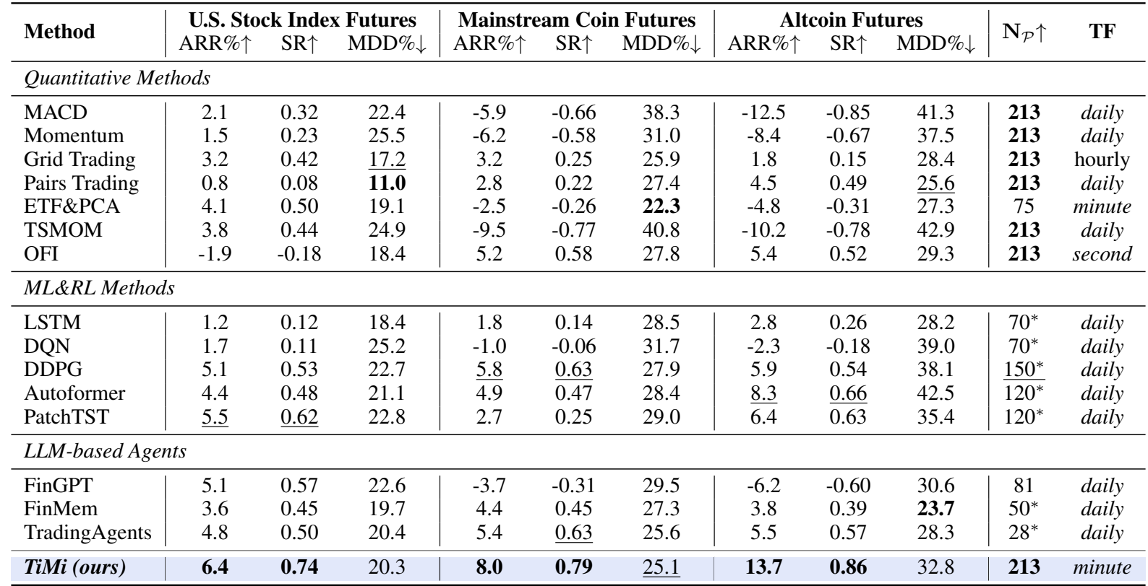
Live trading, Jan–Apr 2025
06 · RESULTS
BEST
Return and Sharpe in all 3 markets
NOT BEST
Max drawdown, e.g. 32.8% on altcoins
NOTE
* = baseline estimated from partial runs
Table 3, Song et al. (ICLR 2026) · ARR = annualized return · SR = Sharpe · MDD = max drawdown
07
Notes:
[CUE] Original Table 3 · point at the boxed TiMi row · best return + Sharpe everywhere · drawdown not best · stars = estimated · ~25 s Here's the main results. The boxed row at the bottom is TiMi. It made money in all three markets, and it has the best return and Sharpe ratio in every one of them — best on altcoins, at 13.7% annualized with a Sharpe of 0.86.

Slide 8
Fast and capital-efficient
07 · EFFICIENCY
1.53
137 ms
0.91
profit/loss per unit of capital
average latency per action
Sortino ratio on altcoins
P99: 185 ms
TradingAgents: 0.58
TradingAgents: 1.32
Not a clean sweep: in the 2024 backtest, plain momentum (TSMOM) beat TiMi's return in two of three markets.
Song et al. (ICLR 2026): Tables 1, 2, 5 and Section 4.2
08
Notes:
[CUE] 3 numbers left → right · then the honest caveat · ~20 s And because there's no LLM in the loop, it's fast — about 137 milliseconds per action. It also has a better Sortino ratio than TradingAgents, and it makes more per dollar invested. To be fair, though, it's not a clean sweep: in the 2024 backtest, a plain momentum strategy actually beat it on returns in two of the three markets.

Slide 9
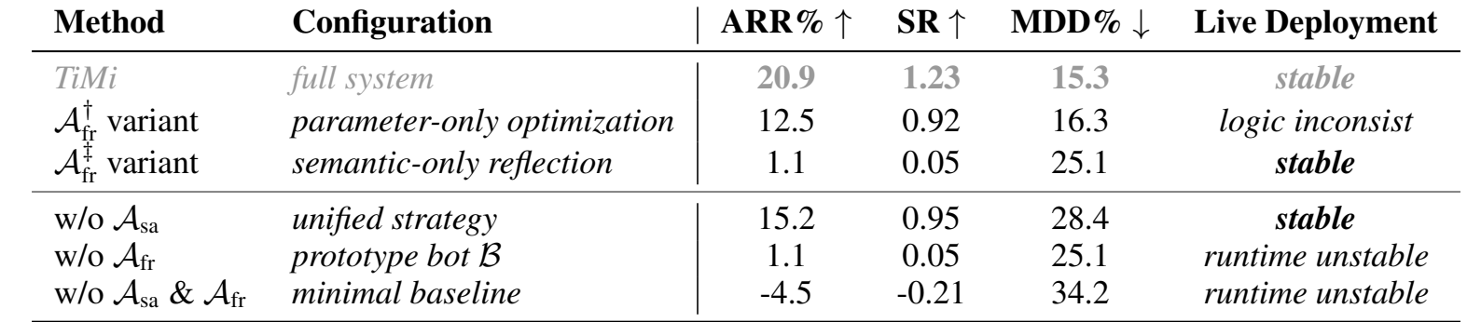
Every agent earns its place
08 · ABLATION
No Reflection → no return
No Adaptation → 2× risk
Return 20.9% → 1.1%
Max drawdown 15.3% → 28.4%
Table 4, Song et al. (ICLR 2026) · A_sa = Strategy Adaptation · A_fr = Feedback Reflection
09
Notes:
[CUE] Original Table 4 · point at the two boxed rows · 21% → 1% · drawdown doubles · ~20 s This is their ablation study. Look at the two boxed rows. Drop the strategy adaptation agent, and returns hold up okay, but max drawdown nearly doubles, from about 15 to 28 percent. Drop the reflection agent — that's the "prototype bot" row — and returns fall from about 21% to roughly 1%, so the bot basically just breaks even. And if you drop both, you're actually losing money.

Slide 10
LLMs as engineers, not traders
09 · TAKEAWAYS
WHAT WORKS
CAVEATS
Decoupling kills live latency
Only 4 months of live data
Code output is auditable
Some baselines estimated
Math reflection → rules
New market = re-tuning
TiMi · ICLR 2026
10
Notes:
[CUE] Say the headline · 3 wins (left) · 3 caveats (right) · thank you · ~20 s So, Let’s wrap things up: the big lesson here is to use LLMs as engineers, not traders. Separating the thinking from the trading kills the latency problem, having the output be code makes it auditable, and the math-based reflection turns mistakes into actual rules.

