Slide 1

ICLR 2026 / FINANCIAL TIME SERIES
VTA
Reasoning on Time-Series
for Financial Technical Analysis
Accurate forecasts with readable technical analysis
Kelvin J. L. Koa, Jan Chen et al.
arXiv:2511.08616v2

Slide 2
BACKGROUND
02
Why explain stock-price forecasts?
Price histories contain interpretable signals
Moving averages describe trends. Momentum tracks price changes.
10 trading days
10-day forecast
Historical prices and volume
A future price path plus an explanation
The missing link
LLMs struggle with raw numbers; time-series models rarely explain.

Slide 3
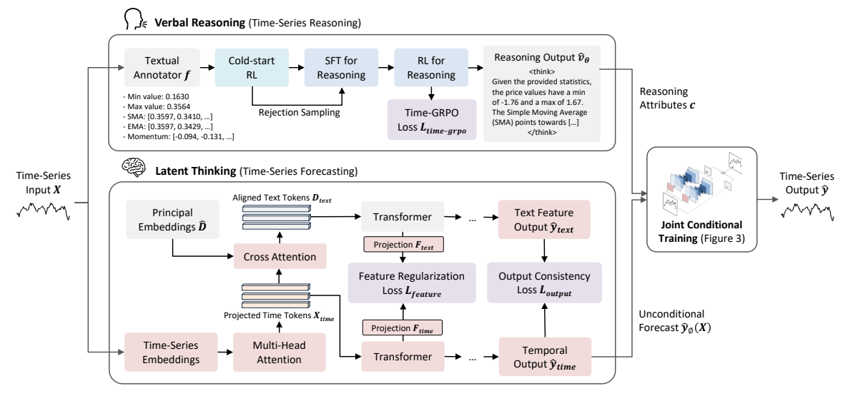
METHOD
03
Two models, one conditioned forecast
Qwen2.5-7B
GPT-2 backbone
Technical reasoning trained with GRPO
Numerical forecasts guided by reasoning attributes

Slide 4
RESULTS
04
Better forecasts across four stock datasets
U.S., Chinese and European markets
4.6%
MSE reduction vs. CALF
lower overall MSE
vs. CALF, the strongest baseline
3.69 / 5
Expert score vs. 2.63 / 2.64
for GPT-4.1 mini / DeepSeek-R1
Blind evaluation: 25 experts, 15 samples per expert

Slide 5
CONCLUSION
05
Reasoning can improve numerical forecasting
The contribution
VTA links readable technical analysis
to a dedicated forecasting model.
Explanation quality
Investment value
Experts prefer VTA’s analysis.
Faithfulness still needs direct testing.
Significant factor-adjusted alpha
appears only in China A50.
Next step
Closer alignment between reasoning and forecasts.

