Slide 1
FCMR
Robust Evaluation of Financial
Cross-Modal Multi-Hop Reasoning
Can multimodal models reason across financial text, tables, and charts?
Kim, S., Kim, C., & Kim, T. (2025). Proceedings of ACL 2025, 23352–23380. https://aclanthology.org/2025.acl-long.1138/
Presenter: Kaixin Chen Student ID: 26213050113
Notes:
Good afternoon. Today I will present FCMR, a benchmark for financial cross-modal multi-hop reasoning. The paper asks a simple but important question: can a multimodal language model combine evidence from financial text, tables, and charts, rather than solving each input separately?

Slide 2
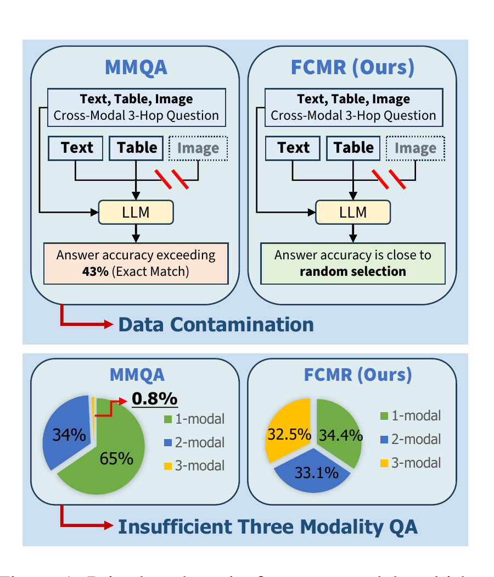
Why existing benchmarks can overestimate reasoning
43.4%
GPT-4o exact match on MMQA
without seeing the image
0.8%
of MMQA questions truly use
three modalities
A model may recall an answer or ignore one modality and still score well.
Notes:
The motivation is that existing benchmarks may reward recall instead of genuine reasoning. On the hardest subset of MMQA, GPT-4o still reaches 43.4 percent exact match when the image is removed. In addition, only 0.8 percent of MMQA questions actually require three modalities. So a high score may hide two problems: data contamination and shortcuts that let the model ignore visual evidence.

Slide 3
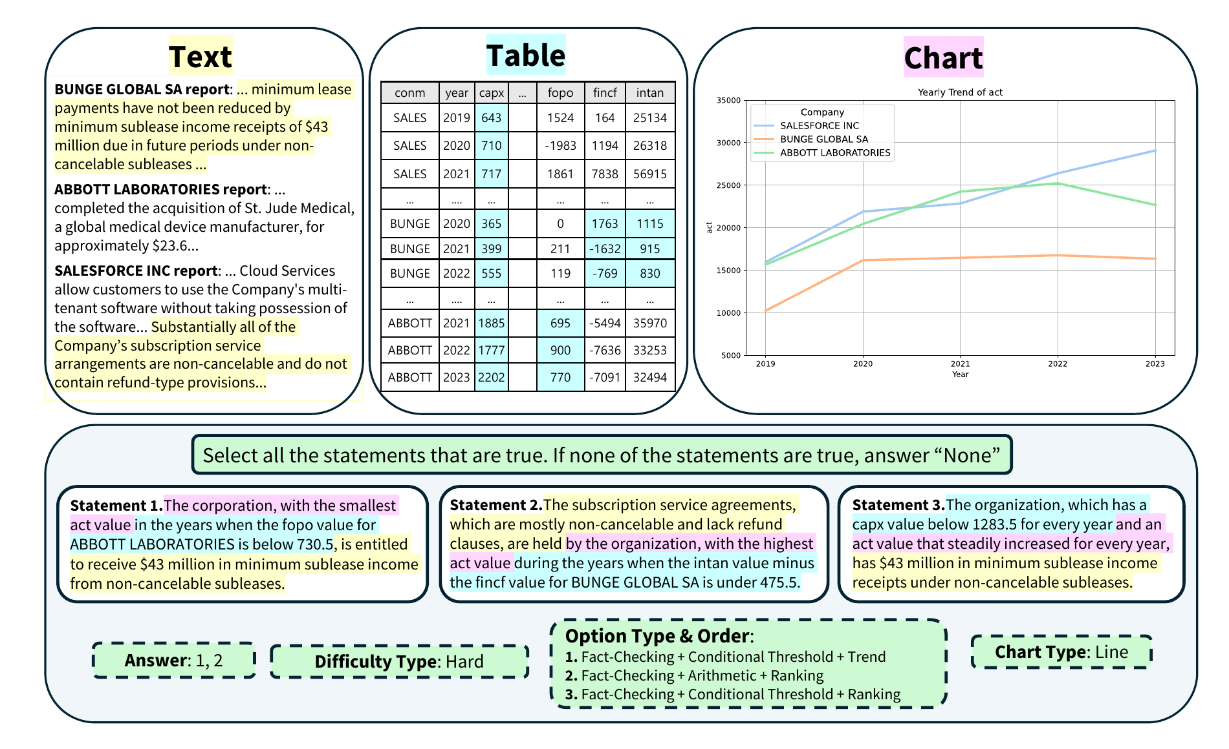
FCMR forces evidence integration across three modalities
2,199
questions
3
difficulty levels
3-hop
hard reasoning
All
modalities required
Hard questions require three-hop reasoning across text, tables, and charts.
Notes:
FCMR addresses these shortcuts by constructing every question from text, a financial table, and a chart. Easy questions use one-hop statements, medium questions use two-hop combinations, and hard questions require three-hop reasoning across all three modalities. The final dataset contains 2,199 questions. The model must select every true statement, so partial reasoning does not receive credit. This example shows why the task is difficult: the model must retrieve a fact from a report, apply a numerical condition in the table, and then identify a trend or ranking from the chart.

Slide 4
State-of-the-art models still fail on hard reasoning
Accuracy on the Hard split (%)
30.4%
best multimodal
model
Random
12.3
GPT-4o
24.4
Main bottleneck
Information retrieval
Claude 3.5 Sonnet
30.4
The main bottleneck is retrieving the right evidence across modalities.
0
35
Financial AI needs better retrieval and grounded reasoning, not only larger models.
Notes:
The results show a large gap between fluent answers and reliable reasoning. On the hard split, random selection scores about 12.3 percent. GPT-4o reaches 24.4 percent, while the best multimodal model, Claude 3.5 Sonnet, reaches only 30.4 percent. The authors then divide the reasoning process into planning, modality identification, retrieval, and reasoning. Their key diagnosis is that information retrieval is the main bottleneck. Models may identify the correct modality, but still fail to extract the required evidence. My takeaway is that progress in financial AI needs better grounded retrieval and cross-modal reasoning, not only larger models.

Slide 5
THANKS

