Slide 1
KDD 2025 · VIDEOCONVICTION
01
VideoConviction:
A Multimodal Benchmark for Human Conviction
and Stock Market Recommendations
Understanding stock recommendations and speaker conviction
Michael Galarnyk · Veer Kejriwal · Agam Shah et al.
Georgia Institute of Technology · Stanford University
Presenter: 26213050139 Yufan Deng
Source: Galarnyk et al., KDD 2025; public author version, arXiv:2507.08104v1.
Notes:
I'm Yufan Deng. Today I'll present VideoConviction, a KDD 2025 paper about stock recommendations and how strongly speakers express them in financial videos. It asks: Can AI understand these recommendations? And does stronger conviction make a recommendation a better investment?

Slide 2
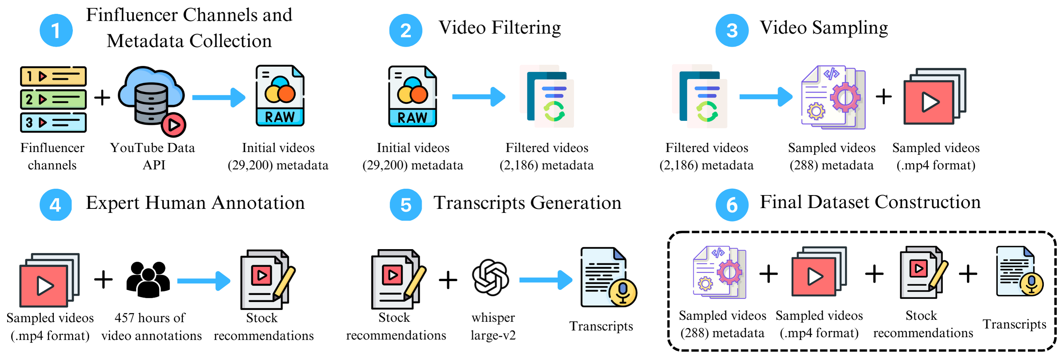
DATASET · FROM VIDEOS TO TRACEABLE SEGMENTS
02
Linking video understanding with fintech
Full videos
Advice segments
Annotations
YouTube channels
288
687
6,063
22
43 h · ~9 min on average
Expert-localized intervals
5 experts · 457 h of work
Finance creators
Source: p. 2, Table 2; pp. 3–4, Section 3, Figure 1. Table 2 reports 687 segments; an earlier passage reports 673.
Notes:
The dataset contains 288 financial videos totaling 43 hours, from 22 YouTube channels. Five experts spent 457 hours annotating them, identifying 687 recommendation segments and producing 6,063 annotations. Alongside text, the dataset preserves video links and timestamps, so each recommendation can be checked against the original video. This makes the annotations easier to verify and revisit.

Slide 3
TASKS · RECOMMENDATIONS AND CONVICTION
03
From stock tickers to actions to conviction
T
TA
TAC
Ticker
Ticker + Action
Ticker + Action + Conviction
Identify stock tickers
Add buy / sell / hold actions
Add conviction levels 1–3
AAPL
AAPL · Buy
AAPL · Buy · 3
Conviction: how firmly the speaker expresses the recommendation (levels 1–3)
Tone of voice
Facial expressions
Overall delivery
Title consistency
Hesitant or assertive?
Attitude conveyed visually
Wording and expression
Does the title match the clip?
Experts rate expressed conviction, not model confidence or the probability that the recommendation is correct.
Source: p. 4, Table 4; p. 6, Section 4.2; p. 11, Table 8. AAPL · Buy · 3 is an illustrative task example.
Notes:
The three tasks increase in difficulty. T identifies stock tickers. TA adds actions such as buy, sell, or hold. TAC adds conviction: how firmly the speaker expresses the recommendation. For example, AAPL, Buy, 3 means a buy recommendation for Apple, with conviction level three. Experts consider tone, facial expressions, overall delivery, and consistency between the title and segment. This measures the speaker's conviction, not model confidence or the probability of being correct.

Slide 4
EXPERIMENTS · EXPERT-SELECTED SEGMENTS HELP
04
Relevant segments help; understanding remains hard
GPT-4o · Multimodal input
TAC 19.60 → 27.86
With relevant segments given,
TAC improves by 8.26 F1 points.
Important limitation
Experts select the segments.
Automatic localization needs
separate validation.
Source: p. 6, Table 6; F1 × 100. Evaluated in February 2025 with expert-selected segments provided as input.
Notes:
Can AI understand the recommendations? With multimodal GPT-4o, replacing full videos with expert-selected segments raises ticker F1 from 64.95 to 83.47, and full TAC F1 from 19.60 to 27.86. Focusing on relevant content helps, but scores remain low when actions and conviction are included. Models often mistake general market commentary for explicit trading recommendations. These segments were identified by experts; whether automatic localization delivers the same gains requires separate validation.

Slide 5
FINANCIAL ANALYSIS · CONVICTION AND RETURNS
05
Sounding certain does not imply higher returns
Annualized return (%)
SPY: 11.28%
Follow buys: 9.74% · Weighted: 4.47%
Risk and robustness
Reverse strategy: 17.90% a year.
Sharpe ratio: only 0.41.
Exclude stocks below $5:
Annualized return: -20.97%.
Source: pp. 7–8, Section 5, Table 7. Backtests: Jan. 2018–Aug. 2024; human labels, not automated model trading.
Notes:
Stronger conviction also does not mean higher returns. In historical backtests using human labels, following buy recommendations returns 9.74% annually, below SPY's 11.28%. Weighting by conviction yields only 4.47%. Trading against the creators returns 17.90%, but its Sharpe ratio is just 0.41. Excluding low-priced stocks turns its annualized return negative, to minus 20.97%. The tallest bar therefore does not establish a robust trading strategy. These results highlight the importance of checking risk and robustness alongside headline returns.

Slide 6
TAKEAWAYS · UNDERSTANDING AND EVALUATING ADVICE
06
Fintech value: extract recommendations and assess quality
01
02
03
Structure content
Assess advice
Check robustness
Extract ticker, action, conviction;
keep timestamps for comparison
and traceability.
Follow buys: 9.74% < SPY: 11.28%.
Stronger conviction does not
guarantee higher returns.
The reverse strategy is sensitive
to low-priced stocks. Check risk
and sample sensitivity.
Sounding certain does not make advice worth investing in.
Sources: p. 5, Table 5; pp. 7–8, Section 5 / Table 7; p. 13, Table 10. Fintech implications are my synthesis; backtests use human labels.
Notes:
From a fintech perspective, this paper turns financial videos into comparable, traceable recommendation records and evaluates their quality through historical backtests. Evaluating financial content requires looking at returns, risk, and sensitivity to the sample. It connects video understanding with a concrete question about investment value. My takeaway is simple: understanding what creators recommend is only the first step. Sounding certain does not make a recommendation worth investing in.

