Slide 1
FINBERT / PAPER READING
FINANCIAL NLP
Financial Technology and Artificial Intelligence
FinBERT
READING FOCUS
01 Model design
A Large Language Model
for Extracting Information from Financial Text
Finance vocabulary
and BERT pretraining
02 Controlled tests
Sentiment benchmarks
and mechanism checks
Allen H. Huang | Hui Wang | Yi Yang
HKUST / Renmin University of China
03 Financial relevance
Contemporary Accounting Research
40(2), 806-841 | 2023
ESG and earnings-call
market evidence
Presenter: Chaofan Cheng
01 / 09

Slide 2
FINBERT / PAPER READING
READING ROADMAP
Outline: the paper and its evidence
Research question → Methods → Results and applications → Conclusion
Paper logic | What I focus on | Evidence
01 Motivation & model | Why does financial text need its own model? | Sections 1-2 Figure 6
02 Sentiment benchmarks | Does finance training improve classification? | Section 3 Table 1
03 Robustness & applications | Why does it work? Where else is it useful? | Figure 1; Tables 3-5 Table 7
04 Conclusion & assessment | What is well supported? What still needs testing? | Section 6 Reader assessment
02 / 09

Slide 3
FINBERT / PAPER READING
01 / MOTIVATION
Research question
THE GAP
Financial text differs from general text
Prior approaches
Dictionaries and bag-of-words
use limited sentence context.
Special vocabulary and sentence context
can change the meaning of a statement.
What this paper tests
Example from the paper: “allowance”
Finance-adapted BERT versus
general BERT, classical ML,
and earlier deep models.
Context | Typical meaning
Everyday English | Money given to a child
Financial text | Amount planned for a future cost
Can domain training improve accurate extraction of financial information?
03 / 09

Slide 4
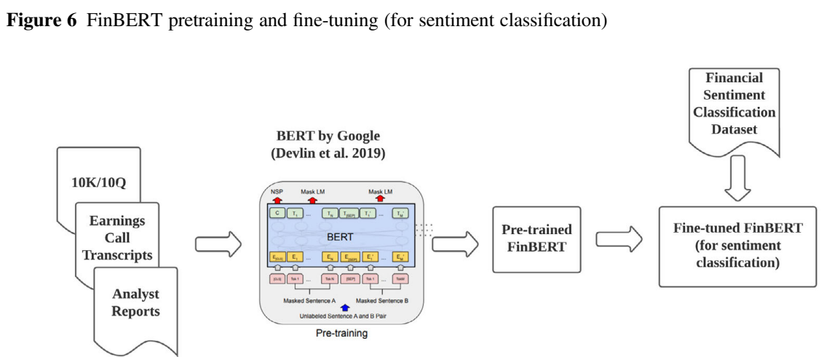
FINBERT / PAPER READING
02 / MODEL & DATA
Method and experimental setup
BERT BASE architecture • 12 layers • 768-dimensional representations
Pretraining corpus
4.9B tokens
2.5B Corporate filings
1.1B Analyst reports
1.3B Earnings calls
Financial vocabulary
30,873 tokens
~41% overlap with BERT
Pretraining objectives
Fine-tuning head
Evaluation split: 10,000 sentences
Masked words (15% of tokens)
Next-sentence prediction
[CLS] representation → softmax
Positive / Neutral / Negative
Train 8,100 | Validation 900
Test 1,000 | Same split for ML models
04 / 09

Slide 5
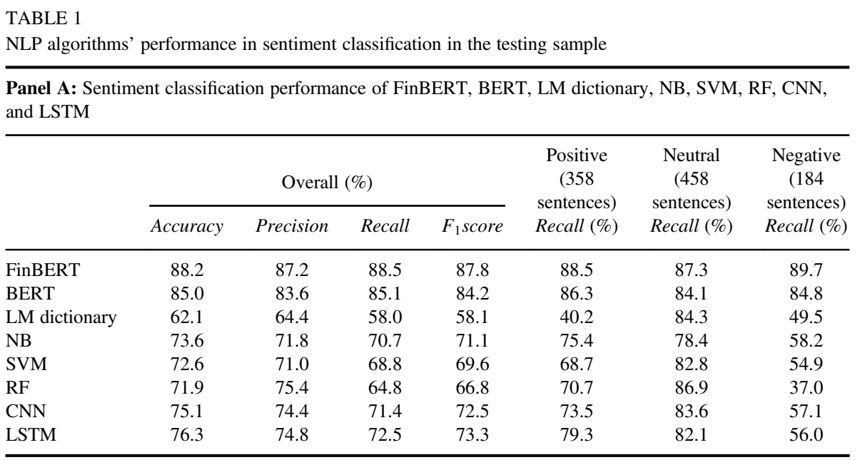
FINBERT / PAPER READING
03 / MAIN BENCHMARK
Results: sentiment classification
Common test set: 1,000 sentences | Accuracy, F1 and class-specific recall
Reading the
comparisons
BERT → +3.2 pp
Domain vs. general pretraining
LSTM → +11.9 pp
Pretraining vs. earlier deep NLP
Dictionary → +26.1 pp
Contextual learning vs. word lists
88.2%
87.8%
89.7%
Overall accuracy
F1 score
Recall for negative sentences
05 / 09

Slide 6
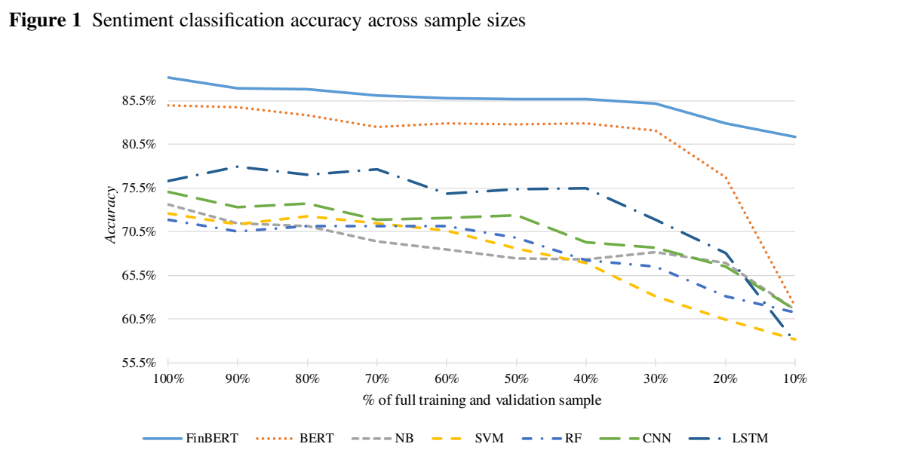
FINBERT / PAPER READING
03 / MECHANISMS
Additional tests: why does FinBERT work?
Three checks: fewer labels, word order, and financial vocabulary
Only 10% of labeled data
81.3%
FinBERT vs. 62.0% for BERT
+19.3 pp advantage
810 training + 90 validation
Test fixed at 1,000 sentences
Context check: shuffled words
Finance vocabulary: larger advantage
FinBERT: 88.2% → 76.9% (−11.3 pp)
Finance-rich: +4.0 pp | Finance-poor: +2.4 pp
06 / 09

Slide 7
FINBERT / PAPER READING
03 / APPLICATIONS
ESG classification and market evidence
ESG classification
Earnings-call market test
2,000 labeled sentences; 200 in the test set
28,873 calls | Three-day abnormal returns
Tone model | Coefficient | Adjusted R²
FinBERT | 0.907 | 0.080
BERT | 0.873 | 0.079
LM dictionary | 0.640 | 0.069
Higher explanatory power for call tone
with firm controls and time effects
Four labels: Environmental, Social,
Governance, and Non-ESG
Association evidence; not a trading backtest
07 / 09

Slide 8
FINBERT / PAPER READING
04 / MY READING
Conclusion and critical assessment
Domain knowledge + context improve financial text analysis
Evidence: stronger sentiment labels, fewer labeled examples, and financial applications
Reading point | What the paper provides | My assessment / next test
Domain comparison | FinBERT beats general BERT; finance vocabulary supports the gain. | Domain, corpus size and vocabulary change together. Better isolate each factor.
Evaluation overlap | Some labeled text is in pretraining. Authors report a non-overlapping PhraseBank robustness check. | Useful robustness evidence. Also test new firms, later periods and Chinese financial text.
Economic interpretation | Call tone is more closely associated with market reactions. | This supports information extraction. It does not establish causality or future trading profits.
Engineering trade-off: ~2 days of pretraining on 4 Tesla P100 GPUs; reusable model released
08 / 09

Slide 9
FINBERT / PAPER READING
Financial Technology and Artificial Intelligence
Thank you for your attention.
09 / 09

