Slide 1

NEURIPS 2025 · PAPER READING
Fin-o1: On the Transferability of Reasoning-Enhanced
LLMs and Reinforcement Learning to Finance
Lingfei Qian, Yan Wang, Xueqing Xie, Jian-Yun Nie, et al.
The FinAI · Georgia Tech · Yale · U. Montreal
Question. Do reasoning-enhanced LLMs and RL transfer to finance?
Answer. Financial CoT data + GRPO: Fin-o1 rivals models 10x larger.
Notes:
Good morning everyone. Today I will present Fin-o1, a NeurIPS 2025 paper from the FinAI team. The paper asks a simple question: do the reasoning-enhanced LLMs and reinforcement learning techniques behind models like o1 and DeepSeek-R1 actually transfer to finance?
The answer is not obvious, because finance is hindered by three gaps: there is no high-quality public financial chain-of-thought dataset, the major RL algorithms have never been compared on financial tasks, and there is no comprehensive benchmark. This paper closes all three gaps with FinCoT, the Fin-o1 models, and the FinReason benchmark.

Slide 2
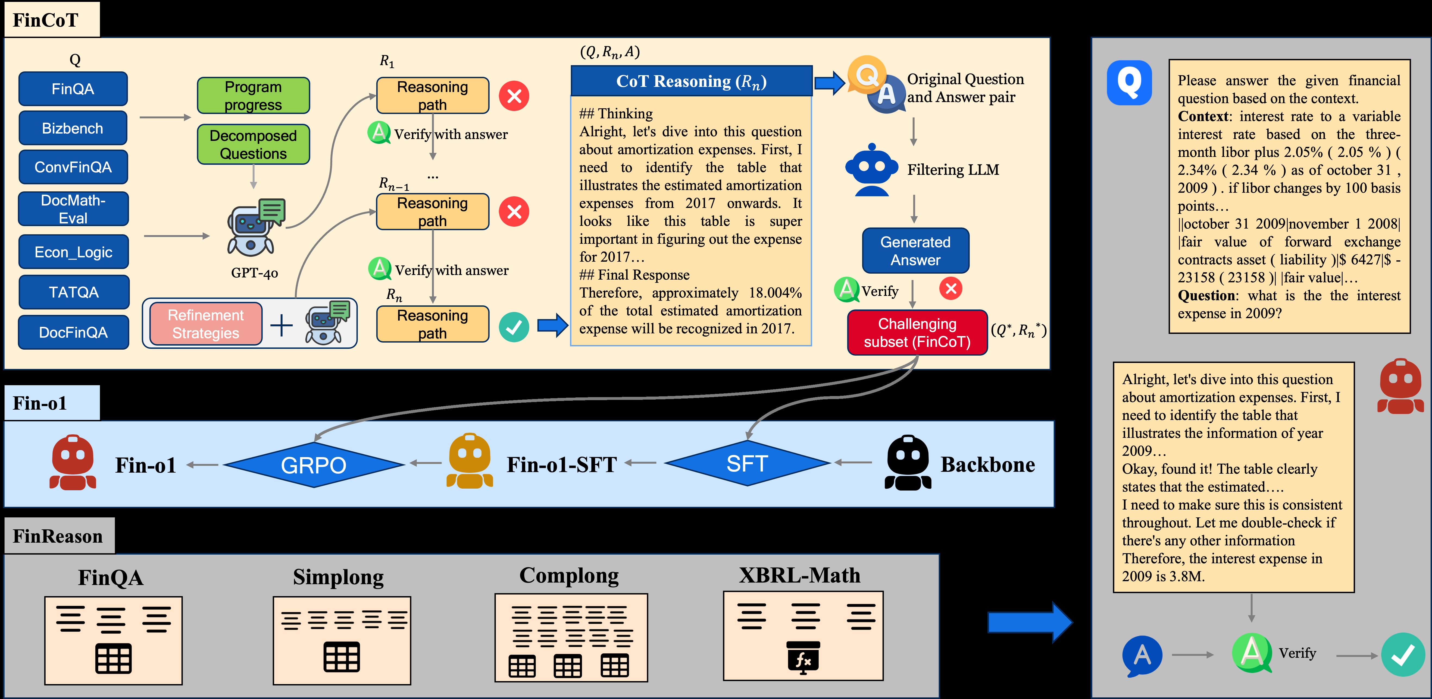
SECTION 2 · METHOD
Build High-Fidelity Financial CoT, Then Train with RL
FinCoT · 9,186 QA PAIRS
1 Domain-guided supervision — programmatic steps plus expert sub-questions
2 Iterative LLM refinement — multi-round verification via GPT-4o
3 Difficulty-aware filtering — keep only challenging pairs
Split: 7,686 for SFT + 1,500 for RL
Fin-o1 · QWEN3 BACKBONE
Backbone → SFT → RL (GRPO)
Multi-faceted reward: accuracy · logic · format · length
Figure 1. Overall framework of FinCoT, Fin-o1, and FinReason (Qian et al., 2025)
Key finding: GRPO yields reliable gains across all tasks; PPO and DPO do not.
2 / 3
Notes:
Now the method, which has two parts. First, they build FinCoT, the first high-fidelity financial chain-of-thought corpus. They start from seven existing QA datasets, then apply a three-stage pipeline: domain-guided supervision using programmatic steps and expert-curated sub-questions; iterative LLM refinement, where GPT-4o revises and verifies the reasoning over multiple rounds; and difficulty-aware filtering, which discards pairs a small model can already solve. This yields 9,186 pairs, split into 7,686 for supervised fine-tuning and 1,500 for reinforcement learning.
Second, they train Fin-o1 on a Qwen3 backbone: SFT followed by RL. Their GRPO reward is multi-faceted — it rewards accuracy, logical consistency, format, and response length, which is crucial for long financial documents. And the key finding is that GRPO yields reliable gains, while PPO and DPO do not.

Slide 3
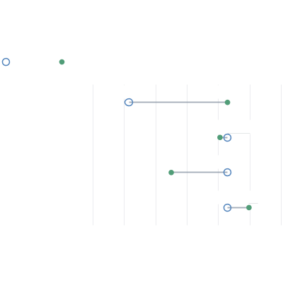
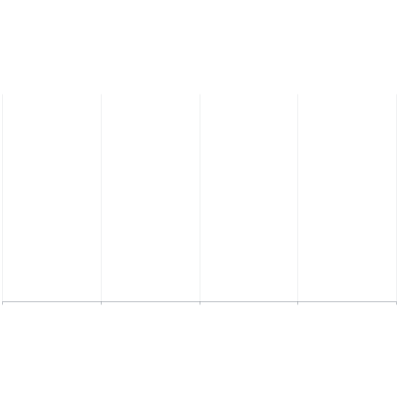
SECTION 3 · EVALUATION
FinReason: General Models Fail; Fin-o1 Matches Models 10x Larger
FinReason benchmark: 4 tasks — tables (FinQA), long context (Simplong), equations (XBRL-Math), multi-table (Complong) · 29 LLMs · LLM-as-judge
Overall accuracy on FinReason (avg, %)
Ablation (8B): SFT data and RL methods
%
Before
After
Δ
DianJin-R1-7B
34.83
52.28
58.58
Fin-R1-7B
34.85
Backbone -> SFT
+6.30
GPT-4o-mini
57.89
58.10
58.58
Qwen3-32B
57.92
SFT + PPO
-0.48
Fin-o1-8B
59.95
54.99
58.58
GPT-4o
60.83
SFT + DPO
-3.59
Fin-o1-14B
61.07
58.58
59.95
GPT-o1-preview
61.45
SFT + GRPO
+1.37
DeepSeek-V3
61.87
50
52
54
56
58
60
62
0
20
40
60
80
Average accuracy (%)
01 General reasoning models degrade on finance, especially long-context and multi-table.
02 Fin-o1-14B (61.07) rivals DeepSeek-V3; 8B beats GPT-4o-mini at 1/10 scale.
03 GRPO is the only RL method that reliably improves over SFT.
3 / 3
Notes:
Finally, they introduce FinReason, which covers four complementary tasks — reasoning over tables, long contexts, equations, and multiple tables. They evaluate 29 LLMs using an LLM-as-judge paradigm.
Two findings stand out. First, general reasoning models fail to transfer: specialized models like Fin-R1 score only about 35 on average, and strong models drop sharply on long-context and multi-table tasks. Second, Fin-o1-14B reaches 61.07, essentially tied with DeepSeek-V3 and GPT-o1, while the 8B model beats GPT-4o-mini at one-tenth the scale.
The ablation on the right explains why: SFT data helps, but among the RL methods, only GRPO improves over SFT. The takeaway is that financial reasoning needs specialized data, models, and optimization — it cannot be solved by scaling alone. Thank you.

