Slide 1

Green Pace
Security Policy Presentation Developer: Jorge bermudez

Slide 2

OVERVIEW: DEFENSE IN DEPTH
The implementation of this security policy aims to safeguard every level of the organization's structure. Employing Defense in Depth (DID), the policy employs a variety of defense strategies to minimize the likelihood of attackers exploiting vulnerabilities. In the event that an attacker manages to bypass one layer, there exists an additional layer to impede their progress. This approach effectively mitigates the potential impact of a successful breach by an attacker.

Slide 3

THREATS MATRIX
Likely Risk is more likely to occur STD-INT32-C STD-MSC52-CPP STD-STR02-C STD-STR50-CPP STD-MEM52-CPP STD-ERR51-CPP STD-CTR51-CPP | Priority High risk/Threat needs attention STD-STR50-CPP STD-STR02-C STD-MEM52-CPP STD-INT32-C STD-MSC52-CPP
Low priority | Unlikely
Risk has a low chance of a threat | Risk unlikely to occur
STD-DCL55-CPP | STD-DCL55-CPP
STD-ERR51-CPP | STD-FIO50-CPP
STD-FIO50-CPP | STD-DCL52-CPP
STD-DCL52-CPP
STD-CTR51-CPP

Slide 4
10 CORE SECURITY PRINCIPLES
Validate Input Data
STD-INT32-C
STD-STR50-CPP
STD-MEM52-CPP
STD-FIO56-CPP
STD-DLC52-CPP
STD-CTR51-CPP
Heed Compiler Warnings
STD-INT32-C
STD-STR50-CPP
Architect and Design for Security Policies
STD-MSC52-CPP
STD-MEM52-CPP
STD-ERR51-CPP
Keep It Simple
STD-DLC52-CPP
Default Deny
STD-STR02-C

Slide 5
10 CORE SECURITY PRINCIPLES
Adhere to the Principle of Least Privilege
Sanitize Data Sent to Other
Systems
STD-STR02-C
STD-DCL55-CPP
Practice Defense in Depth
Use Effective Quality Assurance Techniques
STD-INT32-C
STD-STR50-CPP
Adopt a Secure Coding Standard
STD-MSC52-CPP
STD-CTR51-CPP

Slide 6
CODING STANDARDS
Data Type (STD-INT32-C) – Ensure that operations on signed integers do not result in overflow
Data Value (STD-MSC52-CPP) – Value returning functions must return a value from all exit paths
String Correctness (STD-STR50-CPP) – Guarantee that storage for strings has sufficient space for character data and the null terminator
SQL Injection (STD-STR02-C) – Sanitize data passed to complex subsystems
Memory protection (STD-MEM52-CPP) – Detect and handle memory allocation errors
Assertions (STD-DCL55-CPP) – Avoid information leakage when passing a class object across a trust boundary
Exceptions (STD-ERR51-CPP) – Handle all exceptions
Input/Output (STD-FIO50-CPP) – Do not alternatively input and output from a file stream without an intervening positioning call
Declaration (STD-DLC52-CPP) – Never qualify a reference type with a const or volatile
Containers (STD-CTR51-CPP) – Use valid references, pointers, and iterators to reference elements of a container

Slide 7
ENCRYPTION POLICIES
Encryption in Rest – Encryption at rest is used to protect data that is stored on a physical storage device, such as an SSD. By encrypting data on the disk, an attacker will not be able to view the data unless authorized to do so.
•
Encryption at Flight – Encryption at flight occurs when data is encrypted while it is in the process of being transmitted through a network. This is most important for companies that use the open internet to transmit data. This prevents an attacker from intercepting to data and being able to view it.
Encryption in Use - Encryption in use ensures that all sensitive data is always protected, regardless of use or location of data.

Slide 8
TRIPLE-A POLICIES
Authentication – Authentication only allows verified users to access data. This is used for most databases so that users can only access the data if they have been granted permission. A user will have to have a granted login to access a database or they will have to create a new account if allowed.
Authorization – Users are given specific permissions depending on their access level. Depending on access level, some users may only be able to view data, while others may be able to modify data within a database.
Accounting – It is beneficial to monitor user actions within the database. Accounting allows for tracking of things such as files that are accessed by users and any changes they made in the database.

Slide 9
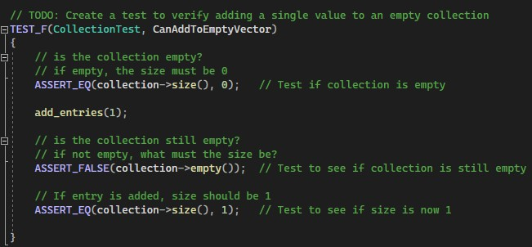
Unit Testing: CanAddToEmptyVector
This unit test checks to ensure functionality of adding a single value to an empty collection. This is a positive test.
Unit Test Code Result

Slide 10
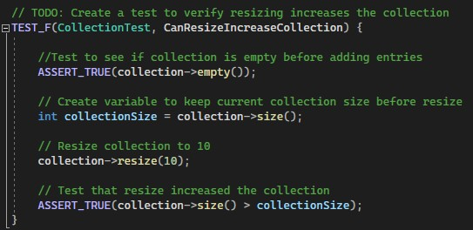
Unit Testing: CanResizeIncreaseCollection
This unit test checks that resizing the vector can increase the collection. This is a positive test.
Unit Test Code Result

Slide 11
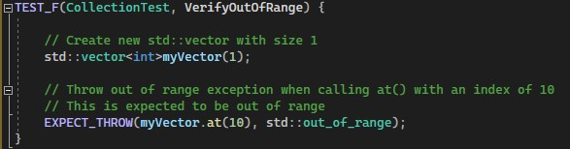
Unit Testing: VerifyOutOfRange
This unit test checks that the std:out_of_range exception is thrown when calling at() with an index out of bounds. This is a negative test.
Unit Test Code Result

Slide 12
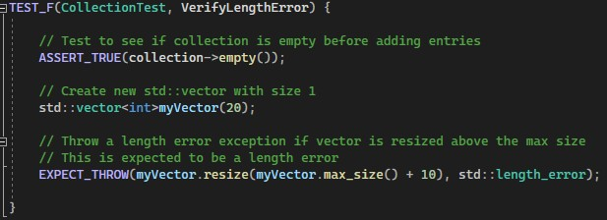
Unit Testing: VerifyLengthError
This unit test checks that an error will be thrown if the vector is resized above the max size.
Unit Test Code Result

Slide 13
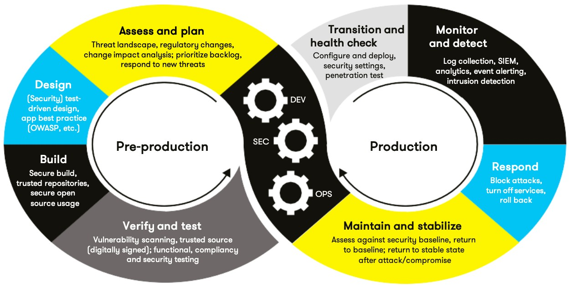
AUTOMATION SUMMARY

Slide 14
TOOLS
Green Pace utilizes the DevSecOps pipeline approach to enact DID and employ secure techniques. This approach initiates with a preliminary phase in which planning, designing, constructing secure code, and authenticating and evaluating the system take place. Subsequently, the operational phase encompasses program upkeep, prompt threat response, vigilant threat monitoring and detection, as well as smooth transitions and health assessments.
•
The Lightweight Directory Access Protocol (LDAP) facilitates swift user information querying. It oversees the access and upkeep of unchanging data, encompassing items like usernames, passwords, email addresses, and other confidential details.
Active directory (AD) is used to store sensitive information and is a secure way to control access to network resources.

Slide 15
RISKS AND BENEFITS
The potential consequences of deferring the implementation of security policies far outweigh the risks associated with initiating policy implementation at an early stage. Waiting introduces the jeopardy of squandering time, financial resources, and reputation, especially if the project reaches completion with numerous vulnerabilities. Such a scenario could lead to the disadvantageous situation of having to start anew or jeopardizing both client data security and the company's standing.
The remedy to this dilemma lies in commencing security implementation right from the outset. This approach guarantees a heightened level of security across the program and significantly diminishes the probability of encountering vulnerabilities.

Slide 16
RECOMMENDATIONS
- Always maintain clear and efficient communication with fellow developers.
- Refrain from incorporating any "backdoors" into the system.
- Establish a comprehensive plan for addressing breaches in case they occur.
- Adhere consistently to coding standards.
- Automate any repetitive tasks for increased efficiency.

Slide 17
CONCLUSIONS
•
Security should be implemented from the very beginning of the development process, beginning at the planning phase.
•
Always use DiD when developing a program. Create multiple layers of security to prevent an attacker from breaching the system.
•
Use the Triple-A architecture to aide in detecting a data breach.

Slide 18
REFERENCES
•
Are you following the top 10 software security best practices? Application Security Blog. (2021, July 1). Retrieved August 20, 2023, from https://www.synopsys.com/blogs/software-security/top-10- software-security-best-practices/
•
30 tips for software developers to enhance software security - codesigningstore. Code Signing Store. (2022, April 6). Retrieved August 20, 2023, from https://codesigningstore.com/tips-for-software- developers-to-enhance-software-security

