Slide 1
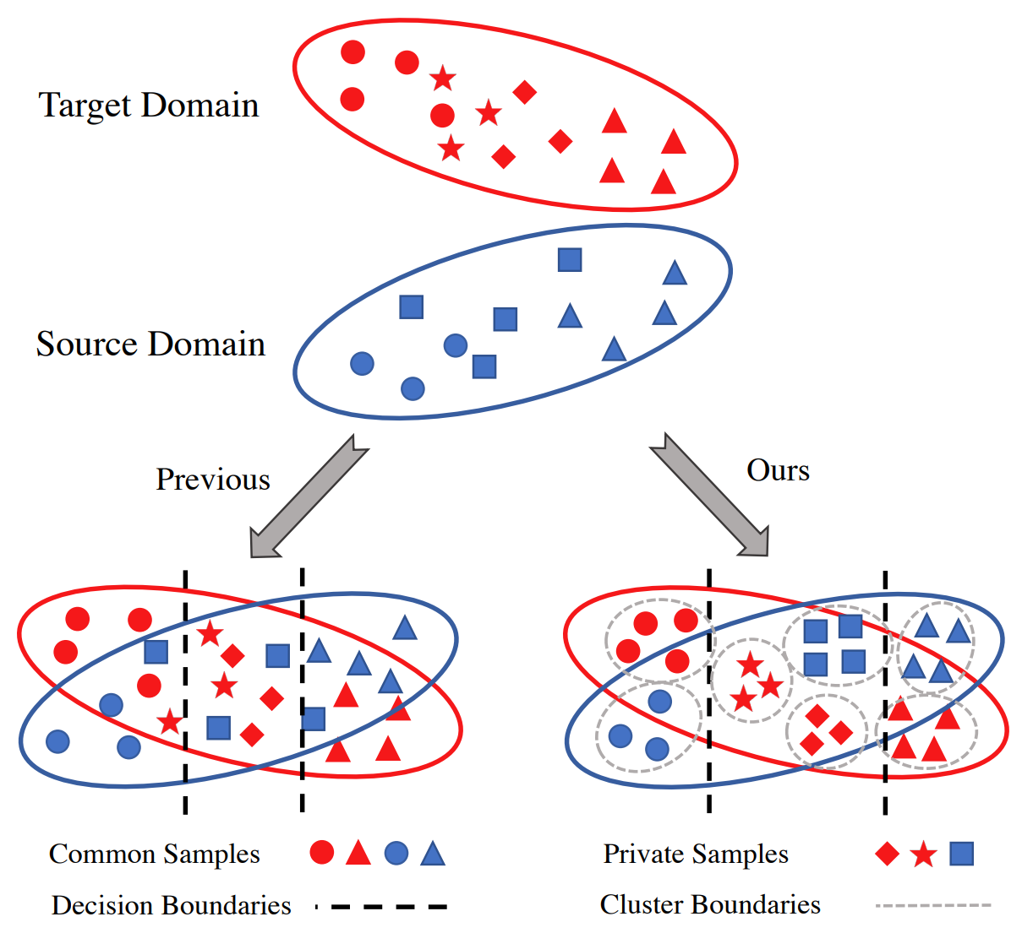
Domain Consensus Clustering for Universal Domain Adaptation
Propose Domain Consensus Clustering (DCC)
Exploits the domain consensus knowledge to discover discriminative clusters on both common samples and private ones
The semantic-level consensus among cluster centers is utilized to identify cycle-consistent clusters as common classes
Design a novel metric named “domain consensus score” to utilize the sample-level consensus to specify the number of target clusters
Tackle UniDA problem from a new perspective
Allows both domains to own private classes
G. Li, G. Kang, Y. Zhu, Y. Wei, and Y. Yang, “Domain Consensus Clustering for Universal Domain Adaptation,” CVPR, 2021, pp. 9757-9766.

Slide 2
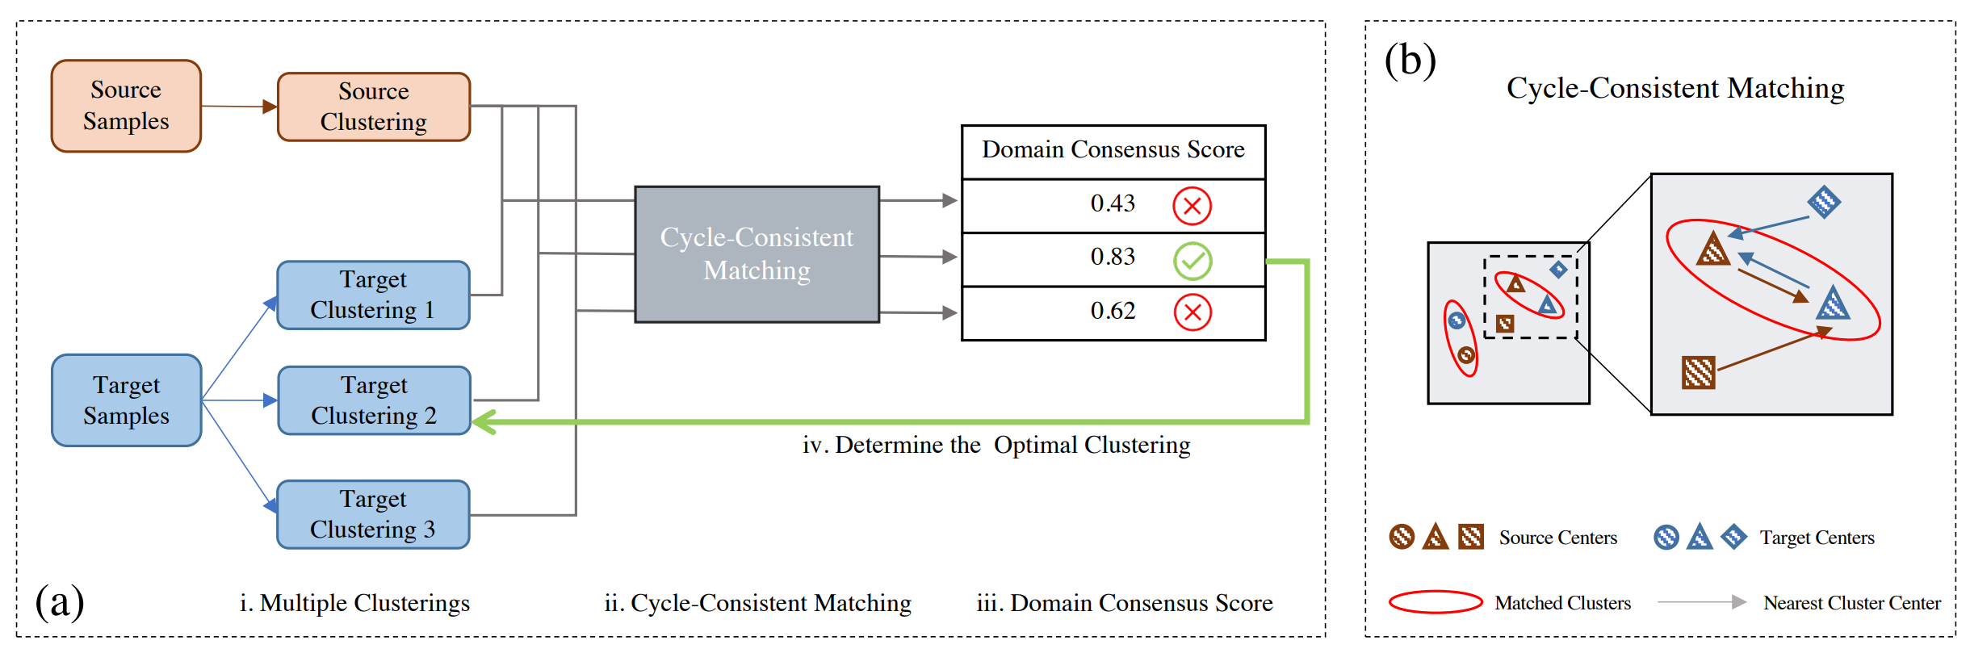
Domain Consensus Clustering for Universal Domain Adaptation
To select the optimal target clustering from multiple candidates
To identify clusters representing common classes from both domains
Determine the optimal target clustering
If two clusters from different domains act as the other's nearest neighbor, samples from the two clusters are identified as common samples that share the same semantic labels.

Slide 3
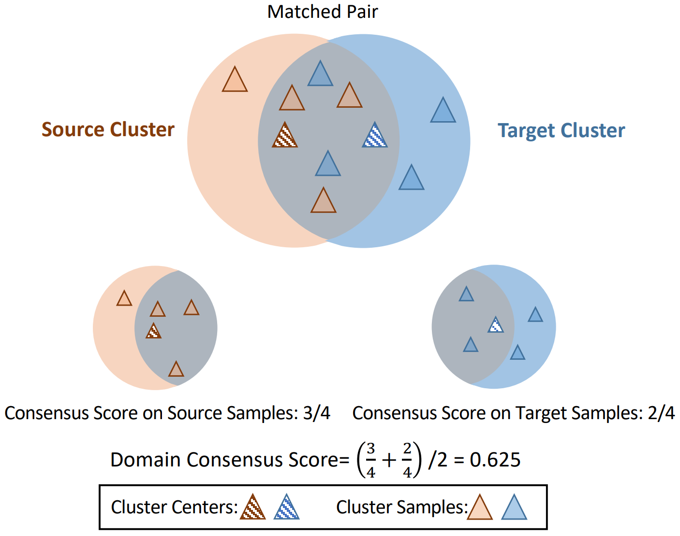
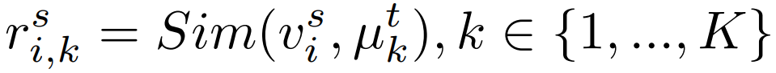
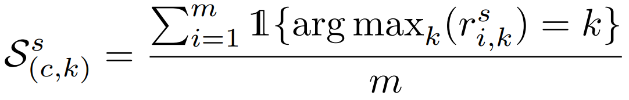
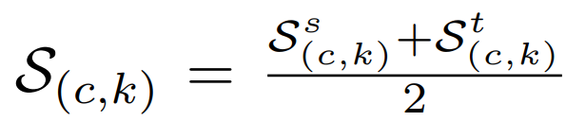
Domain Consensus Clustering for Universal Domain Adaptation
Cycle-Consistent Matching (CCM)
Aim to mine both common classes and individual private classes simultaneously with discriminative clusters
To link clusters from the same common classes through mining semantic-level consensus
Domain consensus score

Slide 4
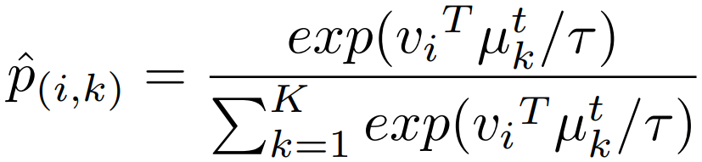
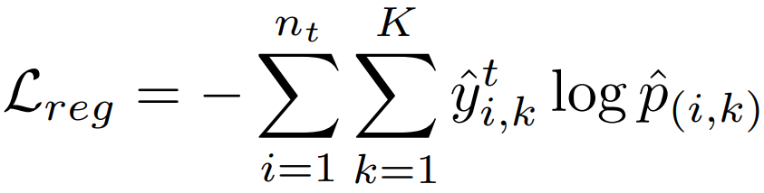
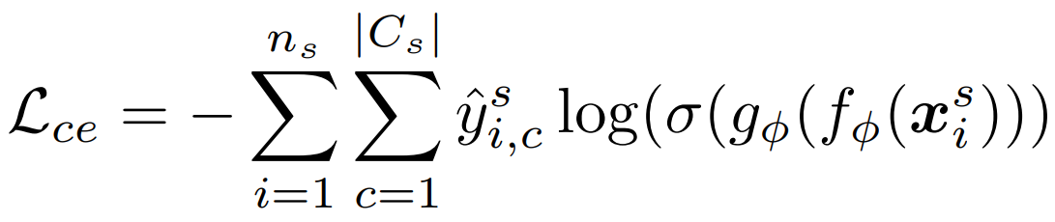
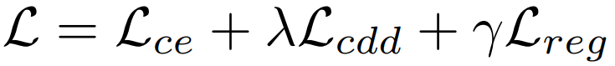
Domain Consensus Clustering for Universal Domain Adaptation
Clustering update strategy
Alternative update → two stop criteria
Score가 일정횟수로 떨어지면 stop searching
일정횟수 만큼 특정값 유지하면 K 고정
Prototypical regularizer
To enhance the discriminability of target clusters
Contrastive Domain Discrepancy (CDD)
To minimize the intra-class discrepancies and enlarge the inter-class gap
Overall objective

Slide 5
Domain Consensus Clustering for Universal Domain Adaptation
Datasets
Office-31
Office-Home
VisDA
DomainNet
Evaluation
ACC : the mean of per-class accuracy over common classes and unknown class
HM : the harmonic mean on accuracy of common samples and private ones.
Backbone
ResNet-50 with the backbone pretrained on ImageNet
VGGNet as backbone for OSDA task on VisDA

Slide 6
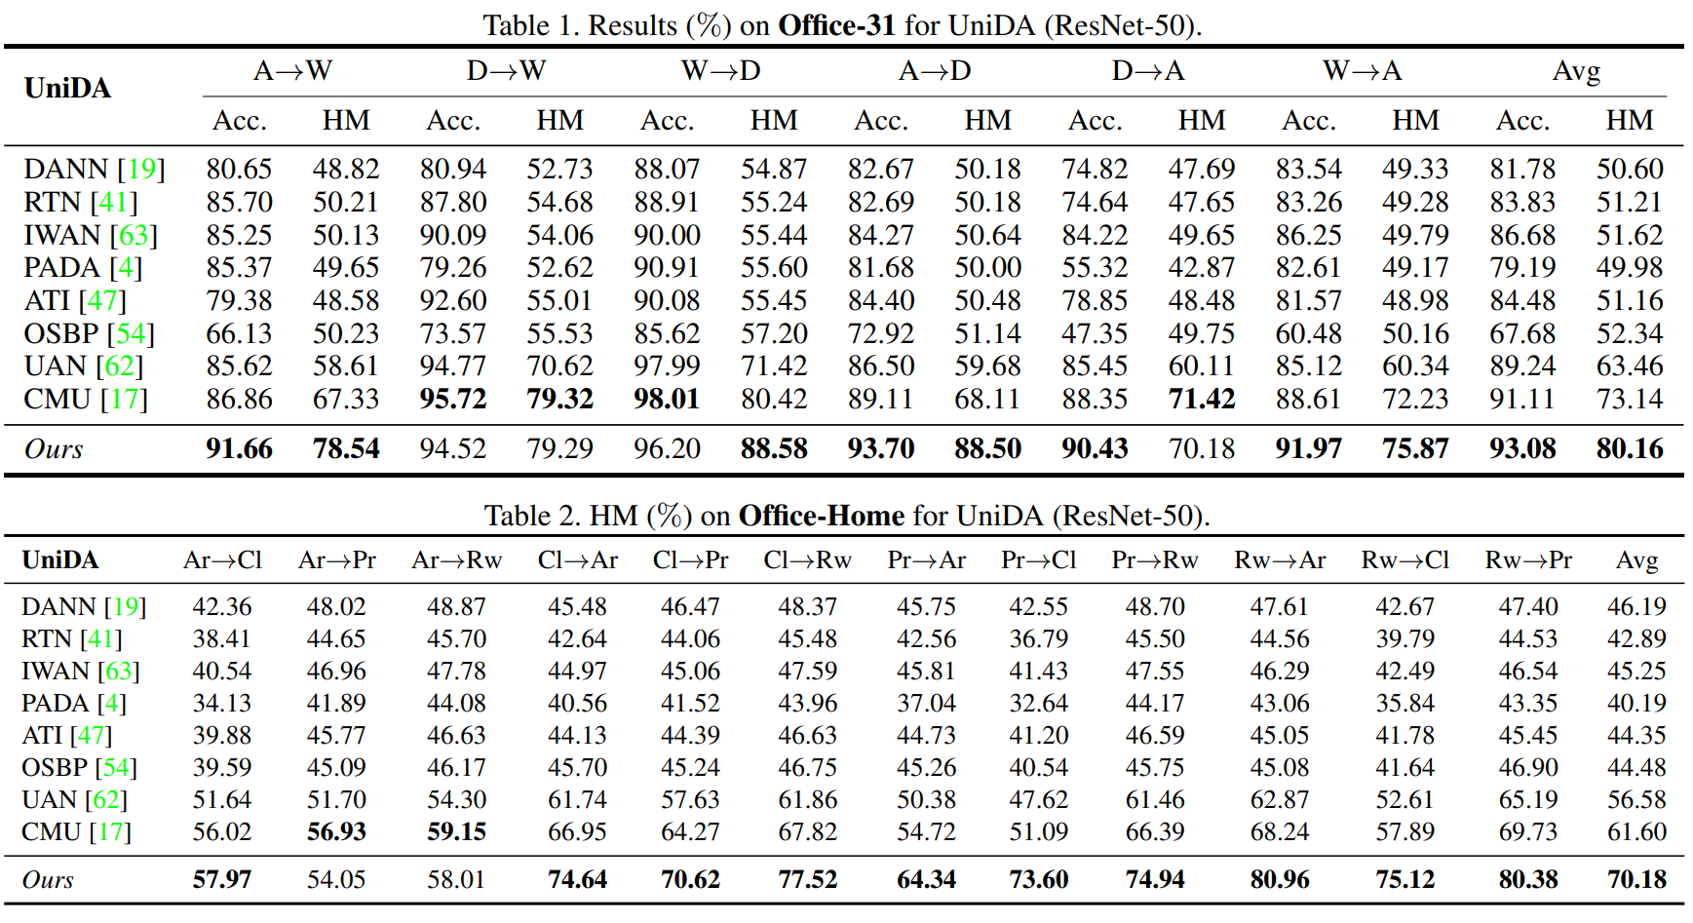

Slide 7
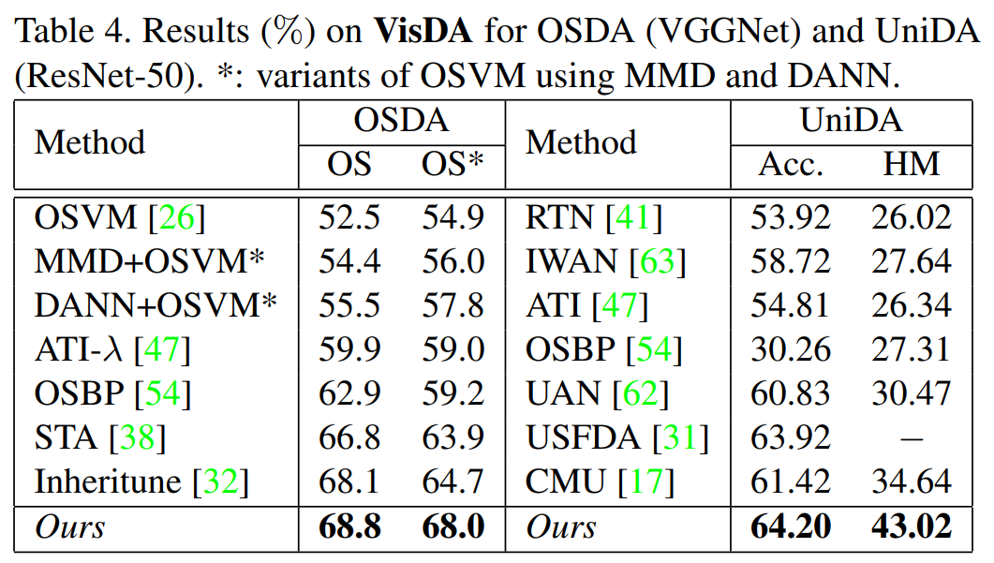
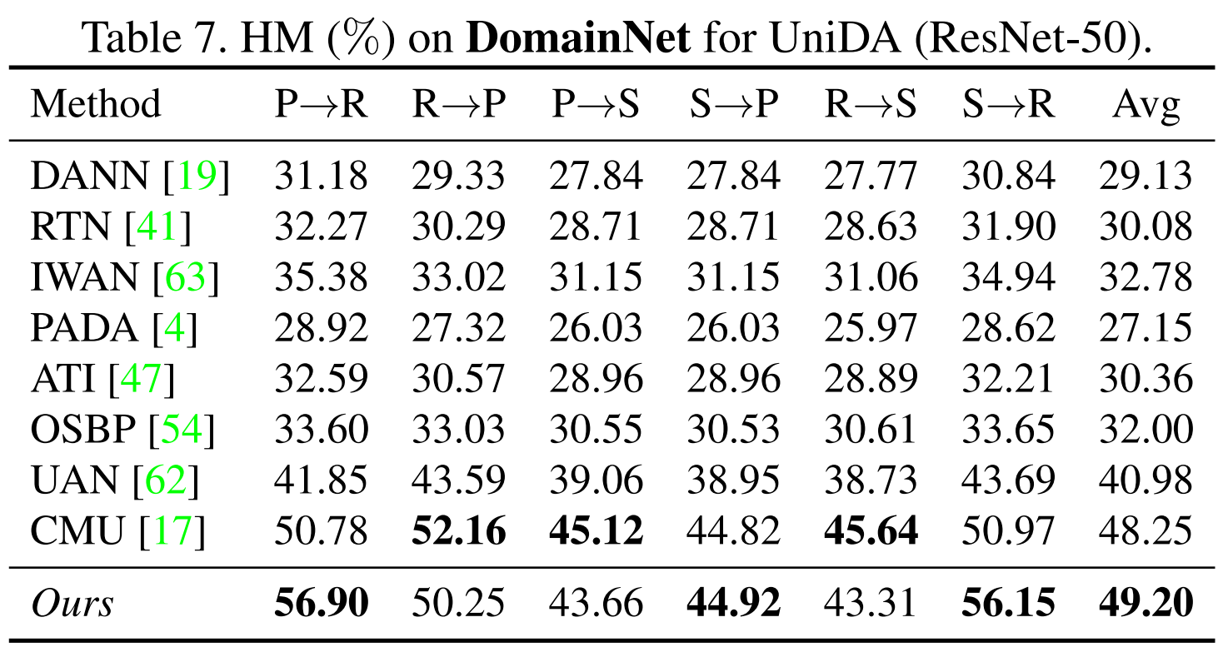

Slide 8
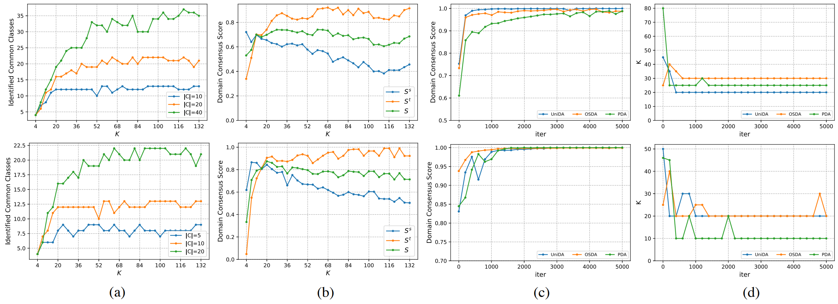
Number of identified common classes w.r.t K under varying |C|.
(Decomposed consensus score w.r.t. K.
The evolution of consensus score as training progresses.
The first row is extracted from AR->Rw of Office-Home and the second row is from A->D of Office-31

Slide 9


