Slide 1

程序优化
计算机系统导论 讨论班 @ 北京大学
向星雨
10/26/22

Slide 2
程序优化
编译器能自动优化
code moving
用移位和加减法代替乘除
expression reuse
Optimization blockers
函数调用可能有副作用
pointer aliases

Slide 3

程序优化
Compiler-level optimizations
消除 loop inefficiencies (strlen(): $O\left(n^{2}\right)→O(n)$)
减少函数调用
减少访存

Slide 4
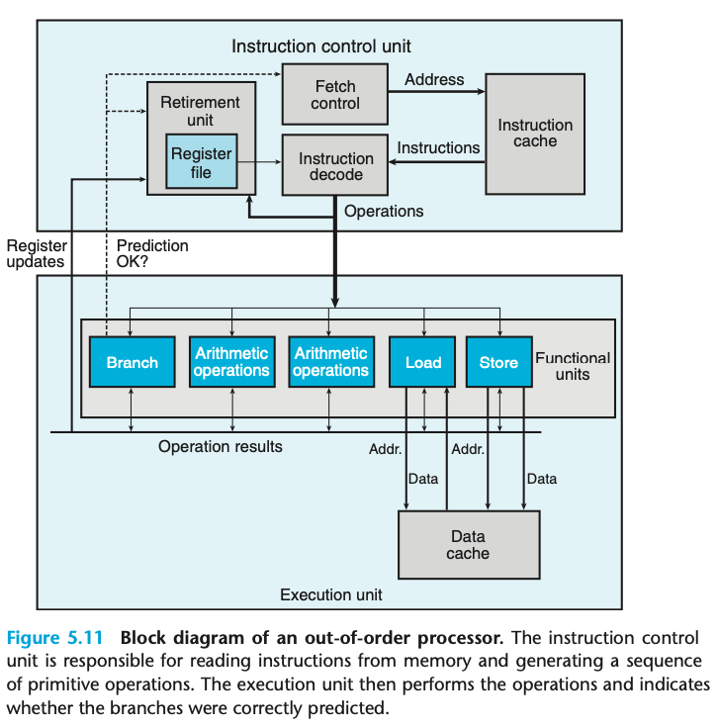
现代处理器结构
In-order issue
Out-of-order execution
In-order commit
Dynamic Scheduling
Speculative execution
Register renaming
CPI 可能 < 1

Slide 5
F0
Integer (1)
F2
Inst $
F4
Mult1 (10)
LD | F6 | 34+ | R2
Mult2 (10)
LD | F2 | 45+ | R3
F6
Registers
mul | F0 | F2 | F4
F8
Add (2)
sub | F8 | F6 | F2
div | F10 | F0 | F6
F10
add | F6 | F8 | F2
…
Divide (40)
Insn Status
Inst | ID1 | ID2 | EX | WB
LD#1
LD#2
MULTD
SUBD
DIVD
ADDD
FU Status
FU | B | Op | dst | src1 | src2 | Q1 | Q2 | R1 | R2
Int | No
Mult1 | No
Mult2 | No
Add | No
Div | No
Reg Status
 | FU
F0
F2
F4
F6
F8
F10
Scoreboard
Pasted from the slides of Computer Architecture Fall 2022, Peking University. Lecturer: Prof. Jie Zhang

Slide 6
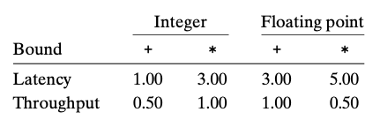
Two bounds on CPE

Slide 7
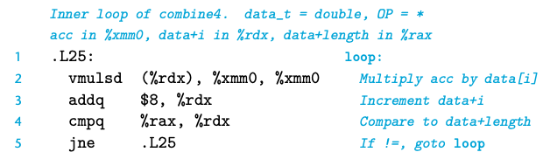
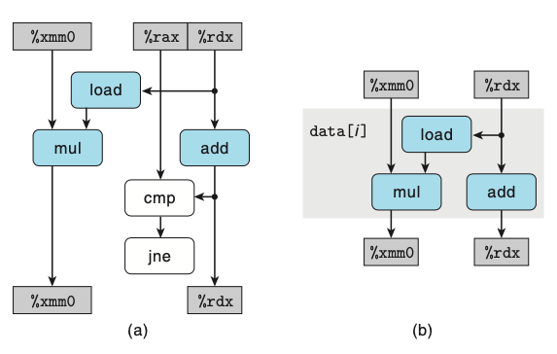
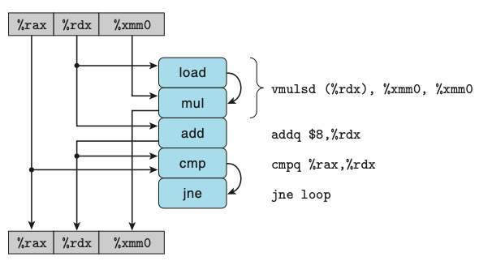
Data-flow graph

Slide 8
提高并行度 Parallelism
Loop unrolling
Multiple accumulators
Reassociation

Slide 9
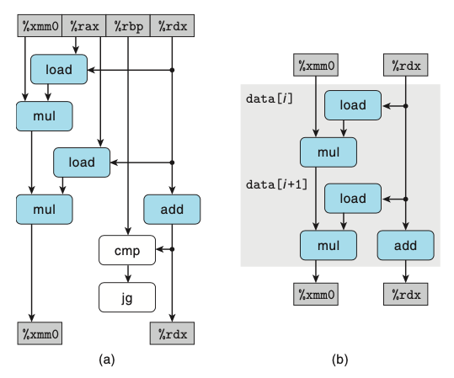
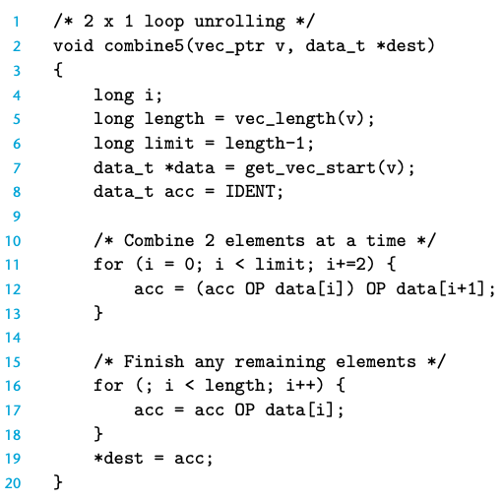
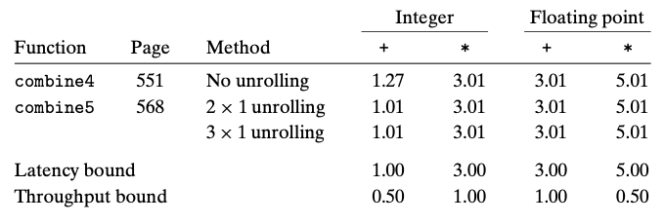
Loop unrolling

Slide 10
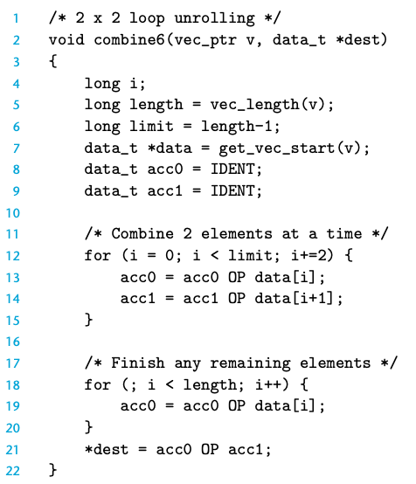
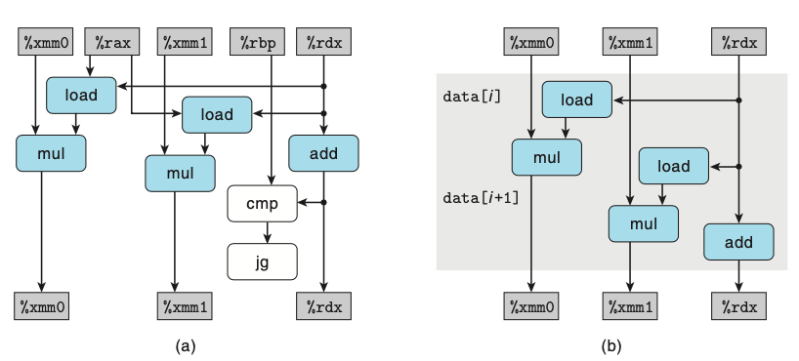
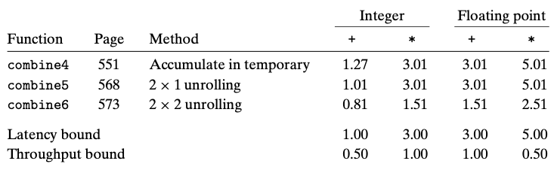
LU + Multiple accumulators

Slide 11

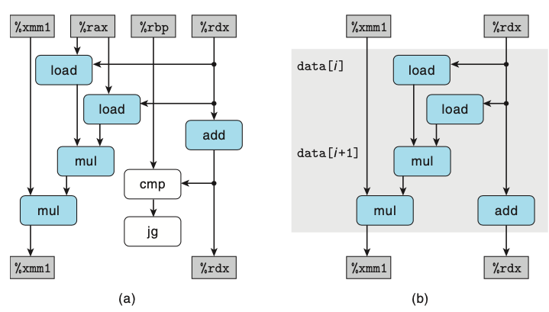
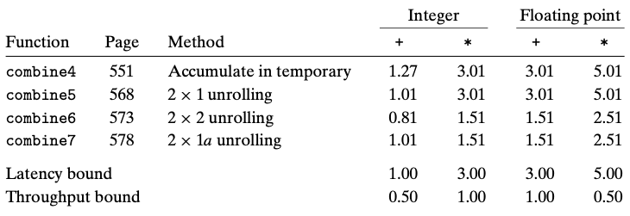
LU + Reassociation

Slide 12
局限
Register spilling
Floating point operations: reassociation?
Misprediction Penalties

Slide 13
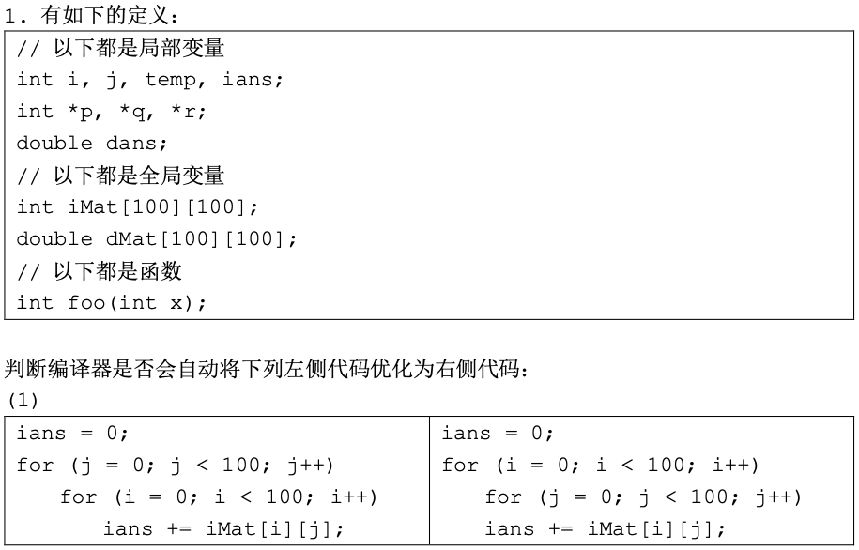

例

Slide 14
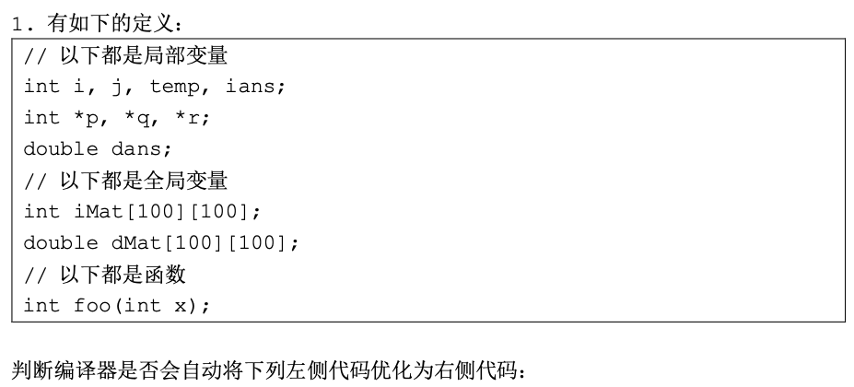
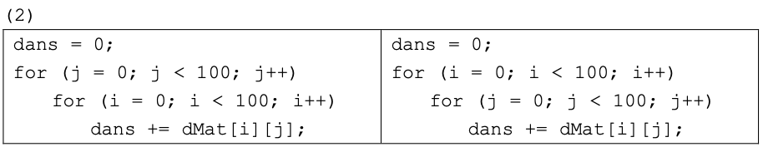
例

Slide 15
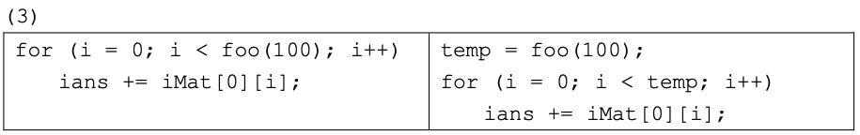
例

Slide 16
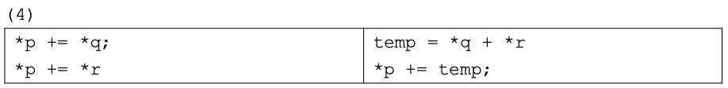
例

Slide 17
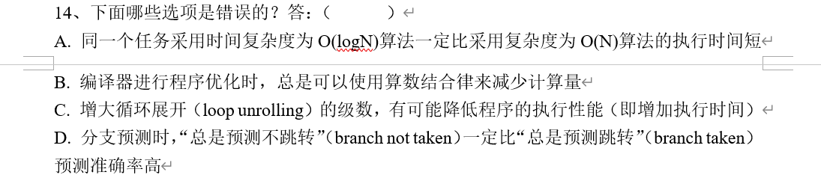

例

Slide 18
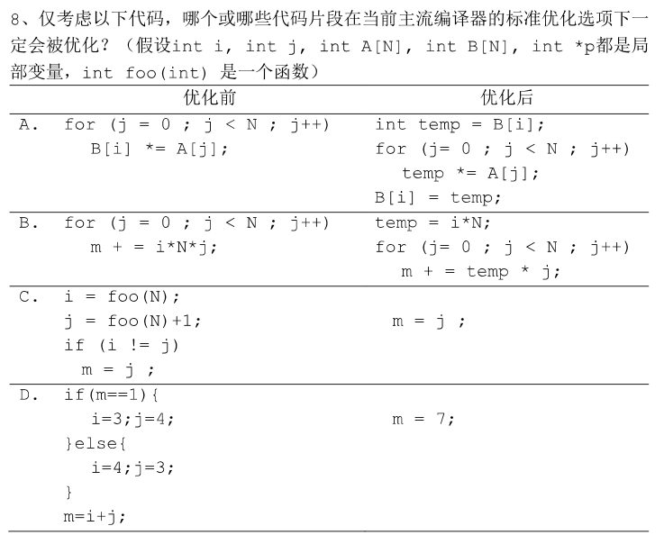

例

Slide 19
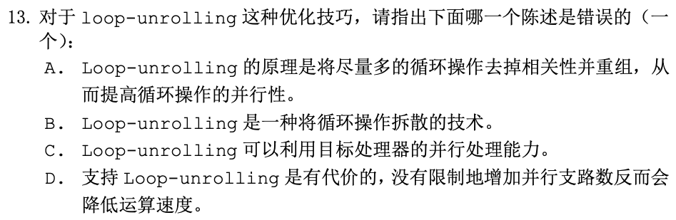
例

