Slide 1
Software & Hardware Interface (Data Section)
Jiaming Xu
2023.9.20

Slide 2
Why binary digits
the first commercial computer did offer decimal arithmetic
decimal signal is hard for hardware
electrical signal is recognized as on and off much more efficiently

Slide 3
Why main memory in binary sizes
binary size: main memory (DRAM, SRAM)
information is preserved by binary numbers
addresses in loads and stores are binary numbers
decimal size: web package, disk

Slide 4
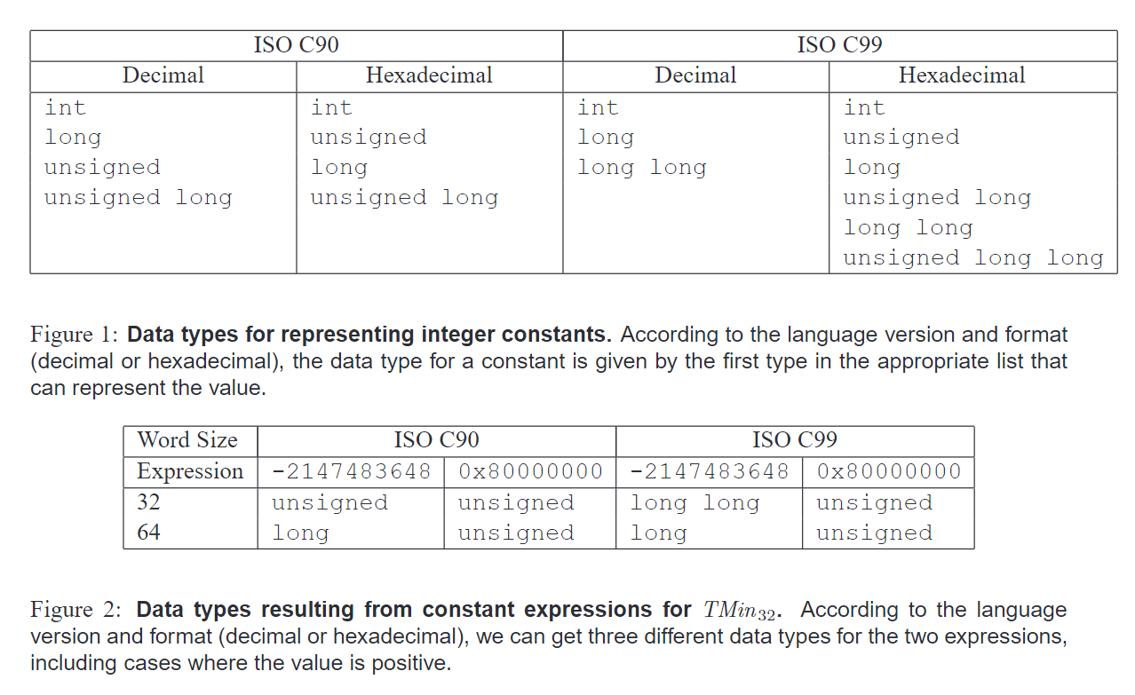
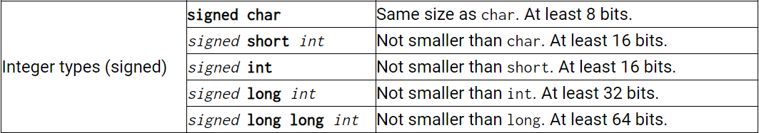
Why Tmin -2147483647-1
-X = -(X)
1. find data type to represent 2147483648
2. negates it

Slide 5
Why unsigned
memory addresses naturally start at 0 and continue to the largest address
negative addresses make no sense

Slide 6
ALU
learn it in Digital Logic Design

Slide 7
Handle integer overflow
C/C++/Java is not everything
Ada/Fortran notification
even an exception to stop the program in MIPS
add/subtract √
multiply x

Slide 8
Separate floating-point registers
twice register w/o using up extra bits of instruction
twice the register bandwidth
create a separate set of data transfer instructions

Slide 9
Reference
CS:APP Web Aside DATA:TMIN: Writing TMin in C
Computer Organization And Design: The Hardware/Software Interface (David a. Patterson, John L. Hennessy) Chapter 1,2,3

