Slide 1

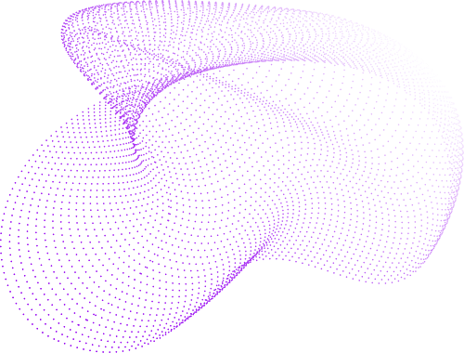

SamANTa
Ant Colony Optimization
(ACO)
Denisenko Sofia 1820249051
Antipov Aleksei 1820249061
Makarov Pavel 1820249064
Bylkova Kristina 1820249049

Slide 2
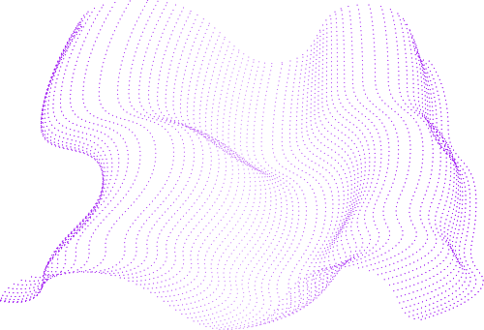
SamANTa
Outline
What is ACO?
Initialization
Applications of ACO
Pheromone Update
Concept
Ant Movement
Principle
Demonstration
Algorithm Workflow
Q&A

Slide 3
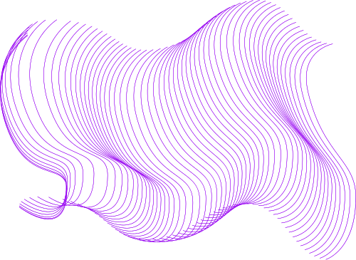
SamANTa
What is ACO?
The Ant Colony Optimization (ACO) algorithm is a probabilistic technique used for solving computational problems that can be reduced to finding good paths through graphs. It is inspired by the behavior of ant colonies, while they are searching food.
CONTINUE

Slide 4


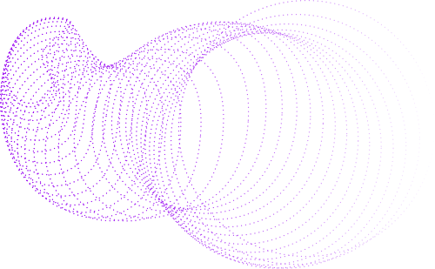
SamANTa
Applications of ACO
Routing in telecommunication networks
Traveling Salesman
Scheduling
Graph Coloring
Constraint Satisfaction
CONTINUE

Slide 5
SamANTa
Concept
Ants move from home to food source (Ants are blind);
Each ant moves at random;
Ants use pheromones to find the shortest path;
Pheromones evaporate quickly;
Ants prefer to use shorter paths with a denser pheromone.
CONTINUE

Slide 6
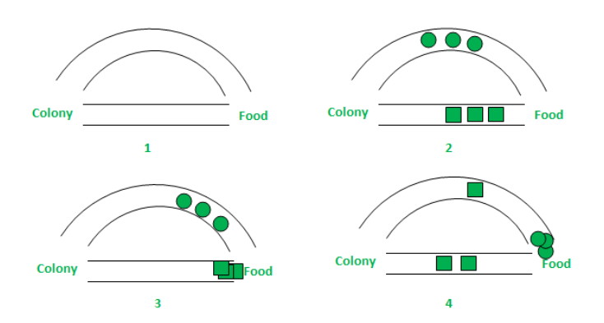
SamANTa
Principle
CONTINUE

Slide 7

SamANTa
CONTINUE
Initialization | Define the problem as a graph, initialize pheromones, and set parameters to guide the optimization process.
Pheromone Update | Adjust pheromone levels by evaporating old trails and reinforcing edges used in better solutions.
Ant Movement | Each ant constructs a solution by probabilistically choosing paths based on pheromone levels and heuristic values.
Algorithm Workflow

Slide 8


SamANTa
CONTINUE
Initialization
Represent the problem as a graph.
Initialize pheromone levels on all edges with a small constant value to ensure all paths are initially equally probable.
Define key parameters

Slide 9
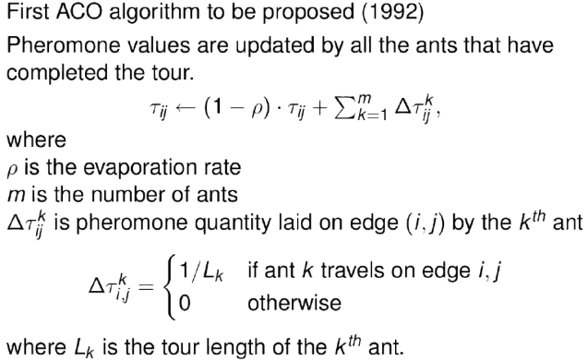
SamANTa
Pheromone Update
CONTINUE

Slide 10
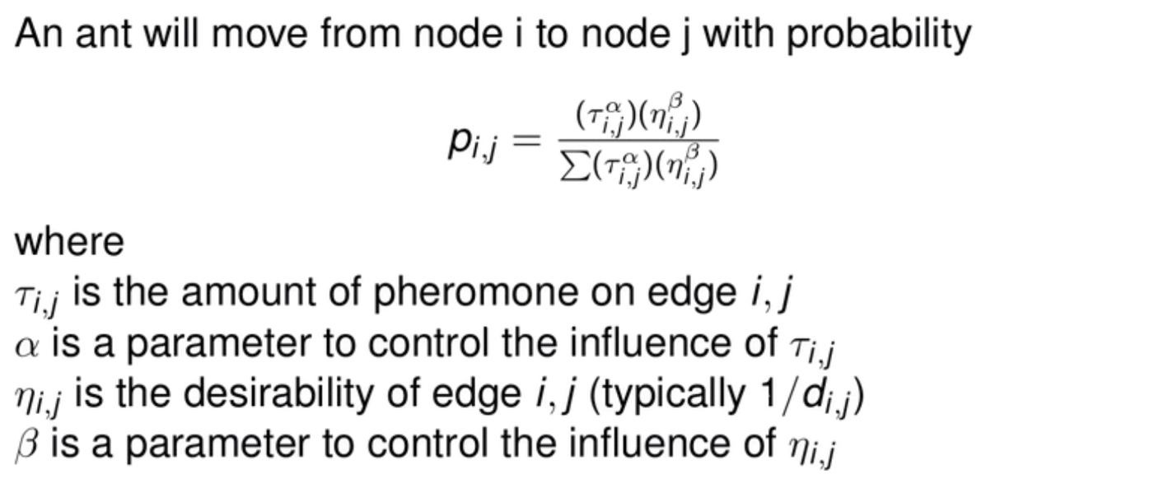
SamANTa
CONTINUE
Ant Movement

Slide 11
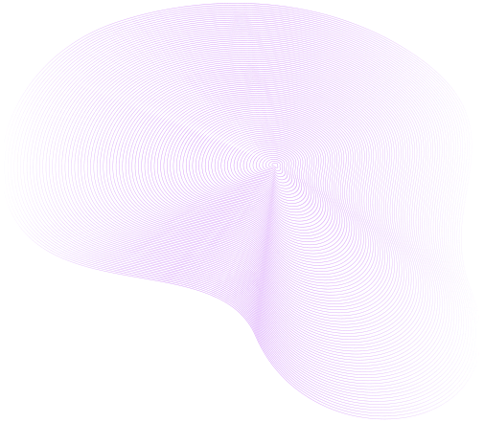
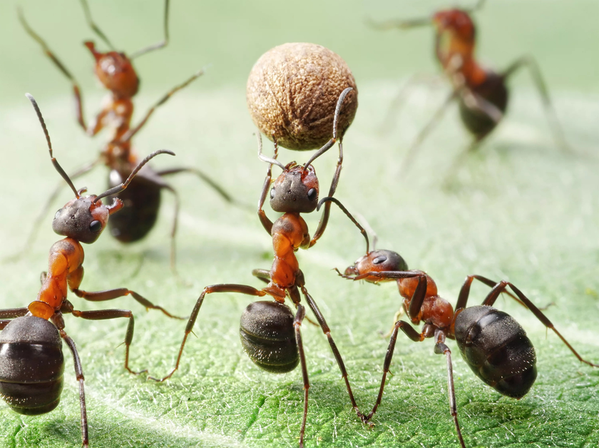
SamANTa
Demonstration
Click here!

Slide 12


Feel free to ask questions!
SamANTa
Our WEChats:
soffiyka
kr1st1nab
wxid_g3zdo77zmw5n22
Enc0reMan
Thank you for your attention!
Call us
911

