Slide 1
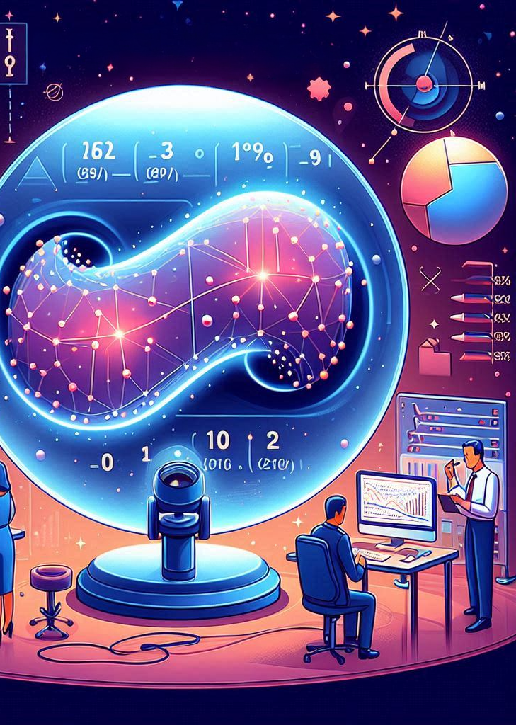
Understanding Maximum A Posteriori (MAP)
Maximum a Posteriori (MAP) is a statistical method used to make the most likely decisions by combining past experience (prior data) with new observations.
1820249062 KARSAKOV MIKHAIL 1820249063 POLIANSKAIA POLINA 1820249056 CHAIKO MARIA

Slide 2
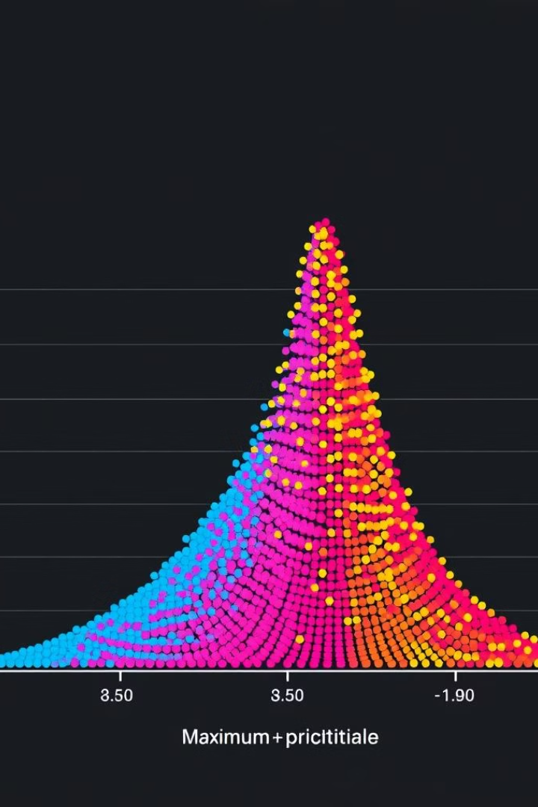
Importance in Statistical Inference
1
Incorporating Prior Knowledge
MAP estimation leverages prior information, such as previous studies or expert opinions, to enhance the estimation process. This integration of prior knowledge with observed data leads to more informed and reliable parameter estimates.
2
Regularization and Robustness
In cases of limited or noisy data, MAP acts as a regularization technique, preventing overfitting and improving the generalization of statistical models. By incorporating prior distributions, MAP produces more stable estimates, especially with small sample sizes.
3
Optimal Decision Making
MAP provides a framework for decision-making under uncertainty. By modeling uncertainty through probability distributions, it allows for weighing trade-offs and making optimal decisions based on available evidence.

Slide 3

Flexibility and Adaptability of MAP
MAP estimation is adaptable to various complex systems and phenomena. It allows the integration of diverse information sources, including domain knowledge, experimental data, and simulations, making it suitable for applications in fields like engineering, biology, economics, and machine learning.

Slide 4
Applications of MAP Estimation
Technology
Other Industries
Real-World Applications
In machine learning, MAP trains models with Bayesian approaches. It's also used in signal processing for denoising and reconstructing signals.
Finance utilizes MAP to update market parameter beliefs based on new data. In neural networks, it's applied for posterior weight estimation.
MAP aids in natural language processing, prediction systems, navigation, robotics, and medical diagnostics by incorporating prior knowledge with new data.

Slide 5

Mathematical Foundations of MAP Estimation
MAP estimation relies on Bayes' theorem, which describes how to update beliefs based on new evidence. The theorem states:
P(θ∣X) is the posterior probability (the probability of hypothesis θ after seeing data X).
P(X∣θ) is the likelihood function (probability of seeing data X if hypothesis θ is true).
P(θ) is the prior probability (initial confidence in the hypothesis).
P(X) is the normalization constant (total probability of the data).

Slide 6
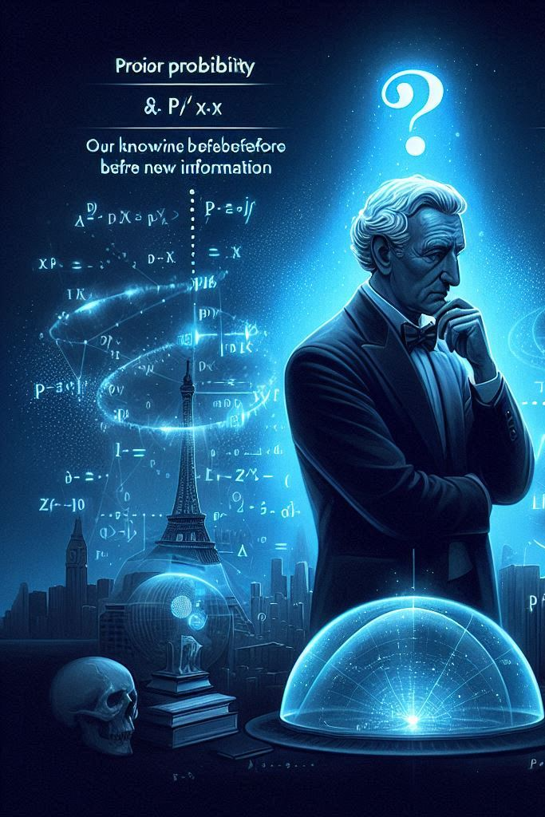
Understanding Prior and Posterior Probabilities
In Bayesian inference, prior probability (P(θ)) represents our knowledge before new information, while posterior probability (P(θ∣X)) reflects our updated understanding after considering new data. Bayes' theorem facilitates the transition from prior to posterior probability.

Slide 7
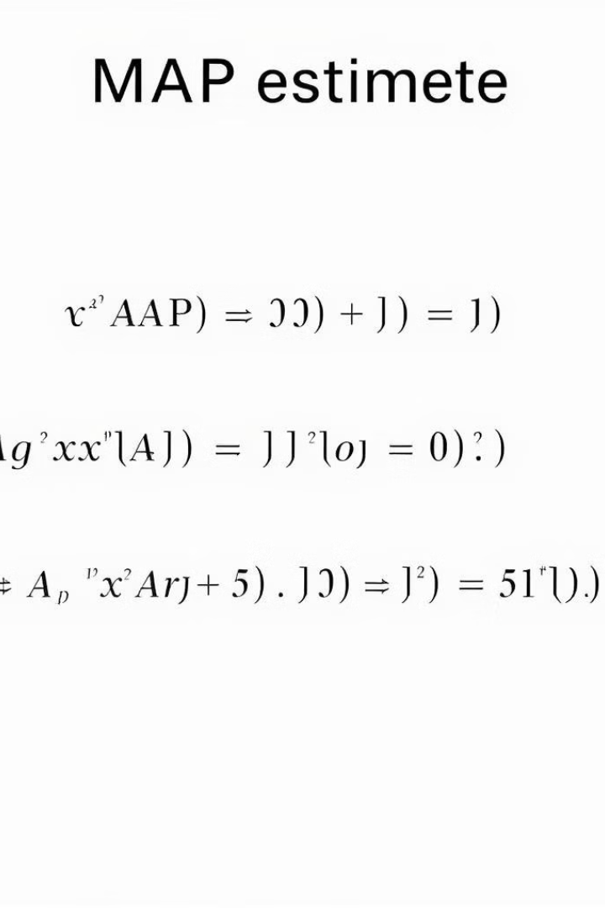


Calculating MAP Estimation
MAP estimation aims to find the hypothesis (θ) that maximizes the posterior probability (P(θ∣X)). Since P(X) is constant, the MAP estimation formula simplifies to:
This formula combines the likelihood (how well data fits the hypothesis) with the prior probability (how likely the hypothesis was initially).

Slide 8


Example with Gaussian Noise
Consider a system:
y = a⋅x + n,
where 'a' is constant, and 'n' represents additive white Gaussian noise. The goal is to estimate 'x' (e.g., temperature) using measurement 'y'.
In this case, the likelihood is the probability of observing 'y' given 'x', following a Gaussian distribution centered around 'a⋅x'. The prior distribution represents our initial knowledge about 'x' (e.g., temperature limits). The posterior distribution combines likelihood and prior, with the MAP estimate being the 'x' value maximizing this distribution.

Slide 9

Real-Life Application of MAP Estimation
Imagine determining whether your mother took an apple or an orange from a fruit bowl. You know she prefers apples (P(apple) = 0.6) over oranges (P(orange) = 0.4). Finding orange peel (likelihood), with
P(orange peel∣apple) = 0.1 and P(orange peel∣orange) = 0.9, makes it more likely she took the orange.

Slide 10

Thank you for
your attention!

