Slide 1

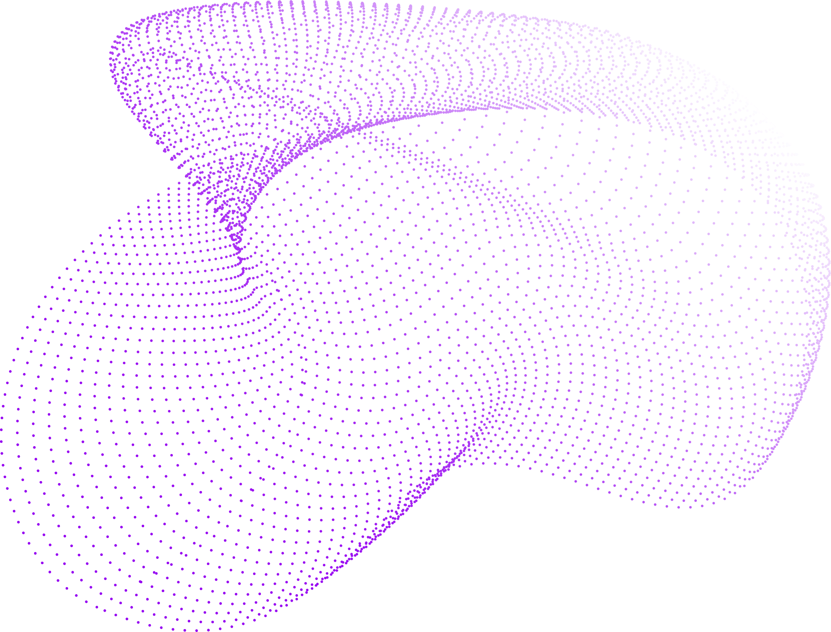

SamANTa
Segment Anything Model
(SAM)
Denisenko Sofia 1820249051
Antipov Aleksei 1820249061
Makarov Pavel 1820249064
Bylkova Kristina 1820249049

Slide 2

SamANTa
Outline
What is Image Segmentation?
The Architecture of SAM
What is SAM?
Applications of SAM
Input Prompts
Demonstration
Key Features
Q&A

Slide 3
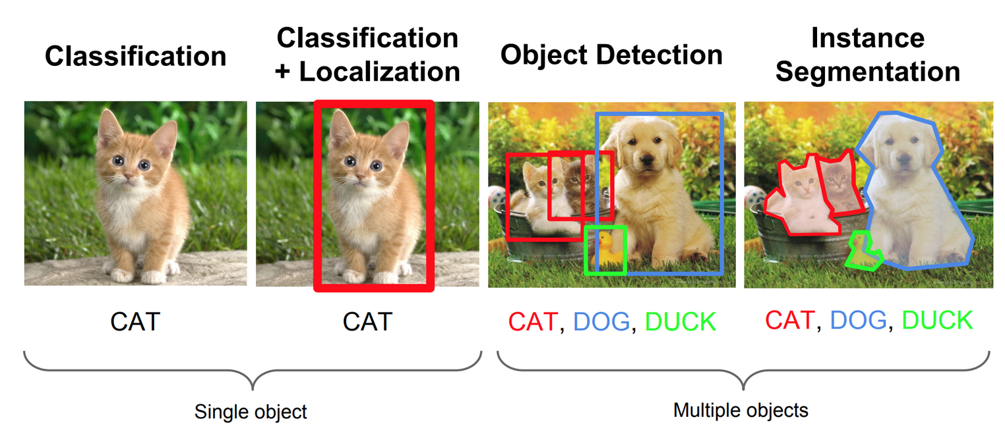

SamANTa
What is Image Segmentation?
CONTINUE

Slide 4

SamANTa
What is SAM?
SAM is a promptable segmentation system with zero-shot generalization to unfamiliar objects and images, without the need for additional training.
CONTINUE

Slide 5



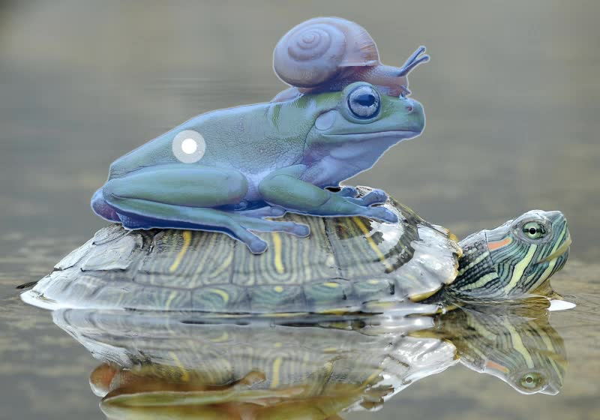

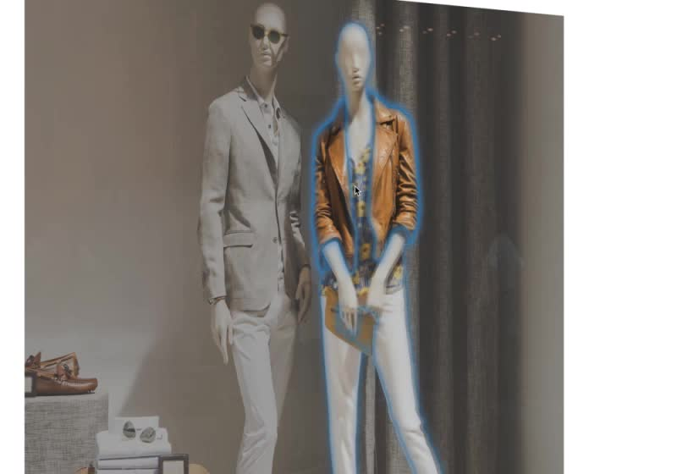
SamANTa
Input Prompts
Interactive points and boxes
Automatically segment everything in an image
Generate multiple valid masks for ambiguous prompts
CONTINUE

Slide 6


SamANTa
Extensible outputs
Output masks can be used as inputs to other AI systems. For example, object masks can be tracked in videos, enable imaging editing applications, be lifted to 3D, or used for creative tasks like collaging.
Key Features
Zero-shot generalization
SAM has learned a general notion of what objects are. This understanding enables zero-shot generalization to unfamiliar objects and images without requiring additional training.
CONTINUE

Slide 7

SamANTa
CONTINUE
Image Encoder | Extracts features from the input image.
Prompt Encoder | Encodes user input, such as clicks or text prompts.
Mask Decoder | Generates a segmentation mask based on the image and prompt features.
The Architecture of SAM

Slide 8
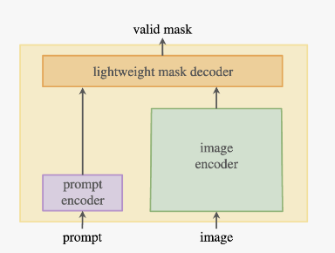
SamANTa
CONTINUE
The Architecture of SAM

Slide 9

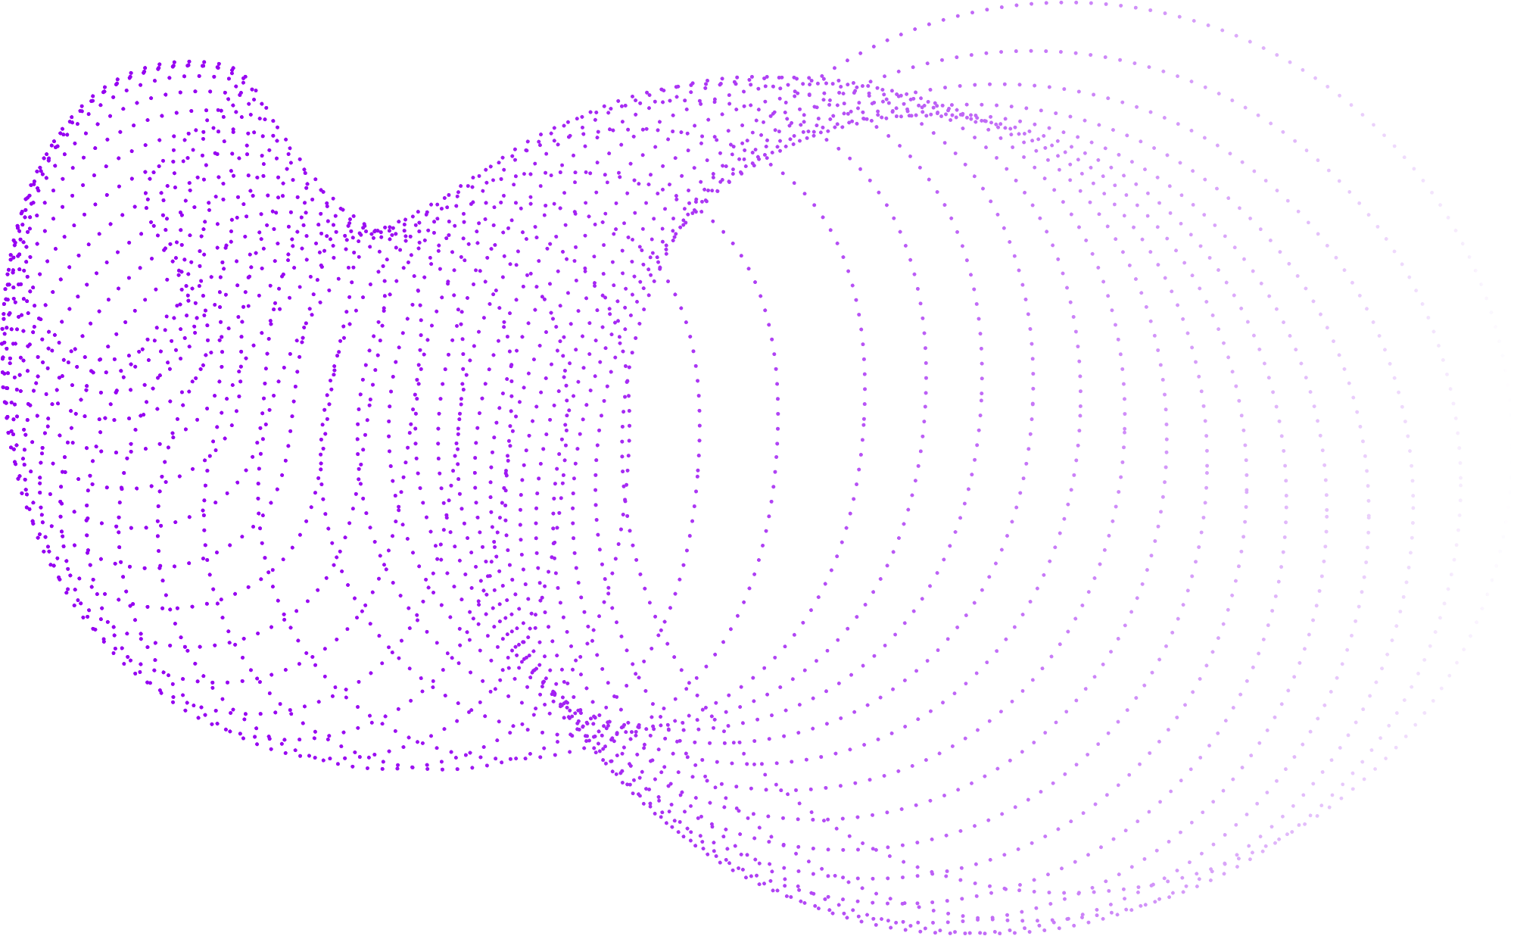
SamANTa
Applications of SAM
Image Editing
Computer Vision
Object Recognition
Medical Imaging
CONTINUE

Slide 10


SamANTa
Demonstration
Click here!

Slide 11


Feel free to ask questions!
SamANTa
Our WEChats:
soffiyka
kr1st1nab
wxid_g3zdo77zmw5n22
Enc0reMan
Thank you for your attention!
Call us
911

