Slide 1

Introduction of EDIS
Qun Wen

Slide 2
Main Concepts
Enterprise Intergration Architecture (EIA)
Enterprise Service Bus (ESB)
Extract-Transform-Load Processing Pattern (ETL)

Slide 3
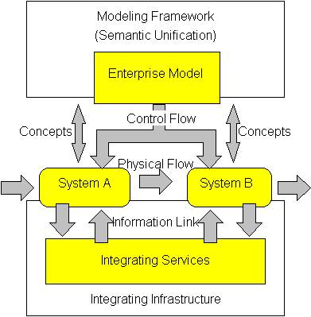
Enterprise Integration Architecture

Slide 4
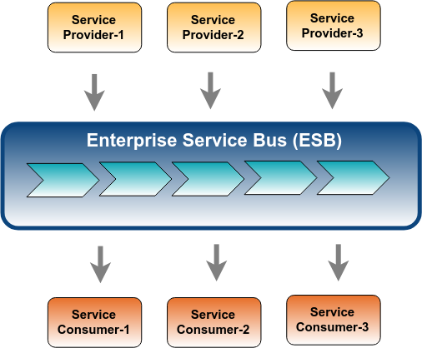
Enterprise Service Bus

Slide 5
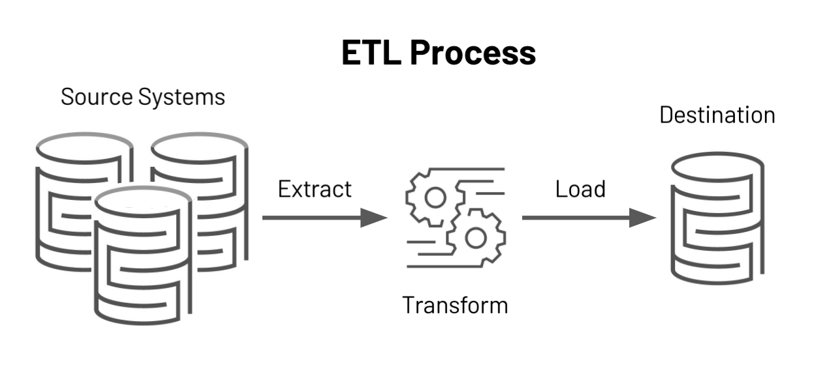
ETL Processing Pattern

Slide 6
Composition of EDIS
Canonical Message Model (CMM)
Messaging Infrastructure: Kafka, MQ
IBM Integration Bus (IIB): ESB Server
Integration Applications: (Business Object Project)
IDE: IBM Integration Toolkit (version 10.0.0.x): Eclipse based tool
Version Control System: Dimensions

Slide 7
Canonical Message Model
Defined in XML Schema (XSD) Format
Message Based

Slide 8
Integration Applications
Integration Applications (Business Object)
Each BOD processes ETL logic
An Integration Application consists of one or more integration flows
Each flow consists of multiple Integration Nodes which implementing Enterprise Integration Architecture (EIA)
An Integration Node can be defined as a sub-flow to increasing the reusability

Slide 9
Transformation
Compute Node (ESQL)
Java Compute Node
Other Types of Compute Node
Default Output Message Format: XML
Other Supported Format: JSON, AVRO…

Slide 10
Other Sub-flows
Auditing Sub-flows: Input Audit Sub-flow, Output Audit Sub-flow and Exception Handling Sub-flow;
Conversion Sub-flow: Xml to Json Sub-flow, Xml to Avro Sub-flow
Encryption Sub-flow: Protegrity etc.

Slide 11
EDIS Development Process
Requirement
Design
Development
QA Test
Deployment

Slide 12
Requirement
CMM
Mapping Sheet
BORD - Business Object Requirement Document

Slide 13
Design
BODD: Business Object Design Document
BOIDD: Business Object Implementation Details Document

Slide 14
Development
Validate Requirement Document
Create Integration Application
Coding: ESQL and Java
Deployment Override Properties
Unit Test

Slide 15
QA
Validate Requirement Document
Prepare test messages
Apply Tests
Prepare test results document and Sign off.

Slide 16
Development
Cutoff Plan:
Deployment descriptor
Application Bar file
Bar override properties
SanitTest document
Tasklist
Peer Review Result
Deployment Tracking Document
Schedule Deployment and support

Slide 17
Resources
Requirement:

