Slide 1
Homework 3 Hardware Implementation of Single Cycle MIPS
Digital System Design
Speaker: Kane
Instructor: 吳安宇教授
Date: 2020/04/08

Slide 2
Introduction to Single-cycle MIPS Processor

Slide 3
MIPS processor
Any instruction set can be implemented in many different ways.
— In a basic single-cycle implementation all operations take the same amount of time—a single cycle.
— A multicycle implementation allows faster operations to take less time than slower ones, so overall performance can be increased.
— Finally, pipelining lets a processor overlap the execution of several instructions, potentially leading to big performance gains.(Final project)

Slide 4
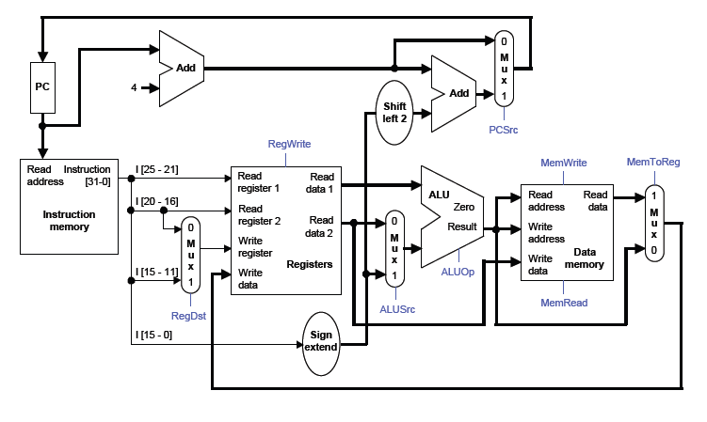
Datapath

Slide 5
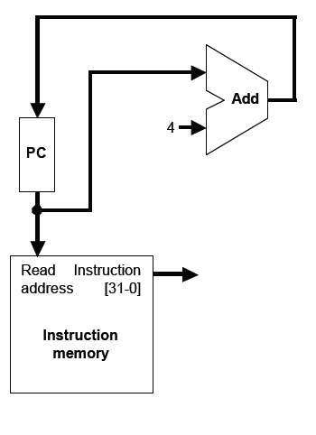
Instruction fetching
The CPU is always in an infinite loop,
fetching instructions from memory and
executing them.
The program counter or PC register holds
the address of the current instruction.
MIPS instructions are each four bytes
long, so the PC should be incremented by
four to read the next instruction in sequence.

Slide 6
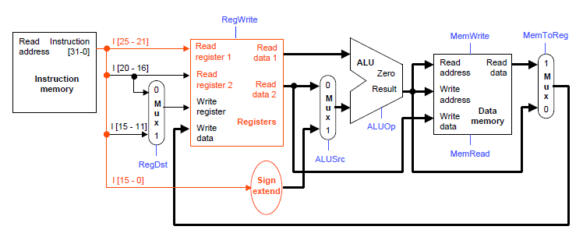
Instruction Decode
The Instruction Decode (ID) step reads the source register from the register file.

Slide 7
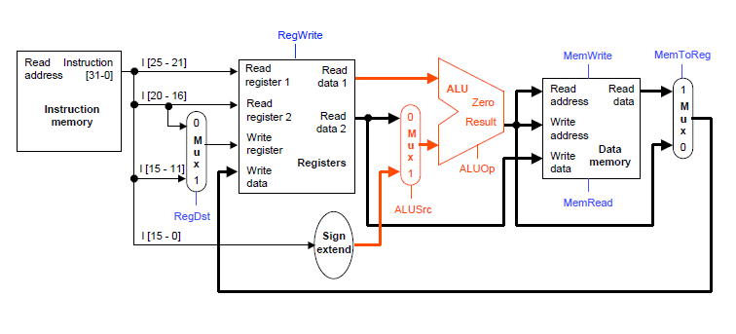
Execute
The third step, Execute (EX), computes the effective memory address from the source register and the instruction’s constant field.

Slide 8
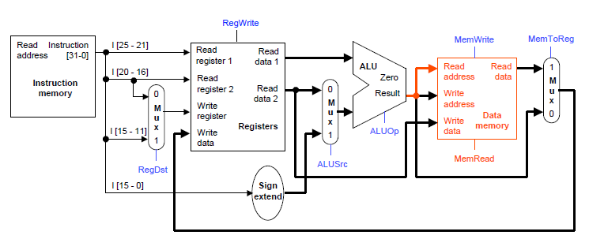
Memory
The Memory (MEM) step involves reading the data memory, from the address computed by the ALU.

Slide 9
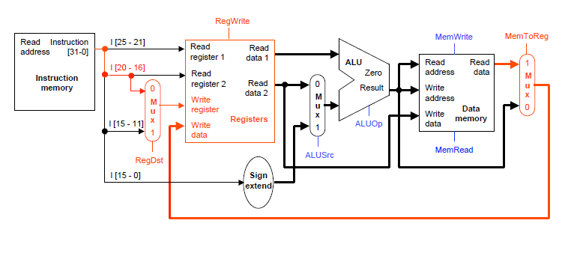
Write Back
Finally, in the Writeback (WB) step, the memory value is stored into the destination register

Slide 10
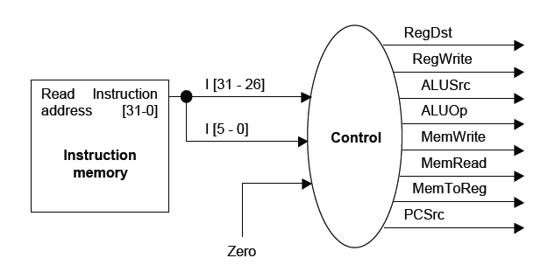
Control Unit
The control unit needs 13 bits of inputs.
— Six bits make up the instruction’s opcode.
— Six bits come from the instruction’s func field.
— It also needs the Zero output of the ALU.
The control unit generates 10 bits of output, corresponding to the signals mentioned on the previous page.

Slide 11
Homework 3
Single-cycle MIPS Processor

Slide 12
Problem Statement
Using Verilog, implement the single-cycle MIPS processor:
Supported instructions:
add, sub, and, or, slt
lw, sw
beq
j, jal, jr
Testbench/Memory model provided

Slide 13
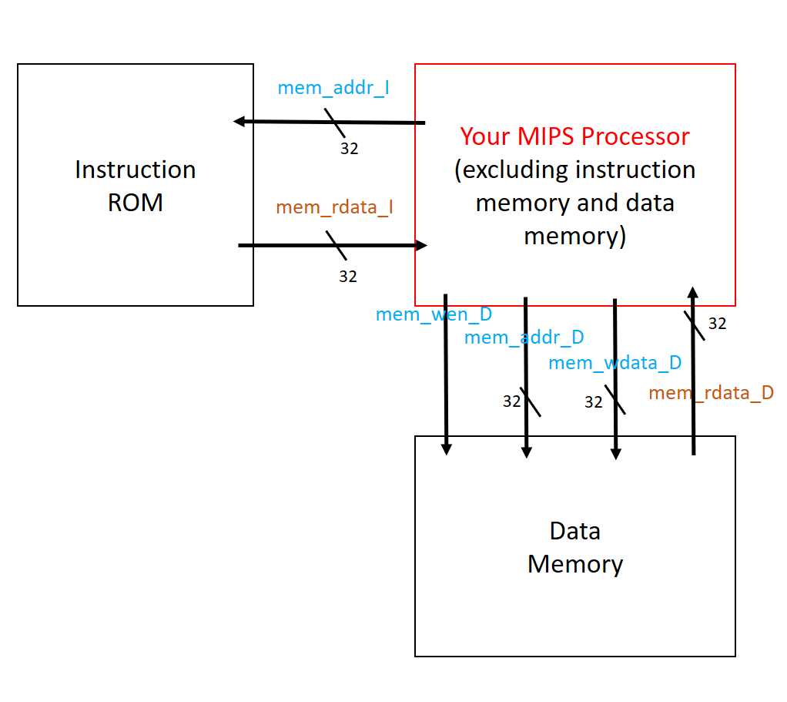
Block Diagram(1/2)
Instruction ROM:
contains the testing instructions
Data Memory:
contains the stored data
Used for testing your circuit
mem_wen_D:
mem_wen_D is high, writing data to D-mem when the next clk arrive; else reading
data from memory to chip.

Slide 14
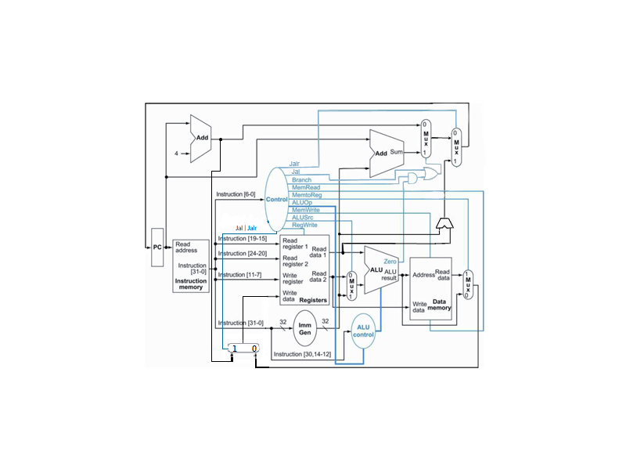
Block Diagram(2/2)
mem_addr_I
mem_rdata_I

Slide 15
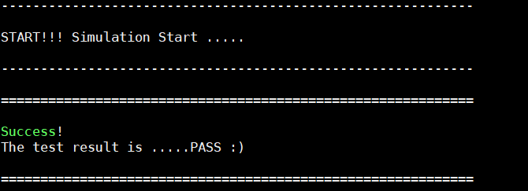
Testbench
The testbench will
Initialize the instruction rom and the data memory
Reset your circuit
Execute the instructions, and check the values stored in data memory to see whether your circuit is correct
If your function is correct, you will see the following

Slide 16
Clock/Reset/Register File
Clock: positive edge triggered
Reset: active low synchronous reset
Register file
All registers are reset to 0 when reset occurs.
Register $0 must be always 0

Slide 17
Memory
Instruction ROM and data memory are included in the testbench
As for data memory
32 words x 32 bits
The input signal mem_wen_D is high, writing data to D-mem when the next clk arrive; else reading data from memory to chip.

Slide 18
Memory Addressing
In MIPS, the memory address is byte address.
In Instruction ROM and data memory , the memory address is word address.
Both the memory size of Instruction ROM and data memory in this work are 32x32, so their input address is 5-bit wide.
You are encouraged to observe the connection between each module in MIPS_tb.v .

Slide 19
Simulation & Synthesis
Check “MIPS/ verilog/ readme.txt”
3 Major Things
RTL coding & simulation
Logic Synthesis
Gate-level simulation & debugging/refinement
Files needed for simulation
RTL code: CHIP.v
Gate-level code: CHIP_syn.v
Timing info (SDF file): CHIP_syn.sdf
Design library (DDC file): CHIP_syn.ddc

Slide 20
※Notice
Latches are not allowed in gate level code after synthesis, use Flip-flop instead.
Negative Slack and Timing Violations are not allowed after synthesis.
The tsmc13.v file is not allowed to be downloaded! Or you may offend the copyright protected by NTU & CIC!

Slide 21
Grading Policy
RTL (40%): function correctness
Synthesis (30%): correctness
Report (10%)
Area*Timing (20%)
TA: 蔡文喬
daniel@access.ee.ntu.edu.tw
TA: 馬咏治
kane@access.ee.ntu.edu.tw

Slide 22
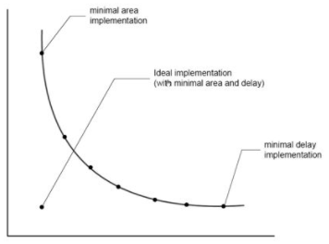
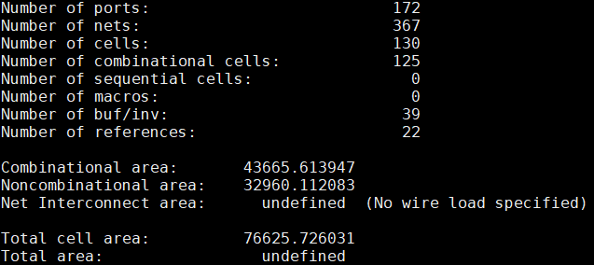
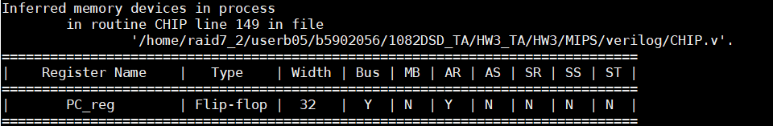
Report
Timing
Simulated timing (ns)
Gate-level simulation clock cycle
(i.e. The cycle you passed testbench after synthesis)
Area(um^2)
report_area
Cost(A*T)
Area*Gate-level simulation clock cycle
ScreenShot
Inferred memory devices in process
(※No latch should be inferred!)
Area

Slide 23
Submission(1/2)
For each topic, you need to submit 4 files + 1 report
RTL code: CHIP.v
Synthesis:
CHIP_syn.v,
CHIP_syn.sdf,
CHIP_syn.ddc
Report: report.pdf
Compress all the files into one ZIP file
File name: DSD_HW3_學號.zip
EX: DSD_HW3_b06901001.zip
Upload the file to Ceiba
Deadline: 2021/04/29 24:00 ※Late submission is not allowed

Slide 24
Submission(2/2)
DSD_HW3_學號/
MIPS/
CHIP.v
CHIP_syn.v
CHIP_syn.sdf
CHIP_syn.ddc
RISCV/ (Optional)
CHIP.v
CHIP_syn.v
CHIP_syn.sdf
CHIP_syn.ddc
CHIP_RV32IC.v
CHIP_RV32IC_syn.v
CHIP_RV32IC_syn.sdf
CHIP_RV32IC_syn.ddc
report.pdf

