Slide 1
HW3: Hardware Implementation of Single Cycle RISC-V
Digital System Design
Speaker: Kane
Instructor:吳安宇教授
Date: 2021/04/08

Slide 2
Homework 3
Single-cycle RISCV Processor

Slide 3
Problem Statement
Using Verilog, implement the single-cycle RISC-V processor:
Supported instructions:
add, sub, and, or, slt
lw, sw
beq
jal, jalr
Most specifications are the same
(Bonus) Compressed-Instruction(p.11)

Slide 4
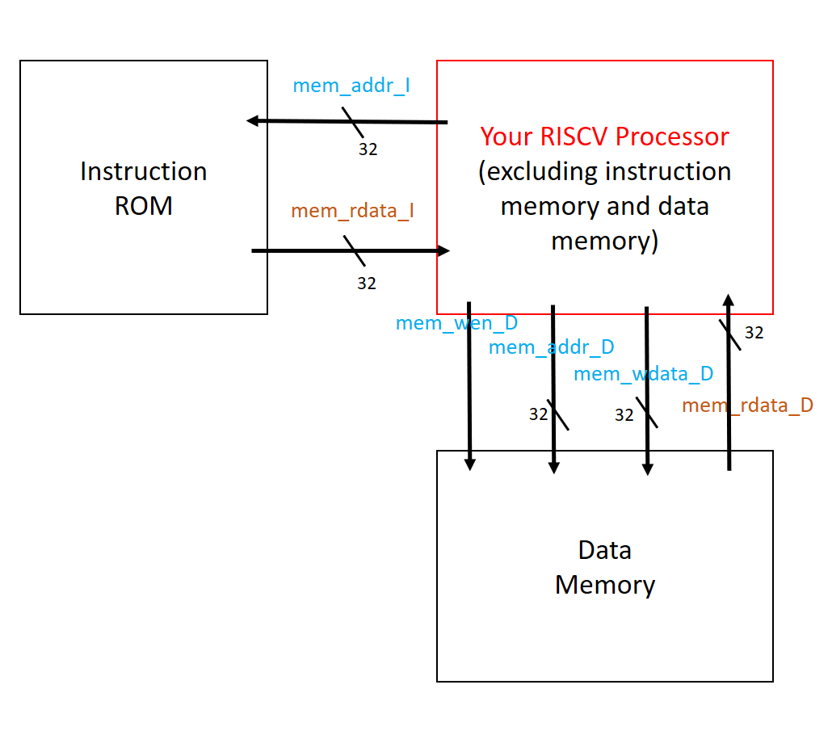
Block Diagram(1/2)
Instruction ROM:
contains the testing instructions
Data Memory:
contains the stored data
Used for testing your circuit
mem_wen_D:
mem_wen_D is high, writing data to D-mem when the next clk arrive; else reading
data from memory to chip.

Slide 5
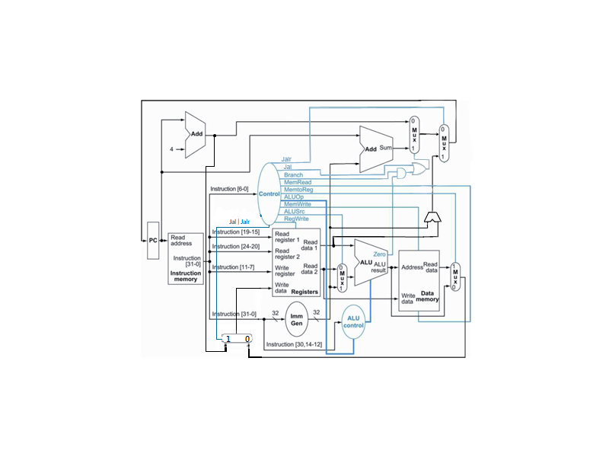
Block Diagram(2/2)
mem_addr_I
mem_rdata_I

Slide 6
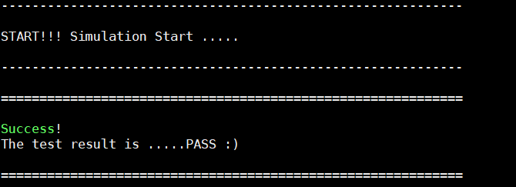
Testbench
The testbench will
Initialize the instruction rom and the data memory
Reset your circuit
Execute the instructions, and check the values stored in data memory to see whether your circuit is correct
If your function is correct, you will see the following

Slide 7
Clock/Reset/Register File
Clock: positive edge triggered
Reset: active low synchronous reset
Register file
All registers are reset to 0 when reset occurs
Register x0 must be always 0
There is no endianness issue!
If you store 32’h12345678 in x8, RF_8_w[31:0] = 32’h12345678

Slide 8
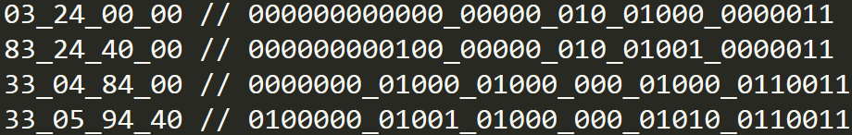
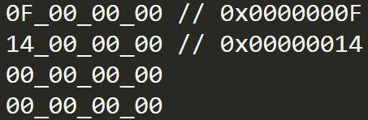
Memory Layout
Instruction memory for RISC-V
Data memory for RISC-V
Conversion between big/little-endian
out[31:0] = {in[7:0], in[15:8], in[23:16], in[31:24]};

Slide 9
Memory
Instruction ROM and data memory are included in the testbench
As for data memory
32 words x 32 bits
The input signal mem_wen_D is high, writing data to D-mem when the next clk arrive; else reading data from memory to chip.

Slide 10
Memory Addressing
In RISCV, the memory address is byte address.
In Instruction ROM and data memory , the memory address is word address.
Both the memory size of Instruction ROM and data memory in this work are 32x32, so their input address is 5-bit wide.
You are encouraged to observe the connection between each module in RISCV_tb.v .

Slide 11
(Bonus) Compressed-Instruction
Your RISCV also needs to support 16-bit compressed instructions.
One of the suggestion is creating a decompressor module to distinguish whether the inst. is compressed or not. Recovering the 16-bit inst. to 32-bit inst. by 1-1 mapping, and then processing as usual.
Supported instructions:
C.add, C.sub, C.and, C.or
C.lw, C.sw
C.beqz
C.jal, C.jalr
Use +define+RTL+RV32IC / +define+SYN+RV32IC to test
More information: Introduction_to_RISCV_C-extension&implementation.pptx

Slide 12
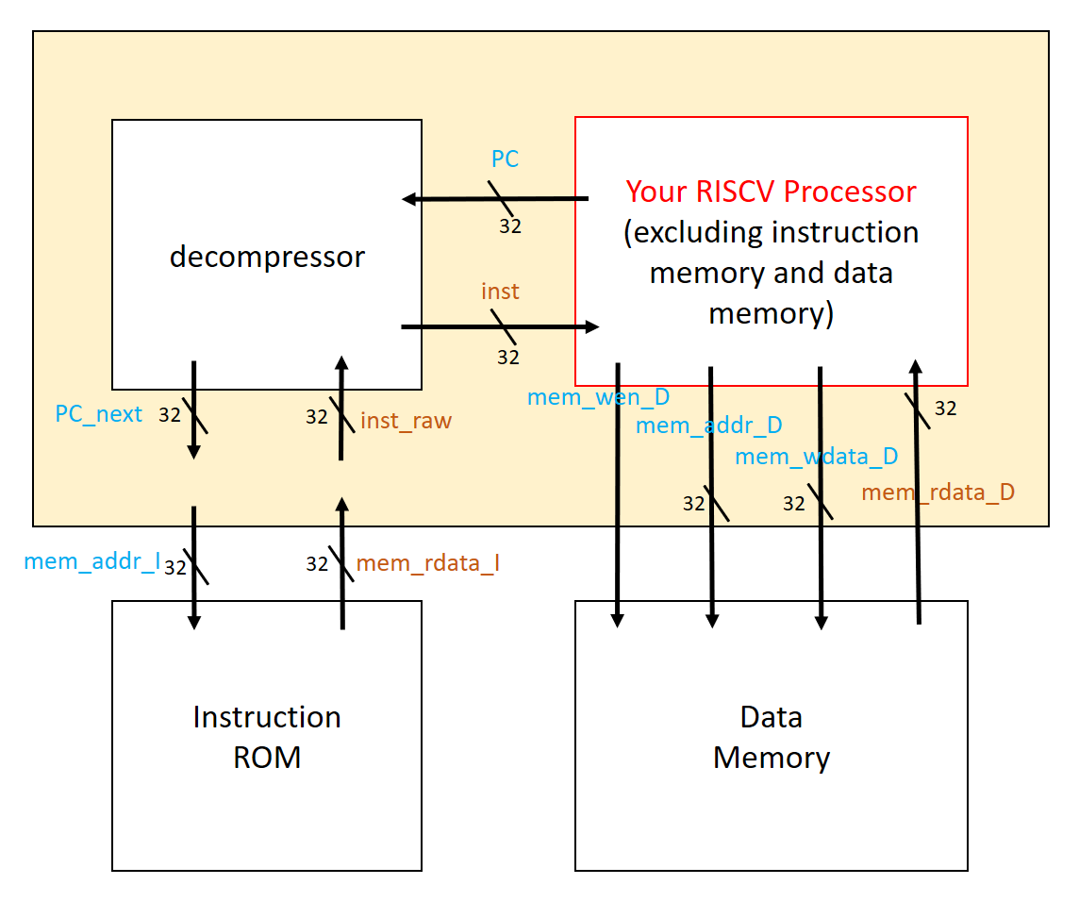
Block Diagram
Instruction ROM:
contains the testing instructions
Data Memory:
contains the stored data
Used for testing your circuit
decompressor:
Resolve the raw inst. from I-ROM and output the correct mem_rdata_I to CHIP
Maintain the PC and output the correct address to fetch inst. from I-ROM

Slide 13
Simulation & Synthesis
Check “RISCV/ verilog/ readme.txt”
3 Major Things
RTL coding & simulation
Logic Synthesis
Gate-level simulation & debugging/refinement
Files needed for simulation
RTL code: CHIP.v
Gate-level code: CHIP_syn.v
Timing info (SDF file): CHIP_syn.sdf
Design library (DDC file): CHIP_syn.ddc

Slide 14
※Notice
Latches are not allowed in gate level code after synthesis, use Flip-flop instead.
Negative Slack and Timing Violations are not allowed after synthesis.
The tsmc13.v file is not allowed to be downloaded! Or you may offend the copyright protected by NTU & CIC!

Slide 15
Grading Policy
RTL (40%): function correctness
Synthesis (30%): correctness
Report (10%)
Area*Timing (20%)
TA: 蔡文喬
daniel@access.ee.ntu.edu.tw
TA: 馬咏治
kane@access.ee.ntu.edu.tw

Slide 16
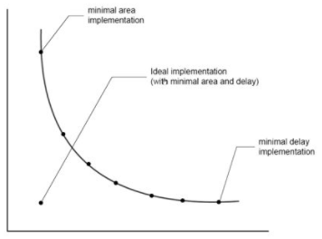
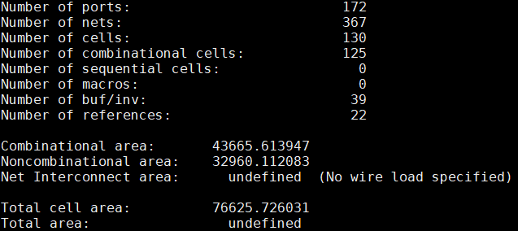
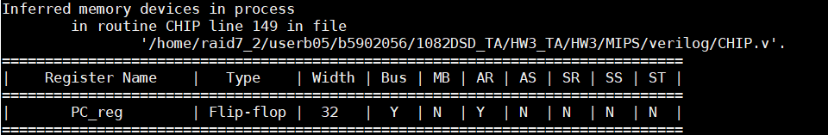
Report
Timing
Simulated timing (ns)
Gate-level simulation clock cycle
(i.e. The cycle you passed testbench after synthesis)
Area(um^2)
report_area
Cost(A*T)
Area*Gate-level simulation clock cycle
ScreenShot
Inferred memory devices in process
(※No latch should be inferred!)
Area

Slide 17
Submission(1/2)
For each topic, you need to submit 4 files + 1 report
RTL code: CHIP.v
Synthesis:
CHIP_syn.v,
CHIP_syn.sdf,
CHIP_syn.ddc
Report: report.pdf
Compress all the files into one ZIP file
File name: DSD_HW3_學號.zip
EX: DSD_HW3_b06901001.zip
Upload the file to Ceiba
Deadline: 2021/04/29 24:00 ※Late submission is not allowed

Slide 18
Submission(2/2)
DSD_HW3_學號/
RISCV/
CHIP.v
CHIP_syn.v
CHIP_syn.sdf
CHIP_syn.ddc
(optional)
CHIP_RV32IC.v
CHIP_RV32IC_syn.v
CHIP_RV32IC_syn.sdf
CHIP_RV32IC_syn.ddc
MIPS/ (Optional)
CHIP.v
CHIP_syn.v
CHIP_syn.sdf
CHIP_syn.ddc
report.pdf

Slide 19
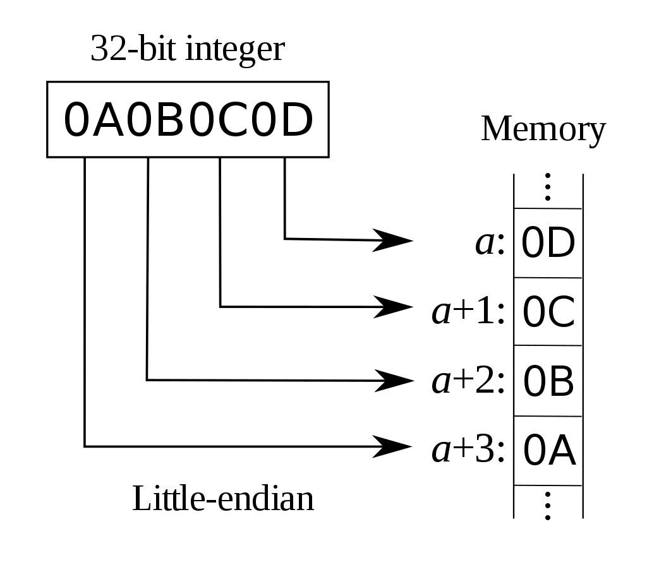
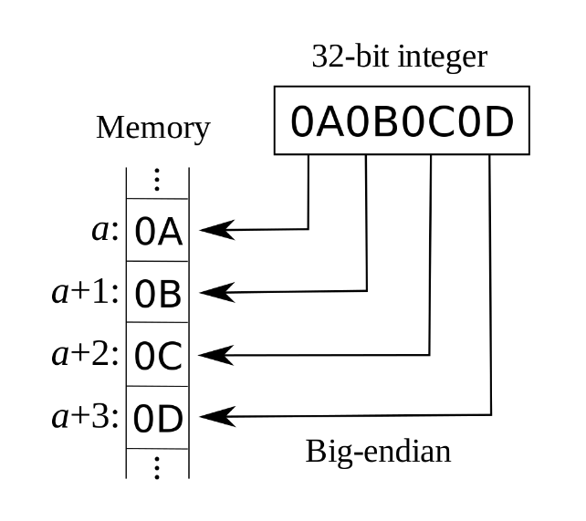
Appendix A
Why Little endian?
Fetch with the same address if a given value is stored in different width
32bit 0x0D0C0B0A
64bit 0x000000000D0C0B0A
We can always fetch the lowest 32bit address
Mainstream
Intel x86

