Slide 1
DSD HW4
Speaker: Kane
Date: 2021/05/06

Slide 2
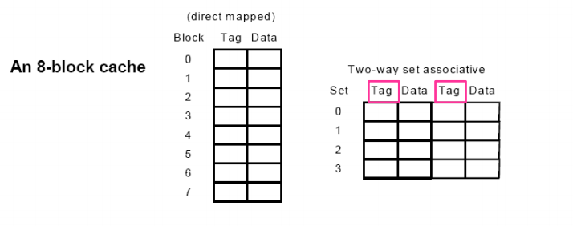
Cache Specification
Implement two architectures
Direct-mapped
Two-way associative
8 blocks with 4 words in each block
Write-through & write back are both available write policies
Least Recently Used (LRU) & Least Frequently Used (LFU) are both available placement policies

Slide 3
I/O Interface of The Cache Unit

Slide 4
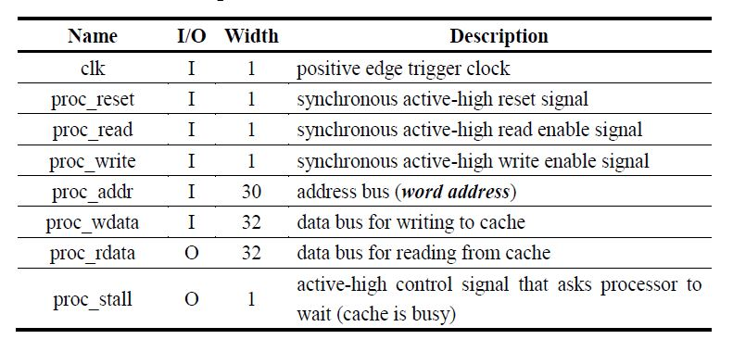
I/O Specification of The Processor Interface

Slide 5
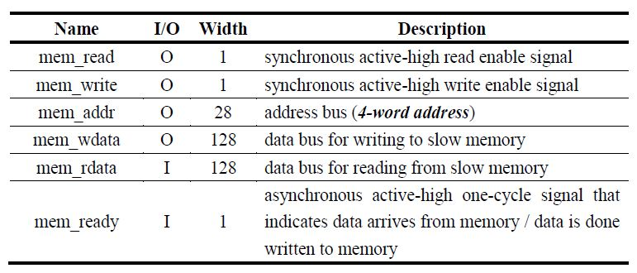
I/O Specification of The Memory Interface

Slide 6
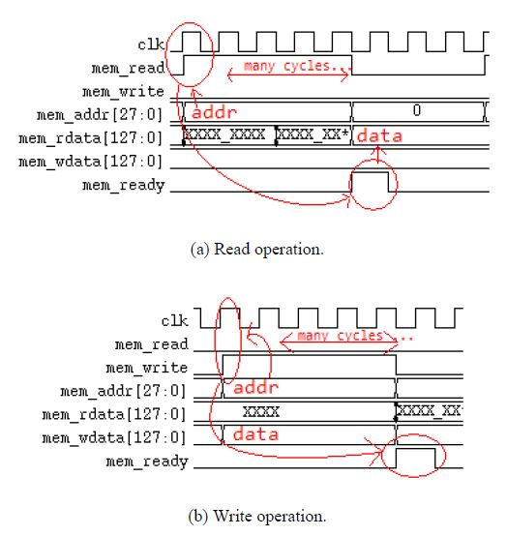
Timing Diagram of The Memory Interface

Slide 7
Stall
When the cache needs to access data from the memory and then wait for several cycles, the proc_stall signal should be set high to stall the processor.
Two possible cases where a stall is necessary
Read miss in both write-through and write-back caches
Write hit in only write through caches
Notes:
Note that since write miss can be regarded as “read miss then write hit”, a write miss in write-through caches involve two successive stalls, while only one stall is needed in write-back caches.

Slide 8
Cache Design (35% Each)
Evaluation is only based on the given testbench “tb_cache.v”
RTL Simulation (20%)
Synthesis
No latches
No negative endpoint slack
No timing violations
Gate-level Simulation (15%)
10% partial points if you pass the gate-level simulation with timing violations or negative endpoint slacks
Still need to pass the RTL simulation and no inferred latches
Performance is not part of the grading criteria
Specify your cycle time in the report
Still encouraged to optimize it for your final project

Slide 9
Bonus (Up to 10%)
If your cache units are implemented with other skills that enhance the performance significantly
Describe your methods or architectures in detail in the report
Regulations
direct-mapped & two-way associative
8 blocks with 4 words each
Notes:
其他地方都可以改，包含write policy、placement policy等等，鼓勵同學多想

Slide 10
Report (30%)
Cycle time to pass the post-synthesis simulation
cache_syn.sdc
tb_cache.v
General Specification
Write policy
Placement Policy
Finite State Machine
Performance
Read/Write miss rate
Execution cycles
Stalled cycles
Comparison of the two architectures and their results
Notes:
tb_cache.v並不包含計算miss rate, execution cycles, stalled cycles的功能，要請同學自己加入幾行code來計算
提示：條件主要看proc_stall升起降下並搭配當下在read或write應該並不難

Slide 11
Note
Follow the submission requirement
Deadline: 2021/05/20 23:59
Late submission penalty: 20% off per day

