Slide 1
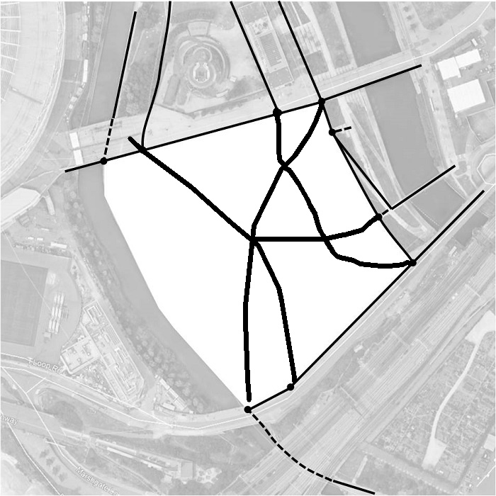
We will ask you to draw pedestrian movement lines on this side of the screen (canvas)

Slide 2
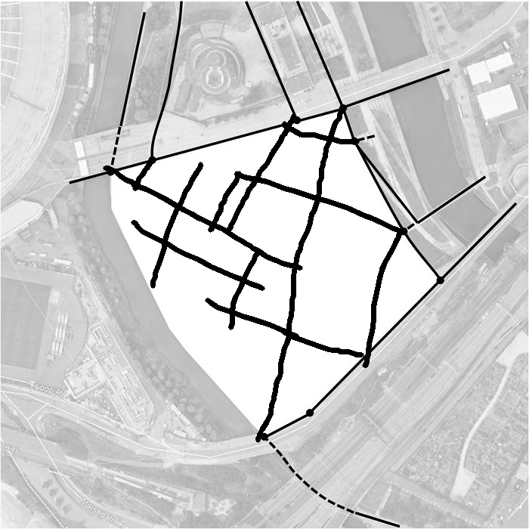
We will ask you to draw pedestrian movement lines on this side of the screen (canvas)

Slide 3
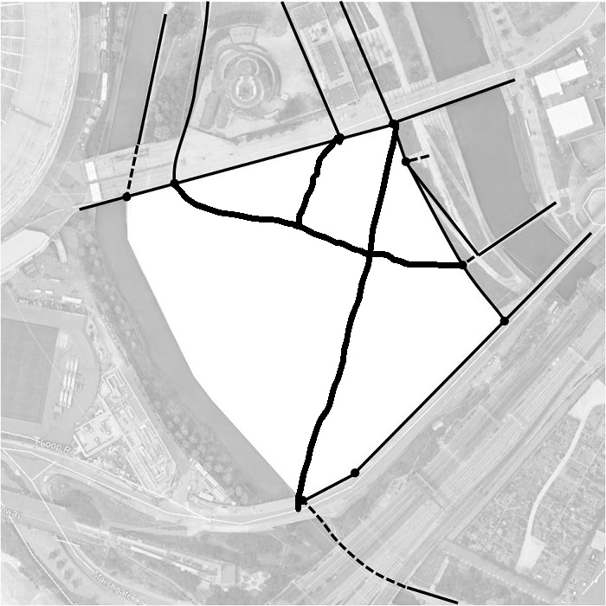
We will ask you to draw pedestrian movement lines on this side of the screen (canvas)

Slide 4
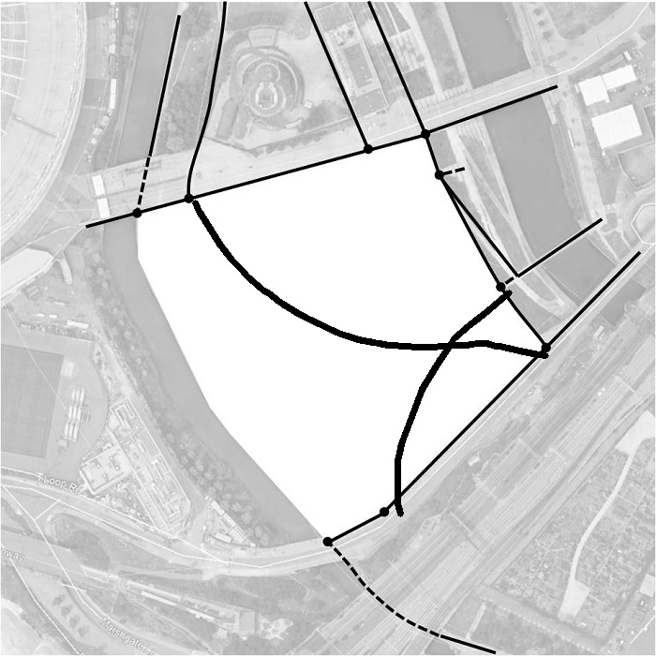
We will ask you to draw pedestrian movement lines on this side of the screen (canvas)

Slide 5
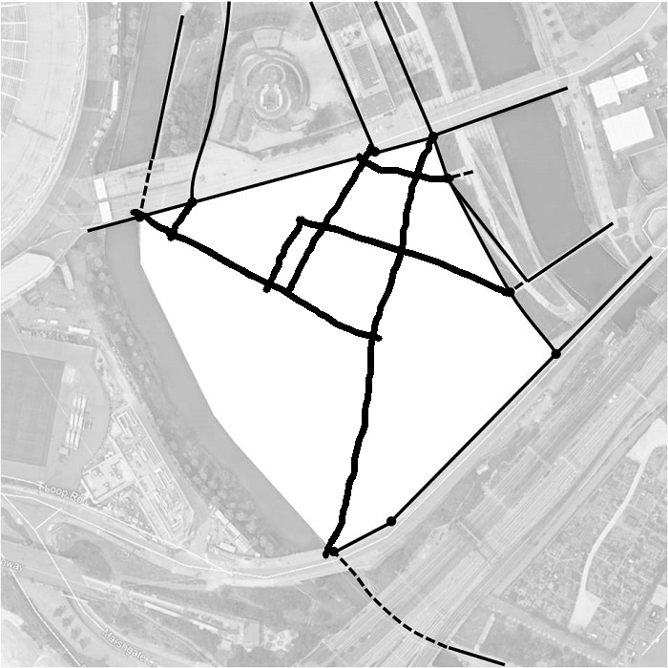
We will ask you to draw pedestrian movement lines on this side of the screen (canvas)

Slide 6
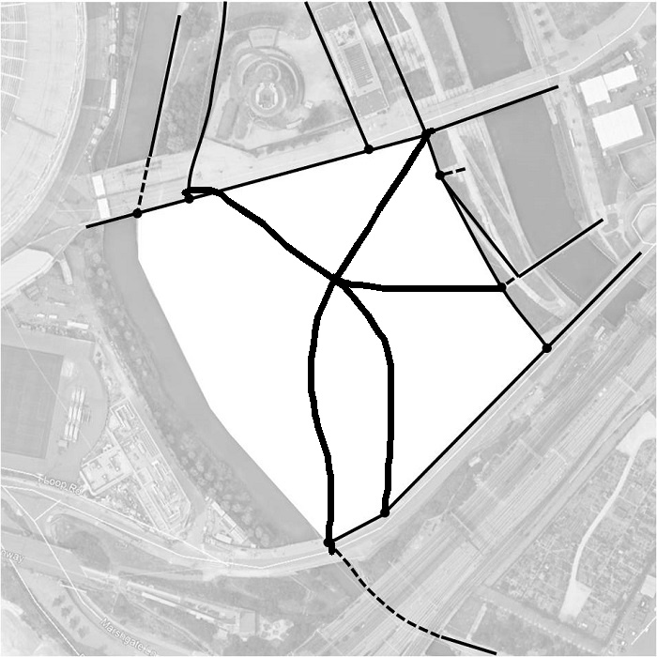
We will ask you to draw pedestrian movement lines on this side of the screen (canvas)

