Slide 1
LET US MAKE SURE YOU ARE SEEING THE RIGHT SCREEN

Slide 2
LET US MAKE SURE YOU ARE SEEING THE RIGHT SCREEN

Slide 3
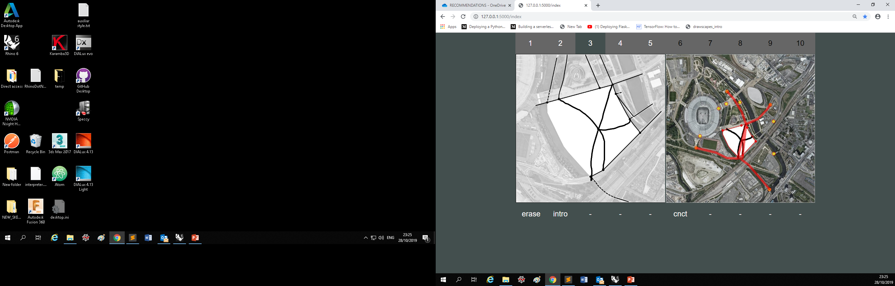
YOU SHOULD SEE TWO SCREENS SIDE BY SIDE…

Slide 4
YOU SHOULD SEE TWO SCREENS SIDE BY SIDE…

Slide 5
YOU MAY BE SEEING BOTH SCREENS ON TOP OF EACH OTHER

Slide 6
YOU MAY BE SEEING BOTH SCREENS ON TOP OF EACH OTHER

Slide 7
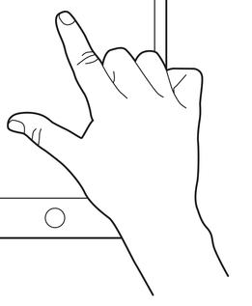
TO CORRECT IT TOUCH OUTISDE THE CANVAS IN THE SCREEN TO ADJUST SCREEN SIZE

Slide 8
TO CORRECT IT TOUCH OUTISDE THE CANVAS IN THE SCREEN TO ADJUST SCREEN SIZE

Slide 9

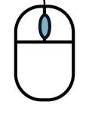
+
OR CLICK “CONTROL + SCROLL” IF YOU ARE USING A MOUSE

Slide 10
… UNTIL THE SCREEN BECOMES LIKE THIS

