Slide 1
WE WILL NOW CHECK WHAT WE HAVE DRAWN

Slide 2
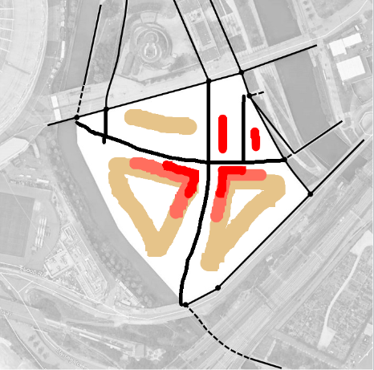
BASE
PLYNTH
TOWER
WE ESTIMATE HOW MUCH AREA YOU HAVE DRAWN

Slide 3
BASE
PLYNTH
TOWER
WE ESTIMATE HOW MUCH AREA YOU HAVE DRAWN…

Slide 4
x 2
x 5
x 10
…WE FACTOR IT BY THE NUMBER OF STOREYS…

Slide 5
BASE
Communal spaces
PLYNTH
Teaching - research spaces
TOWER
Residence
…AND THE PREDOMINANT USE

Slide 6
YOU HAVE DRAWN
15,000 m2
340 Students living
500 Researchers
UCL EAST PROPOSED
100,000 m2
1,200 Students living
1,000 Researchers
WE COMPARE YOUR RESULTS WITH UCL EAST PROJECT

Slide 7
USE THIS BUTTON FOR CALCULATIONS

Slide 8
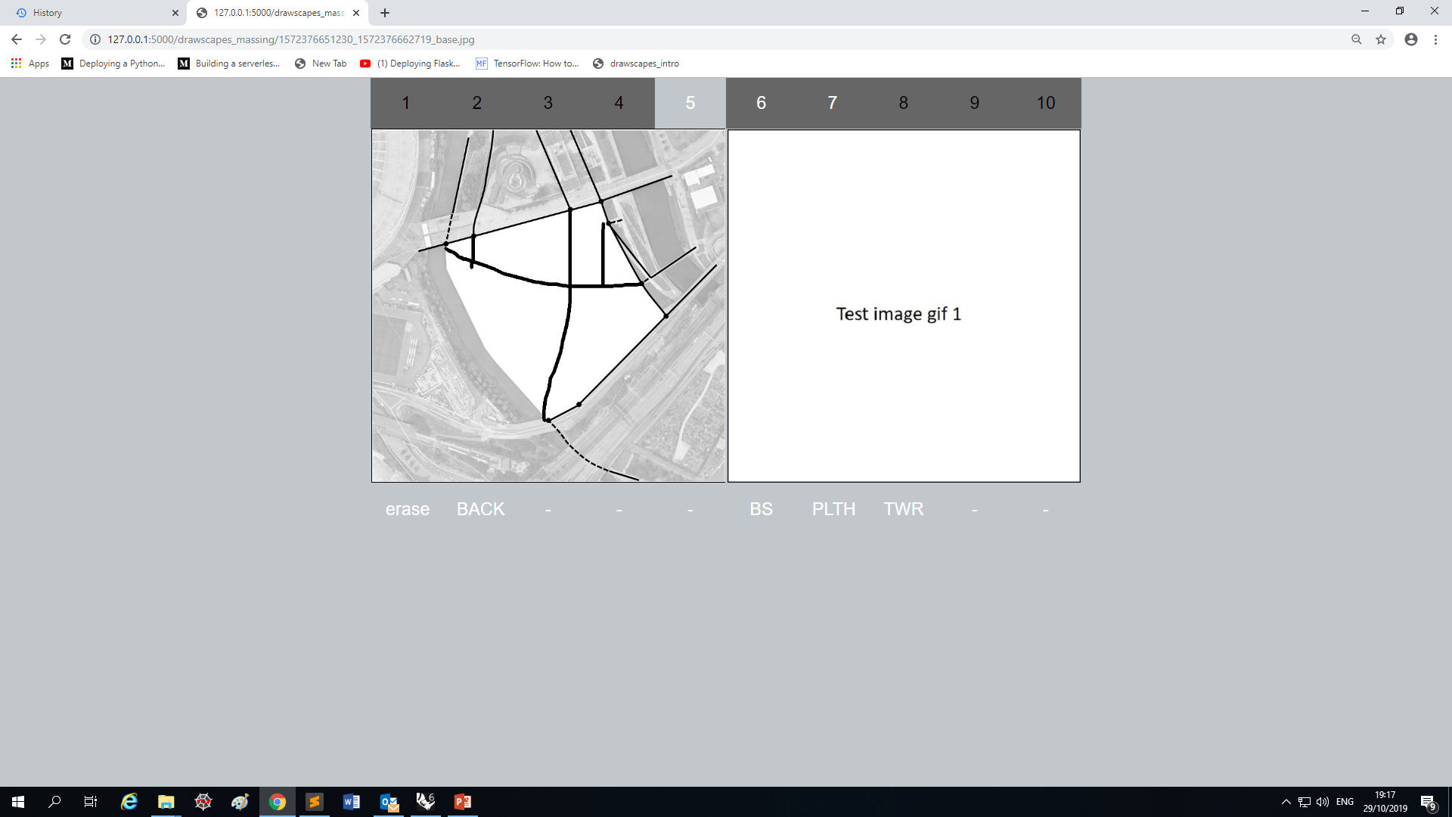
ERASE TO GO BACK AND REDRAW BUILDINGS…

Slide 9
7
….WHEN YOU ARE HAPPY CLICK ON STEP 7

