Slide 1
WE WILL FINALLY LOCATE KEY LAND USES LINKED TO PUBLIC ACTIVITIES

Slide 2
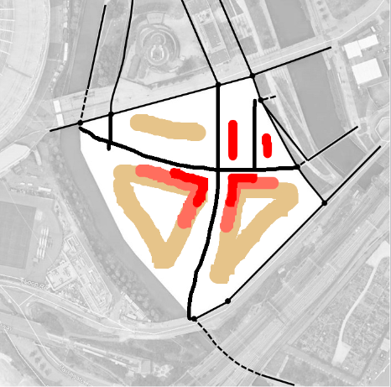
WE WILL DRAW A SMALL CIRCLE WHERE WE THINK THESE FUNCTIONS WILL BE

Slide 3
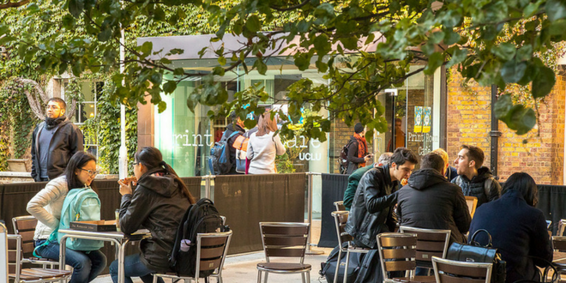
WILL LOCATE CAFES AND RESTAURANTS

Slide 4
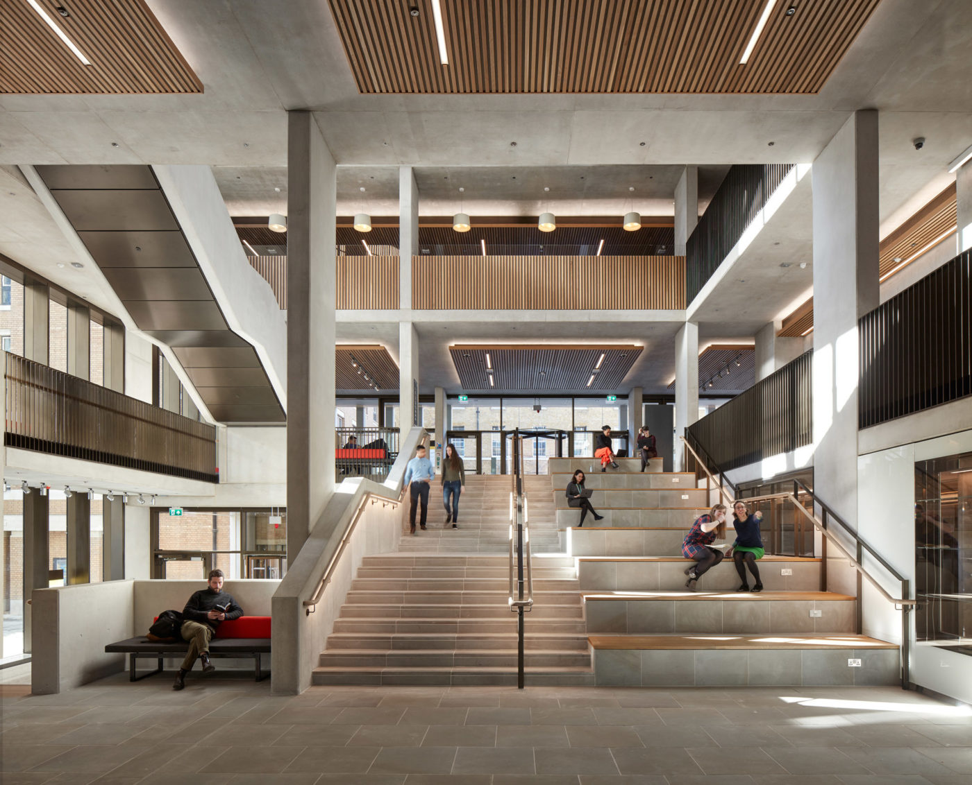
AND COMMUNAL MEETING AREAS

Slide 5
USE THESE BUTTONS

Slide 6
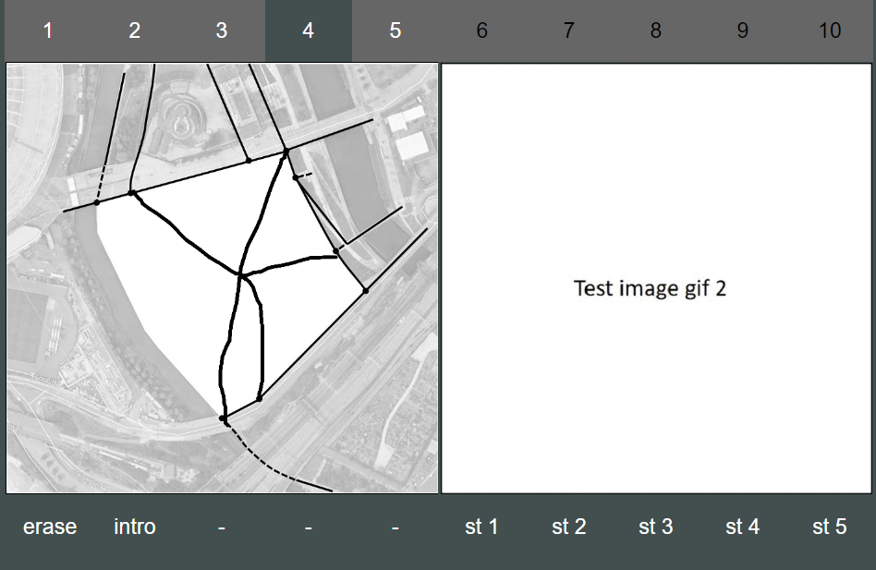
8
….WHEN YOU ARE HAPPY CLICK ON STEP 8

