Slide 1
YOU CAN NOW CHOOSE A STYLE FOR THE PUBLIC SPACE AROUND THE BUILDINGS

Slide 2
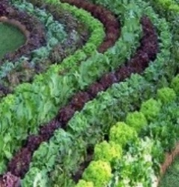
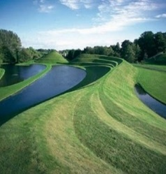
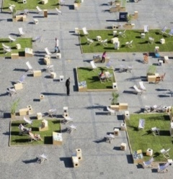
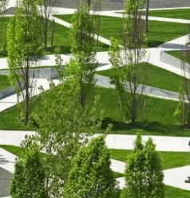

Slide 3
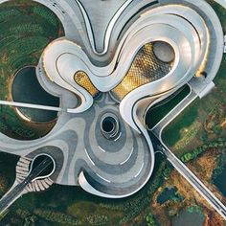
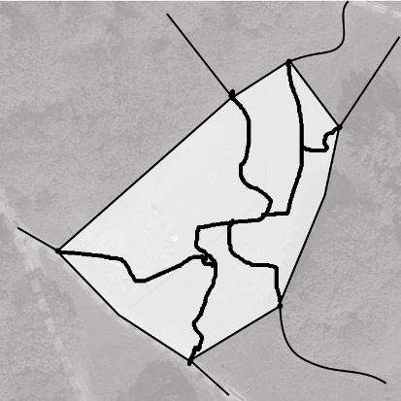
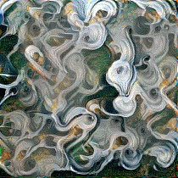
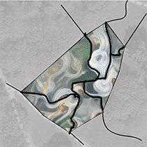
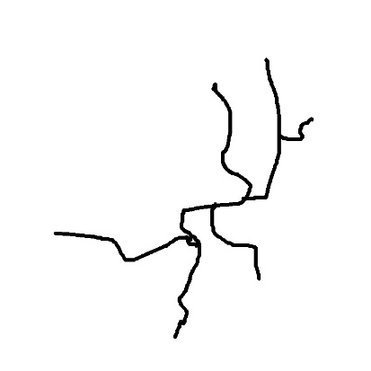
THE COMPUTER WILL TRY TO GRAFT THAT PUBLIC SPACE APPEARANCE TO YOUR DDRAWING

Slide 4
THE COMPUTER WILL TRY TO GRAFT THAT PUBLIC SPACE APPEARANCE TO YOUR DDRAWING

Slide 5
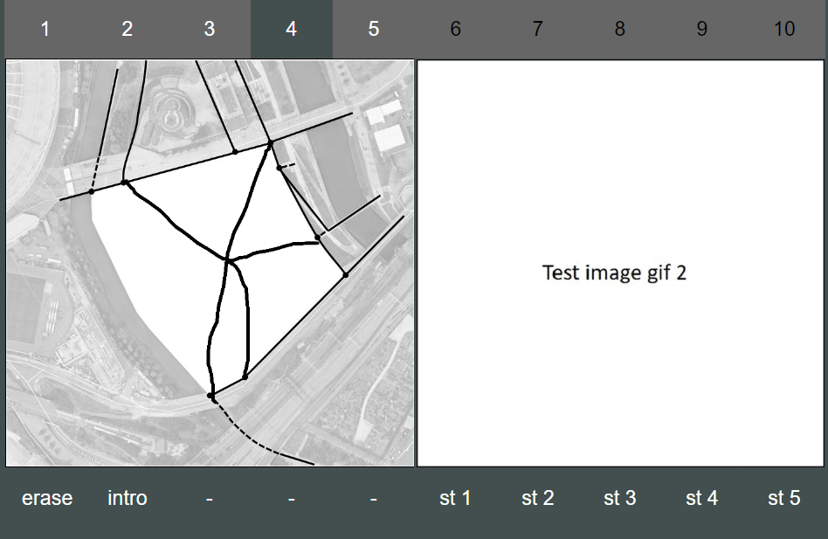
9
….WHEN YOU ARE HAPPY CLICK ON STEP 9

Slide 6
USE THESE BUTTONS

